Slide 1
YOUR JOURNEY TO SAP S4/HANA 50% FASTER.
100% SAFER.
Presented by: Lagom/ Panaya
Date: 14th June 2019

Slide 2
AGENDA
State of the Market
Our Approach
What Next?

Slide 3
STATE OF THE MARKET

Slide 4
ANZ is on par to the global trends
A majority (Over 70%) of respondents reporting that they are exploring SAP S/4HANA at some level
Of this 70%, 19% are early adopters we have categorized as leaders who have already implemented the solution or are in the process of implementing it.

Slide 5
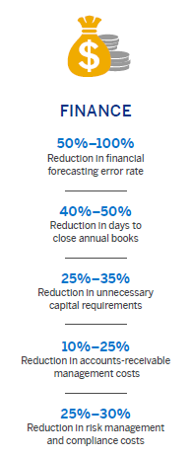
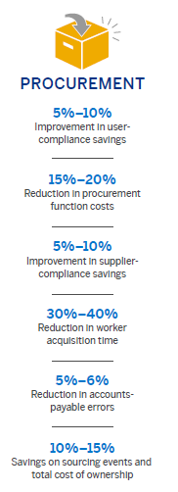
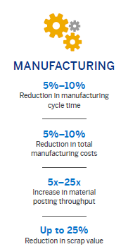
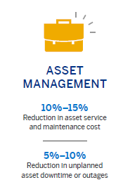
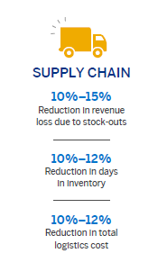
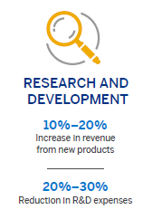
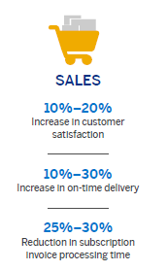
Source: SAP infographics at www.s4value.com
Some Tangible benefits of being on S4

Slide 6
Benefits of Moving to S4/Hana
Geographe
Australia
Colgate-Palmolive
USA
T&G Global Limited
New Zealand
Use of disruptive technologies in the mining sector with SAP S/4HANA Cloud
Quest for rapid, cutting-edge, technology-enabled business innovation
SAP S/4HANA® as the center of the company’s digital core
97%
On-time delivery for increased customer satisfaction
User-friendly
Solutions for rapid, broad adaption of transformative IT solutions
“ SAP software helped us lower IT costs by
consolidating multiple complex systems into one simple solution. We now have real-time visibility into inventory to meet customer needs better. We have laid the foundation for future growth and increased revenue while eliminating inefficiency.” — Jonathan Good, Chief Technology and Operating Officer, T&G Global Limited
Lower
Costs of IT
“With SAP S/4HANA Cloud, the information employees need is available anywhere there’s a browser or a mobile phone connection. They can get answers to our customers’ questions right away, giving customers a solution often within minutes.” — Holly Hyder, Corporate Development, Geographe Enterprises
“ We’re excited about SAP’s strategy and how it is extending its capabilities with a development platform that will enable us to drive innovation going forward.” — Mike Crowe, Chief Information Officer,
Colgate-Palmolive Company
Introduce Business efficiency
Enhance process efficiency
Lower operational cost
Efficiency & Innovation
Scalable
IT landscape with greater transparency
Real-time
Reporting, analysis and insights across the entire enterprise
Eliminate
Inefficiencies in operations
Secure
Low-maintenance platform
100%
Of Colgate revenue managed using integrated SAP solutions
Improve
Speed of planning

Slide 7
Customer Experience so far
IMPLEMENTATION CHALLENGES
BARRIERS TO COMMENCE JOURNEY
70% of projects fail to meet go-live
50% of projects exceed budget
Significant planning effort
Substantial effort required in pre-transition
Unclear SAP journey
Insufficient data to make an informative view
Cloud-hosted S/4 operating model is different
Unclear re Total Cost of Operating

Slide 8
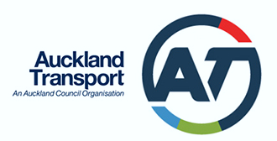
Lagom
What We Do?
SAP Road mapping
SAP Consulting
SAP Architecture
SAP Capability (Functional & Technical)
SAP Solutions
Request for Proposal (RFP)
Business Case
Strategic Advisory and Assurance
Programme/Project Delivery
Change/ Data/ Deployment/ Testing
Digital Enablement
Delivery Management
Our Customers
Our Partners
BUILD
SELL

Slide 9
Panaya
SaaS SAP Change Acceleration Platform
Established 2006, Built for SAP
2000+ SAP Customers, 30% Fortune 500
2-5x Faster Time to Market,
30-50% Lower Testing Effort
ZERO Go-Live failures
Notes:
Put more Australian Logos and NZ logos in there.

Slide 10
Proven Customer Success
“We shortened project duration and effort by over 50% (2,394 to 1,139 hours – savings of 1,255 hours) while reducing business disruption.”
“We accelerated UAT cycles of 40 testers in 7 locations and over 1,000 test cases – completed in just two weeks. Defect management, resolution and retesting included.”
“We reduced Testing effort for our EWM project by 70% and had Zero go live issues”
“By working with Panaya, we completed a 3 year process in less than 6 months.”

Slide 11
OUR APPROACH

Slide 12
Your Journey with Lagom
to S/4HANA
Operations/BAU
Hand over to support
S4 centric operating model
Smooth Transition
Measured Go-Live
Go Live
Framework
People
Tools
2- 6 months migration
Mobilisation
Execution
Total Cost of Operating
Approach
Benefits
Greenfield vs Brownfield
Assessment
Business
Case
Approach
Pre/ During/ Post
Technical Migration plan
Notes:
The use case for System Conversion
Is your system tailored to your specific business process or highly customized?
With a system conversion, previous investments made over years of use will not be lost while change impact is minimized. If business processes and customizations secure daily operations and efficiencies, you should chose a system conversion
Can you convert from SAP ERP to SAP S/4HANA in a single step?
Single-step conversion is possible for SAP ERP 6.x (any enhancement pack) single stack, Unicode systems. According to SAP statistics, a majority of customers fulfill this criterion.
Do you require previous transactional data in the new system?
The requirement to retain all data in the system is a very strong indication for conversion

Slide 13
TECH ASSESSMENT

Slide 14
Panaya’s Automated Change Impact Analysis Engine
Current State
Standard Blueprint
What will break
Client Configurations
How to fix
What to test
Crowd Wisdom
An out of the box S4 Project Execution Blueprint

Slide 15
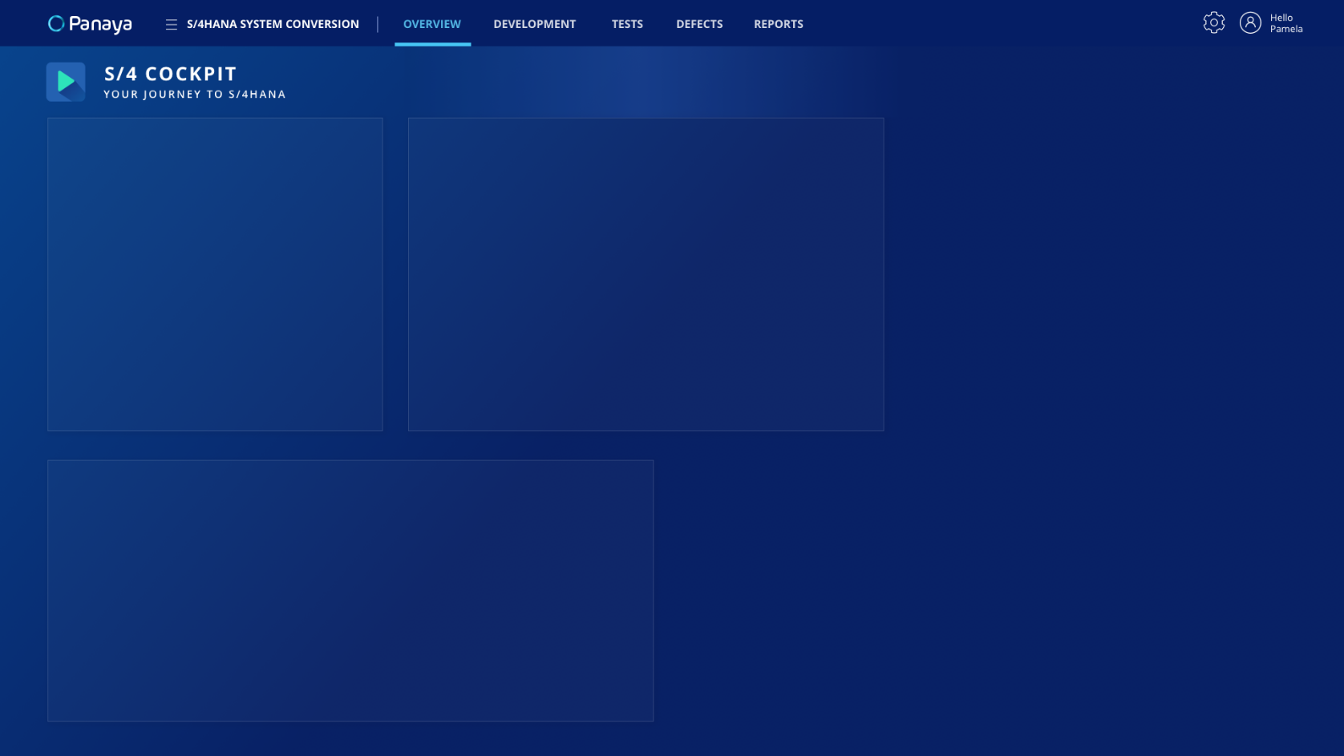
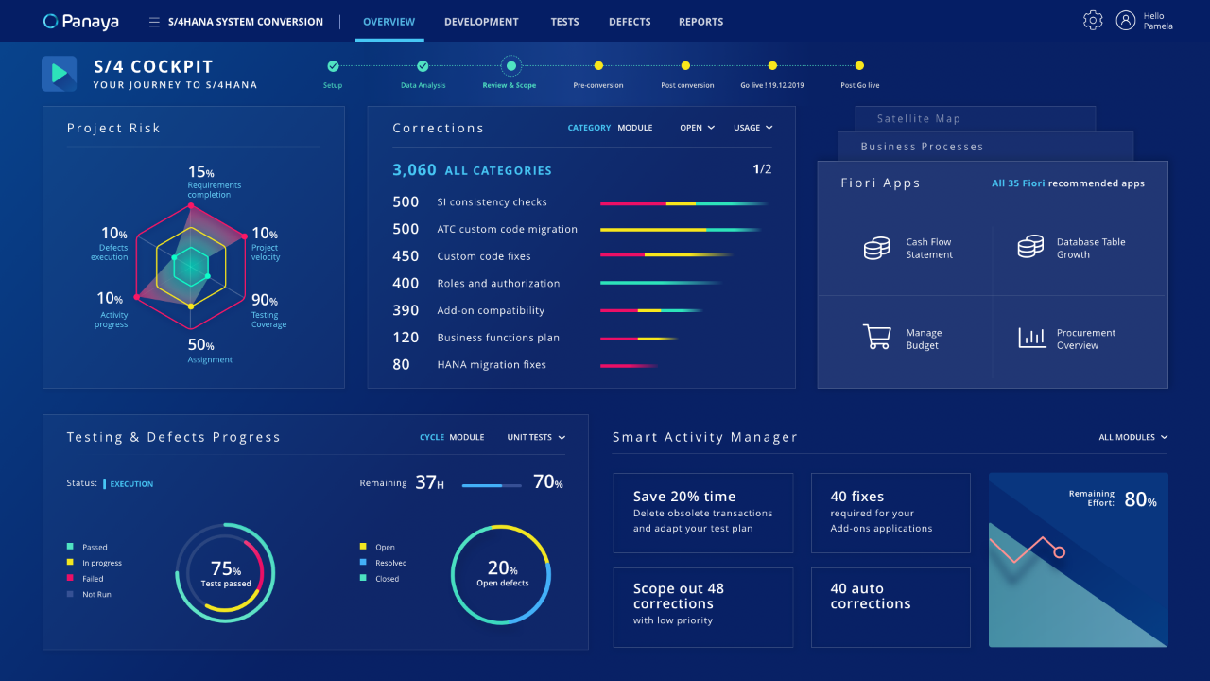
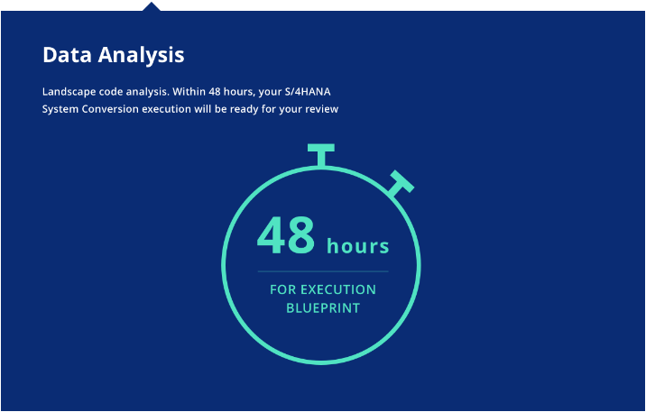
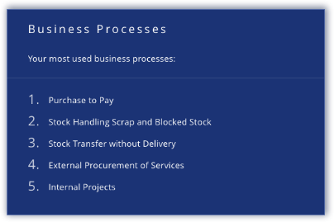
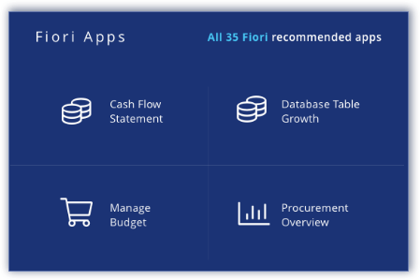
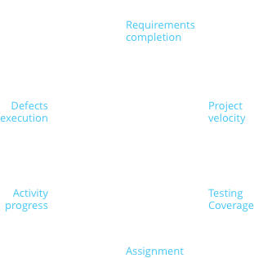
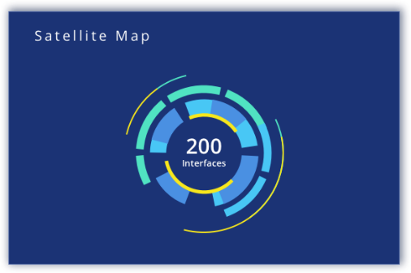

Slide 16
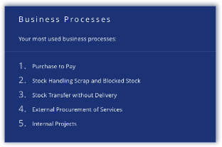
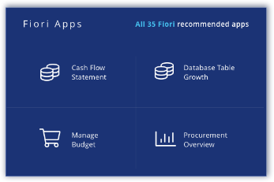
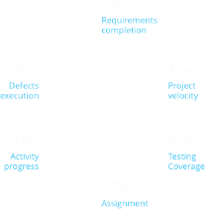
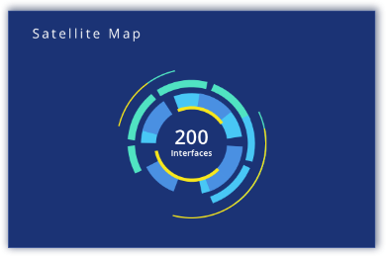

Slide 17
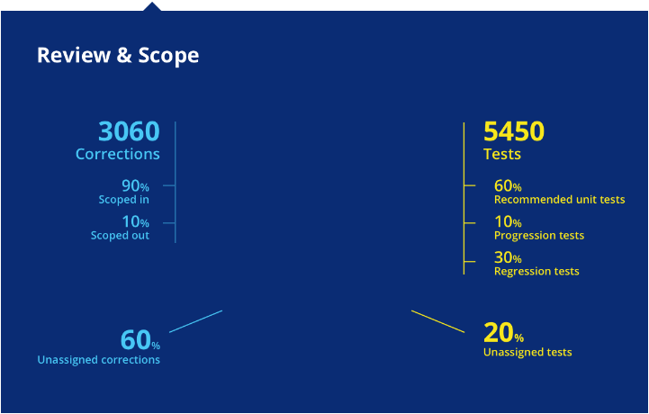

Slide 18
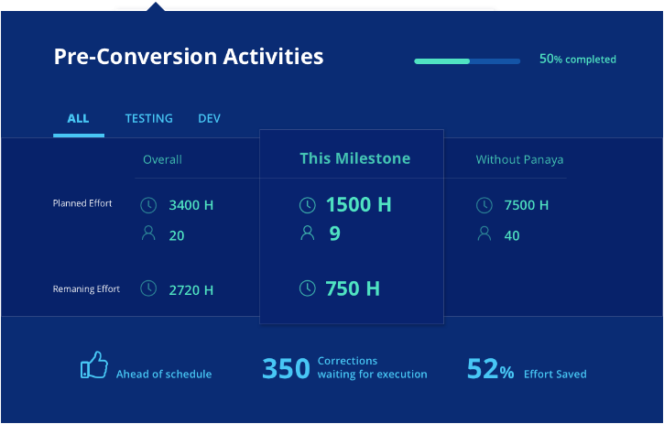

Slide 19
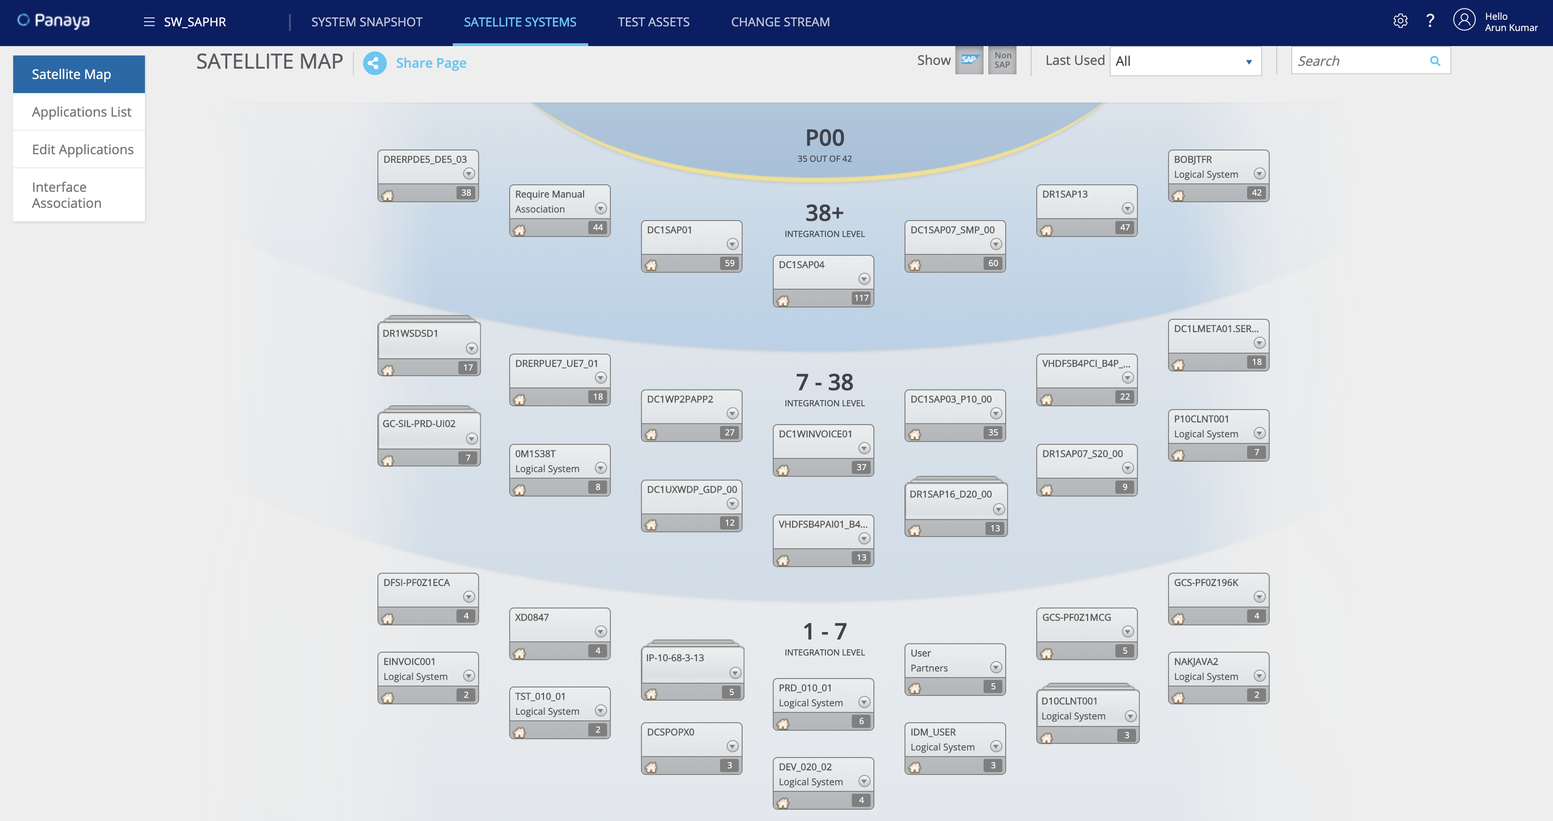

Slide 20
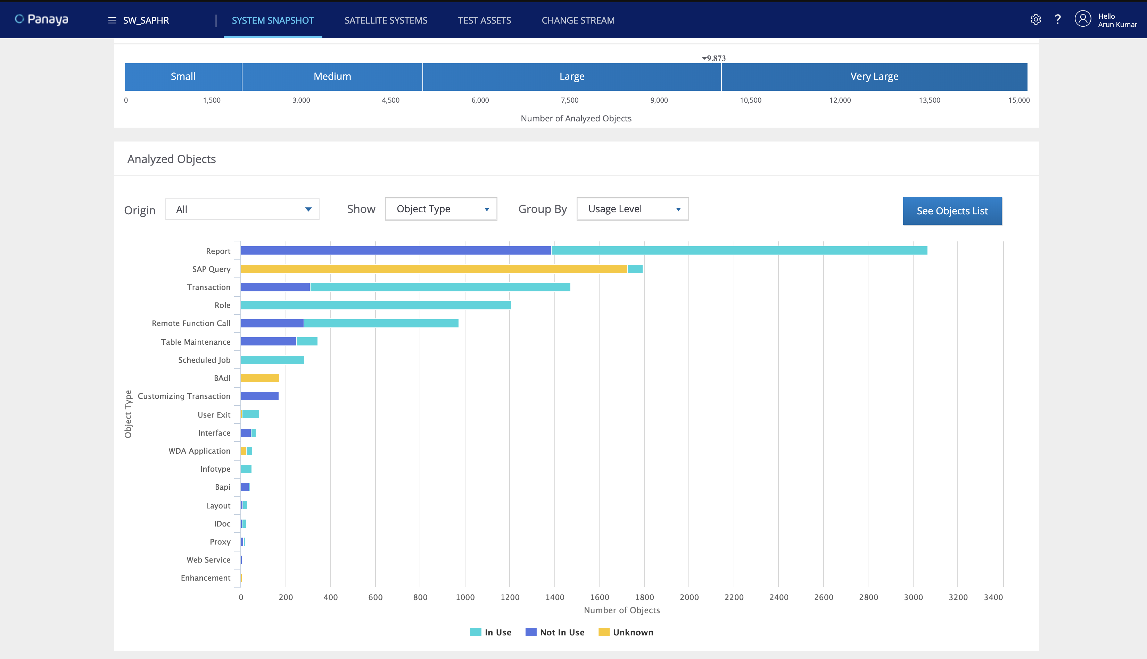

Slide 25
Success Stories
Hillarys, a Leading UK-based International Retailer, delivered S4 Hana Migration 6 times faster than planned
Hillary’s migrated its SAP Business Suite to S/4HANA (ECC, CRM & BW) and upgraded ECC5 to readiness for S/4HANA, while managing the effects of the changes on the other aspects of SAP (SMP, PI).
“By working with Panaya’s CloudQualityTM Suite, Hillarys completed a three-year process in less than six months.”
Head of ICT, Hillarys
FGC Record Time SAP S/4HANA® Migration - Risk-Free with Panaya
Reducing corrections time by 50% and testing time by at least 30-50%
“Panaya RDx was a key factor of success to our SAP S/4HANA migration. Going forward, we will use Panaya to manage all of our SAP® changes.” IT Manager, FGC
Catalan Railways is responsible for transporting 80 Million Passengers a year. Any system change had to be implemented with minimal downtime and customer impact.

Slide 26
WHAT NEXT?

Slide 27
TECH ASSESSMENT
INDICATIVE PLAN

Slide 28
The only impossible journey is the one you never begin
- Anthony Robbins
Thankyou
lagom-group-limited
contact@lagomgroup.co.nz
lagomgroupnz
+64 988 90972
www.lagomgroup.co.nz

