Slide 1



Digital Data Transformation Powered by SNP BLUEFIELDTM Approach
Choose
SNP BLUEFIELD™
for SAP S/4HANA
Marcus Scott, Managing Director

Slide 2
SNP BLUEFIELDTM

Slide 3
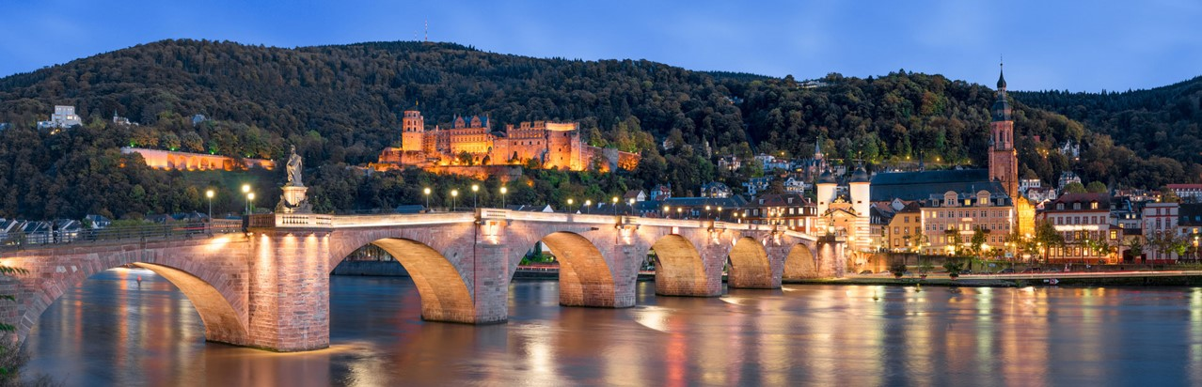


SNP I The Transformation Company
Headquarters
Heidelberg (DE)
Founded
1994
The key benefit that we promise our customers is time. The ability to respond quickly to changes in the competitive landscape is a key competency in today’s global economy.
Employees
> 1.350
Projects
> 10.000
Dr. Andreas Schneider-Neureither
CEO

Slide 4
SNP I APAC and Middle East
Offices
Malaysia
Singapore
China
Australia
Business Landscape Transformation
SNP's core competencies are the development of innovative software and consulting products to optimize SAP system landscapes and business processes.
Our value proposition: "Added value from SAP."
Employees
> 250
Portfolio
SAP ANS
SAP Roll-Outs
SAP Consulting
SAP Developments

Slide 5
SNP I Global Presence
Americas
EMEA
APAC
300
900
100
    1,300 employees
    1,000 experienced IT experts
    Worldwide delivery centers for your transformation projects
Branch office
Delivery center
Training center
R&D

Slide 6


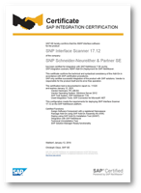
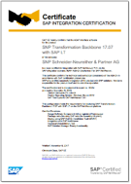

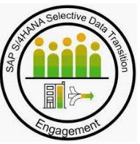



SNP I Proven Industry Standard Approach
PROVEN
APPROACH
SAP-CERTIFIED
GLOBAL ALLIANCES WITH SAP
INTERNAL PROCESSES
EXPERTICE
Our software and our consulting approach were examined by two leading auditors.
SNP Interface Scanner
SNP Transformation Backbone with SAP LT
Germany, Argentina, Poland, United Kingdom
Close cooperation in the further development of the SAP Landscape Transformation Software
OEM partnership with SAP
Our internal pro-cesses comply with DIN ISO 9001 to meet customers requirements and other demands of product or service performance quality.
Member of SAP S/4HANA Selective Data Transition Engagement community.

Slide 7


SNP I Automation Drives the Entire Data Transformation Lifecycle
PREPARATION
SNP TRANSFORMATION
BACKBONE WITH SAP LT
OPTIMIZATION
Fact-based decision making
Automated transformation
Respond rapidly to change
Reduce project risk: improved understanding and planning with analysis software
Reduce project timelines, business interruption, cost and risk with proven automated approach
Understand and improve your systems, processes and data

Slide 8
SNP I Be Smart − Start Your Automated Transformation
Changing business models
New technologies
SNP
TRANSFORMATION
PORTFOLIO
Proven
approach
CrystalBridge
Experienced
experts
Global alliances
& partners
Global delivery
Preparation
Transformation
Operation
SNP ANALYSIS
Strong
customer
base
SNP TRANSFORMATION
BACKBONE WITH SAP LT
Stable and
reliable
partner
SNP GOVERNANCE
Scale any size & complexity
Keep control of your transformation projects
Mitigate your project risks
Reduce costs and save time

Slide 9

S/4HANA TRANSFORMATION
BLUEFIELD GIVES
YOU OPTIONS
21/08/2019
NZSUG Auckland Event + SAP Forum
9
Notes:
WHY? UNLOCKING THE POTENTIAL OF SAP S/4HANA! Combine all Migration paths toe S/4HANA. BLUEFIELD gives you options!!!

Slide 10
GREENFIELD
START WITH AN EMPTY SYSTEM
START FROM SCRATCH AND RE-INVENT EVERYTHING
ADAPT ALL PROCESSES TO THE NEW SYSTEM
BROWNFIELD
IN-PLACE TECHNICAL UPGRADE OF YOUR EXISTING SYSTEM
GIVES YOU YOUR SAME R/3 SYSTEM RUNNING ON S/4HANA
SAME BROKEN PROCESSES, SAME UNUSED CUSTOMIZATION
ENCOMPASSES BOTH GREENFIELD AND BROWNFIELD

Slide 11

The Traditional Way
The traditional way = Massive human intervention
Analysis
3 months
1 year
2 years
Design 6 months
Implementation 12 months
Execution 6 months
Testing 6 months
Go-live
3 months
Hypercare
21/08/2019
NZSUG Auckland Event + SAP Forum
11

Slide 12

SNP BLUEFIELDTM
ACCELERATED BUSINESS TRANSFORMATION THROUGH INTELLIGENT SOFTWARE
Selective and simultaneous business and technical transformation
Pick and choose where and what you want to innovate.
No reimplementation
Collapse the brownfield roadmap into a single go-live
Get the benefits of S/4HANA right away
Selectively leverage your customizations and historical data

Slide 13
The SNP Way: Completely Streamlined Processes via Automation
The SNP way = Heavily automated/algorithmic
Analysis 1 day
1 year
2 years
Design 2 weeks
Implementation 4 weeks
Execution 3 weeks
Testing 2 weeks
Go-live
in
months
Go-live 1 day
Hypercare 2 weeks
21/08/2019
NZSUG Auckland Event + SAP Forum
13

Slide 14
Test
GO-
LIVE 1
Test
GO-
LIVE 2
Test
GO-
LIVE 3
Test
GO-
LIVE 4
Test
GO-
LIVE 5
Test
GO-
LIVE 6
Test
GO-
LIVE 7
Preparatory
data archiving
Legal entity rationalization
New GL conversion
Business partner implementation
BROWNFIELD
upgrade
Condition record migration
Cloud migration
Collapse your entire modernization roadmap
into a single go-live
80%
REDUCTION
IN TIME AND EFFORT
7 TEST CYCLES AND CUTOVERS REDUCED TO 1

Slide 15
The SNP Way: 80%+ Faster – Success Guaranteed
Transformation Speed (Months)
Transformation Success Rate
24+
-75%
100%
¹ Based on 10,000+ projects over 25 years.
33%
6
Traditional
SNP
Traditional
SNP¹

Slide 16

Enable FULL Digital Re-Invention with SNP BLUEFIELDTM
Carve-out
Splitting of system
Removed unused entities
Chart of Accounts
Standardization
Uniform COA
Upgrade
R/3 4.6C
ERP 6.0 EHP8 or S/4HANA
OS/DB migration
Virtualization
Consolidation
System merge
Any-to-any
Single harmonized processes
Retire redundant systems
New GL
PCA, COPA
Full historical conversion
Near-Zero Downtime
Custom Programs
Optimize for SAP HANA
Harmonize
Consolidate
Retire
Reorganization
Legal Entity rationalization
Tax restructuring
Controlling, HR, Purchasing merge
Transfer to the Cloud
Virtualization
OS/DB migration
HANA adoption
Hyperconverged infrastructure
Technical
Unicode conversion
Single code page
Multi-code page
Byte order conversion
Near-Zero Downtime

Slide 17


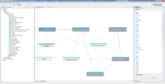
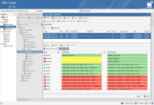
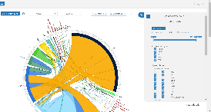
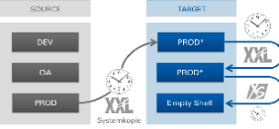
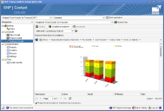
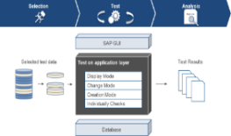
SNP I End-to-End Transformation Automation Platform
Masking and Scrambling
during Test Cycles
ANALYZE
TRANSFORM
VERIFY
Business Process Analysis
Landscape
Analysis
SNP Interface Scanner
SNP Rapid Empty Shell Creation
SNP Transformation Backbone
SNP Data Consistency Verification
Analysis and visualization of SAP business processes derived from transactional history
Analysis and comparison of systems, data and configuration
Automatic discovery, analysis and documentation of your communications topology
Extraction and creation of business-specific target systems
Unique software with pre-defined content ensuring easy and secure transformations
Close the loop in data transformation through automated verification of data integrity
CURRENT SOURCE ERP SYSTEMS
S/4HANA TARGET
EMPTY SHELL
FINAL S/4HANA TARGET SYSTEM

Slide 18




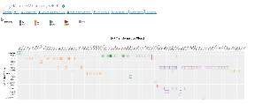
SNP S/4HANA Migration – Approach
Software-based Analysis
SNP System Scan /
SNP CrystalBridge
Standard
Choice of the
optimal approach
SNP S/4HANA
Conversion
Extended
SAP ERP / ECC
SAP S/4HANA
Bluefield
Brownfield
Greenfield
SNP S/4HANA Fitting
(Deep Analysis)

Slide 19


















S/4HANA I REFERENCES

Slide 20
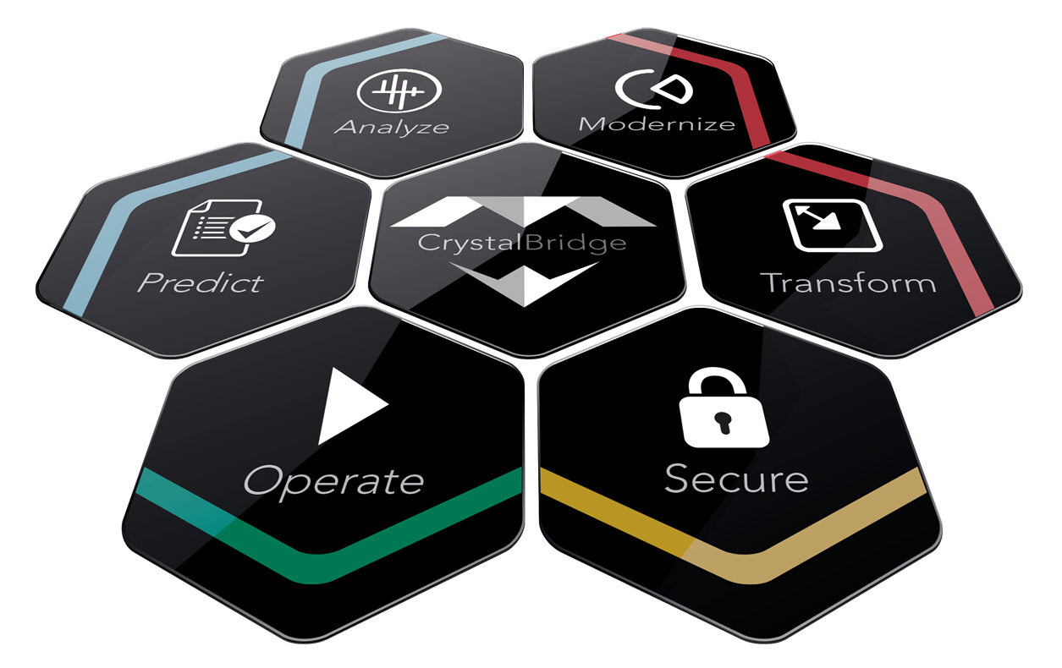
SNP CrystalBridge
NZSUG Auckland Event + SAP Forum

Slide 21







SNP CrystalBridge: VALUE DISCOVERY
  360° Analysis and Comparison of Landscapes, Processes, Structures, Data, Interfaces, Languages, …
NZSUG Auckland Event + SAP Forum

Slide 22



Selective Migration powered by CrystalBridge
Project Steps
1. Organize
Selection of Org-Units in use
2. Design
Check Migration Objects used by selected Org-Units
3. Time Based Selection
See Tables and Objects to be migrated
4. Plan
S/4HANA Migration
Business Questionnaire
5. Setup
Download the scoping results to start the Project
6. Control
Control the project in Solman
Source SAP Landscape
Org Unit 1
SNP
TRANSFORMATION
PORTFOLIO
Org Unit 2
CrystalBridge
Org Unit 3
Preparation
Transformation
Operation
SNP ANALYSIS
Org Unit 2
SNP TRANSFORMATION
BACKBONE WITH SAP LT
Org Unit 4
SNP GOVERNANCE
Org Unit 3
Target SAP Landscape
NZSUG Auckland Event + SAP Forum

Slide 23
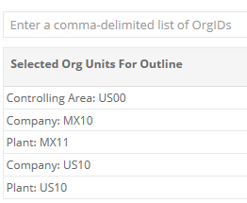
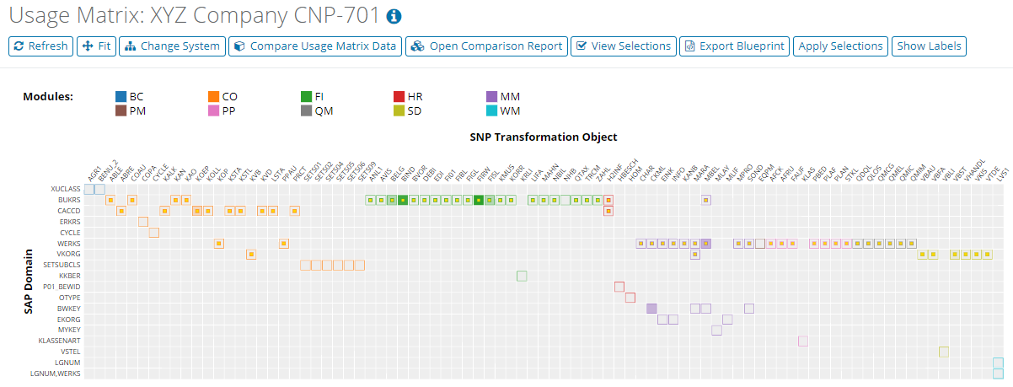
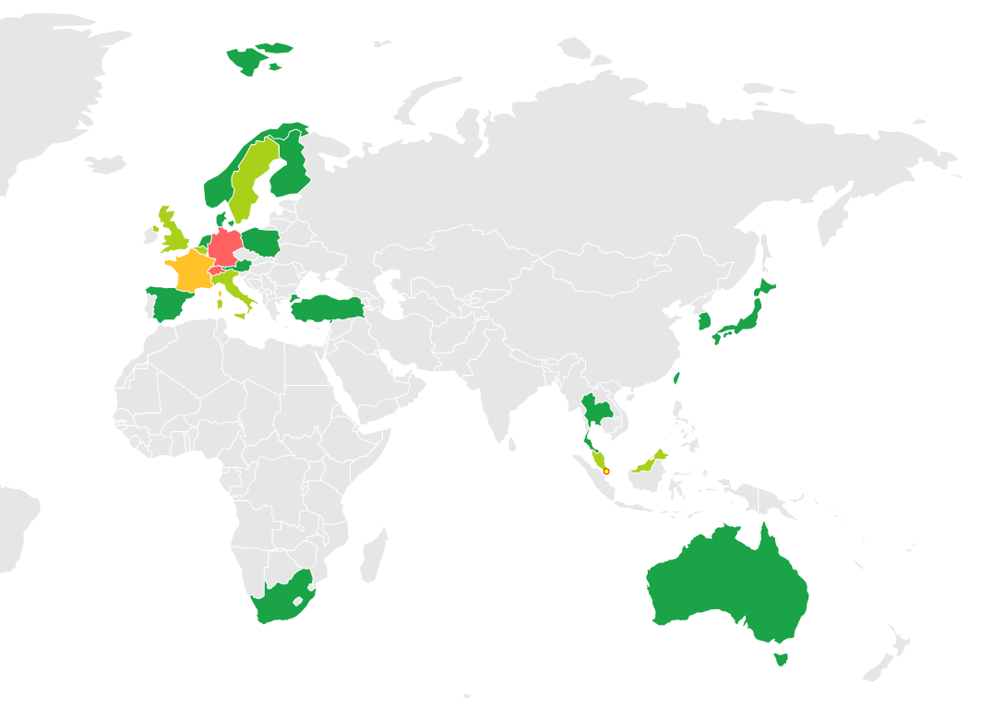
Selective Migration powered by CrystalBridge
Steps in CrystalBridge
1. Organize
Selection of Org-Units in use
2. Design
Check Migration Objects used by selected Org-Units
3. Time Based Selection
See Tables and Objects to be migrated
4. Plan
S/4HANA Migration
Business Questionnaire
5. Setup
Download the scoping results to start the Project
6. Control
Control the project in Solman
View Locations
Select Organization Unit
Usage Matrix – before Selection
NZSUG Auckland Event + SAP Forum

Slide 24
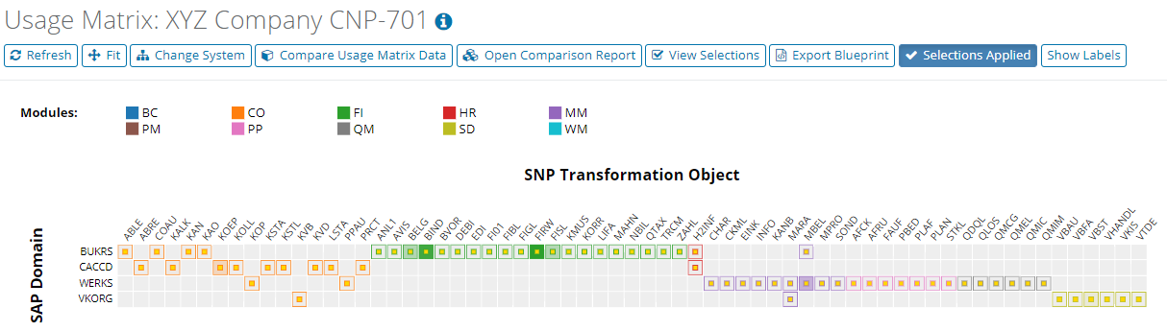
Selective Migration powered by CrystalBridge
Steps in CrystalBridge
1. Organize
Selection of Org-Units in use
2. Design
Check Migration Objects used by selected Org-Units
3. Time Based Selection
See Tables and Objects to be migrated
4. Plan
S/4HANA Migration
Business Questionnaire
5. Setup
Download the scoping results to start the Project
6. Control
Control the project in Solman
Usage Matrix Apply Selection
NZSUG Auckland Event + SAP Forum

Slide 25
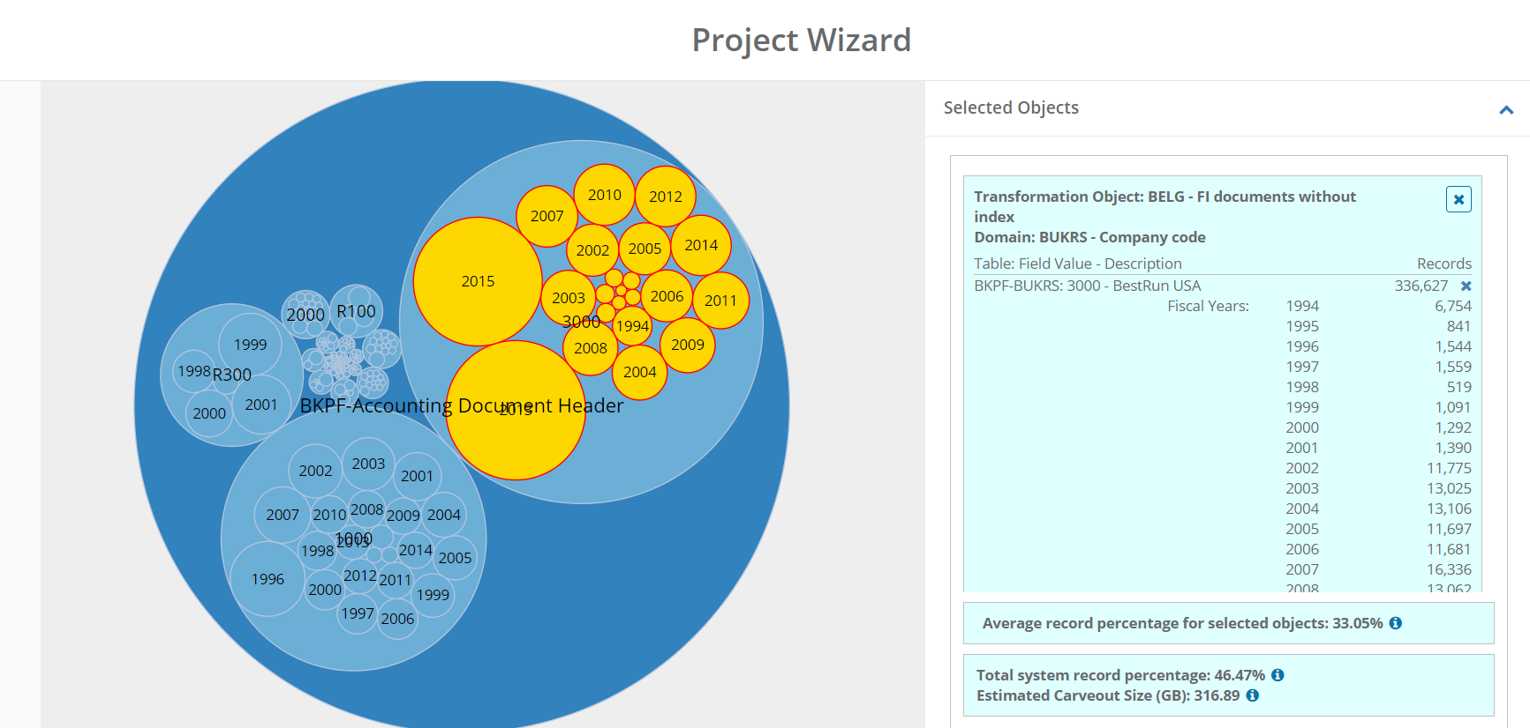
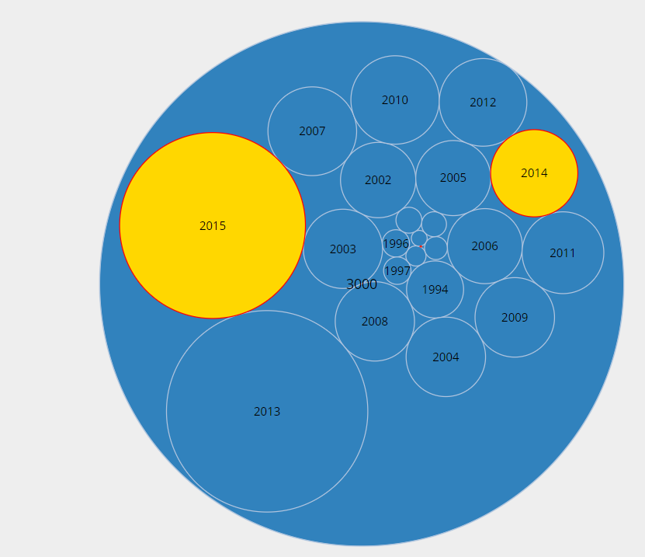
Time Slice powered by CrystalBridge
Steps in CrystalBridge
1. Organize
Selection of Org-Units in use
2. Design
Check Migration Objects used by selected Org-Units
3. Time Based Selection
See Tables and Objects to be migrated
4. Plan
S/4HANA Migration
Business Questionnaire
5. Setup
Download the scoping results to start the Project
6. Control
Control the project in Solman
Define the time slice in selected Org. Units
NZSUG Auckland Event + SAP Forum

Slide 26

Business Requirements powered by CrystalBridge
Steps in CrystalBridge
1. Organize
Selection of Org-Units in use
2. Design
Check Migration Objects used by selected Org-Units
3. Time Based Selection
See Tables and Objects to be migrated
4. Plan
S/4HANA Migration
Business Questionnaire
5. Setup
Download the scoping results to start the Project
6. Control
Control the project in Solman
Business Requirements for S/4HANA Migration
    New General Ledger
      Ledger Change
      Change from Account to Ledger Approach
    Business Partner Harmonization
    New Asset Accounting Change of Posting Rules
    Additional Data Cleansing
    Master Data Hamonization
NZSUG Auckland Event + SAP Forum

Slide 27
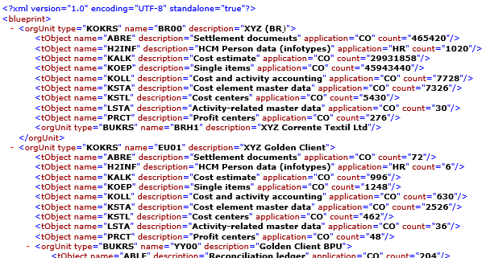
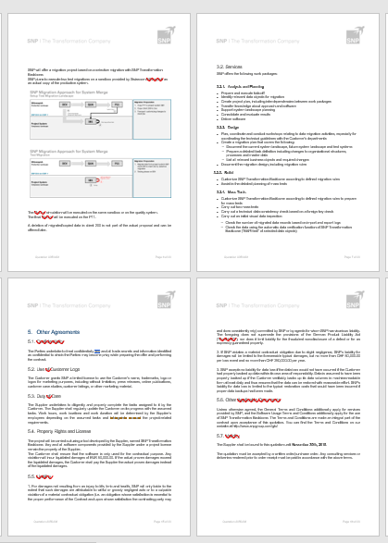
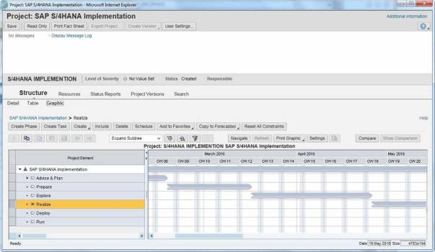
Selective Migration powered by CrystalBridge
Steps in CrystalBridge
1. Organize
Selection of Org-Units in use
2. Design
Check Migration Objects used by selected Org-Units
3. Time Based Selection
See Tables and Objects to be migrated
4. Plan
Estimate Size and Structure of Target System and download blueprint (XML)
5. Setup
Download the scoping results to start the Project
6. Control
Control the project in Solman
Export Selection for TC
Export Selection for Blueprint in Word
Export Selection for Planning in SolMan
NZSUG Auckland Event + SAP Forum

Slide 28
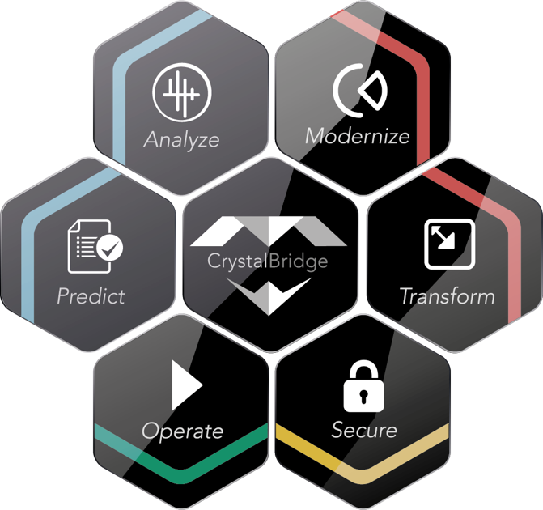
SNP Software Products
SNP Dragoman
Automated Translation of SAP Systems
SNP Data Provisioning & Masking
Analysis and Comparison of Repository Objects, Customizing and Number Ranges of SAP System
SNP Interface Scanner
Analysis and Documentation of used Interfaces to SAP System
SNP System Scan
Technical Analysis of used SAP Modules, Organizational Units, Tables, Repository and System Usage
SNP Transformation Backbone
Unique Software with pre-defined content ensuring easy and secure transformations
NZSUG Auckland Event + SAP Forum

Slide 29
S/4HANA TRANSFORMATION
BLUEFIELD GIVES
YOU OPTIONS
21/08/2019
NZSUG Auckland Event + SAP Forum
29
Notes:
WHY? UNLOCKING THE POTENTIAL OF SAP S/4HANA! Combine all Migration paths toe S/4HANA. BLUEFIELD gives you options!!!

Slide 30
Disclaimer
  © 2018 SNP SE or an SNP affiliate company. All rights reserved. No part of this publication may
  be reproduced or transmitted in any form or for any purpose without the express permission of
  SNP SE or an SNP affiliate company.
  The information contained herein may be changed at any time without notice. Some software products marketed by SNP SE and its distributors contain proprietary software components of other software vendors.
  This document is a preliminary version and not subject to your license agreement or any other agreement with SNP. This document contains only intended strategies, developments, and functionalities of the SNP product and is not intended to be binding upon SNP to any particular course of business, product strategy, and/or development.
  SNP assumes no responsibility for errors or omissions in this document. SNP does not warrant the accuracy or completeness of the information, text, graphics, links, or other items contained within this material. This document is provided without a warranty of any kind, either express or implied, including but not limited to the implied warranties of merchantability, fitness for a particular purpose, or non-infringement.
  SNP shall have no liability for damages of any kind including without limitation direct, special, indirect, or consequential damages that may result from the use of these materials. This limitation shall not apply in cases of intent or gross negligence.
  SAP and other SAP products and services mentioned herein as well as their respective logos are trademarks or registered trademarks of SAP SE (or an SAP affiliate company) in Germany and in several other countries.
  All other product and service names mentioned are the trademarks of their respective companies.
  Heidelberg, Germany 2019
NZSUG Auckland Event + SAP Forum

