Slide 1
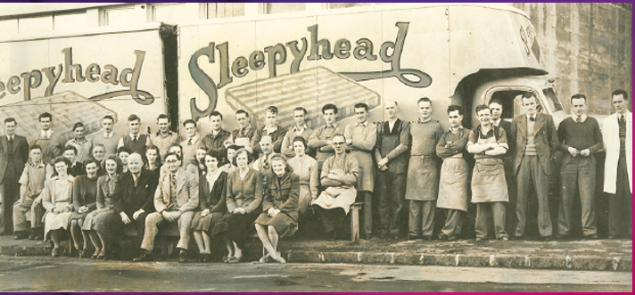
Applying Agile to Successful ERP Implementations
Alistair Morgan (Comfort Group) & Christian Wehrle (Deloitte)

Slide 2
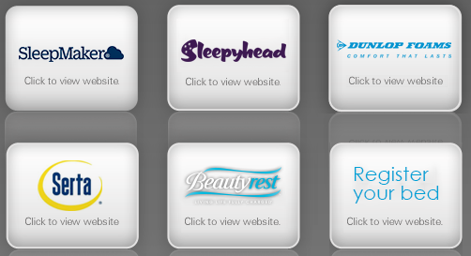
Who are the New Zealand Comfort Group?
Comfort Group – The Business
Primarily a consumer goods manufacturing business
Manufacture and distribute products across three main divisions:
Foam
Bedding
Flooring
Dominant in the NZ market and also significant sales in AU and the wider APAC region
Comfort Group - History
NZ-based family business established in 1935
Currently run by Graeme and Craig Turner
Agility is in our DNA

Slide 3
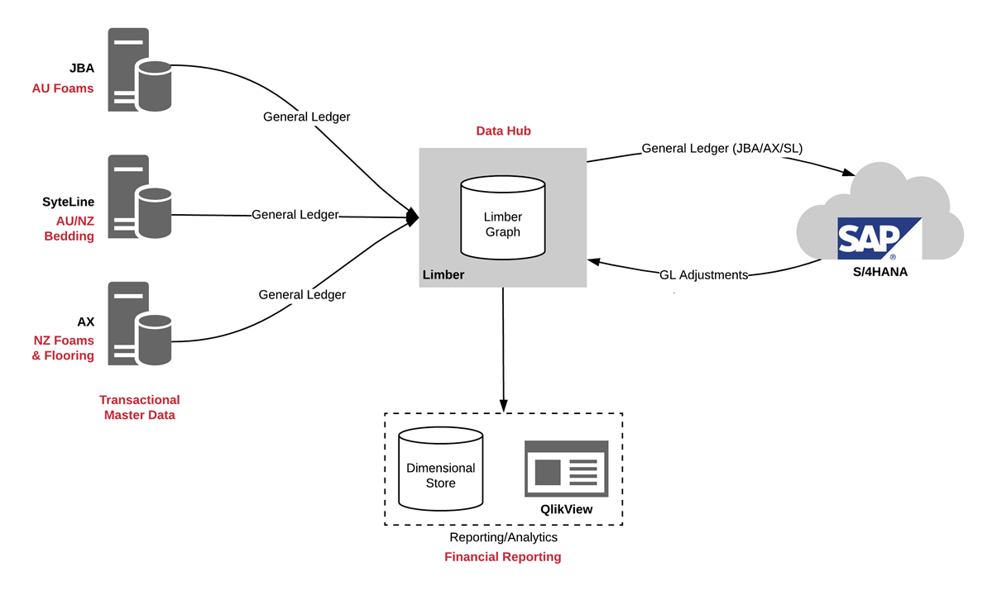
Architecture

Slide 4
Overview of the Current Plan/Roadmap
2019 |  |  |  |  |  |  |  |  |  |  |  | 2020 |  |  |  |  |  |  |  |  |  |  |  | 2021
JAN | FEB | MAR | APR | MAY | JUN | JUL | AUG | SEP | OCT | NOV | DEC | JAN | FEB | MAR | APR | MAY | JUN | JUL | AUG | SEP | OCT | NOV | DEC | JAN | FEB | MAR | APR | MAY | JUN
NEO Central Finance
NEO for Flooring
NEO for NZ Foams
NEO AU Foams
NEO for Bedding
Post-Implementation Support

Slide 5
ERP Solution Process Scope
JUL
AUG
SEP
OCT
NOV
DEC
JAN
FEB
Flooring – Sales/AR
Flooring – Purchasing/AP
Flooring – Production
Available Capacity*
Flooring - Deployment
OMS Replatform+
Flooring – Data Warehouse
Flooring – Sales Portal

Slide 6
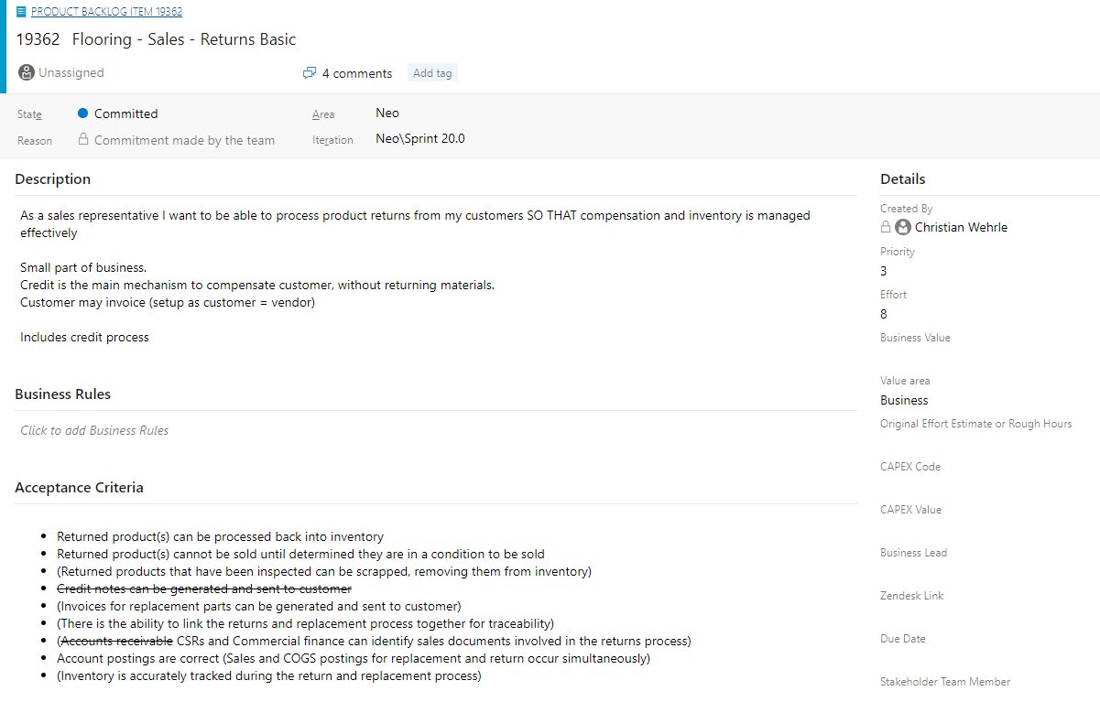
Stories Within Phases

Slide 7
Our Story Delivery Pattern
Input into further stories
Pre-Sprint
Delivery in Sprint
Sprint Review
Story Definition
Problem Analysis
Design
Validate Design
Build
Validate Solution
DONE
Live Demo
Definition of Done

Slide 8
Our Team
Developers, Business Analysts, Consultants
Cross-functional
Co-located
Self-organising
Deliver business outcomes
Product Owner
Scrum Master

Slide 9
Lessons Learnt – Product & Approach
Product
Agile Approach
01
02
03
01
02
03
S/4HANA Public Cloud Maturity
Difficult to change solution build. Currently lacks support for multiple teams.
Agile Deployment
Early discovery of fit; highly effective change management
Technical Release of Change
Significant planning required to manage impact of regular change.
TCG Readiness
Team capability and leadership buy-in.
Incident Management
Key to have Preferred Success and to get the right resolver involved with high priority incidents.
SAP and Deloitte Readiness
Deloitte willingness to undertake the journey. SAP willingness to listen.
9

Slide 10
Questions

