Slide 1



Modern Business Intelligence
New Zealand SAP User Group Forum 2019

Slide 2

AGENDA
Centrix
Foodstuffs
BI – Evolution
Embedded BW
Remote Source - CAR SDI Connection
Native HANA
BW/4HANA Migration Path
Business Intelligence 10 years ago vs Business Intelligence today
Q&A

Slide 3

Centrix Holdings Ltd. was established in 1996 and is an SAP Partner.
We are a SAP consulting company based in Hamilton, New Zealand & Cologne, Germany.
We are precise and diligent, with a history of solid work in New Zealand, and have worked for top-tier companies, both in New Zealand and Europe.
Our main strengths are:
SAP BASIS & ABAP
SAP Business Intelligence Consulting
Functional Consulting
AMS Support for SAP Clients 24/7

Slide 4
































Client Portfolio
4

Slide 5


Foodstuffs - About us
New Zealand North Island Co-operative
96 years serving New Zealanders
All stores owner-operated
Customer focused retailer and wholesaler
North Island only – sister co-op in the South Island
One large competitor and many small competitors
Revenue is $7.7b (2018 store sales)
3.7% increase in store sales from previous year
5

Slide 6




Foodstuffs - About us
Owner / Operator model
332 Stores
PAK ’n SAVE, New World, Four Square, Gilmours
22,000+ team members
6

Slide 7

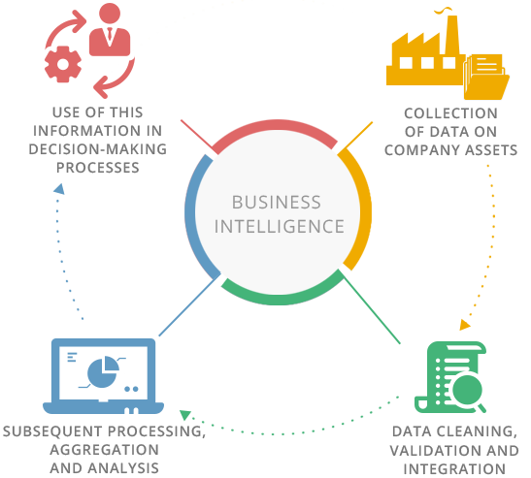
BI - Evolution
Started as gathering information about market trends.
Nowadays BI is seen as the usage of technology to compile and analyze data, translate it into useful information, and make strategic decisions based on the results.
The target is to obtain data from multi-sources, a fast integration and data analysis for obtaining results in a simple way.
7

Slide 8

BI - Evolution
10 years ago:
Performance impacted → A separate system for Analytics and reporting purposes
Difficult to get real time reporting
Data needs to be extracted into OLAP system (SAP BW)
Different layers of persisted data in order to get the required results / many BW object types
(Initially) few source systems in BW
Data was consumed with BEx tools only (BO later) through BW objects only
8

Slide 9

BI - Evolution
Today:
Due to HANA's architecture and speed, possible to get good reporting performance
With HANA getting real time reporting is easier (SDA/SDI, Embedded BW)
Possible to read and integrate data in Remote Sources without extracting the data
Less layers / Less BW object types - easier to manipulate data without persisting it
Multisource (through HANA) - connections to many systems / Very good integration between Native HANA and BW objects
Data can be consumed by many different tools (BO, SAC, Analysis for Office, Excel, non-SAP) and allowing connection directly to HANA views
9

Slide 10
BI - Evolution
1980s-2000s
2000s-2010s
2010s →
Historical & Static reporting.
Decision Support Systems rise.
Online Analytical Processing (OLAP).
Data warehousing
Self Service BI analytics.
Analytic Platforms.
Interactive Reporting.
Data mining.
In-memory.
Dashboards / Score cards.
Native HANA (data from SAP/Non-SAP sources to HANA DB).
Actionable Insights
Predictive Analysis.
Big Data
Embedded BW
BW4HANA
Visualizations – SAC.

Slide 11


Centrix’s contribution in Foodstuffs
Embedded BW: Assets and GL
Remote Source: CAR SDI Connection
Native HANA: Assets History Sheet / Master Data / Integration with BW

Slide 12

Guiding principles
Speed : minimal lag between processing & analytics
Avoid unnecessary replication of data
Answering some technical challenges – in respect of the volume, velocity & variety of data
Strategies adjustments and guidelines according to evolution in the BI area

Slide 13

Embedded BW - Assets and GL
Embedded BW comes included in S/4 HANA and takes advantage of HANA’s fast processing speed
Transactional data and Master Data are read on-the-fly
Special Business Content delivered for this purposes
Standard content leveraged by custom Native HANA developments
Scenarios
  Central Finance with restricted transactional processing
Benefits Reached
  Real-time insight support
  Space freed → 4.8%
13

Slide 14
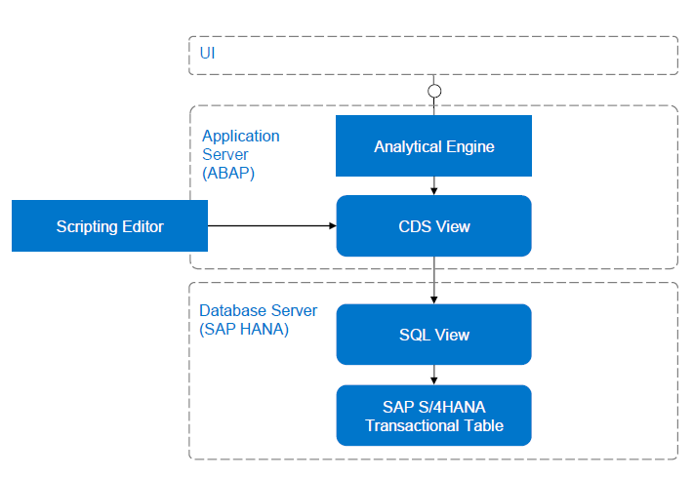
Embedded BW GL & Assets- Design
Enriched SAP BI Content
Transient provides , HANA views or CDS Views?
Master Data
  Transactions posted against multiple master data objects
  Representation of master data object
Hierarchies
  Virtual
  Info object
Deployment & Access Options
14

Slide 15

Remote Source - CAR SDI Connection
SAP Customer Activity Repository (CAR) collects, cleanse, and centralise the customer’s and point-of-sale (POS) data in real time
Big retail table - one source accessed from BW through HANA using HANA Smart Data Integration (SDI)
Benefits Reached
                Real-time insight support
        Space freed → 28%
15

Slide 16
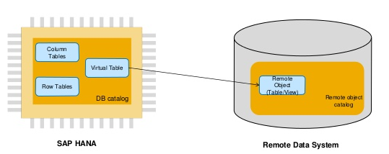
CAR SDI Connection
Virtual Table (s) on BW
Specific business needs addressed
Limit volume of requested data per instance
Fast changing master data – master data read on the fly
Virtaul Integration to sales data
16

Slide 17
How Foodstuffs got there
Patching, Refresh and up to date brings new and updated functionality
Sandbox systems => Useful for PoC
Time investment in PoCs
Strategies adjustments and guidelines according to evolution in the BI area

Slide 18


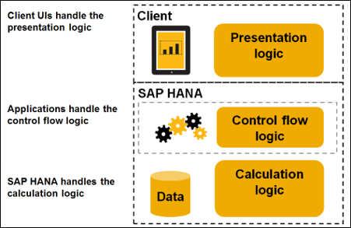
Native HANA developments and Integrations
Data modelling by using native HANA objects (mainly Calculated Views, Virtual Tables, Database Tables)
Extraction of SAP/Non-SAP sources to HANA and it’s use for reporting in HANA DB
Master Data Integration and consumption
Master Data Changes reflected instantly (Real Time)

Slide 19

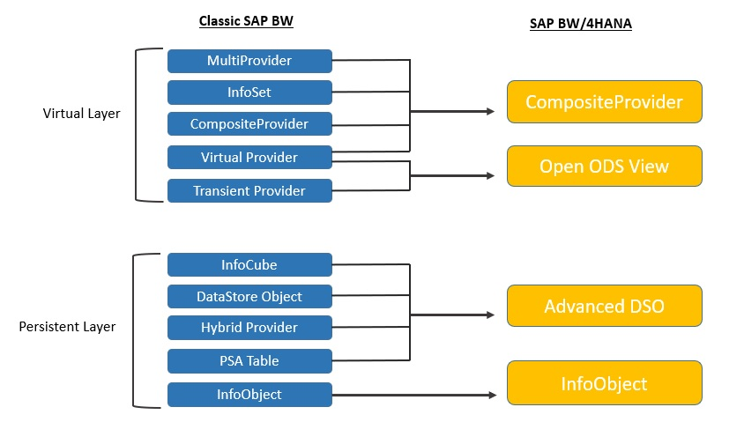
BW/4HANA Migration Path - What

Slide 20



BW/4HANA Migration Path - How
7.50 SP 12 to SP 14 with BW/4HANA Add-On
Bigger picture -> BW/4HANA – That’s where we’re heading to!
Analysis of the BW/4HANA migration path - what was required in reality? How did all the white papers and guides were translated in reality to our case?
Objects to be converted -> Notes and efforts migrating old objects (not only in the BW side but also in the ECC Side)
Why we chose Compatibility Mode
20

Slide 21
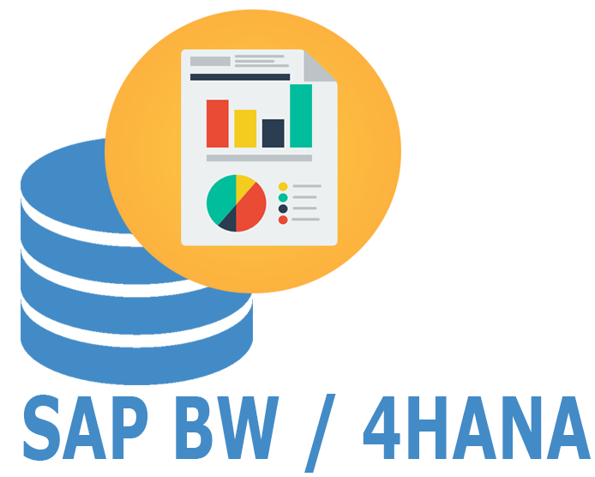
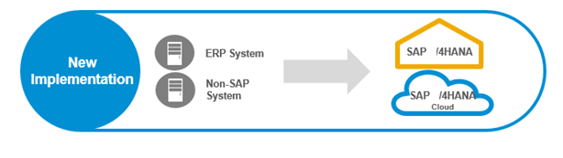
BW/4HANA Migration Path - How
Three modes:
BW mode (keep operating as before)
Compatibility mode (stop creating new objects with old BW types)
B4H mode (new B4HANA objects, migration ready)
Different strategies:
Parallel System
Conversion of the existing systems
Greenfields Implementation
21

Slide 22
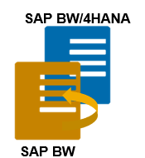
BW/4HANA Migration Path – How
Good opportunity for analysing currently used and obsolete objects → Don't spend time migrating and converting obsolete objects.
Gradual change in order to continue operating.
Many objects require manual adjustments and analysis.

Slide 23

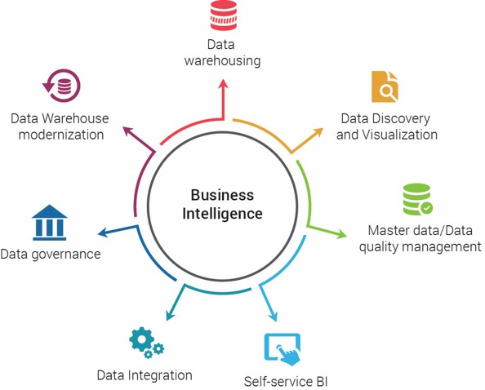
BI 10 years ago vs BI Today
Data invasion → Data available now is everywhere really quickly, answers for questions we're not even asking
The importance of asking the correct questions
Innovation not only comes from doing new things to answer the same questions, it also comes from asking new questions

Slide 24




Q&A Session
Contact
info@centrix-consulting.com
www.linkedin.com/company/Centrix-Holdings-Ltd-
www.Centrix-Consulting.com

Slide 25
THANK
YOU

