Slide 1
S/4HANA Finance migration and DB conversion
Auckland NZSUG + SAP Summit 2019
Bonnie Hohlfeld, Chris Attwood

Slide 2
Agenda
Auckland NZSUG + SAP Summit 2019
Bonnie Hohlfeld, Chris Attwood

Slide 3
Agenda
Auckland NZSUG + SAP Summit 2019
Bonnie Hohlfeld, Chris Attwood
Overview of the Business
Overview of the SAP Landscape
Project scope and benefits
Project facts and figures
Execution of the migrations
Cutover weekend
Lesson learnt

Slide 4
Overview of Business
Auckland NZSUG + SAP Summit 2019
Bonnie Hohlfeld, Chris Attwood

Slide 5

We make sure New Zealanders get more out of life.

Slide 6





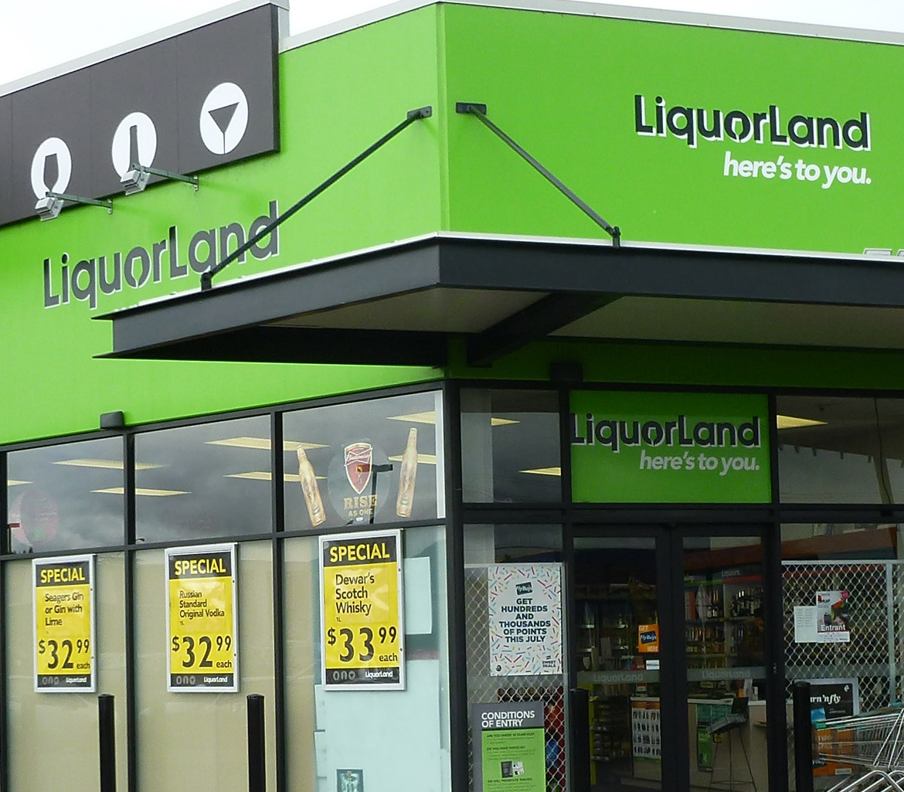

Slide 7



In the North Island…
335
22k
stores
people
$7.9b
1.3m
customers every week
sales

Slide 8
Overview of SAP Landscape
Auckland NZSUG + SAP Summit 2019
Bonnie Hohlfeld, Chris Attwood

Slide 9
Overview of the SAP History @ FSNI
Auckland NZSUG + SAP Summit 2019
Bonnie Hohlfeld, Chris Attwood
1996 - Implemented SAP on AS/400 - 3.0F
2001 - Migrated to AIX/DB2 – 4.6C
2008 - SAP rollout to Gilmour’s
2012 - Project Lightening Phase 1 Go-live ECC 6.0 EHP6
2017 - ECC upgrade to EHP8
2018 - Migration of ECC on HANA with S/4 Fin 1605
2019 - All remaining apps migrated to HANA

Slide 12
SAP Finance modules and add-ons
Accounts
Payable and
Accounts
Receivable
New GL and
Reporting
Asset
Accounting
Cash Management
Project
Systems and
Controlling
Flexible
Real Estate
Management
Open Text VIM
and Agency Business
GLWAND,
GLSU

Slide 13
Project scope and benefits
Auckland NZSUG + SAP Summit 2019
Bonnie Hohlfeld, Chris Attwood

Slide 14
Transition Paths
  S/4 HANA
  1709+
HANA
Cust, Vend & Site conv
  S/4 HANA Finance 1605
HANA
  ECC
  EhP8
HANA
  ECC
  EhP8
Non HANA

Slide 15

Benefits of approach
Platform for further enhancements
Increased SAP system performance
Time savings via transactional efficiencies
Enhanced user experience - fiori apps

Slide 16
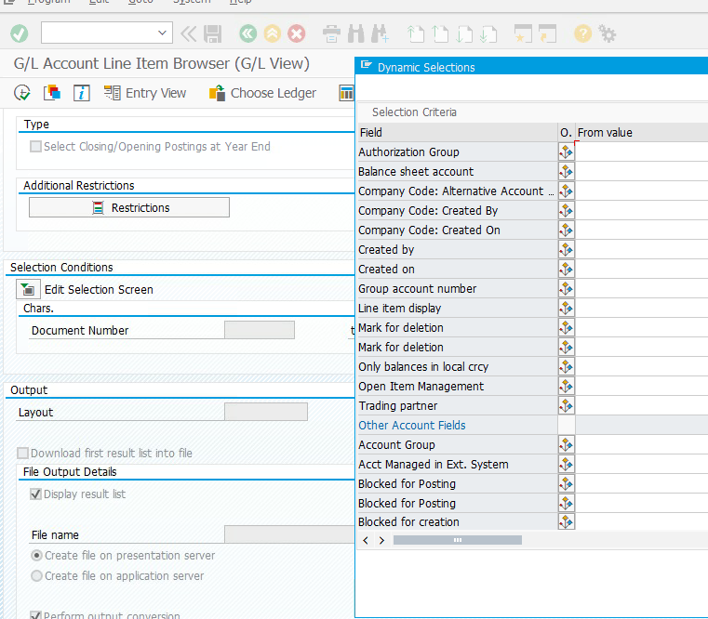
Powerful reporting
FBL1H
FAGLL03H.
FBL5h

Slide 17
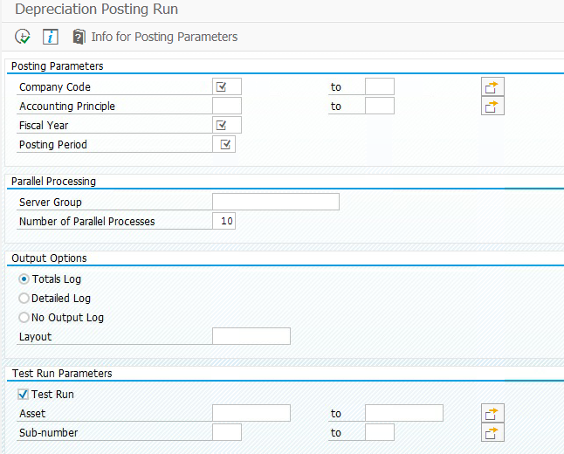
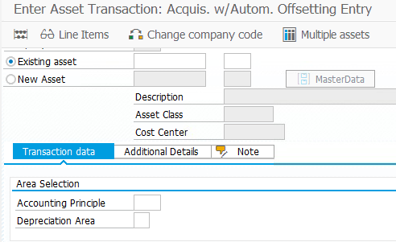

Slide 18
Project facts and figures
Auckland NZSUG + SAP Summit 2019
Bonnie Hohlfeld, Chris Attwood

Slide 19
15
Key project stats
10
No of migrations
Workstreams
6 mths
Duration
300
42hr
825
Reviewed notes
Outage
Code modifications

Slide 20

MAY-18
JUN-18
JUL-18
AUG-18
SEPT-18
OCT-18
POC
SANDBOX TESTING
DEV TESTING
QA TESTING
PPRD
PROJECT AND CHANGE MANAGEMENT
CUSTOM CODE REVIEW

Slide 21
DB Migration
Auckland NZSUG + SAP Summit 2019
Bonnie Hohlfeld, Chris Attwood

Slide 22
DB Migration
DB migration approach
Migration was incorporated into our “standard” yearly patching cycle.
Minimizing Downtime was a key consideration
Dual Landscape to minimize the impact on BAU and other projects

Slide 23
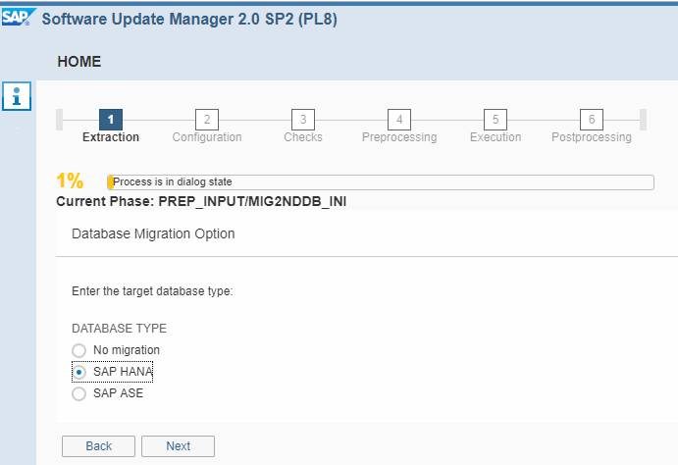
Tools – SUM DMO
DB Migration

Slide 24
DB Migration
Post installation of add-on
New config becomes available
New roles and tcodes
New CDS views and technical tables
No postings are possible until the migration is completed

Slide 25
S/4HANA Finance activities
Auckland NZSUG + SAP Summit 2019
Bonnie Hohlfeld, Chris Attwood

Slide 26


Key Finance Activities
Readiness
Checks
Preparation
Activities.
FI Config
Finance Migration.
Validations

Slide 27
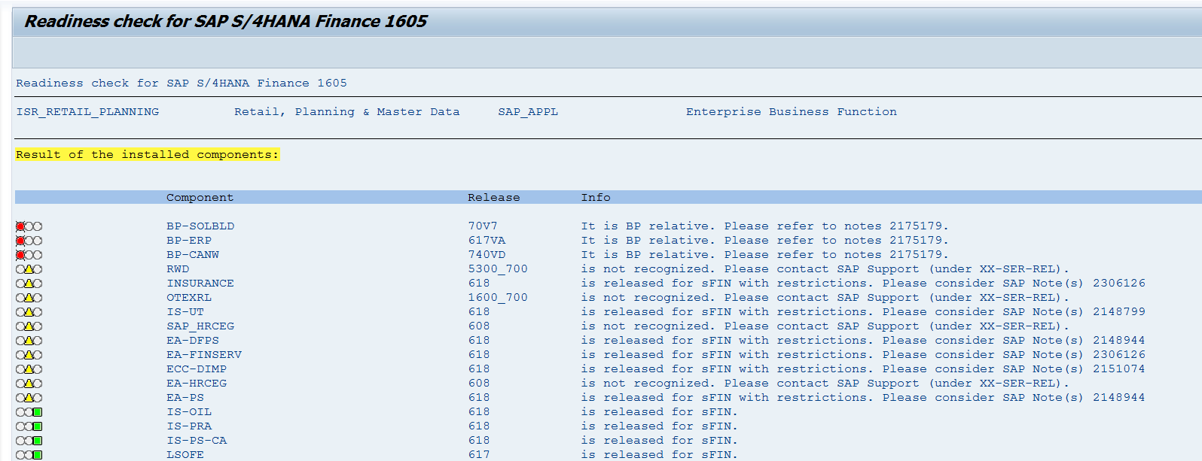
Readiness check continued
Readiness
Checks
Notes:
The prerequisites check is an ABAP report that does a preliminary check whether your current system meets the conditions for implementing SAP Simple Finance. This ABAP report is available by SAP Note implementation.

Slide 28
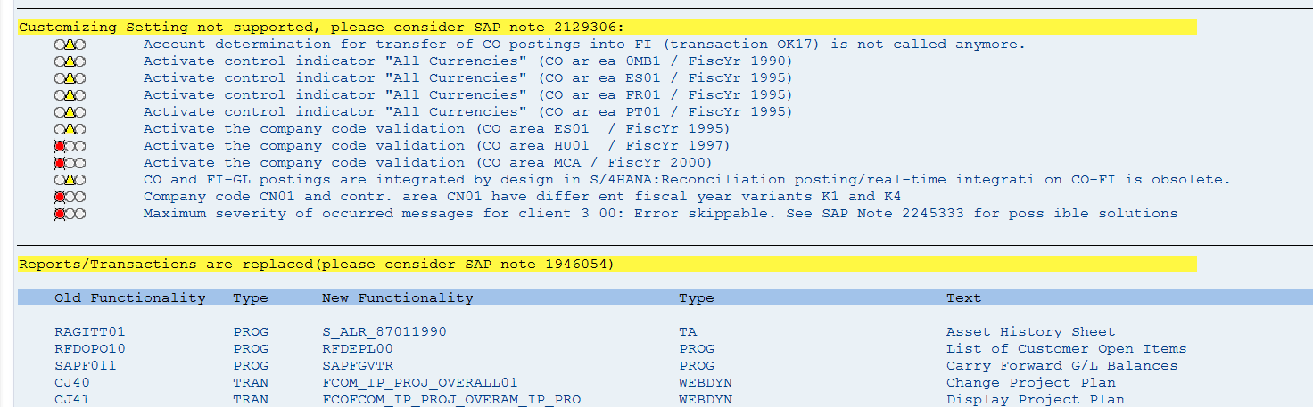
Readiness check continued
Readiness
Checks
Notes:
It

Slide 29
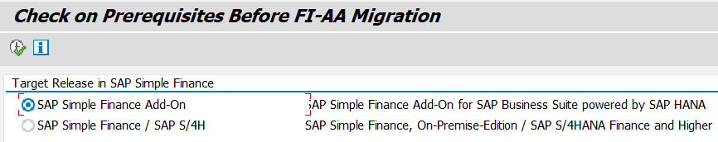
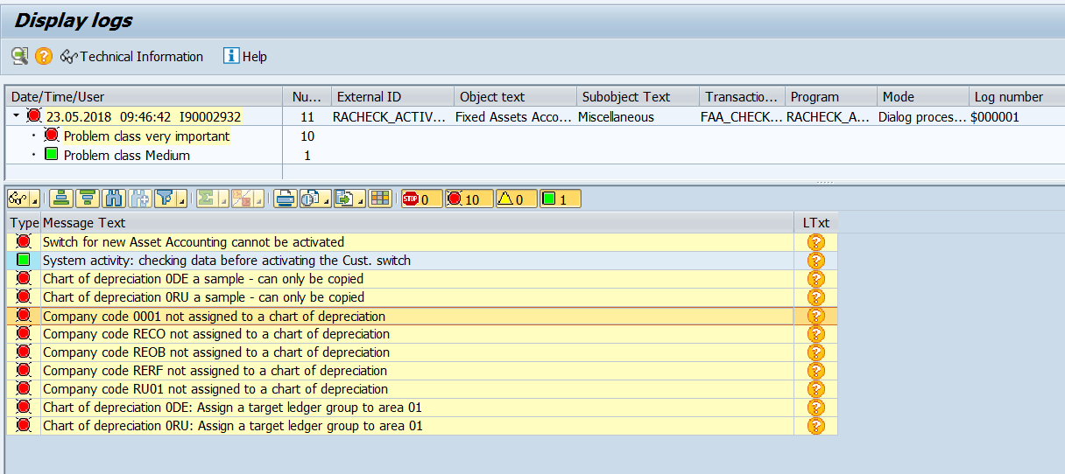
FI-AA Prerequisite check
Readiness
Checks

Slide 30
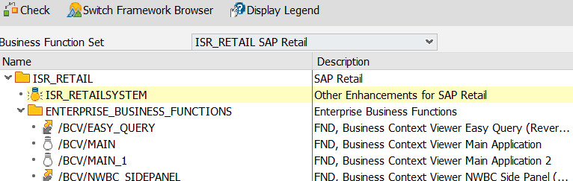
Finance preparation activities
Preparation
Activities.
Activate business functions – SFW5
Period end closing
  Asset specific (prior year as well)
  GL specific (completed month-end)
Extract pre-migration validation reports
  GL balances
  Asset balances
  AR and AP balances

Slide 31
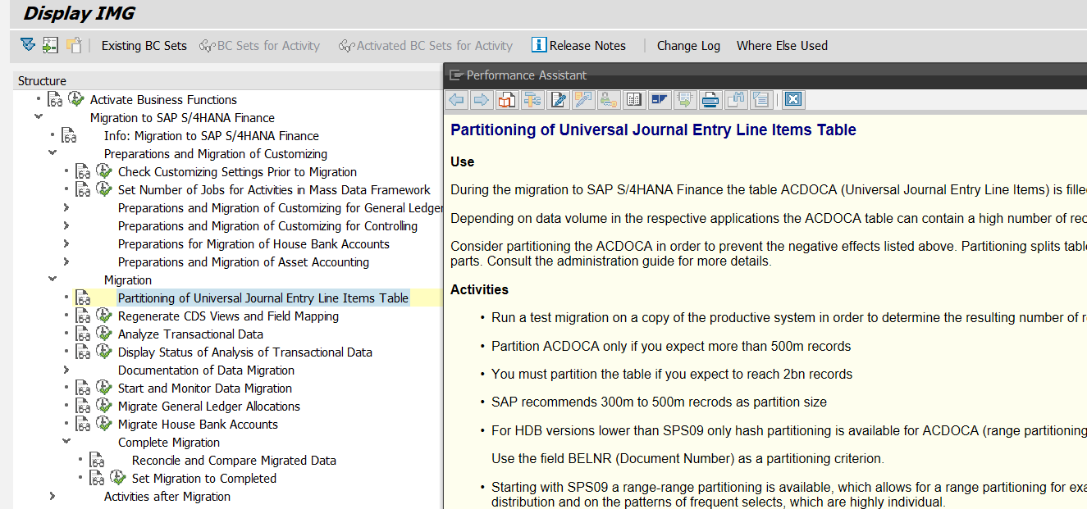
FI Config

Slide 32
Key Finance Activities
Readiness
Checks
Preparation
Activities.
Config and Impacts
Finance Migration.
Validations

Slide 33
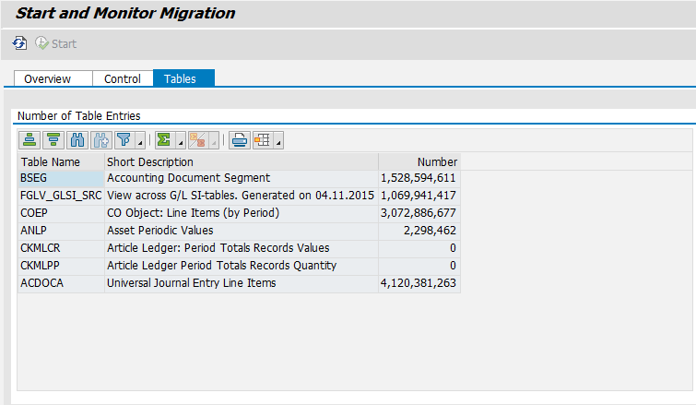
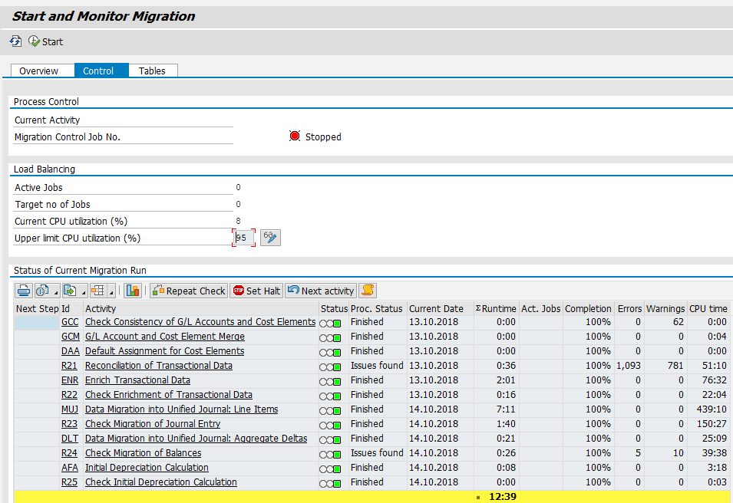
Finance Migration Cockpit
Finance Migration.

Slide 34
Post migration activities
Validations
Extract post migration reports
Perform validations and comparisons

Slide 35
First run findings
Auckland NZSUG + SAP Summit 2019
Bonnie Hohlfeld, Chris Attwood
Reality did not equal the vision

Slide 36
Learnings of first run
Duration 9 days
Sizing
CDS views
Didn’t wait for SAP, did a workaround
Numerous asset issues
Sub optimal partitioning

Slide 37
MAY-18
JUN-18
JUL-18
AUG-18
SEPT-18
OCT-18
POC
SANDBOX TESTING
DEV TESTING
QA TESTING
PPRD
ITERATIVE TESTING
LEGACY LOADS & ASSET REGISTERS
DOWNTIME PREP
CUSTOM CODE REVIEW
PROJECT AND CHANGE MANAGEMENT

Slide 38
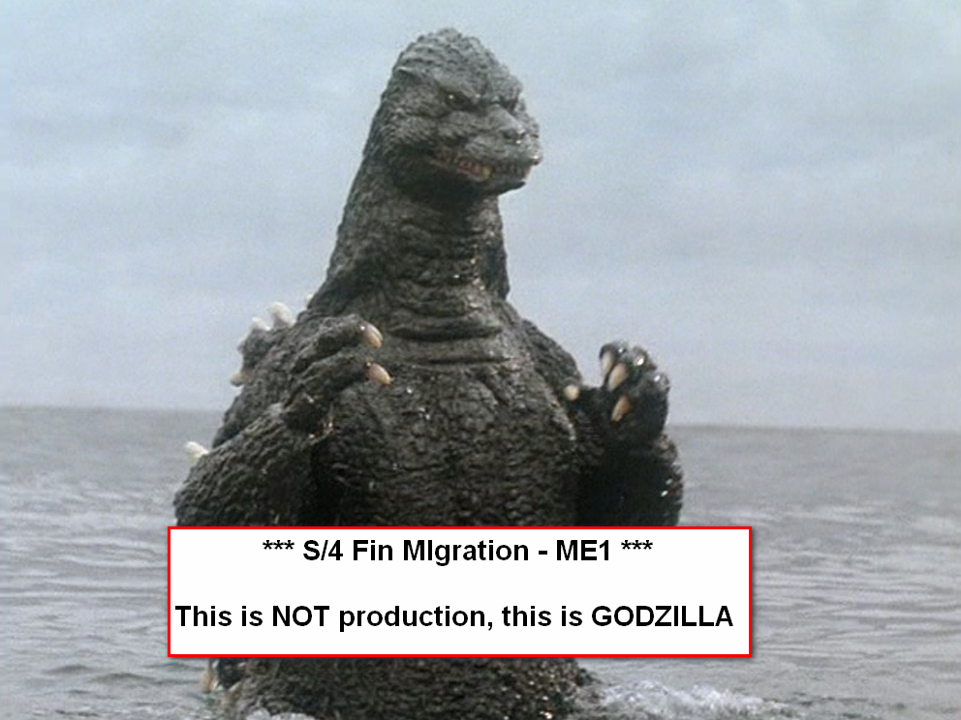

Slide 39
Iterative Tests
Auckland NZSUG + SAP Summit 2019
Bonnie Hohlfeld, Chris Attwood
If at first, you don’t succeed, dust yourself up and try again, try again ..

Slide 40
Move to Iterative testing
DB Iterative Tests
Migration testing needed production sized hardware!
Allowed ongoing development of the migration while COE teams continued to deliver work
We were able to asses the effect of the limited variables available to us
Allowed us to build a body of knowledge around SUM DMO / SAP HANA and FINMIG screens, across the team.

Slide 41
Iterative testing: Key migration Variables (1)
DB Iterative Tests
HANA Parameters – SAP HANA Parallelism / Delta Merge
HW sizing – Need production like HW to do meaningful testing
Data volumes – Archiving data had significate influences on runtime, in particular the cluster tables which are converted
  CDCLS -> CDPOS converted to 12 billion rows
  KOCLU -> KONV converted to 14 billion rows
  COEP had more than 3 billion rows and this triggered a code rewrite by SAP

Slide 42
Iterative testing: Key migration Variables (2)
DB Iterative Tests
# of Migration streams : 5 threads per CPUs – 480 was our sweet spot
  we peaked at 6GB/sec output on our MSSQL server NIC
Use a history file for the table splits – to decrease the export/import “tail”
Created Primary keys on cluster table targets before they where loaded.
Run SAP HANA in OVERWRITE Mode for the import
Increase of parallelism in MS SQL from 1 to 4

Slide 43
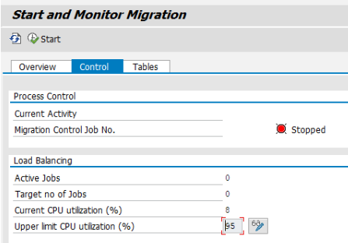
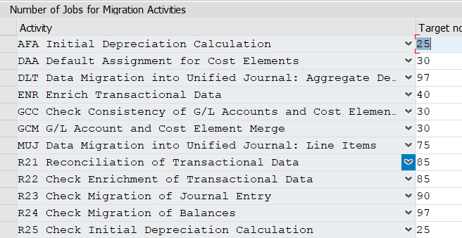
FI Migration Iterative Tests
Number of jobs
Adjusting jobs on the fly +/-
Review load balancing packages
Monitor each step SAP trace

Slide 44
Cutover weekend
Auckland NZSUG + SAP Summit 2019
Bonnie Hohlfeld, Chris Attwood
.

Slide 45
Downtime Management
Identified key BO’s
Socialize the outage time
Critical process solutions
Detailed plan to track progress

Slide 46
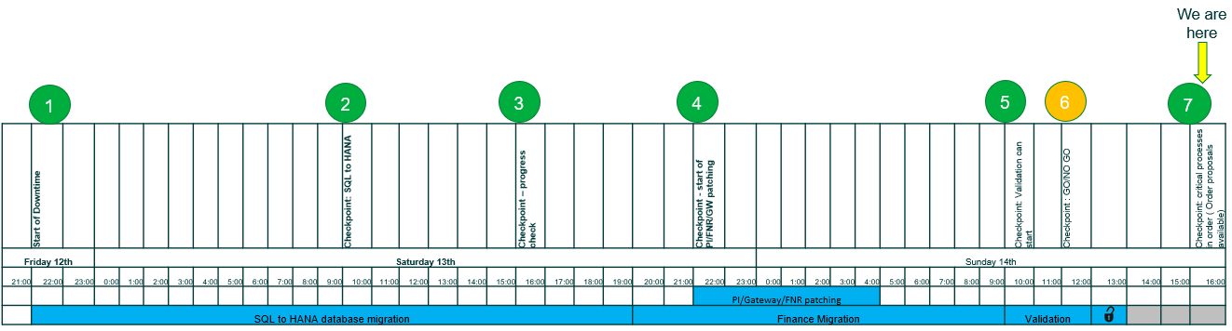
Hour by hour plan to track against
.
Shift Schedule for the 42 hours
Checkpoints and Go-no go decision points
Senior Stakeholder Support

Slide 47

Cut-over weekend

Slide 48
“…this project was described as being the new benchmark for all Projects to measure themselves against ”
Peter Muggleston, CIO 2018
Auckland NZSUG + SAP Summit 2019
Bonnie Hohlfeld, Chris Attwood

Slide 49
Lessons Learnt
Order Production Hardware early
Spring Clean your Database.
Repetition
Make use of the available
SAP services

Slide 50
SAP Services and Tools
Near Zero Downtime (NZDT)
Going Live Service
Code Inspector
ABAP SQL Monitor
Expert on Demand
OS / DB
Migration
Service

Slide 51
Platform for further enhancements
Continued deployment of S/4HANA Finance apps
Embedded reporting – real-time
Data aging
SAP Analytics Cloud
KNOA

Slide 52

Any questions?
Thank you
52
Finance Users
26 April 2018
Thank you!
Notes:
Thank you for joining us and we leave you with an African proverb as the Thought for the day.
“If you want to go fast, go alone. If you want to go far, go together”

