Slide 1

Rising to the EAM Data Challenge
Strategic Master Data Across the Enterprise

Slide 2
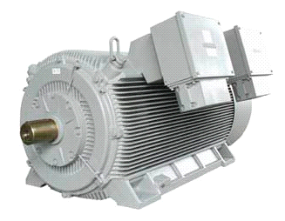
Enterprise data lives in multiple systems of record
Reliability
Systems
Engineering
system
    Business is transacted in real-time across connected devices and systems
    Digital twins must remain in sync to maintain data integrity
SCADA
GIS
Content
Management
Plant
Maintenance
Notes:
Data runs throughout the entire value chain of the organization and is generated by various disparate sources. When we refer to the Digital Twin, we’re talking about how we synchronize and maintain data integrity across these systems of record - both SAP and non-SAP environments.

Slide 3
High quality data enables the intelligent enterprise
Influences every process
Informs every decision
Connects goals to outcomes
High
Quality
Data
Leverages technology
investments
Fuels collaboration
Notes:
The intelligent enterprise looks at high quality data as its foundation. This positive feedback loop is perpetual and fueled by high-quality data. When you focus on data quality, you can begin to trust your data and then in turn make truly powerful decisions.

Slide 4

The reality is…
Data gets dirty
    Complexities
    Diverse landscapes
    Legacy systems
    Regulatory changes
    Rapid growth
    M & A’s
    Knowledge transfer
    Siloed departments
December 3, 2019
4
Notes:
Data can be hard to talk about. Especially in context to the large initiatives or other priorities going on at your company. Data is messy, it’s complicated, complex, ever changing and multiplying at exponential rates.

Slide 5

The data quality gap
56%
8%
3%
of CEOs are concerned about the quality of their data.
of organizations
have reached “transformational” levels of maturity in data and analytics.
of company data meets a minimum threshold for data quality.
Source: KPMG, 2017 Global CEO Outlook.
Gartner, Survey Analysis: Traditional Approaches Dominate Data and Analytics Initiatives, Feb 5, 2018, Harvard Business Review, Only 3% of Companies’ Data Meets Basic Quality Standards, Sept 11, 2017.
Notes:
More than 50%, that’s more than half, of all CEOs survey by Gartner shared that they are concerned about the quality of their data. Instead of saying concerned, they could say, “Don’t Trust” When you are concerned about your data you tend not to trust it, when you can’t trust your data you are exposing the organization to risk and eliminating any opportunity to real-time decision making that can drive both the bottom and top lines.
Scott
How can we ensure it’s integrity is protected regardless of where that data lives, the format it’s in or how it is being managed and used.
Talk about examples of some catastrophic outcomes from bad data quality

Slide 6
Actionable data to outcomes Case Study 1
Large Polymers Manufacturer
MRO SPARE PARTS/Inventory

Slide 7

MRO by the numbers
    Annual spend of roughly $1.5 billion in MRO Spares replenishment
    91% of work orders scheduled, require multiple trips and manual intervention
    Over $150m of MRO Spares Inventory with an annual carry cost of 25%
    Only 31% of critical assets have accurate and complete MRO spares information
December 3, 2019
7

Slide 8
Obsolete inventory analysis
Obsolete Inventory Analysis
Mills / Plants | 12
MRO Spares Balance Sheet | $150,000,000.00
Annual Carrying Cost (25%) | $37,500,000.00
MRO Spares Annual Spend | $350,000,000.00
Camden
MRO Spares Balance Sheet | $12,500,000.00
Annual Carrying Cost (25%) | $3,125,000.00
MRO Spares Annual Spend | $29,166,666.67
Site #1 Materials | 31,962
Materials on BOM | 19,120
Potential Obsolete Materials | 12,842
% of Total | 40.18%
Lack of Inventory and Required Critical Spares | 75.00%
Potential Impact | 10.04%
Value of Potential Obsolete Materials
MRO Spares Balance Sheet | $1,255,592.58
Annual Carrying Cost (25%) | $313,898.14
All Sites | $16,322,703.52
Annual Carrying Costs | $4,080,675.88
Notes:
Some of the most common master data challenges related to enterprise asset management impact three key areas:
Capital projects: Without accurate asset, work and completions data, transition from build to operational phase can be delayed, affecting profitability and operating efficiencies.
Increased health and safety risks: Due to omissions and inaccuracies in asset data, decisions are made based upon bad information, increasing health/safety risks.
Decreased Profitability: Plants in asset-intensive industries must run at optimum capacity to be profitable. Poor quality of asset, work and materials data leads to missing parts or poor maintenance, affecting uptime

Slide 9
Wrench time and asset availability analysis
Wrench time / Asset Availability Analysis
Camden
Total Equipment | 50,399
Total equipment with BOMs | 15,119
Current First Time call Resolution (%) | 30%
New BOM's added to Equipment (automated) | 4,735
New BOM's added to Equipment (manual) | 7,636
New Total equipment with BOM's | 27,490
Future First Time Call Resolution % | 54.55%
Utopia Impact | 81.83%
Notes:
Some of the most common master data challenges related to enterprise asset management impact three key areas:
Capital projects: Without accurate asset, work and completions data, transition from build to operational phase can be delayed, affecting profitability and operating efficiencies.
Increased health and safety risks: Due to omissions and inaccuracies in asset data, decisions are made based upon bad information, increasing health/safety risks.
Decreased Profitability: Plants in asset-intensive industries must run at optimum capacity to be profitable. Poor quality of asset, work and materials data leads to missing parts or poor maintenance, affecting uptime

Slide 10
Actionable data to outcomes Case Study 2
Global petrochemical producer
brownfield asset data quality Improvement

Slide 11
Key business challenges and value impacted by effective asset master data management
Capital project/ turnaround delays | $1 million/day per $billion in asset value | 1.5% of Capital Cost
Information foundation creation | 1 to 3% of capital project budget | Reduce by 10–20%
Safety and environmental | $1–$100 million | Reduce incident risk and cost by 5%
Plant availability | North American refining capacity < 90% | 1% increase in availability
Shop floor productivity | Wrench time averages 35% (world-class 60%) | Improve by 50%
Aging/mobile Workforce | Before 2020, up to 50% of skilled shop floor workforce will retire | Increase knowledge capture Absorb attrition
MRO supply chain disconnected from shop floor | Less than 50% of MRO materials are in equipment bills of materials | Reduce obsolete items (3%) Reduce parts consumption (2%) Reduce returns (30%)
Low adoption of MRO systems | Low adoption rates for 60% of workforce (operators/craftsmen) | Reduce training costs
** Potential benefit from improved asset master data management.
Notes:
11

Slide 12

Brownfield improvement program
    Only 40% of their equipment to be in SAP Plant Maintenance
    Field walkdowns underway to collect brass tags
    Outsourced Machine learning to classify/cleanse/enrich
    Insourced/Outsourced manual enrichment for remaining data
    Accelerate 4-5 year program to 12–18 months
    Focus on Critical Equipment, then expand
December 3, 2019
12

Slide 13
From MRO spares to plant maintenance
Maintaining your data quality initiatives throughout the value chain

Slide 14


The Business Case for Asset Master Data Quality
    Ensuring accurate, complete asset master data can have a direct impact on reducing environmental, health & safety risks, improving operational performance and maintaining regulatory compliance.
Maintenance Inefficiency
Operational Inefficiency
Reduced maintenance ‘wrench-time’
Inadequate preventive maintenance
Poor visibility into asset lifecycle
Increased downtime from equipment failure
Increased mean-time-to-repair
Raw material shrinkage
Excessive MRO Supply Chain Costs
Increased EH&S Risks
Inability to accurately predict spares needs
Unidentified obsolete inventories
Excessive expedited procurement
Safety risks for maintenance staff and operators
Inadequate risk management & quality assurance
Lack of Auditability
Inability to Achieve Operational Excellence
Poor financial accountability
Regulatory compliance risk
Product liability risks from quality
Inability to achieve top quartile performance through advanced maintenance techniques such as reliability-centered-maintenance,
risk-based inspection, performance analytics

Slide 15


Understanding the Business Challenge
Maintaining an accurate, complete Digital Twin in the key systems of record can have a direct impact on reducing environmental, health & safety risks, improving operational performance and ensuring regulatory compliance.
Reliability
Engineering
    The Challenges
SCADA
GIS
    The assets are continuously changing (maintenance, shutdowns/ turnarounds,
    capital projects)
    The Digital Twin includes unstructured data (Operating Manuals, Repair Manuals, Warranties)
    The Digital Twin is distributed among multiple systems of record
Content
Management
Plant
Maintenance
The Challenges

Slide 16

Understanding the Business Challenge
Maintaining an accurate, complete Digital Twin in the key systems of record can have a direct impact on reducing environmental, health & safety risks, improving operational performance and ensuring regulatory compliance.
Reliability
Engineering
    The Challenges
    The assets are continuously changing (maintenance, shutdowns/ turnarounds,
    capital projects)
    The Digital Twin includes unstructured data (Operating Manuals, Repair Manuals, Warranties)
    The Digital Twin is distributed among multiple systems of record
SCADA
GIS
“
Ensuring Synchronization of The Network of Digital Twins is essential to Safety, Efficiency and Operational Integrity.
Content
Management
Plant
Maintenance
“
The Challenges

Slide 17
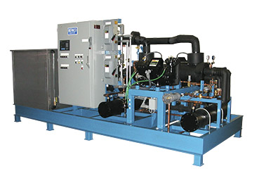
Example: The Digital Twin
  Full end-to-end cycle of creating, enriching, validating and approving a new equipment master using SAP AIN and SAP Asset Information Workbench
Physical Asset
Digital Twin
Electrical Power
Cool Air
Water Outlet
Water Inlet
Driver
Condenser
Pump
Compressor
Dryer
Refrigerant Accumulator
Controlling and Monitoring
Miscellaneous
Boundary
Power
Remote
Instrumentation

Slide 18
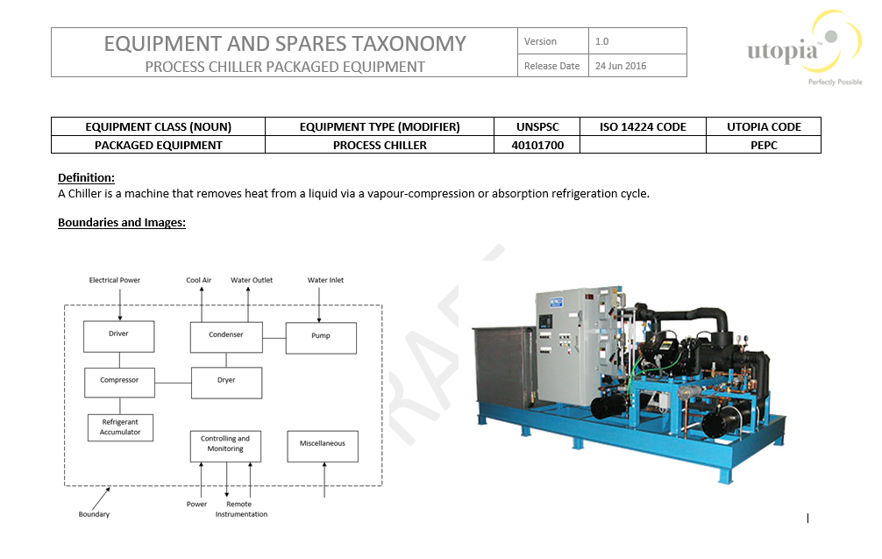
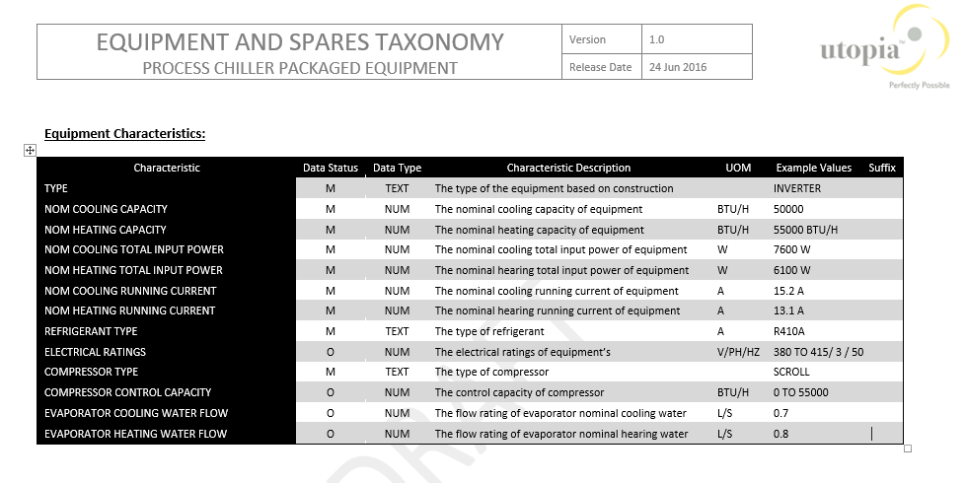
Example: The Source for the Digital Twin
Electrical Power
Cool Air
Water Outlet
Water Inlet
Driver
Condenser
Pump
Compressor
Dryer
Refrigerant Accumulator
Controlling and Monitoring
Miscellaneous
Boundary
Power
Remote
Instrumentation

Slide 19
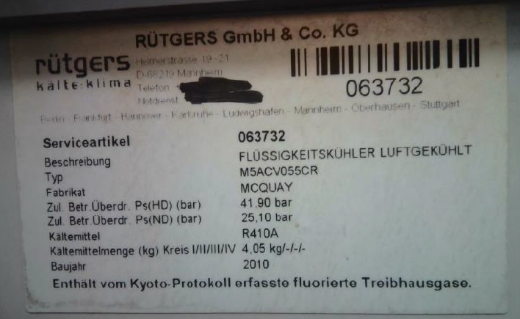

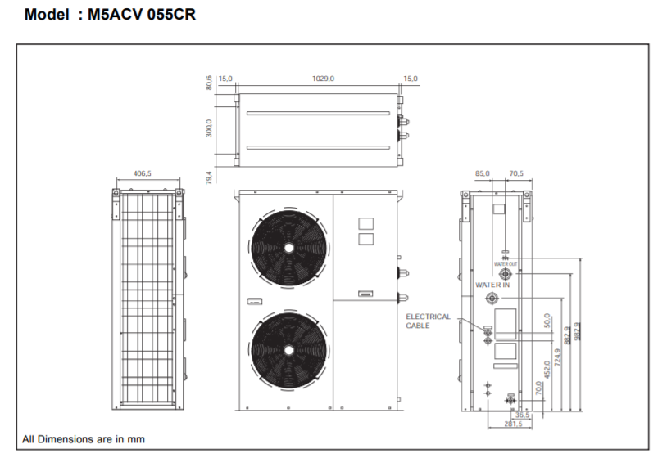
Example: From Brass Tag to Digital Twin in SAP
Customer supplied Brass-Tags (photos) from plant walk-down to Utopia for data enrichment
Utopia placed the information in the SAP Asset Intelligence Network for easy access
“Brass tag” enriched data
Noun | Modifier | Attribute name | Attribute value | Short description | Long description
CHILLER | AIR COOLED | TYPE | INVERTER | CHILLER:AIR COOLED;INVRTR,50000 BTU/H | CHILLER:AIR COOLED;TYPE:INVERTER,NOM COOLING CAPACITY:50000 BTU/H,NOM HEATING CAPACITY:55000 BTU/H,NOM COOLING TOTAL INPUT POWER:7600 W,NOM HEATING TOTAL INPUT POWER:6100 W,NOM COOLING RUNNING CURRENT:15.2 A,NOM HEATING RUNNING CURRRENT:13.1 A,REGRIGERANT TYPE:R410A,ELECTRICAL RATINGS:380 TO 415VAC,50 HZ,3 PH,COMPRESSOR TYPE:SCROLL,COMPRESSOR CONTROL CAPACITY:0 TO 55000 BTU/H,EVAPORATOR COOLING WATER FLOW:0.7 L/S,EVAPORATOR HEATING WATER FLOW:0.8 L/S
CHILLER | AIR COOLED | NOM COOLING CAPACITY | 50000 BTU/H
CHILLER | AIR COOLED | NOM HEATING CAPACITY | 55000 BTU/H
CHILLER | AIR COOLED | NOM COOLING TOTAL INPUT POWER | 7600 W
CHILLER | AIR COOLED | NOM HEATING TOTAL INPUT POWER | 6100 W
CHILLER | AIR COOLED | NOM COOLING RUNNING CURRENT | 15.2 A
CHILLER | AIR COOLED | NOM HEATING RUNNING CURRENT | 13.1 A
CHILLER | AIR COOLED | REFRIGERANT TYPE | R410A
CHILLER | AIR COOLED | ELECTRICAL RATINGS | 380 TO 415VAC,50 HZ,3 PH
CHILLER | AIR COOLED | COMPRESSOR TYPE | SCROLL
CHILLER | AIR COOLED | COMPRESSOR CONTROL CAPACITY | 0 TO 55000 BTU/H
CHILLER | AIR COOLED | EVAPORATOR COOLING WATER FLOW | 0.7 L/S
CHILLER | AIR COOLED | EVAPORATOR HEATING WATER FLOW | 0.8 L/S
December 3, 2019
19
http://www.acson-international.com/files/tm/mcquay/McQuay%20TM2007/M5ACV-2007.pdf

Slide 20
Integrated Object Model – SAP Master Data Governance
Supplier & Customer
Assets
Products
Finance
Material
Accounting ,Controlling and Consolidation
Business Partner Attributes
Basic & Classification Data
Asset Structures
Basic & Classification Data
GL Account/
Chart of Accounts
General Data &
Descriptions
Work Centers
Descriptions
Central Data
Roles
Bank Details
Identification
Units of Measure
Equipment Master
Units of Measure
Financial Reporting
Structures:
Balance Sheet,
P&L Statement
Tax
Tax Numbers
Industry Sectors
Quality Data
Functional Location
Bill of Material
Addresses with Usage and Versions
EAN, UPC
Linear Asset Capabilities
Work Management Objects
Characteristics
Assignment & Variants
Cost Element/
Hierarchies
Business Partner Relationships
Classification
Maintenance Plans
Supplier Attributes
Customer Attributes
Document Link
Maintenance Plan Items
Purchas.
Cost Center/
Hierarchies
Measuring Points
Purchase Info Record
General Data
General Data
Logistics Data
Purch. Org / Vendor / Site
Sales Data
Task Lists
Profit Center/
Hierarchies
Comp. Code
Data
Comp. Code
Data
Plant Data
Service Master
Logistics, Listing, Sales
Purchasing Data
Sales Area Data
Stores
Company
Storage &
Warehouse Data
MRO
Bill of Material
Distribution Center
Tax Indicators
Header: Identifying and Quantity,
Validity Data, Material Data, Texts
Consolidation:
Item, Group &
Hierarchies, Unit,
Break Down Category
Production Version
Listing
Contract Account Attributes*
Item: Detail, Quantity, Status,
MRP and Purchasing Data,
Text and Document Assignment
Sales Org. Data
Value
General Data
Partner-specific
Data
Valuation, Costing,
Material Ledger
Point of Sales

Slide 21



SAP Asset Information Workbench Integration points
1
Asset
Intelligence
Network**
On Premise
Asset Information Workbench
EPCs / Contractors
As-built CAD, Equipment Lists
Governance
Rules &
Workflows
Best Practices Libraries
Systems of Record
2
Transmittal
Management
Approved Multi-Object Change Requests
6
Content Management
5
Manufacturers / OEMs
Catalogs, Specifications
Data Collection
Forms
Asset Information
Staging Area (MOCR)*
Content
Request w/
SmartMatch
7
Plant Maintenance
3
Release To
Operations
3rd Party Libraries
Engineering
Switches, O-Rings, Seals, Bearings
Sensors, Cylinders, Tools, Motors
Digital
Service
Request
4
Business Rules
8
SAP Master Data Governance, EAMx
GIS
SCADA
3rd Party
Data Suppliers
*Multi-Object Change Request.
**Integration provided by Utopia.
Notes:
Drawings, tag register & E-SPIR delivered from engineering and construction firm
New equipment characteristics, recommended maintenance and spares delivered from OEM to content request
Older equipment information from 3rd party libraries responding to content requests
Missing information delivered from 3rd party data suppliers responding to service requests
Master data enriched by standards maintained in best practices library
Completed asset information submitted to governance process via multi-object change request (CR)
Upon validation and approval, as-built asset information released to systems of record
Continued synchronization among assets systems of record maintained by ongoing management of change
SCADA = Supervisory Control and Data Acquisition

Slide 22

Conclusion
    Data is critical to success of organizations
    Linking data improvement to tangible outcomes drives investment
    Analysis of data and careful laying out of real-world risks and opportunities related to that improvement drives organizational change
    UTOPIA and DXC OXYGEN CAN HELP
December 3, 2019
22

