Slide 1
AGL Case Study + Tricentis Tosca Test Automation
Brendan Lester
Senior Principal Consultant
brendan.lester@ttcglobal.com
Thomas Hadorn
Managing Director, APAC
t.harorn@tricentis.com

Slide 2
AGENDA
01. | AGL Case Study
02. | Tricentis Tosca Test Automation
03. | Demo
04. | Questions

Slide 3
Years Months
Delivery Cycle Time
Software Quality
Challenge
Months Weeks
Perceived Disruption
Weeks Days
Days Hours
Technical Complexity & Rate of Change
Hours Minutes
Today
Critical Physical Limit

Slide 7
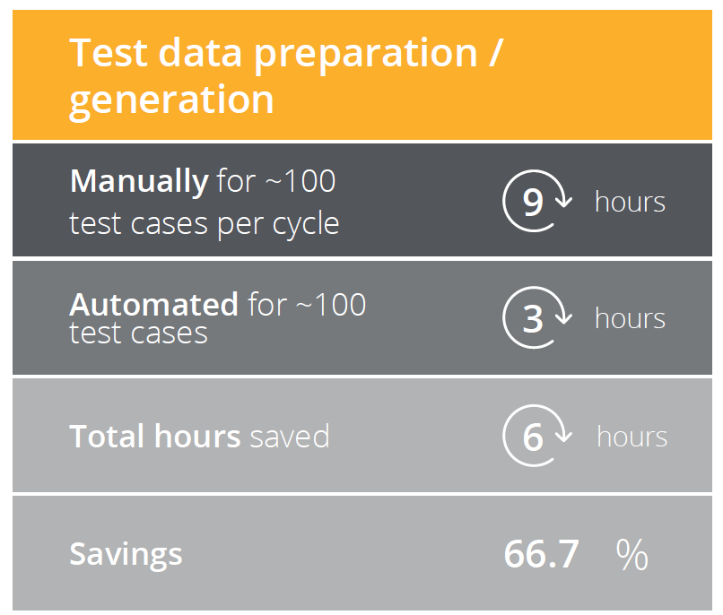
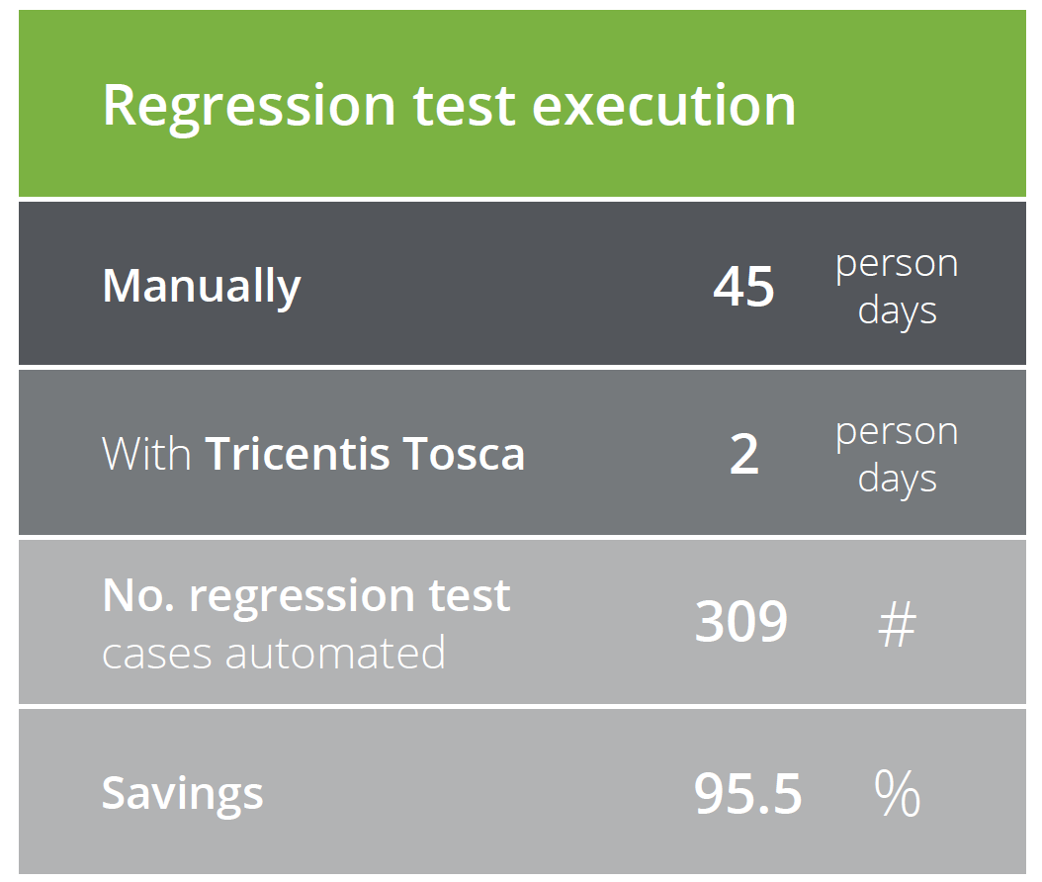
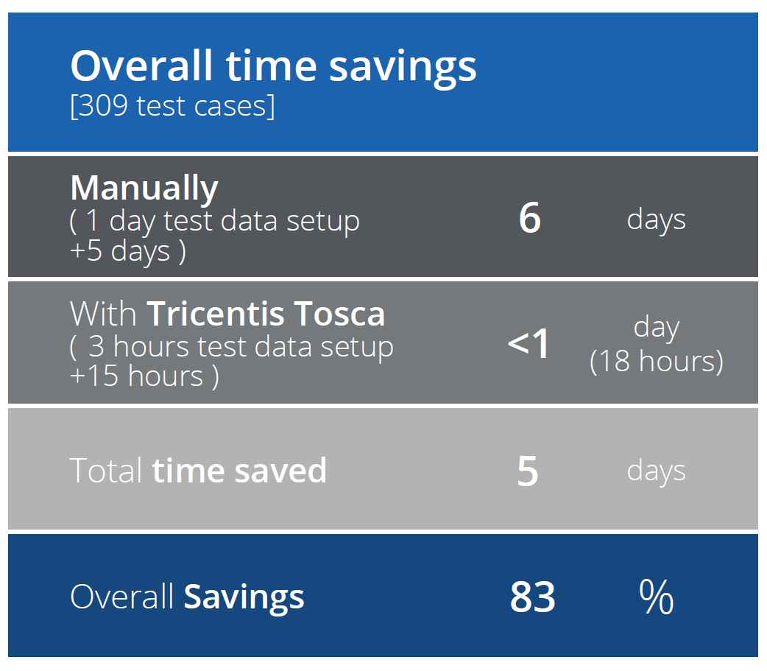
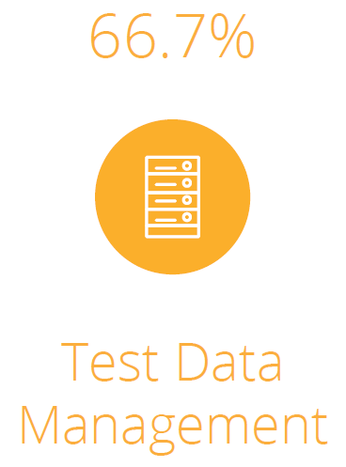
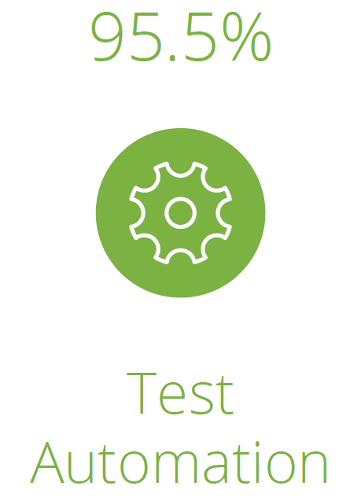
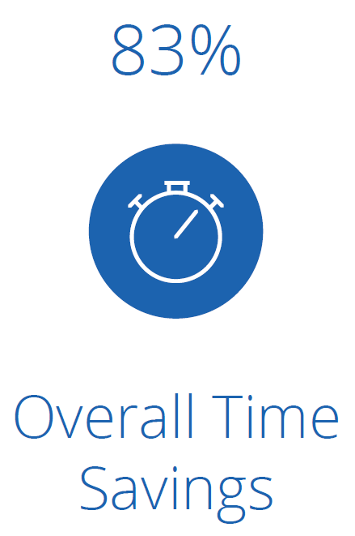

Slide 8
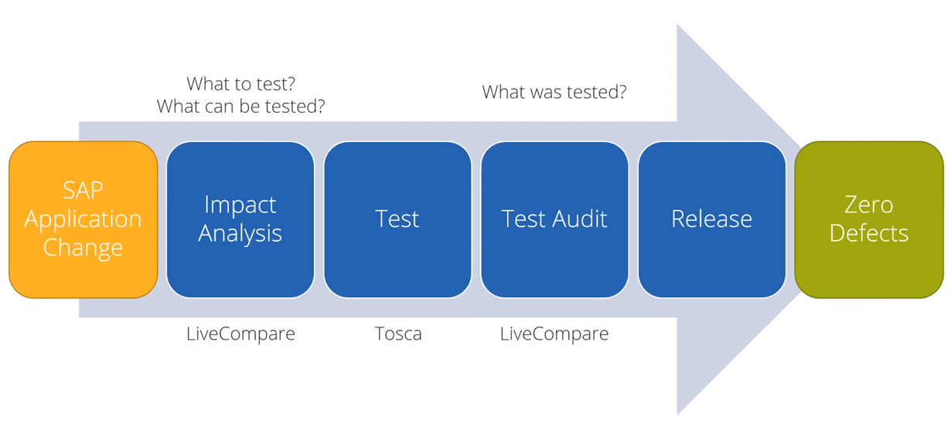
Test within the release process

Slide 9
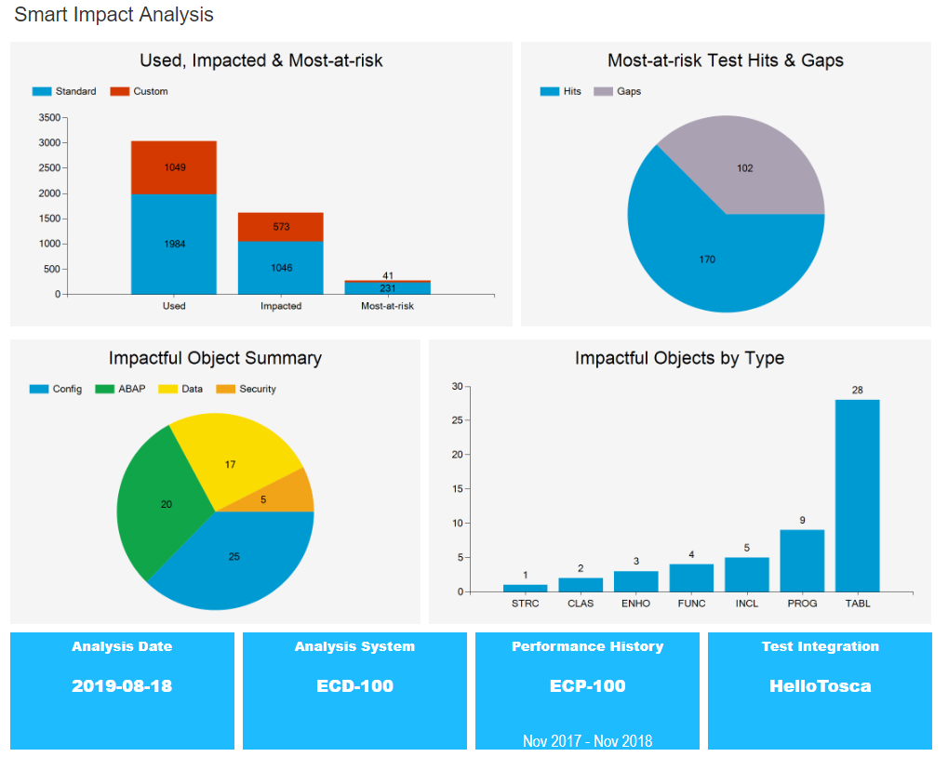
LiveCompare test gaps identified

Slide 10
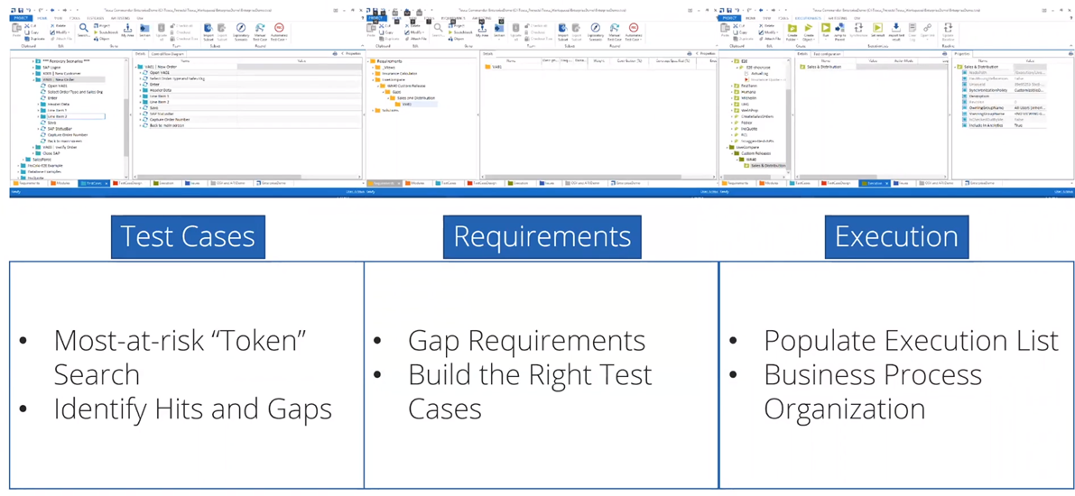
LiveCompare to Tosca boilerplating

Slide 11
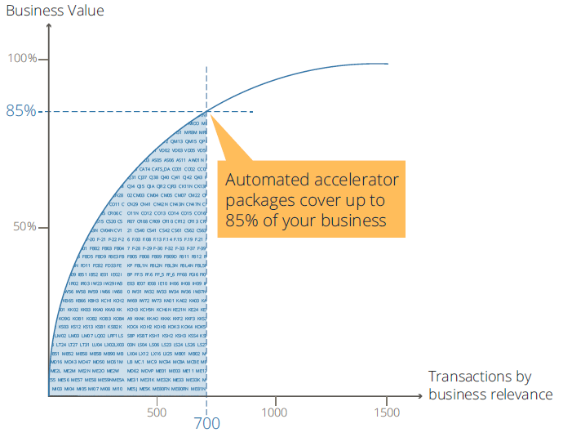
Tricentis SAP Accelerator Packs
Include 700+ of the most requested transaction codes across several industries.
These transactions have been fully automated and serve as automation templates for any SAP project

Slide 12
Demo
Tosca Recoding and running a SAP Create User Transaction

Slide 13
Bonus item Tosca test assets can be reused by Tricentis RPA for Business Process Automation in Production. Leading to further value, savings, speed & quality. Questions

