Slide 1



Slide 2
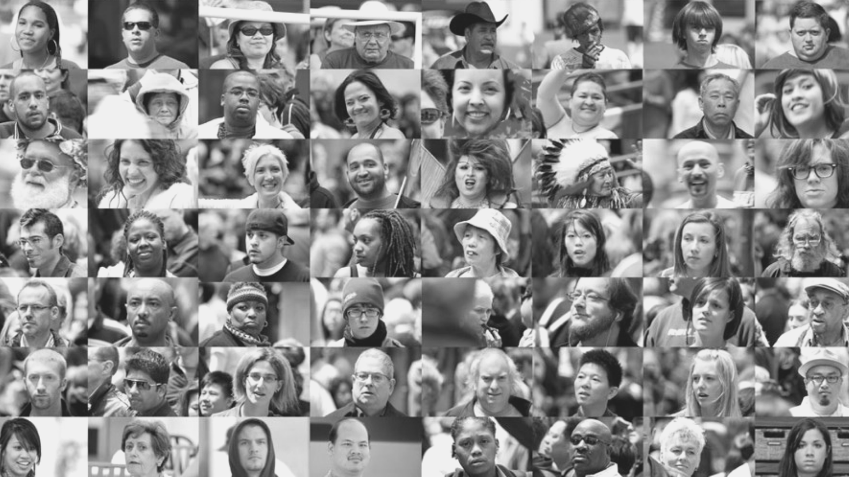
Humans Experience.
Humans Buy.
Not Businesses or Machines.
Humanise Digital

Slide 3
The opportunity for NZ business is everywhere…
we have clear thoughts in our minds.

Slide 4

Beyond Disruption – NZ Survey take-outs
Digital transformation has been high on the agenda of business leaders for some time now, and the results are showing.
Transformation is helping New Zealand businesses compete in their existing markets – and enabling them to enter new ones.

Slide 5








Telsyte findings – NZ organisations
1
2
3
Digital
New Zealand businesses are well on the path to an organisation-wide digital approach
New cloud,
connectivity and customer experience technologies are driving digital agendas
disruption is now high on New Zealand’s corporate agenda
4
6
5
Digital
Speed up
Digital will
usher in workforce
transformation
strategy requires a better approach to non-IT business unit technology spending
success to avoid digital transformation failures
Notes:
How does the IT group adopt and adapt to a more business centric approach.

Slide 6

Classical Transformation
and Migration 101

Slide 7
Classical business transformation approach
Empathising and understanding end users
Transformation blueprint and the relative tangible benefits to be achieved
Alignment to what matters for change and business buy-in as SME’s collaborate to co-design their future enterprise
Notes:
This is the HOW
Empathising and understanding end users (customers, employees and partners) and designing the vision for the future enterprise leveraging both new digital technologies and customer-centric practices.
The outcome will include a transformation blueprint of your digital core requirements and the relative tangible benefits to be achieved
Our approach guarantees initial alignment to what matters for change and generates internal business buy-in as SME’s collaborate to co-design their future enterprise

Slide 8
Transformation approach
Digital transformation – success themes:
An outcome-based approach which focuses on:
Empathising with users, focus on behaviours and user experience first
E2E value chain from the outside in; based on data, customer experience and integration
Next ERP as a foundational system of record holding the single source of truth and underpinning the desired business agility
Empathise & Innovate
Deliver the foundation
Transform & Manage
Notes:
This is the HOW
Empathising and understanding end users (customers, employees and partners) and designing the vision for the future enterprise leveraging both new digital technologies and customer-centric practices.
The outcome will include a transformation blueprint of your digital core requirements and the relative tangible benefits to be achieved
Our approach guarantees initial alignment to what matters for change and generates internal business buy-in as SME’s collaborate to co-design their future enterprise

Slide 9


Classical transformation journey
Set the vision & objectives
Design your transformation blueprint & how you will measure success
Build your foundation or ‘digital core’
Sprint 1
Incrementally integrate new digital capabilities constructing the new business model
Sprint n
Sprint 3
Sprint 2
Build-in complementary innovation areas
Adopt, test and ‘live’/use your new home
Iterate, adapt based on learnings and new market changes

Slide 10
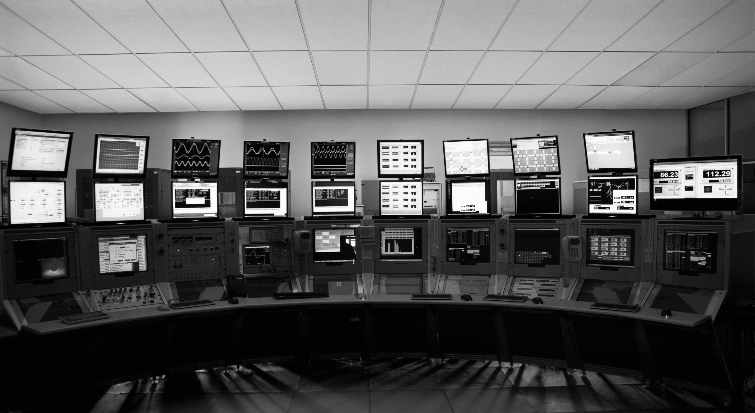
But as ICT… are we enabled to help?
Notes:
But still too often… Technology is shown as the only answer.

Slide 11
ICT traditional approach …
Work with the business to identify perceived pain points for business improvement
Solve single problems
MVP as a point solution
Human (workforce and customer) and experience factors often not identified or considered
Entire landscape and connections not considered

Slide 12
Why it’s not enough …
Islands and complexity are created within the environment
Business case doesn’t stack up
Solution often doesn’t add value – the core value has been eroded
Proof of Concept or MVP approach does not create a production useable environment.
TCO does not reduce
Often it is just about adding more stuff onto existing issues without really re-thinking the business process and problem.

Slide 13
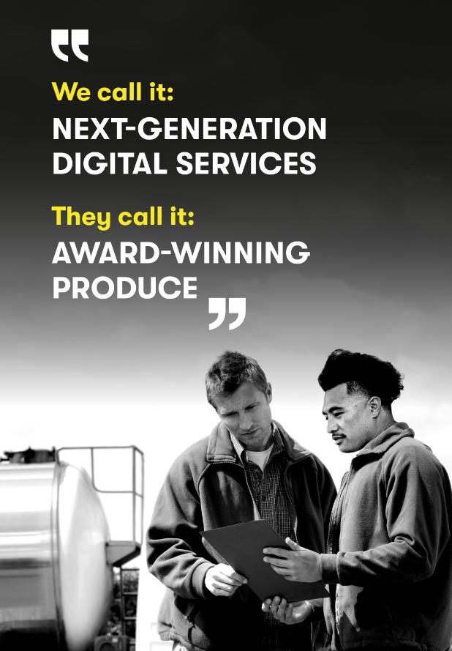
Humanise
Digital
– a human centric approach to IT systems transformation
Notes:
Business
Customer Experience Transformation & Personalisation
Simplification, Automation and Business Cost Out
Greater Business Agility& Changeability
Proactive Health & Safety & Risk Management
“Right now if a human worker does you know, $50,000 worth of work in a factory, that income is taxed. If a robot comes in to do the same thing, you’d think we would tax the robot at a similar level.”
Bill Gates, in an interview with Quartz
Source: Marketwatch

Slide 14

Humanise Digital
Experience Uniqueness. Together.
Drive
Resilience
Enable
Wisdom
Unique
Experience

Slide 15
Humanise Digital
Cultivating the ability to:
Create Unique Experiences
Drive Resilience
Enable Wisdom
Core
Systems of Record
Systems of Simplicity
Systems of Agility
Systems of Convenience
Systems of Synergy
Systems of Insight
Systems of Engagement
Edge
Digital Aspects
Data
Harmonize/ Standardize
DevOps
Automation
Microservices
Personalization
Contextualization
Transactions
Code-to-Rules
Continuous Delivery
Predict & Prevent
Digital Business Networks
Analytics
Anticipatory
Operations
Cloud
Continuous Deployment
Right Response
Ecosystems
Industry
Natural Interactions
Human Aspects
Manage
Responsive
Retrospectives
Streamline
Collaboration
Intelligence
Unexpected
Trust
Transparent
Adaptable
Lean
Supportive
Continuous Learning
Authentic
Protect
Consistent
Agile Approach
Ease-of-Use
Co-operation
Relevance
Digital Native

Slide 16
Humanise Digital: Revitalizing Travel – Relevancy Mapping

Slide 17
Humanise Digital: ICX Airlines Relevancy Mapping
Experience Uniqueness. Together.
Enterprise
Systems of
Digital Aspects
Human Aspects
Edge
Engagement
Contextual
Anticipatory
Natural Interactions
Unexpected
Authentic
Digital Native
Enable Wisdom
Insight
Personalization
Analytics
Decisions
Intelligence
Learn
Relevance
Interaction
MicroServices
Digital Business Networks
Ecosystems
Collaboration
Supportive
Co-operation
Unique Experience
Convenience
Automation
Predict & Prevent
Right response
Streamline
Lean
Ease-of-use
Agility
DevOps
Continuous Delivery
Continuous
Deployment
Retrospection
Adaptable
Continuous
Learning
Drive Resilience
Simplicity
Harmonize
Code-to-Rules
Cloud
Responsive
Transparent
Consistent
Core
Record
Data
Transactions
Operations
Manage
Trust
Protect
Relevancy not understood
Relevancy recognised

Slide 18
Humanise Digital: ICX Airlines Offering Heat Mapping
Experience Uniqueness. Together.
Enterprise
Systems of
Digital Aspects
Human Aspects
Edge
Engagement
Contextual
Anticipatory
Natural Interactions
Unexpected
Authentic
Digital Native
Enable Wisdom
Insight
Personalization
Analytics
Decisions
Intelligence
Learn
Relevance
Interaction
MicroServices
Digital Business Networks
Ecosystems
Collaboration
Supportive
Co-operation
Unique Experience
Convenience
Automation
Predict & Prevent
Right response
Streamline
Lean
Ease-of-use
Agility
DevOps
Continuous Delivery
Continuous
Deployment
Retrospection
Adaptable
Continuous
Learning
Drive Resilience
Simplicity
Harmonize
Code-to-Rules
Cloud
Responsive
Transparent
Consistent
Core
Record
Data
Transactions
Operations
Manage
Trust
Protect
We are doing well
One to work on
Critical gap

Slide 19
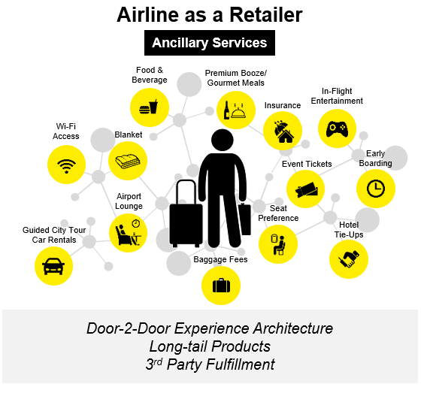
Achieved for Humans
Humanises the digital travel customer experience
Enables agility
Understands the traveler’s context and provides
services relevant to it
Notes:
OTA – Online Travel Agency
GDS – Global Distribution Systems
OA – Other Airline (typically a partner)

Slide 20

Business and ICT integrated success

Slide 21
Moving towards a business outcomes integrated with the Humanise Digital approach
Deliver the Foundation
Further develop user stories (process flows)
Define MVP and sprint plans
Prioritise Sprint Backlogs
Engage and activate scrum master and cross functional teams
First Release MVP
Empathise & Innovate
Transform & Manage
Executive alignment kick-off session
Customer research – voice of customer
Employee understanding – unmet needs and pain points
Journeys & capability mapping
Success metrics & digital vision
Innovation Session
Customer transformation strawman
Humanise Digital Framework assessment
Continuous sprint rollouts
Test, learn, iterate
Expand across additional customer scenarios / areas
Sustainable state
On going HD state assessment
Customer operating model
Data Strategy & architecture
Performance & Governance model
ICT systems enablement based on HD Framework priorities

Slide 22
A human centred design approach
GROW THE BUSINESS
RUN THE BUSINESS
TRANSFORM THE BUSINESS
Traditional
    DXC’s Intelligent migration framework
    Optimization: Cloud, Sourcing etc.
    Business Process Management IT of tomorrow
    DXC autoDetect, autoManage and autoResolve
    The CBO4SAP Portfolio
    From DevOps to AIOps
    Tailored RPA services
Humanise Digital
    Humanize Digital customized Client roadmap and innovation
    Unlocking Synergy with the Arc-Reactor Architecture
    DXC SAP Innovations Lab
Systems of Intelligence
Enabling Wisdom
Integration and Microservices
Digital Business Networks
Digital Supply Chain
Delivery Resilience
Demand Driven Supply Chain
Robotic Process Automation
Pathway Methodology co-developed with SAP
IDS for SAP – Industrial Delivery System methodology
Localized Autonomic processes
39 integrated delivery centers worldwide
IT4IT value streams and DevOps/AIOps best practices
Human Resource Management
DXC Bionics Platform
People Enablement
PaaS for SAP: A full stack managed cloud service
Analytics
Systems of Insight
Humanize Digital
As-a-Service consumption
Industry specific Humanize Digital methodology
DXC Digital Transformation Centers
Convenience based consumption
Voice-of-Customer: NLP sentiment analysis
DXC Digital Travel Platform
Digital Services
Contextual Services
Creating the Demand-Driven Agile Enterprise - DDSCN
DXC Model Bank of the future
Traditionally Digital
Humanise Digital

Slide 23
Key take- outs …
Build platforms and systems that enable both “resilience” and “wisdom”.
When planning to support and enable business transformation consider the human aspects not just systems.
Engage early to ensure business and ICT alignment beyond a POC and MVP view.

Slide 24

Discover how you can humanise digital at your organisation with a free Design Thinking Workshop
Find out more at bit.ly/DXCUX

Slide 25
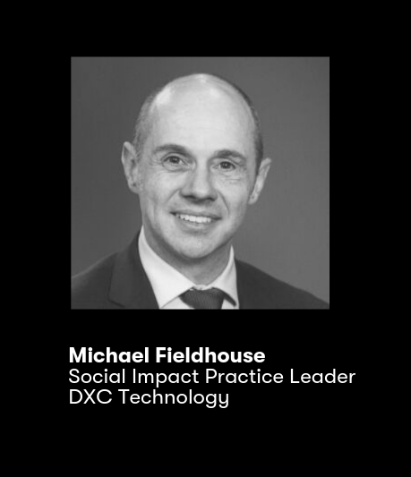
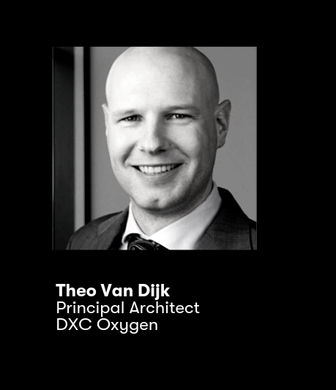
Don’t miss our other presentations
12:45pm
Rewiring your workforce - Our Neuro-Diverse Future
3:45pm
Automated Testing for SAP,
a real-world example at nxp

Slide 26
Humans Experience.
Humans Buy.
Not Businesses or Machines.
Humanise Digital

