Slide 1
HR Technology Going big in the cloud
People & Culture
August, 2018
Confidential to Fonterra Co-operative Group

Slide 2
Content
Go big, go global:
our journey to go live with
Successfactors
What happened next?
What is in the future?

Slide 3
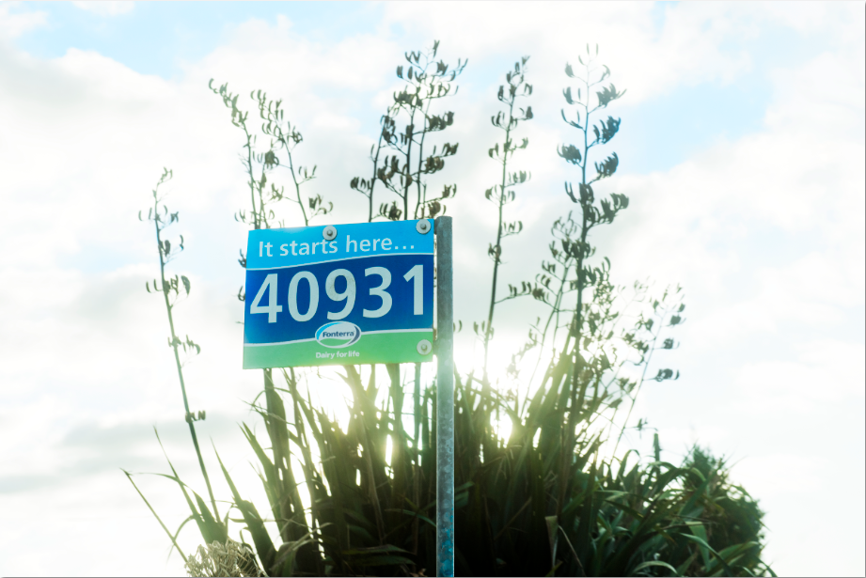
Who are we?
The world’s most trusted source of diary nutrition
Global Dairy Co-op
Manufacturing B2B, B2C, Research & Innovation
Farmer owned
10.5k farmers
Volume of Milk FY17: 23b LME
What we stand for:
Our People
Our Farmers
Trust in Dairy Sustainability and more…

Slide 4
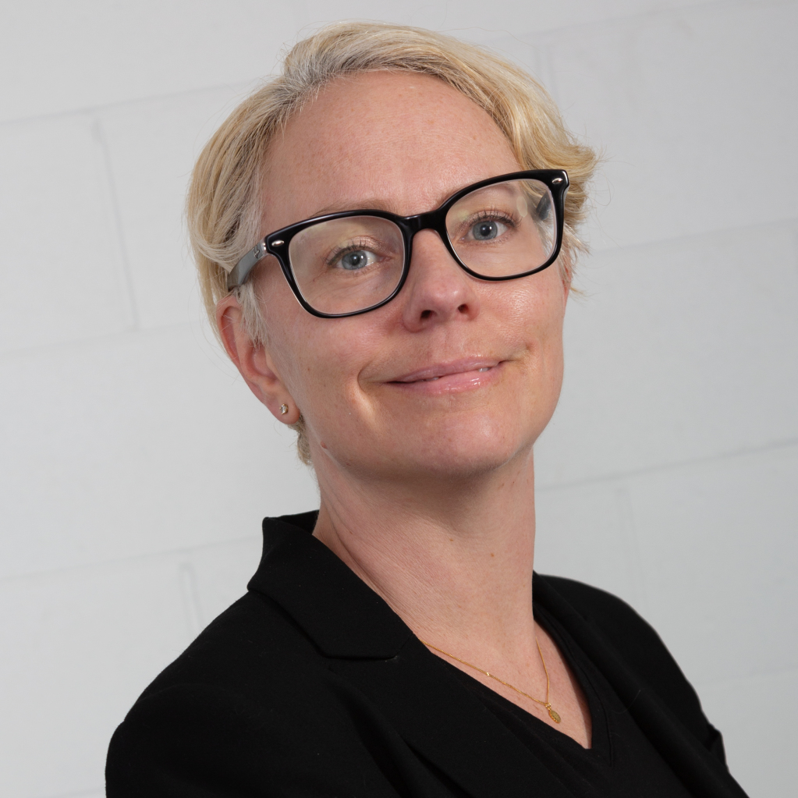
Introductions
Tina Lundkvist
HR Systems & Analytics Manager
With Fonterra for 7 years
Key Experience:
Systems, Analytics & Data governance, Finance,
Project & Process leadership and HR
In the banking and dairy industry

Slide 5
The MY Fonterra (Successfactors) Employee Central Deployment Deep Dive
Sucessfactors Journey

Slide 6
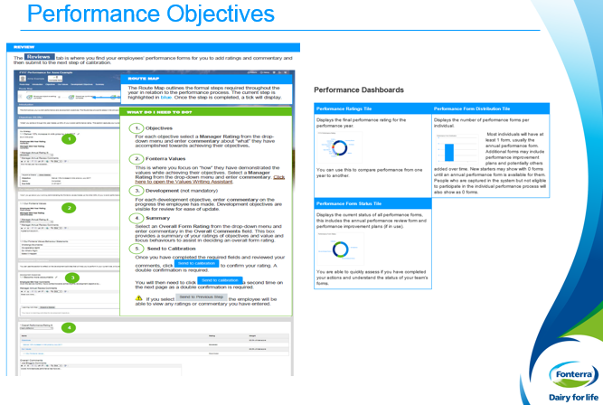
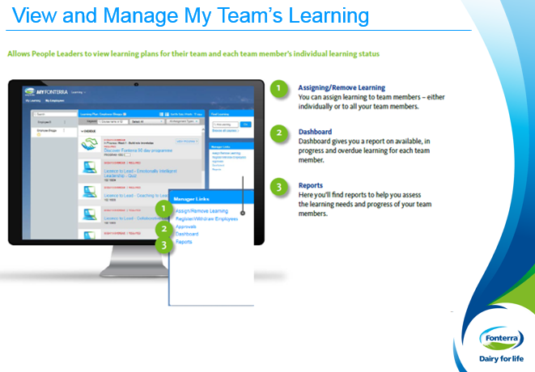
Fonterra Successfactors Journey
August 2015
Performance
Objectives
Development and Succession
Employee Profile
September 2017
MY FONTERRA Central
Delegated Authority
September 2016
Learning

Slide 7
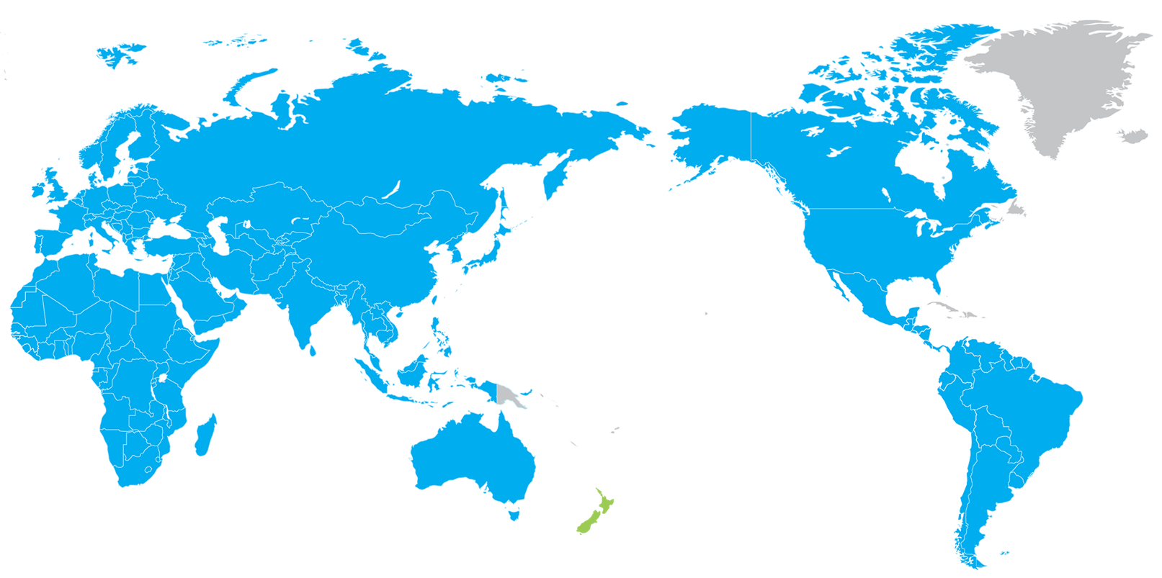
Deployment Scope
29
Countries
4
Languages
22,000
Employees
4,000
Contingent Workers
Agile, Big bang globally…
Notes:
This is essentially our scope our people

Slide 8
Strong partnership
Partners
Locations
Diversity
2
SF - POIT
4
9
Nationalities
AUCKLAND – Melbourne - Wellington - HAMILTON
Notes:
Key to success was a strong vendor partnership – with the implementation partner (POIT) and our back office support partner (HCL)
Good technical expertise across the team – the right people appointed
Make good use of communication technology as spread geographically
Benefitting from diversity of thought

Slide 9
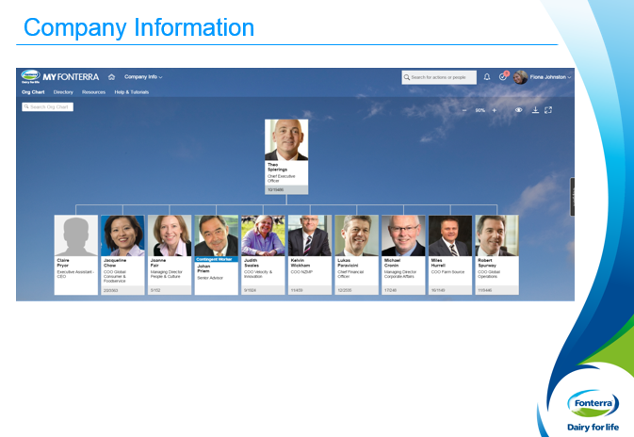
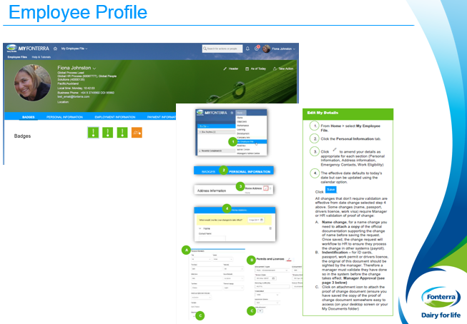
With Employee Central
Many firsts: New Cloud Integration Technology + People Profile + Advanced Reporting and…
Deployed
Notes:
When we started the journey we know there would be many firsts – we are to a company that are comfortable pioneers
The use case was enrichment is data that can support all our people processes- big data
Including org data for org structures
Enriched employee and talent profile
MY Fonterra Central Processes – we designed these in house
MY Fonterra Reporting – including the ability to self-source reports – we now have a handful of people who can run Advanced Reporting queries, design and schedule reports.
It was clear from the start there were a number of firsts – pioneering is rather scary specifically when you go big bang
The integration technology was a first – SF Cloud Solution
People Profile with Contingent Workers – with murky legacy data this is a bit of a challenge
We were interested in deploying Advanced reporting – something only used by a handful of organisations across the globe at the time.
Although we are not sizist – when it comes to user testimonials we needed some feedback from similar orgs with similar challenges and POIT got us in touch with a global transport organisation in the US that had operations in 10 countries. That was great.
So far we have processed: 2500 new positions, 6800 training courses, 8000 badges and 3 cycles of performance

Slide 10
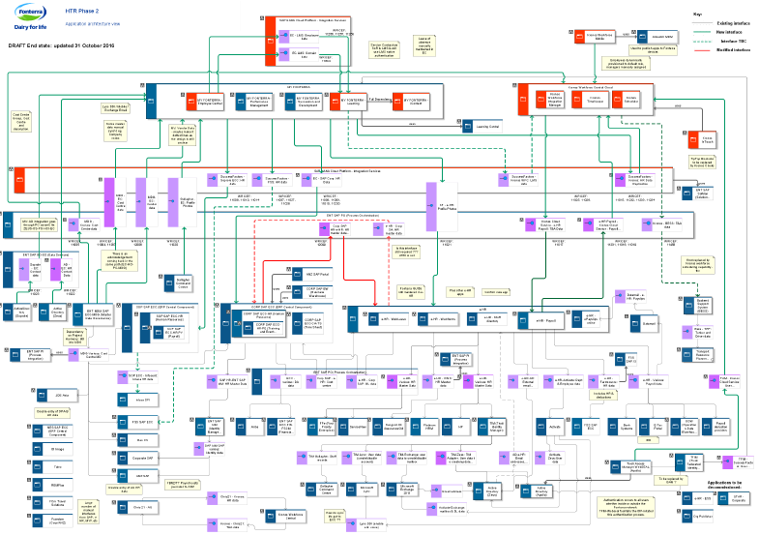
System Architecture Diagram Challenge
Integration, at a glance…pioneering SCI
Notes:
Now to the challenges – this is our System Architecture – MY Fonterra is at the core to everything we do. It starts of the identity management process. It also ends it.
We have two instances of ECC integrated one in Latin America with a data model configured differently.
We last have 6 new tools lined up to be integrated.
To add to the challenge before we went live a separate project to bring Delegate Authority through create custom design in to MY Fonterra was initiated. It was built around our Job Functions and job roles that was still a framework in the making.

Slide 11
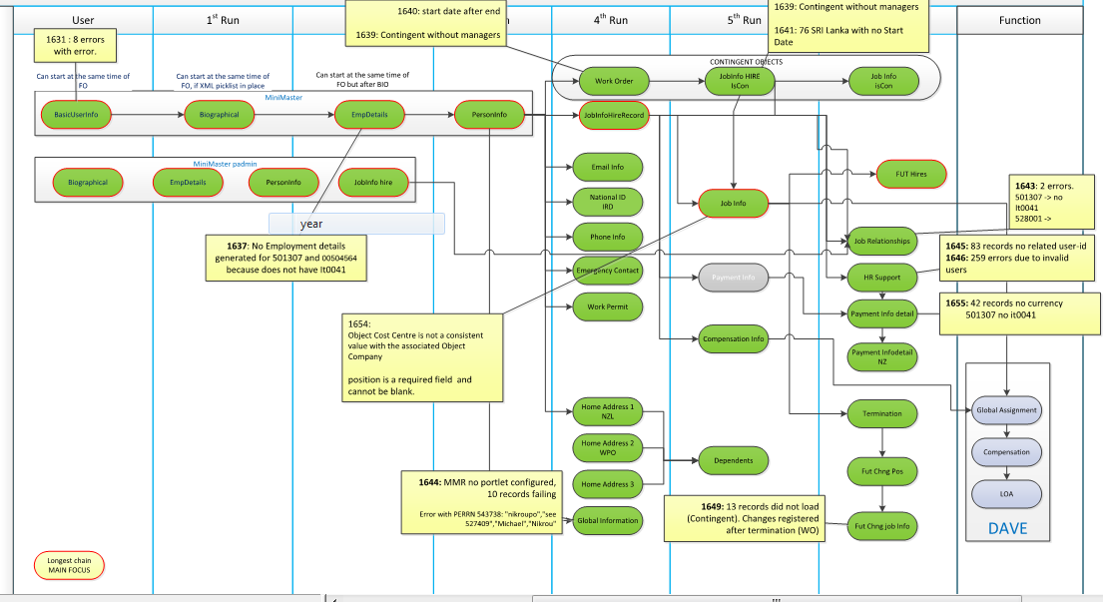
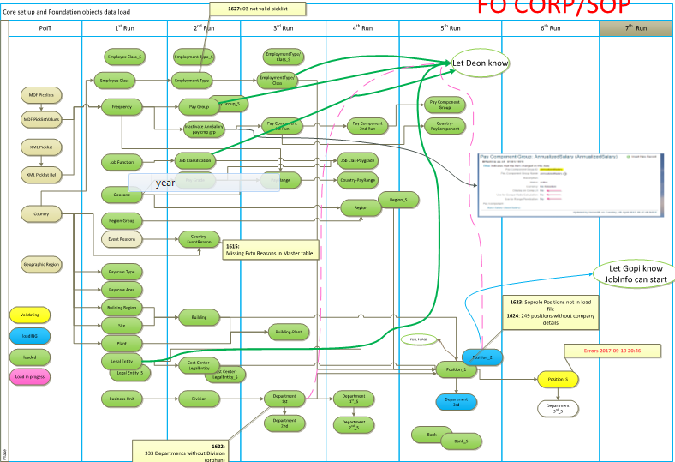
Master Data Governance
Core Components
Employee Information
Org Data (foundation objects)
Approach
Cleanse existing data as source
Perfect missing information
‘Lift and Shift’ from source
Load into Successfactors
Notes:
Data is centred around employee information and Foundation objects – mainly MDF design. This are the critical path tables.
Our data strategy was to lift and shift
Data cleanse had to happen in the source system
Data perfecting happened in Excel files only where it had to mainly for new design features.
We got a project room with the worst Wifi in the whole of Fonterra – to make matters worse at go live

Slide 12
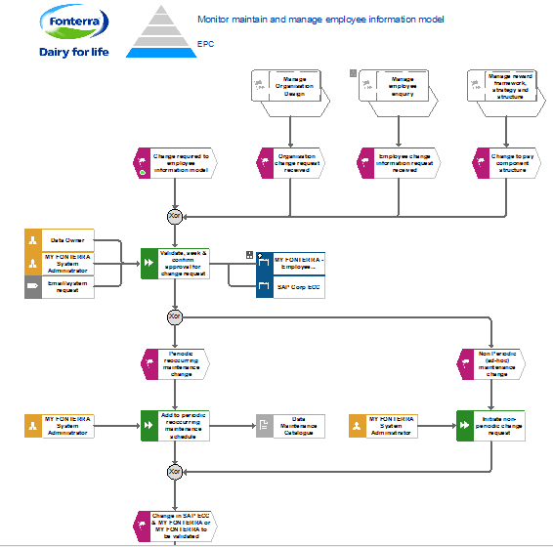
Design of Business Rules, RBP and Workflows
Notes:
The most complex challenge was to get on top of business rules, workflow and RBPs - role based permissions.
RBPS – sets up roles, assigned dynamically for what user groups can view and edit – we aimed for simplicity in design but we ended up with 54 roles – at the complex end of the spectrum for sure.

Slide 13
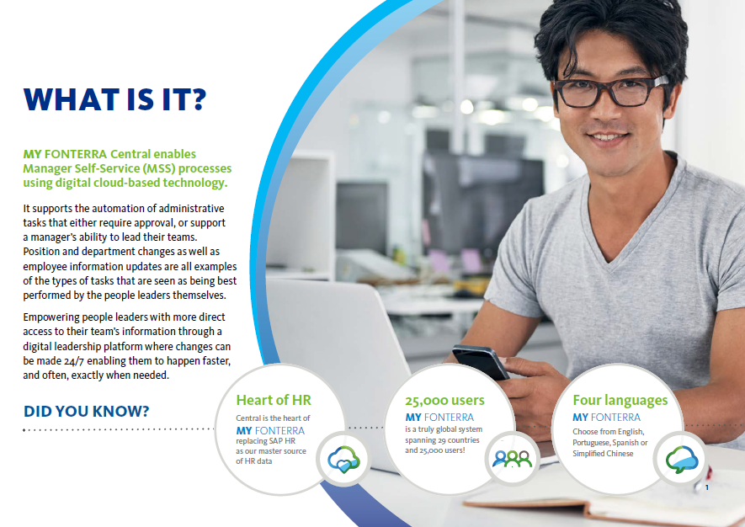
The Change Management Plan
Notes:
Our change approach – Manager self service in NZ and HR supported processes overseas.
We needed to communicate to all managers and employees – 25000 what was changing for them
What will I stop, start and continue doing.
As well as what is my plan.
Training happened on skype or through walk in centres as well as through a knowledge portal or a overlay training software called Walk Me

Slide 14
Where to Next
The Future of Work

Slide 15
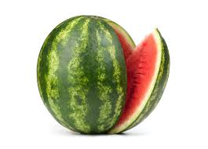
What are we working on?
In play
Enhance what we’ve got
Advanced/ Predictive analytics tools
Robotic Process Automation (RPA)
Underway
Capability architecture
Data Lake
Culture/Sentiment/EVP
Go Mobile!
Connected to
Our end to end demand/ innovation
The places we occupy
How we communicate
Data Security/ Azure AD
Water-million
Notes:
What is next on our roadmap
To enhance and perfect what we have - in terms of end to end solution
We are going mobile – in MY Fonterra
We are looking at the future of work through Job and career architecture in MY Fonterra and other tools
We are looking at a data lake with a HR data lab having been set up this week where we can combine and analyse all HR data – Through R/Python to be visualised in Tableau.
This is to drive our advanced and predictive analytics strategy
We are looking at different types of data sources for our lab – how we communicate, the places we work in and Well being/social media or engage feedback
We have also set up a project hub where employees get the chance to cross skill on project across the business a way to support a gig culture and ensure resource utilisation.

Slide 16
How global marketplace works
Milkyway 2.0 implementation
Will allow you to develop in the following capabilities:
Managing Complexity
Stakeholder Management
Deployed
Master data analysis
Will allow you to develop in the following capabilities:
Collaboration
Analytical Thinking
Marketplace
Sunshine Farms
Will allow you to develop in the following capabilities:
Innovation
Customer Focus
RPA Project
Will allow you to develop in the following capabilities:
Data Analytics
Change Management

Slide 17
Robotic Process Automation (RPA)
Deployed
Robotic Process Automation is:
Computer coded software
Mimics interactions of users
Software ‘robots’ that work cross-functional and cross-application
Enables the automation of repetitive, rule-based tasks
Fast Facts
RPA employs a variety of tools for grabbing digital data, e.g. screen scraping, digital image recognition, or the ability to access a server or be linked to a website
It is considered a ‘digital workforce’ controlled by the business teams
RPA does not disturb underlying computer systems. A “bot” accesses the existing systems and programs in the same way a person would.

Slide 18
Proof of Concept

Slide 19
The End
Questions?
Questions?
The End…

