Slide 1
Change Leadership
Emotional Intelligence on Steroids.

Slide 2
Adoption is Key
70% of Projects are 100% reliant on Change Adoption

Slide 3
The Failure of Change Leadership
McKinsey:
70% of ALL Transformation Programs FAIL!
The Rate is INCREASING!
Change Battle Fatigue is Killing Your Change Programs

Slide 4
Chance of Success without Change
McKinsey Research:
10%
For all Organisations that DO NOT have holistic programs

Slide 5
The Painful Exercise
Dream Big

Slide 6
Tipping Point Leadership
Most People Will Change Without too Much Effort Provided That:
1. You can influence the blockers
2. You can sustain and increase the positivity in those Who are keen for the change
3. You Communicate Well!

Slide 7
Fair Process – Neglect it at Your Peril.
Strategy Formulation (SEE)
(Stories, Elevator Pitch, Open Communication, Nemawashi - Prepare the Soil)
Attitudes (BE)
(I Feel my Opinion Counts)
Behaviors (DO)
(Voluntary Contribution)
Strategy Execution (GET)
(Beyond the Call of Duty)

Slide 8
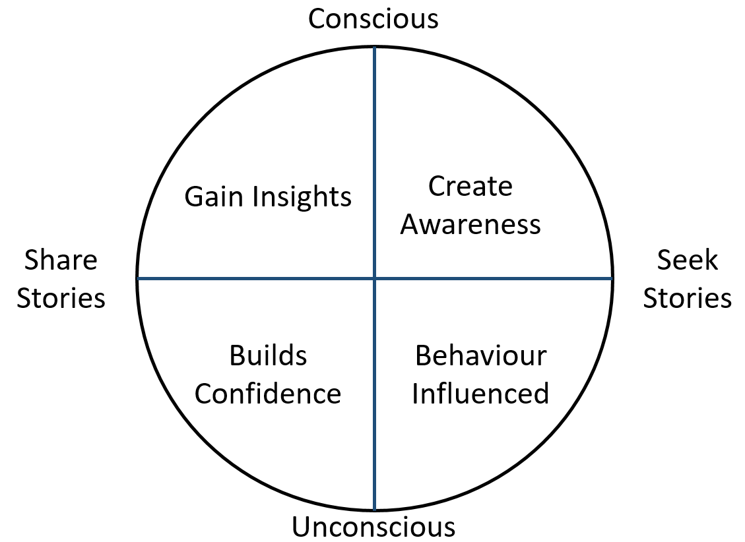
Stories and Trust (More Trust = More Speed)

Slide 9
Understanding How Change Effects You
Denial
Resistance
Exploration
Commitment

Slide 10
That Change Curve
Saboteur's
Fence Sitters
Fully Committed
Unaware
Aware
Understand
Believe
Act
Denial
Resistance
Exploration
Commitment

Slide 11
The Even More Painful Exercise
What do you have to Change to Make the Dream come True?

Slide 12
Four Gates to Possibility
(1.) Things we used to be able to do and CAN still do. | (3.) Things we could do before but CAN’T do now.
(2.) Things we COULDN’T do before and still CAN’T do. | (3.) Things we COULDN’T do before that we CAN do now.

Slide 13
The Bucket List
1. Negative | 2. Interesting | 3. Positive
Put Everything Negative about the change here | Put anything that anyone thinks is interesting about the change in here | Put all the positive thoughts people have about the change in here

Slide 14
The Change Champion
Passing information and skills to people at the coal face
Acting as the first point of escalation for support
Working with process owners to find pockets of challenge and resistance and iron them out.
They are a trusted representative in their own area.

Slide 15
Process Owner
The Throat to Choke When it Comes to Process in the Business
They are Responsible For:
Communication
Monitoring
Execution
Managing Improvement Initiatives
Developing documentation to support the business processes.

Slide 16
Question Time

Slide 17
Trust is Built in Teams over Time

Slide 18
People Love Real Change, They Just Hate Fake Change
 | OPEN | CLOSED
Real Change | Difference Made | Opportunity Lost
Fake Change | Disappointed | I Told You So

Slide 19
The Six Step Stairway Method to Making Change a Regular Occurrence in Your Business
First talk – introduce the idea – ideas should always be planted before going full on because otherwise you will overwhelm them with information they cannot digest.
Notify and Advise (tell people what it is)
Examine the Facts (Explore what the change will mean)
Start the change
Test and Measure (Test out the change and measure the results)
Put the change into Effect (If it tests out well)

Slide 20
Approaches to Utilise for Effective Change
Story early
Facilitate Well
Flexibility in Approach
Achieve Depth
Nut out Opportunities
Contextualise the Group

Slide 21
The Elevator Pitch
One great way to communicate change is to put together an elevator pitch.
This is a short talk or speech about the change highlighting to people what the change is and how they can benefit from it.

Slide 22
The Seven Fake Reasons to Not Change
Time is not the issue – Timing is
Important is far more important than Urgent
This is the way we’ve always done it (Nope, you did it differently before you did it this way)
I like it this way – Lots of people like inefficient time and money wasting things.
It’s too political / too much red tape – Often the red tape only exists in people’s minds
It’s too radical – It was probably well past time for a change
We didn’t budget for this – Just because you didn’t budget for it doesn’t excuse you from throwing money down the toilet doing it the old way.

Slide 23
The Listening Triangle
Listening to Tell Your Own Story (Least effective listening)
Listening to Answer (Your are listening just to give them a reason why or answer their problem)
Listening to Understand (Most effective Listening Technique – Truly listening to understand them and their problems.)

