Slide 1
Headline Verdana Bold
SAP S4 Hana Conversion
The Migration Path of Choice for Existing Customers
June 2017

Slide 2
S4 Hana Conversion - Agenda
During todays presentation we will:
Provide a refresher of the S4 Hana 1610 Migration Options
Discuss what each of these imply and the pro’s and con’s of each from a customer perspective
Provide an overview of what is involved in the “Conversion” process
Discuss our view of how the conversion process should be managed
Talk about preparatory activities that can de-risk and smooth your path to a successful conversion
Highlight some of our learnings about the conversion process
Discuss some of the available options for the provision of hardware for your S4 instance
Run through the key functional changes and highlight the business benefits you will likely see with the new S4 code line post conversion

Slide 3
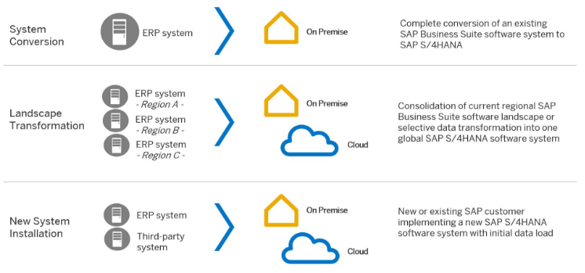
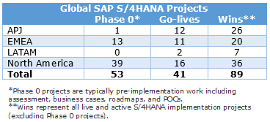
SAP Provided S4 Hana 1610 Migration Options
Deloitte Global S4 Implementations

Slide 4
Pro’s and Con’s of each Migration Option
Option | Description | Pro’s | Con’s
System Conversion | Involves an SAP upgrade to the S4 code line with the exception that it also involves a: Database Migration Number of functional changes Number of data changes | Shorter Migration realisation timeline Suitable for most customers who have a single SAP instance All transaction history is retained Existing customisations are retained No need to develop migration tools | Dependency on SAP delivered code to manage the data migration
Landscape Transformation | This process aims to complete a technical consolidation of a customers multiple SAP instances onto a single instance. The consolidation could be either to one of the existing instances (post conversion) or to a new S4 instance. SAP SLO services manage the migration. | Provides an option for customers with multiple SAP instances All transaction history is retained | SLO data conversion process will be complex Customisations will need to be rationalised and consolidated across instances Significant data cleansing & mapping required
New System Installation | This is either a greenfield implementation or a SAP re-implementation on a new S4 code line instance | Clean cut-over to S4 Follows a typical implementation migration approach Chance to implement best practice design and move away from existing customisations | Longer migration realisation timeline Some customisations will need to be re-developed or re-imported Significant investment for customers on an existing SAP instance Detailed historical data will be lost as a traditional data migration approach
The approach followed was a 3 stage approach as recommended by SAP:
Stage 1 – The system was copied to a new instance

Slide 5
Conversion process overview
Existing SAP ECC System
Converted SAP S4 HANA 1610 System
Copy
Copy SAP ECC System
Upgrade
Upgraded EHP8 System
Convert
The approach followed was a 3 stage approach as recommended by SAP:
Stage 1 – The system was copied to a new instance
Stage 2 – The new system was upgraded to a version suitable for conversion to S4 HANA 1610 in this case EHP8.
Stage 3 – The EHP8 system was migrated to SAP S4 HANA 1610 on a HANA appliance

Slide 6
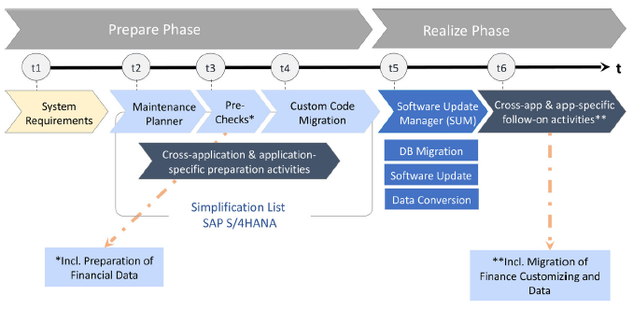
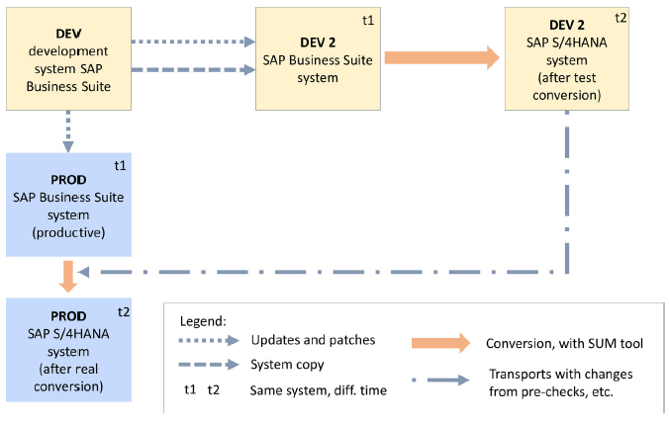
Conversion Process Overview – SAP Approach

Slide 7
Conversion Process Overview – Deloitte Approach
SAP ECC >EHP8
SAP ECC <EHP8
SAP S4 Hana <1610
Customer Dev
Customer Dev 2
Customer Dev S4 HANA
Copy &
Upgrade
Convert
Transport
Customer Test
Customer Test 2
Customer Test S4 HANA
Convert
Copy &
Upgrade
Transport
Customer Prod.
Customer Prod. 2
Customer Prod S4 HANA
Copy & Upgrade
Convert

Slide 8
Preparatory Activities – Data Archiving
If you current SAP instance is large and holds historical data since you initial go-live you must perform some housekeeping prior to commencing your conversion project in the form of archiving. This could be a small project in itself and should focus on:
Archiving of closed historical transaction data from prior years.
Archiving of master data that has been blocked and marked for deletion.
Archiving/deletion of spool and job logs if you are not already doing so.
Archiving/deletion of any other database logs if you are not already doing so.
Completing this housekeeping in advance will likely ensure that you have a smooth conversion in a shorter period of time for the cut-over weekend and with less errors to resolve within each of the trial migration runs!!!

Slide 9
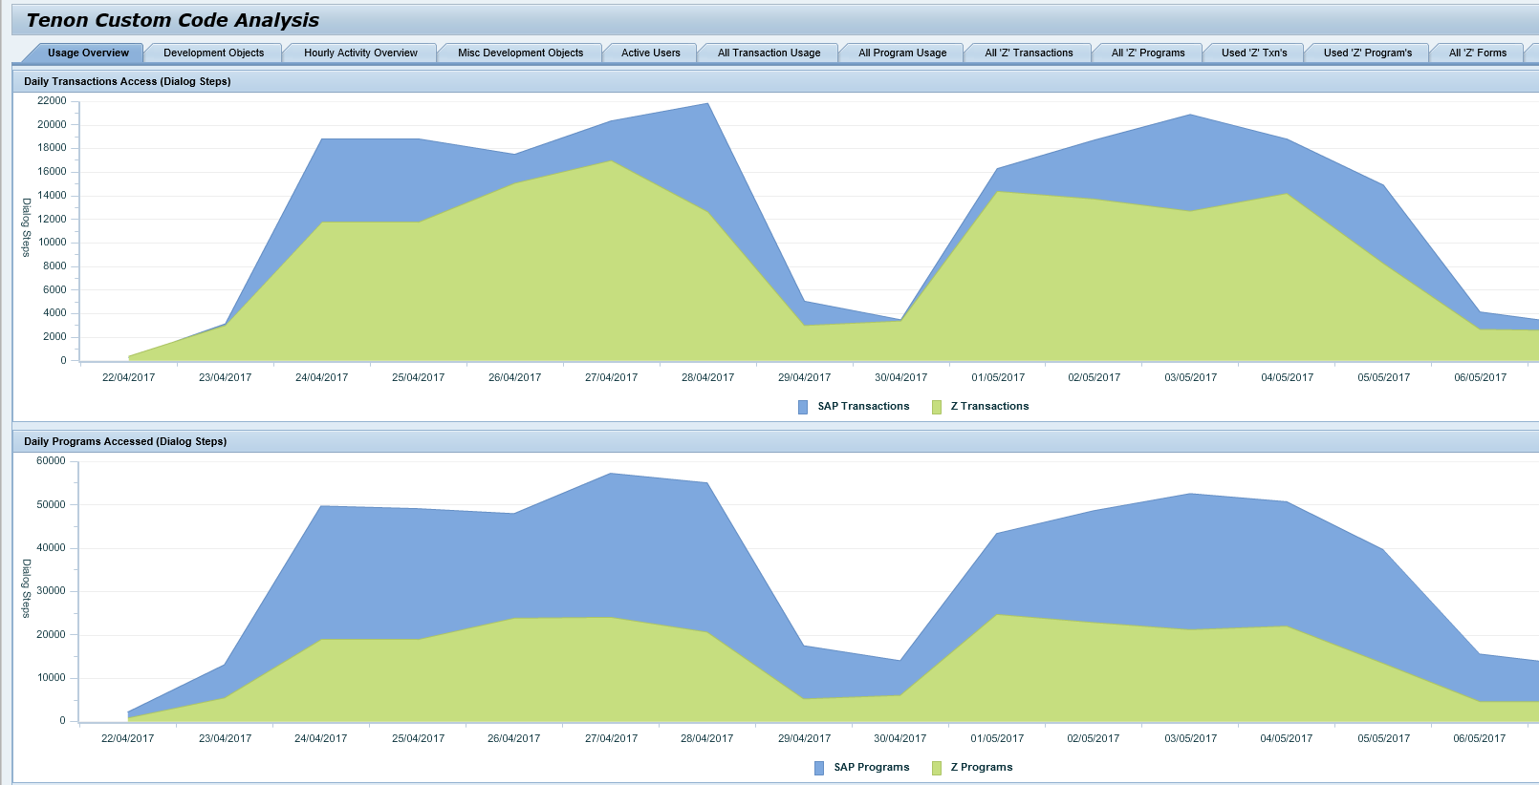
Preparatory Activities – Custom Code Analysis
You must monitor your custom code usage for a period prior to the conversion project commencing and ensure that you already have agreement from the business to remove redundant customisations
These will not be remediated to run on S4 and will be removed from the solution during the initial S4 conversion stage in the development environments.
XXX

Slide 10
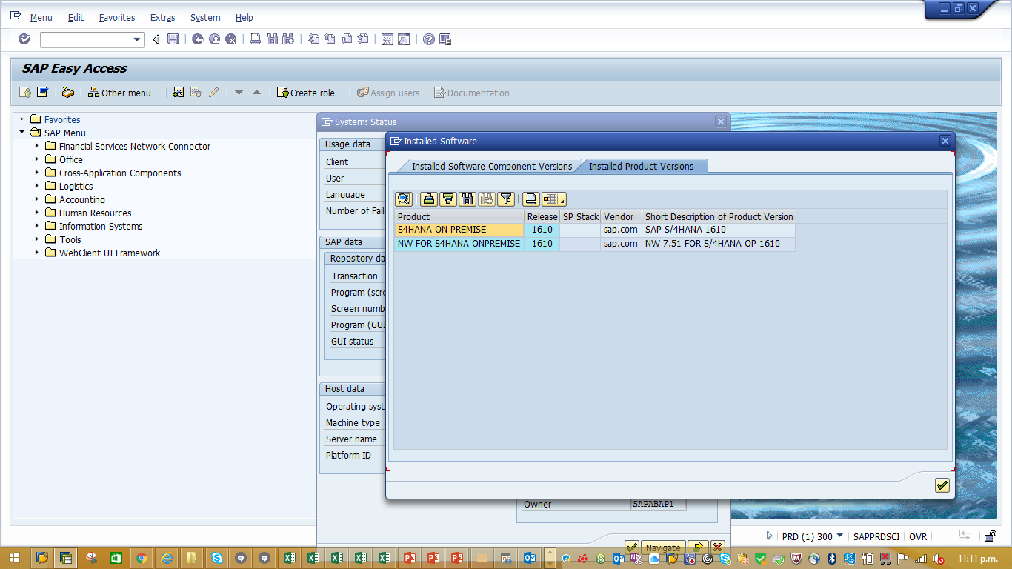
Learning No. 1 – The Sky Has Not Fallen Down

Slide 11
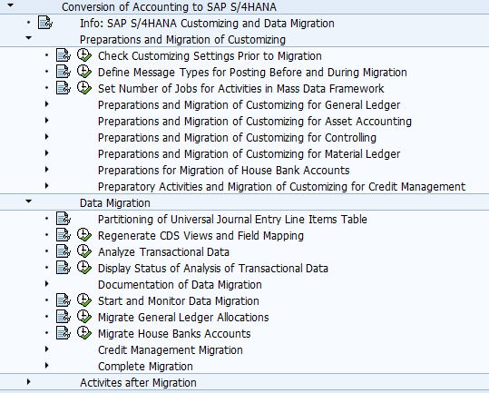
S4 Conversion POC Learnings
The following key learnings were uncovered during the conversion:
We have developed a comprehensive project plan to support the various stages of a conversion project
There are a number of SAP OSS notes that need to be implemented to resolve known issues at various stages and these have now all been documented
These issues will however vary from customer to customer depending on your data and solution scope
The pre-conversion functional activities can be completed seamlessly provided the required notes have been applied
The post conversion functional activities can be completed seamlessly using the SAP guided migration menu

Slide 12
S4 Conversion BW/4HANA
S4 Conversion POC - Overview of BW deployment options
 | BW on any DB | BW on HANA | BW/4HANA
Standard Content
BEx Interface (BEx Analyzer)
Connectivity
Transition
Performance
Dataflows

Slide 13
Hardware Provision - AWS, SAP & Deloitte Offering

Slide 14
Hardware Provision - DATACOM SAP IaaS/PaaS
SAP Partner
Provide hosting and systems management for over a dozen large NZ company/Government SAP customers
Support teams experienced dealing with SAP environments and SAP software partners
Experience across many SAP HANA deployments
SAP deployments to AWS and Azure, hosted, and on-premise, including HANA systems
Multi Tennant SAP Cloud Hosting Environment
Fully SAP Certified for Production Environments
Deployed across two Tier 3+ Data Centres for HA/DR in NZ
Application Servers, Database Servers, HANA Servers
Operating System licensing & support, backups, network, and security services available
Monthly fee
14

Slide 15
Some Key Functional Changes Post Conversion
Many existing functions have been re-developed or improved to align to the principle of one or to maximise the benefits of the new S4 HANA 1610 code line, OS and Database:
Customer and Vendors now managed as Business Partners
principle of one
Materials now support long material number up to 40 char.
new code line
Inventory now managed in material ledger alone
principle of one
Financial accounting ledgers now consolidated eliminating reconciliation differences
new code line
New standard reporting capabilities in S4 with significant performance improvements
new code line, OS and Database
New standard financial consolidation functionality
new code line
New and improved real time banking integration
principle of one
And the list goes on……..
new code line, OS and Database

Slide 16
Key Business Benefits Post Conversion
The following benefits would be delivered to the business post conversion:
Ability to deploy Fiori UI across the board to all business users
improved look in feel in a consistent UI
Single point of data maintenance for Customers and Vendors now managed as Business Partners
One master record representing your relationship with a 3rd party & less data maintenance
Materials now support long material number up to 40 char
ability to comply with international material numbering standards and conventions for long part numbers
Inventory now managed in material ledger alone
batch level inventory valuation capabilities
Financial accounting ledgers now consolidated
no reconciliation differences
New standard reporting capabilities
improved reporting performance and potentially a faster close/soft close
Real time asset accounting postings
faster close/soft close
S4 Hana Purchasing with imbedded integration to the Ariba Network
Ariba network benefits without the full Ariba price tag
MRP performance and functionality improved
Ability to run MRP simulations and actual MRP runs quickly to meet business needs

Slide 17
Some Useful Information
SAP S4 Hana Conversion Guide:
https://uacp.hana.ondemand.com/http.svc/rc/PRODUCTION/pdfe68bfa55e988410ee10000000a441470/1610%20001/en-US/CONV_OP1610_FPS01.pdf
SAP S4 Hana 1610 Simplification List:
https://help.sap.com/doc/560c6fad1b03447583e7327f64f7d964/1610%20002/en-US/SIMPL_OP1610_FPS02.pdf
Deloitte SAP S4 Global Homepage
https://www2.deloitte.com/global/en/pages/technology/topics/sap-s4-hana.html
Deloitte SAP S4 Hana 1610 Release Insights
https://www2.deloitte.com/global/en/pages/technology/articles/sap-beyond-traditional-erp.html

Slide 18
Questions ?

