Slide 1
Incremental Improvements, Change Management and Finding Information
Terry Baker (formerly at Contact Energy)

Slide 2
Legal Disclaimer
This presentation outlines our general product direction and should not be relied on in making a purchase decision. This presentation is not subject to your license agreement or any other agreement with SAP. SAP has no obligation to pursue any course of business outlined in this presentation or to develop or release any functionality mentioned in this presentation. This presentation and SAP's strategy and possible future developments are subject to change and may be changed by SAP at any time for any reason without notice. This document is provided without a warranty of any kind, either express or implied, including but not limited to, the implied warranties of merchantability, fitness for a particular purpose, or non-infringement. SAP assumes no responsibility for errors or omissions in this document, except if such damages were caused by SAP intentionally or grossly negligent.

Slide 3
Agenda
Incremental Improvement
Change Management
Finding Information

Slide 4
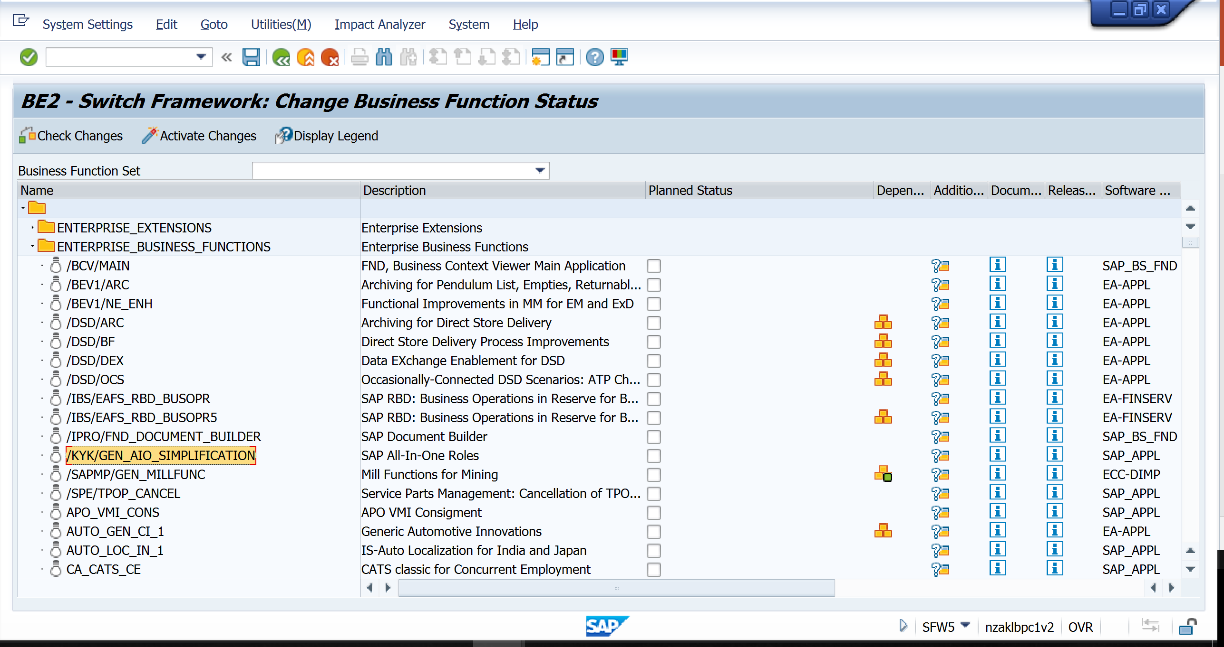
Using the Switch Framework to turn on improvements (SFW5)

Slide 5
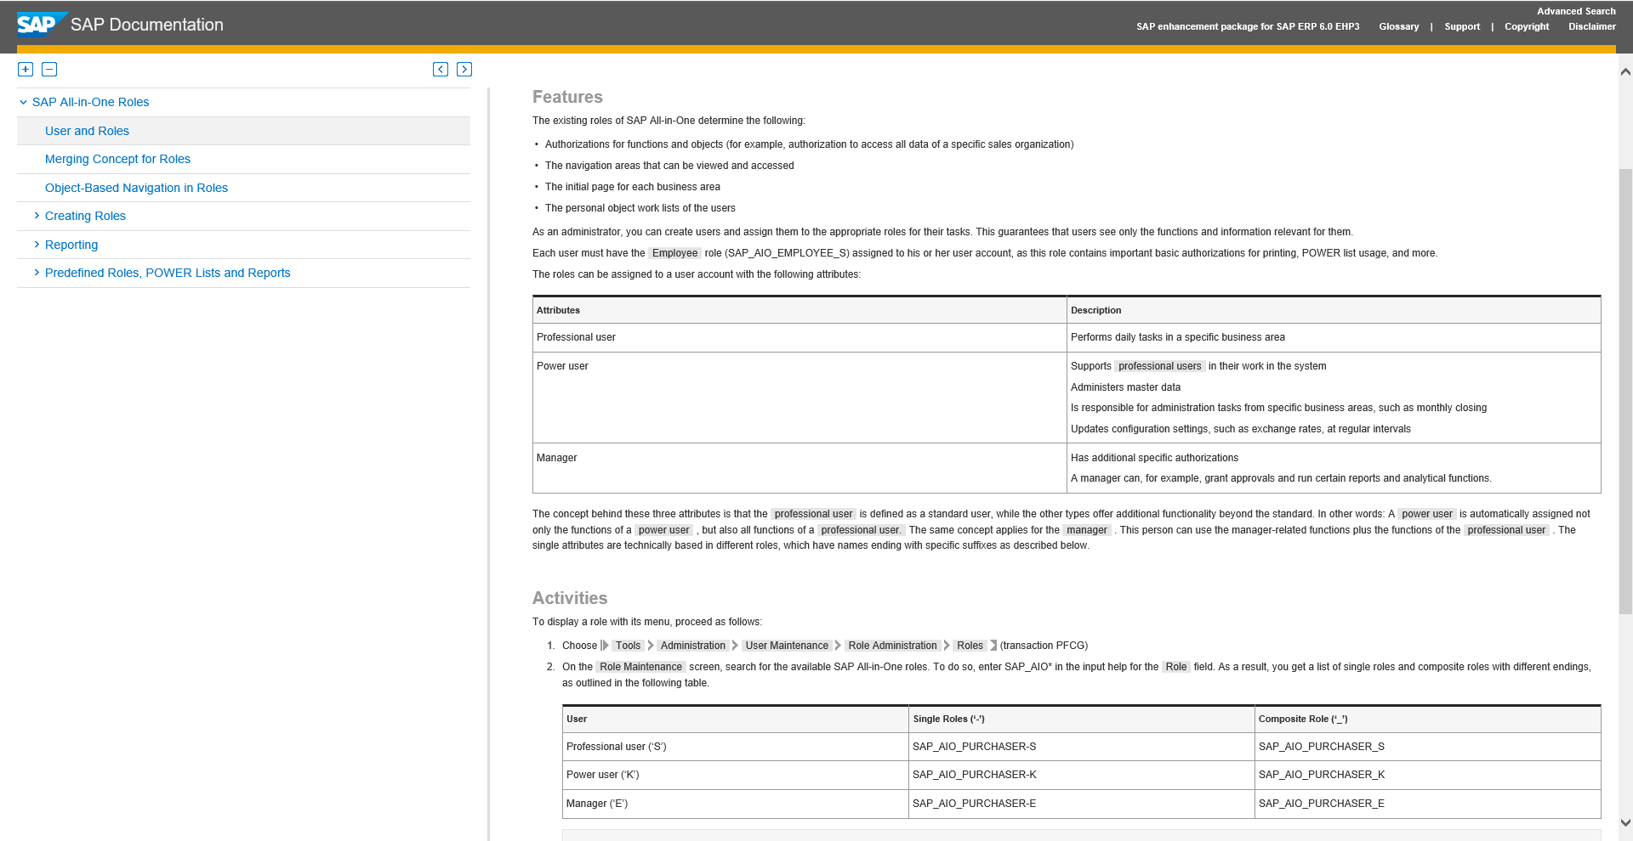
Documentation for Switch Framework options

Slide 6
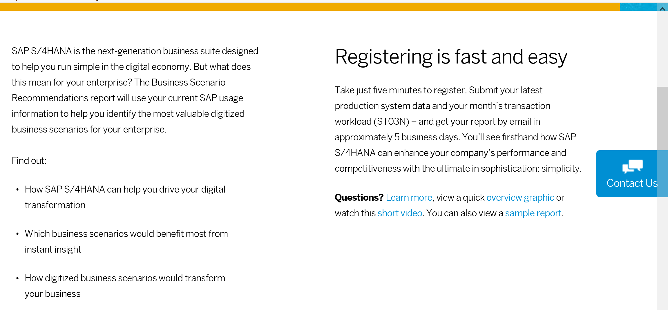
Innovation Discovery
https://www.s4hana.com/

Slide 7
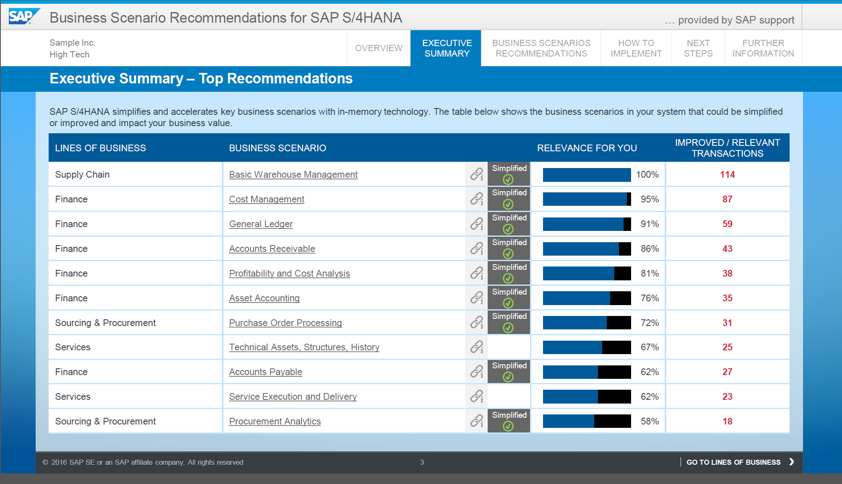
Sample of Innovation Report

Slide 8
Personas to build Screens for Maintenance Related functions

Slide 9
Finding a Document

Slide 10
CV03n – display a DMS document

Slide 11
Developing Screens – Lessons learnt
Ensure you have the right skill set
Business Focus – what key activities does the screen need to perform
Technical Focus – build the screen, and understand Java Scripting
Visual Focus – does the screen look attractive to use and meet model design standards
Security – what roles need the variation, who will this be deployed to

Slide 12
What can you do
Rename fields
Move fields around
Move fields from an obscure tab
Get information from other screens
Send information to other screens
Simplify key clicks by using scripting
Create screens that combine master data with transactions, reports with transactions or master data with reports - anything you like…

Slide 13
Agenda
Incremental Improvement
Change Management
Finding Information

Slide 14
Introducing SAP Activate
SAP Activate
is the innovation adoption framework that expedites SAP solution implementations throughout the customer lifecycle
supports faster, less service intensive deployments and is aiming at continuous adoption of innovations throughout the entire project lifecycle
supports different starting points for customers to adopt SAP solutions in their business.
SAP Best Practices
Cloud
On-premise
Methodology
Configuration Tools

Slide 15
Business Expectations
SHORTEN TIME TO VALUE AND REDUCE COSTS
REDUCE RISKS, WHILE MOVING FORWARD
FLEXIBILITY AND CHOICE
Big-Bang
On premises
Cost
Time to Value
On cloud
On premises
Cost
Time to Value
Incremental Approach
Hybrid
Mobile

Slide 16
Accelerating Delivery of Outcomes
Start with Best Practices
Pre-assemble in Cloud
Agile Build
Pre-assembly
Outcome Based Delivery
+
+
Rapid Deployment Solutions
+
+
+
+
SAP HANA Enterprise Cloud
Best Practices
Additional requirements
=
Customer Value, Efficiency, Speed

Slide 17
SAP Activate Implementation Approach
Transformative
“Let us guide you”
Traditional
“Can I take your order?”
Lead with Best Practices
Rapid, prescriptive, repeatable delivery steps
Accelerated by tools, templates and predefined content
Agile approach
Enabled for the cloud
Consultative approach
Highly customized solution
Development, not configuration
Time consuming and costly

Slide 18
SAPACTIVATE Accelerates Your Journey with these principles
Based on over 40 years of implementation experience.
START WITH BEST PRACTICES Use ready-to run business processes
CLOUD READY Leverage the flexibility and speed of the cloud
VALIDATE SOLUTION Validate to best practices with fit-gap workshops, capture delta
PREMIUM ENGAGEMENT READY Build and Run fully supported via SAP control centers
MODULAR, SCALABLE AND AGILE Structure project to deliver the solution incrementally
QUALITY BUILT-IN Identify risk early with total quality approach

Slide 19
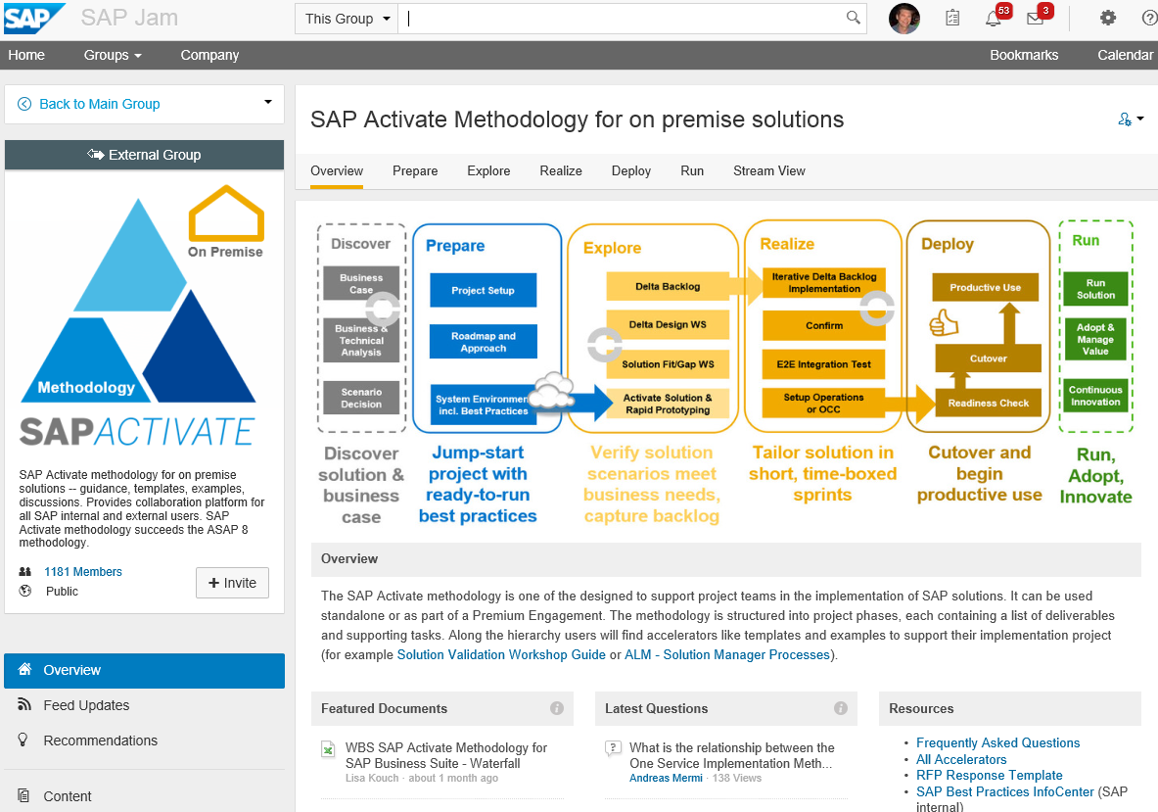
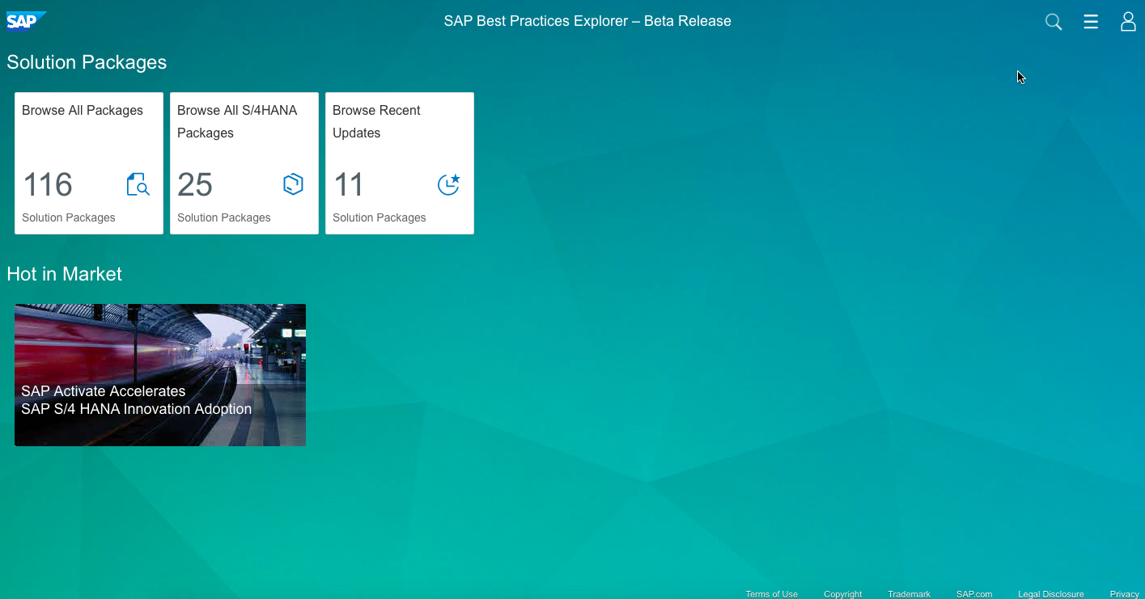
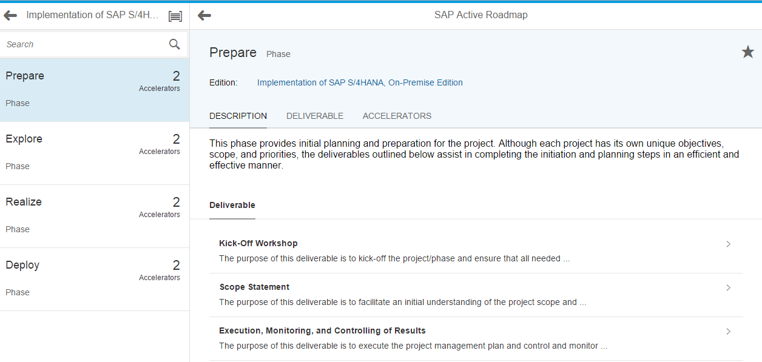
How Customers Access SAP Activate Content
SAP Jam Register @ http://bit.ly/SAPActivate
SAP Best Practices Explorer Access @ http://rapid.sap.com/bp
Roadmap Viewer Access @ https://go.support.sap.com/roadmapviewer/
Collaboration
SAP Best Practices
Methodology
Notes:
SAP Activate Methodology Jam Benefits
Lean and simple, easy to use methodology content
Perfect way to get started and learn about the SAP Activate approach
Collaboration with experts and other users (discussion forums, documents sharing, etc.)
BP Explorer Benefits
Convenient Access SAP Best Practices and RDS content
Simple and Easy Navigation including powerful search
Fiori based environment for consistent user experience
Roadmap Viewer Benefits
SAP Fiori application that provides access to complete methodology content (all tasks and accelerators)
Geared to use in a project, access complete methodology content
Content can also be downloaded into SAP Solution Manager 7.2 as WBS
Transition to Rachel, who will talk about TCS TDM method and how it builds on SAP Activate.

Slide 20
SAP Activate Methodology Training for PMs and Project Leads
Highlighted courses
ACT100 – SAP Activate (2 days course)
ACT200 – Agile Project Delivery (2 days classroom course)
Certification exam – SAP Activate Associate PM – C_ACT_2016

Slide 21
Agenda
Incremental Improvement
Change Management
Finding Information

Slide 22
Enterprise Support Event – Customer Info Days
Wellington 25 July
Auckland 27 July
(free to attend)
Content to be finalised but might include some of the following:
Solution Manager 7.2 + Fiori + S/4 Hana, Best Practice, Activate, Model Company

Slide 23
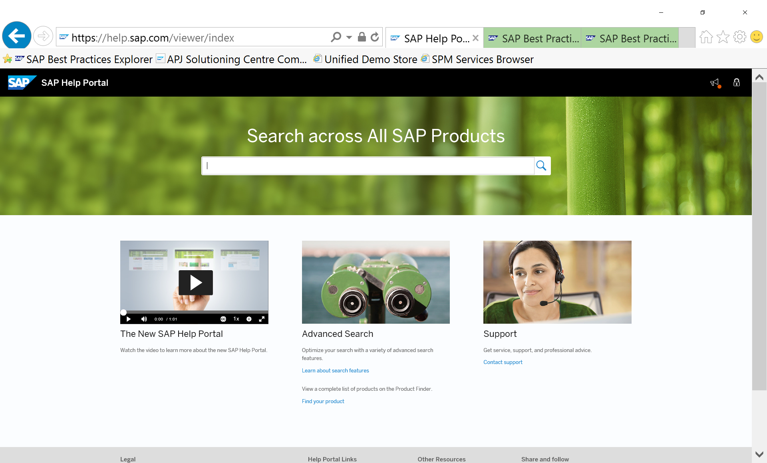
Help Portal

Slide 24
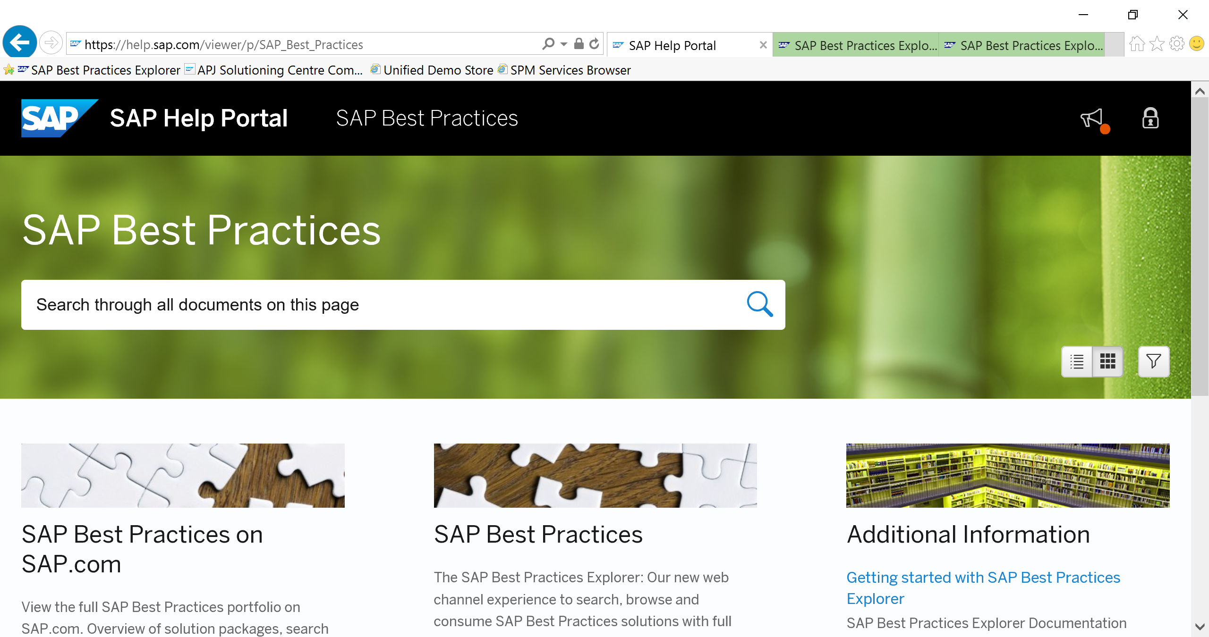
Help Portal – Best Practices

Slide 25
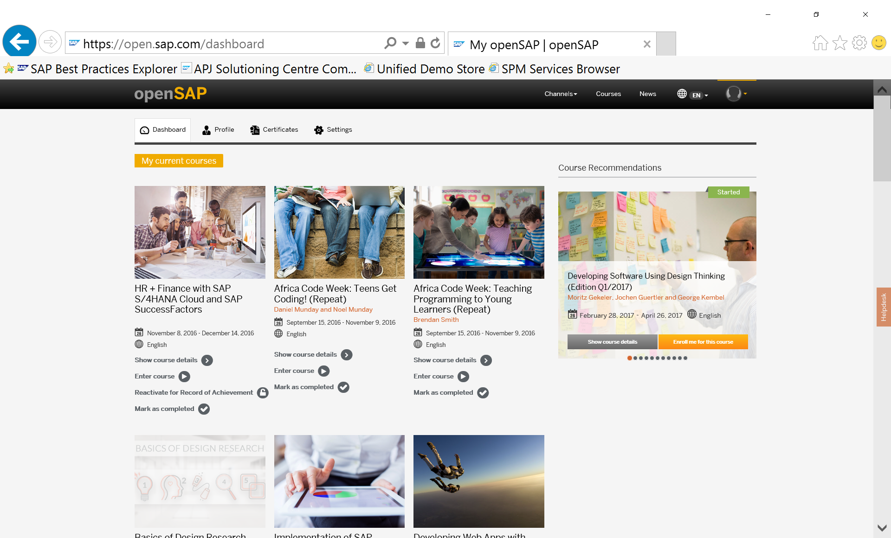
Open SAP

Slide 26
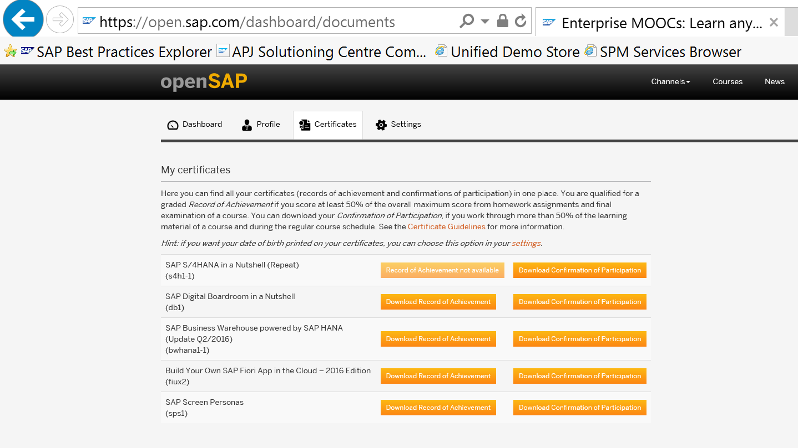
Open SAP – Record of Achievement / Participation

Slide 27
Best Practice Launch Page

Slide 28
Best Practice Scope of Components

Slide 29
Best Practice Scope of a Building Block
Login to see all the detailed attachments !

Slide 30
Best Practice – Overview of a component and related objects

Slide 31
Best Practice Workflows

Slide 32
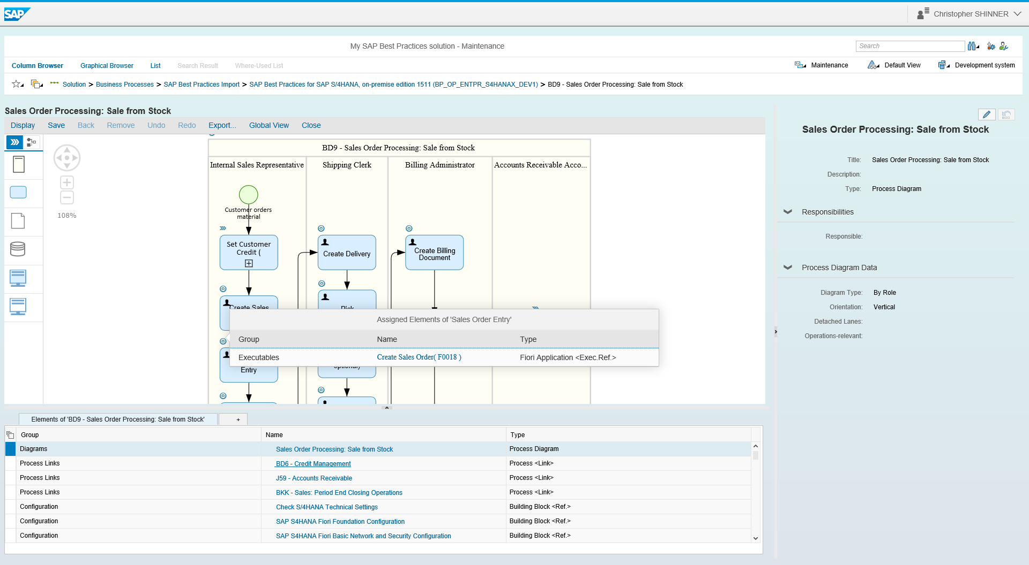
Using SAP Best Practices in SAP Solution Manager 7.2
Process models Get a head start in defining your solution by selecting from a SAP Best Practices process library complete with process models, process diagrams, test scripts, and links to executables, such as Fiori apps, in your solution.
Configuration Understand and document how SAP Best Practices are configured in the configuration guides and activate or adjust the configuration in your solution.
Project guidance Import (WBS) templates based on SAP Activate* to understand the typical project tasks and prepare your own projects.
Import SAP Best Practices easily and at no extra cost in the Solution Administration app in your SAP Solution Manager 7.2 system.
Solution documentation with SAP Best Practices in SAP Solution Manager 7.2

Slide 33
SAP Model Company
Standardization
Innovation
SAP Digital Business Services framework
Acceleration
Simplification
SAP Model Company is a prepackaged, ready-to-use, end-to-end service that delivers relevant, predictable outcomes.
It combines best practices and integrated end-to-end processes (LoB or industry), leveraging customer implementation experiences (“harvesting”).
Following an outside-in approach, it focuses on accelerating implementation time and helps you to get ready for the digitization journey.
SAP Model Company

Slide 34
SAP Model Company service building blocks
Best practices
Preconfigured end-to-end processes
Methodologies and step-by-step approaches combining knowledge of customer projects
End-to-end processes tailored to your industry and line of business
Preconfigured steps for operating the business with SAP software
SAP Solution Manager documentation
Business process documentation ready to use for discovery and fit-gap analysis
Industry reference architecture
Aligned with reference architecture for a particular domain
Engineered services
Sample data
Accelerators for fast onboarding and adoption
Sample master data and transactional data to showcase the business
SAP software
SAP S/4HANA, SAP Hybris solutions, SAP SuccessFactors solutions, industry solutions
Notes:
Slide - Building Blocks:
SAP Best Practices packages provide a solid foundation for SAP solutions. Through years of expertise and best practices in more than 50 countries with well over 10,000 customers, SAP Best Practices address the business needs of customers better than any other. SAP Best Practices packages are developed to help companies of all sizes benefit from proven best practices defined for a wide range of processes and topics which can be leveraged to rapidly ensure a quick return on investment.
SAP Best Practices include clear methodologies and step-by-step approaches.
SAP Best Practices Baseline package provides a comprehensive and flexible business management response to business needs with built in support for best business practices.
SAP Best Practices industry packages are designed to meet industry-specific needs, for example SAP Best Practices for Chemicals.
SAP Best Practices cross-industry packages provide predefined business scenarios that focus on the areas of customer relationship management, supply chain management, and business intelligence.
Pre-configured Processes
Customizing settings, sample master data and relevant documentation. Together with a preconfigured Activate Methodology, the preconfigured system forms the SAP Best Practices product.
Representing a specific branch of industry (such as chemicals or pharmaceuticals) or application component (such as Human Resources).
Industry specific, for example Utilties Industry,
LoB specific, for example R&D/Engineering Idea-to-production
Cross product, for example SAP S/4HANA, SAP hybris.
Engineered Service
Service based on ready-to-use content and service components. Provide end-to-end processes with a clearly defined scope, delivery model, timeline and effort. RDSs are a type of Engineered Service that has an associated software license.
The SAP Service Descriptions define an Engineered Service as: predefined service or project delivered by SAP that has a predefined scope, delivery approach and accelerators.
The service within an RDS is an engineered service.
Solution manager documentation
The SAP Solution Manager Implementation content includes documentation types such as: Business scenario, business process and implementable step descriptions as part of the blueprint content; Configuration documentation as part of the configuration content; Upgrade documentation as part of the upgrade content.
Sample data: Sample master data and sample transactional data specific for an industry to showcase the solution
Industry Reference Architecture:
IndRA reference material focuses on & links two domains (Business & Technology).
Focusses on the Business domain (what a business does at its core) and the technology domain (how is it done)
It leverages SAP’s deep industry knowledge, extensive and unique solution portfolio:
- It provides a holistic business capability view for an industry and links these business capabilities to SAP solutions. - It models key business processes with linked, recommended Solution Architecture.
The four key assets, which will be created by industry or by relevant industry segment are
Business Capability Model
Business Process Model on the Business side and the
Application Map
Solution Architecture on the technology side.

Slide 35
Where to Find More Information
 | SAP Activate on sap.com | http://sap.com/activate
 | SAP Activate Methodology | Register - http://bit.ly/SAPActivate Access - http://bit.ly/SAPActivate_Methodology Roadmap Viewer - https://go.support.sap.com/roadmapviewer/
 | SAP Best Practices Explorer | https://rapid.sap.com/bp/
 | SAP Activate Training Curriculum | https://training.sap.com/us/en/curriculum/activate-sap-s4hana-implementation-with-sap-activate-g-en
 | Open SAP – Online Training | https://open.sap.com

Slide 36
Thank you
Terry Baker
Services Solution Architect,
Digital Business Services
SAP New Zealand and Australia
Level 18, 1 Willis Street | 6011 Wellington | New Zealand
M +64 (0) 27 550 5086
mailto: terry.baker@sap.com
www.sap.com

