Slide 1
SUSE Linux Enterprise Server for SAP Applications

Slide 2

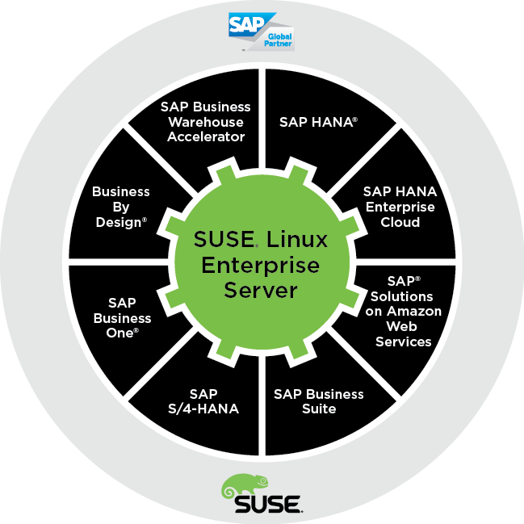
SAP and SUSE
Over 17 Years Of Technology and Engineering Collaboration
Strategic OS For:
  SAP HANA
  SAP Solutions on AWS
  SAP S/4 Hana
  SAP NetWeaver
Market Leadership
  SAP runs on SUSE
  70% of SAP applications running on Linux runs on SUSE
  97% of SAP HANA
Notes:
SUSE has collaborated with SAP for over 17 years, developing the first Amazon EC2 OS for SAP, the first validated open source high availability solution for SAP, and the first validated virtualization solution for SAP. SUSE Linux Enterprise Server is the strategic OS for SAP HANA, Business Warehouse Accelerator and Business ByDesign, and in fact is a development reference platform for UNIX and Linux.
We also provide Integrated Enterprise Support which means that we have a common support line to handle both SUSE Linux and SAP application issues.

Slide 3
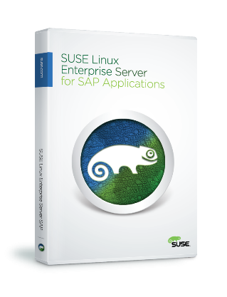
SUSE Linux Enterprise Server for SAP Applications
The Recommended and Supported operating system Platform for SAP HANA
X86 / AWS/ Azure Supported
The First Linux Distribution for Power Systems and z Systems
The Only Linux for SAP HANA on Power Systems
Notes:
SUSE Linux Enterprise Server is THE recommended and supported operating system for SAP HANA
.
SUSE Linux Enterprise Server is a highly reliable, scalable and secure server operating system, built to power mission-critical workloads in physical, virtual and cloud-based environments
.
3

Slide 4
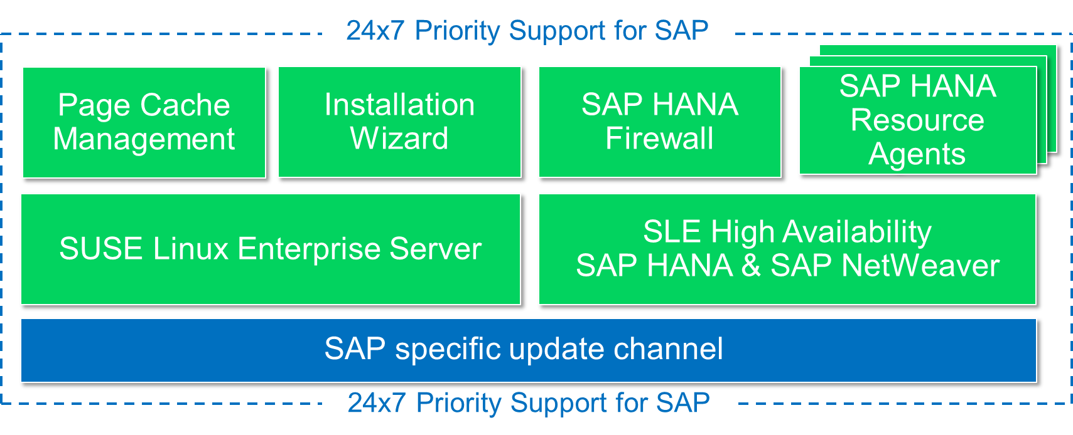
SUSE Linux Enterprise Server for SAP Applications
Built In HA Components To Enable You To Protect Mission Critical Applications
Maintains High Performance Of
Large Workloads
SAP HANA Agents To Preserve
In-memory Data
Integrated Priority Support From
Both SUSE And SAP
The only operating system optimized for SAP Applications

Slide 5



SUSE Linux Enterprise Server for SAP Applications
The Leading Platform for SAP Applications on Linux
The leading Linux platform for SAP HANA, SAP NetWeaver and S/4HANA solutions providing optimized performance and reduced downtime as well as faster migration and SAP landscape deployments.
  Boost performance for mission-critical SAP applications with the Linux OS that is performance-optimized and configurable to sustain high performance of SAP applications
  Reduce downtime of critical operations with built-in business continuity including an advanced high availability solution, and automated data recovery for SAP HANA
  Minimize the time and effort to migrate to S/4HANA and deploy SAP landscapes with a unified solution that includes application installation, migration and superior support
www.suse.com/products/sles-for-sap
5
Notes:
5

Slide 6


What’s new in boosting performance?
Gain optimal performance by deploying SAP applications and SAP HANA on a reference platform used for SAP application development
Prioritize SAP application performance by setting limits for page caching by the Linux kernel to ensure memory availability and high performance
Tune SAP HANA performance using a benchmark tuning option at installation
Maintain peak performance of updated SAP applications with corresponding SUSE Linux Enterprise Server updates through a dedicated update channel

Slide 7
Maintain High Performance Levels With Page Cache Limits
SAP Applications Use Large Amounts Of Memory For Performance
The Linux Kernel Pages Out Memory For Filesystem Performance
The Problem:
  SAP Application Performance Slows
  SAP JAVA Applications Can Be Worse!
The Solution: Page Cache Limit!
  Take Control Of Page Caching To Prioritize Applications
  Limit Paging While RAM Is Available
System Memory
SAP Application
Page Cache Limit
Linux

Slide 8
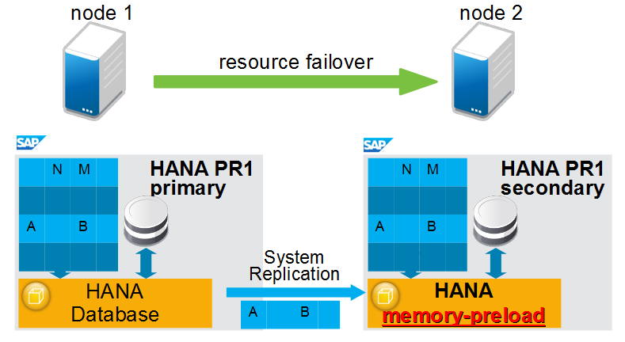
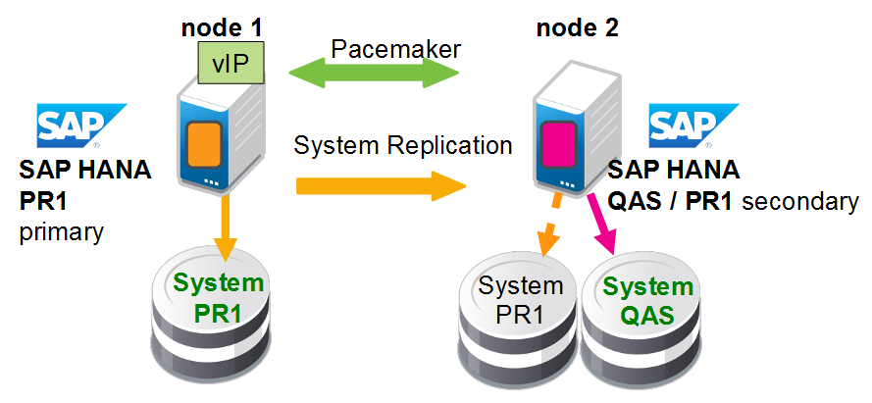
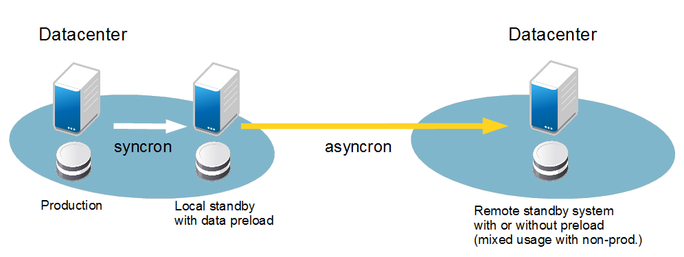
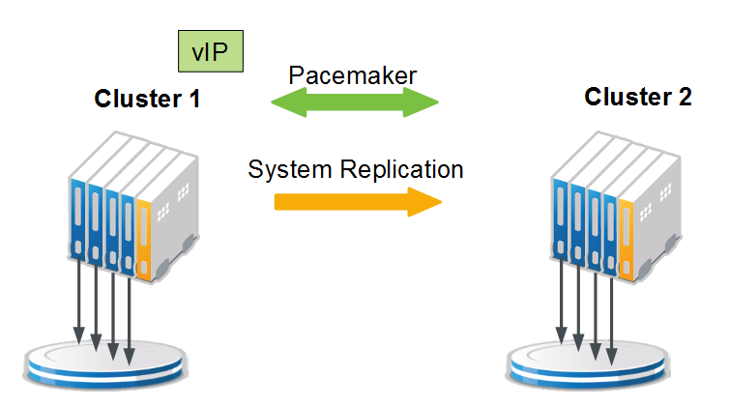
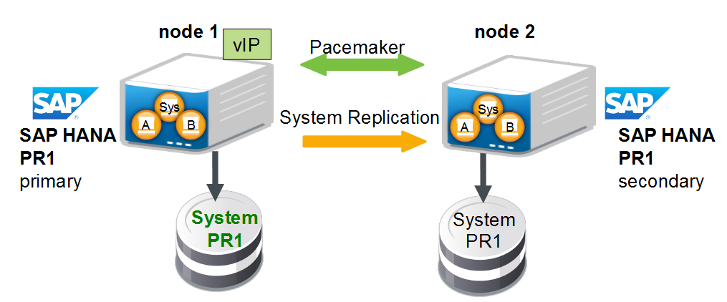
Automate Failover For Multiple High Availability Scenarios
Performance Optimized
Cost Optimized
Chain
Scale-Out *
Multi Tenancy (MDC)
* currently Tech-Preview
Notes:
We touched on the new SAP HANA High Availability scenario in the AWS public cloud already. It perfectly fits into the full picture of supported SAP HANA High Availability scenarios covered with SLES for SAP Applications. Before moving forward let’s get everyone on the same page. When we talk about High Availability scenarios for SAP HANA, there are two important angles to consider. First, the SAP HANA database is taking care of the data replication itself. SUSE is not involved here at all. However, SUSE is introduced when it comes to failover detection and automation. While the SAP HANA team is adding further data replication scenarios, SUSE takes care of delivering the required automation on top. With SLES for SAP Applications 12 SP1 we will deliver automation for 5 of those 6 scenarios out of the box and fully L3 supported. The Scale-Out scenario is not on the installation media, but being delivered as a maintenance update with Tech-Preview status.
SUSE as of today is the only SAP partner capable of providing failover detection and automatic failover for those six SAP HANA high availability scenarios.

Slide 9

Get Seamless Priority Support From SUSE And SAP
Single Point Of Entry
24x7 Priority Support
  1-hour Phone Response
  4-hour Email Response
Knowledgeable SUSE and SAP Staff
Dedicated SUSE Channel For SAP-specific Updates
Notes:
SLES for SAP Applications has an *additional* update channel for patches, fixes and updates of SAP specific packages.

Slide 10
SUSE and Huawei Partnership
Huawei/SUSE SAP HANA solution cooperation that SUSE started with Huawei Server since 2012 and the SLES for SAP revenue is still the main solution.
SUSE is working with Huawei KunLun server. KunLun is the Huawei high-end x86 server with at least 16 sockets. SAP HANA solution is the main use case for KunLun, we’re also working with Huawei to customize special features for KunLun on SLES.
The combination of SUSE Linux Enterprise Server and Huawei's SAP HANA appliance will speed up real-time data analysis and processing for enterprise customers.
Notes:
Reduce complexity
- includes a wizard for easy configuration with just SID,
instance number and IP address
- automates the SR-takeover and IP failover ("bind")
Reduce risk
- delivers a consistent picture of the SAP HANA topology
- provides a choice for automatic registrations and site
takeover preference
Increase reliability
- enables short takeover times in a special for table preload scenarios
- monitors the system replication status to increase data consistency

Slide 11



SUSE Linux Enterprise for Huawei KunLun
Only SUSE Linux Enterprise:
Huawei and SUSE Announce SUSE Linux Enterprise Server
Support for KunLun RAS 2.
Fully supports 576 cores
Supports more than 12 TB RAM
Has Live Kernel Patching for SAP HANA
Provides performance enhancement through memory allocation
Notes:
only SUSE Linux Enterprise can fully support 576 cores (or more than 288)*
only SUSE Linux Enterprise can support more than 12TB RAM (vital for HANA)*
only SUSE Linux Enterprise provides Live Kernel Patching for SAP HANA (so patching the kernel doesn’t require a reboot + reload of multi-TB DB and killing SLA)
only SUSE Linux Enterprise for SAP provides performance enhancement through memory allocation (due to page cache limiter): without this, HANA gets starved of RAM
*from tech pages:
ref:
https://www.suse.com/products/server/technical-information/
https://access.redhat.com/articles/rhel-limits

