Slide 1
Hitting the AIT/Mobile/Ux tri-fecta

Slide 2
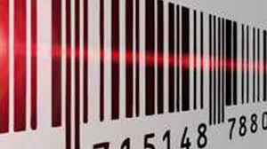
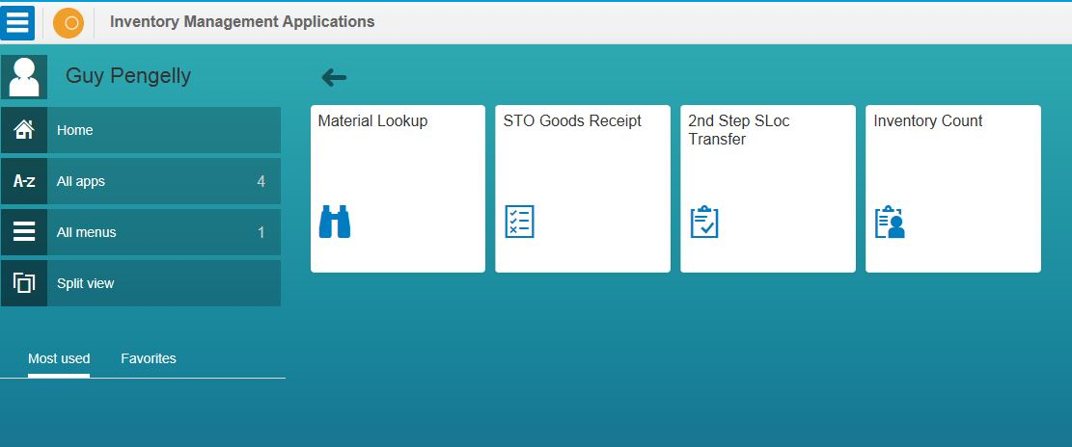
Summary
Automated Identification Technology can help….
Speed
Accuracy
Simplicity
Mobile Applications can deliver…..
Speed
Distributed processing
Ease of use, familiarity
Disconnected processing
A new UX in UI5 can bring…..
Simplicity
Speed
User satisfaction
1 + 1 + 1 = 6
…but together….

Slide 3
Challenges & Motivation
Do more with less
More, and more complex, logistics material → more process
Fewer, and constantly changing, personnel
Process accuracy
Regulatory & Safety challenges
A younger workforce with different expectations

Slide 4
AIT - barcodes
First patent in 1949, inspired by Morse code and drawn in the sand on a beach in Florida
Programmes in the ‘60s and early ‘70s by US railways, General Motors, Jersey Turnpike, KalKan were promising
First use of UPC scanner in June 1974
A 10 pack of Wrigleys Juicy Fruit gum sold by Sharon Buchanan to Clyde Dawson at Marsh’s supermarket in Troy, Ohio.

Slide 5
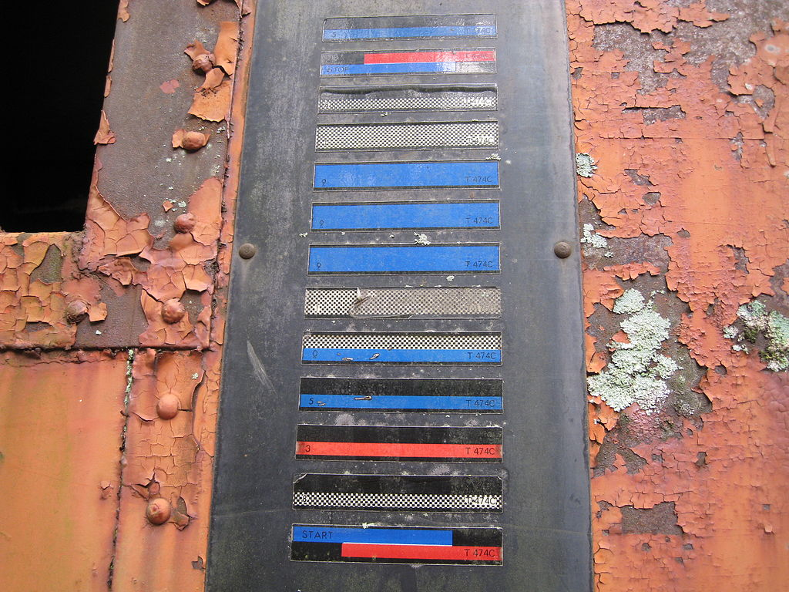
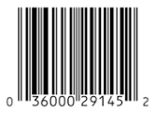
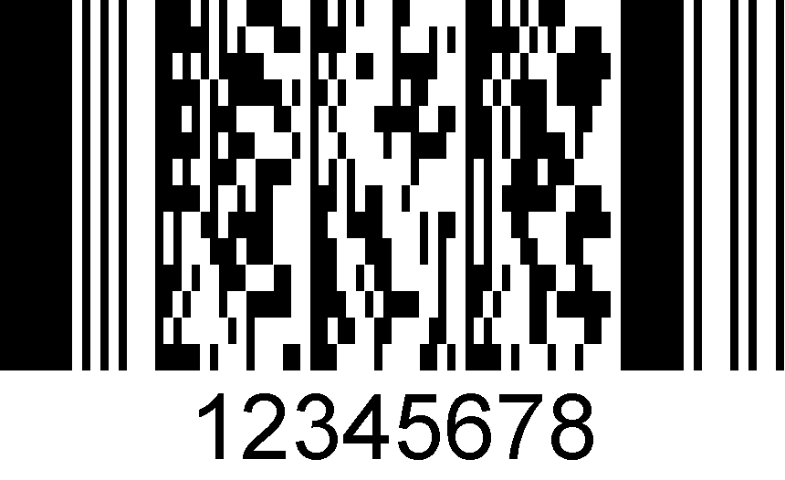
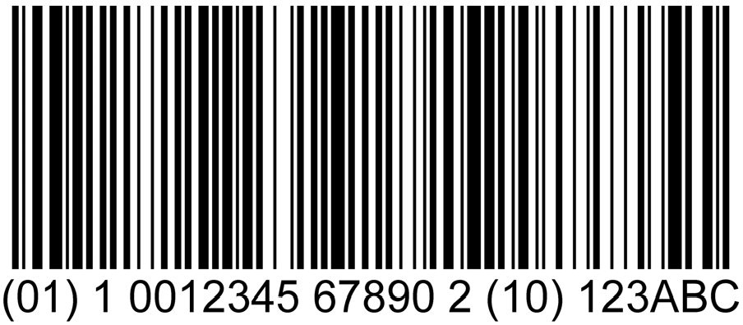
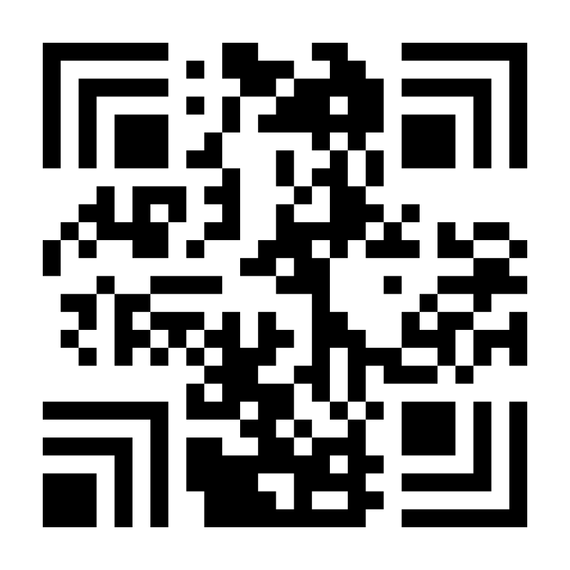
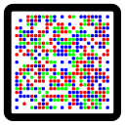
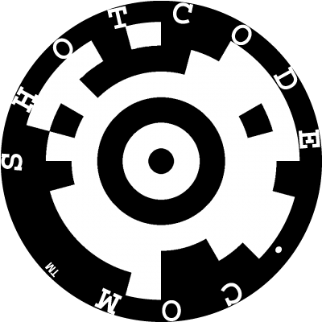
AIT - barcodes
Australia Post
Codabar
Code 25 interleaved/non-interleaved
Code 11
Farmacode
Code 39
….
…
Code 128
DX film edge
EAN2
EAN5
EAN13
GS-1 128
JAN
….
KARTrak
…
NATO Stanag
…
Planet
Plessey
….
UPC
HCCB
Han-Xin
ScanLife
Cronto
Aztec
Shotcode
MaxiCode
Notes:
Aztec
CRONTO
SCANLIFE and shotcode for caera phones
HCCB by Microsoft
Han-Xin to encode chinese charaters
Maxi code used by UPS

Slide 6
AIT - RFID
First patent in 1973, but with technical roots back to the Soviet Union in 1945 as an espionage tool.
Now ubiquitous, multi-form, type, power
Smallest are .05mm square, glued to the back of ants for tracking!
Higher overhead than barcode
Don’t require line-of-sight
Better for counting

Slide 7
AIT keypoints
Standard - GS-1
More-or-less the de-facto standard for non-specialised use → interoperability
Used for all manner of objects, materials, serials, people, places, documents…..
Data carrier independence. Barcode & RFID

Slide 8
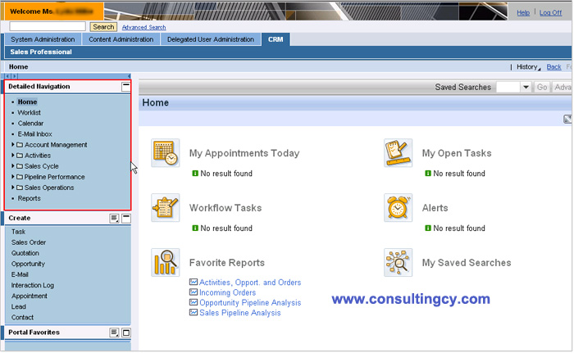
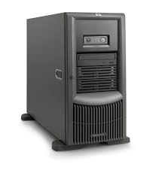
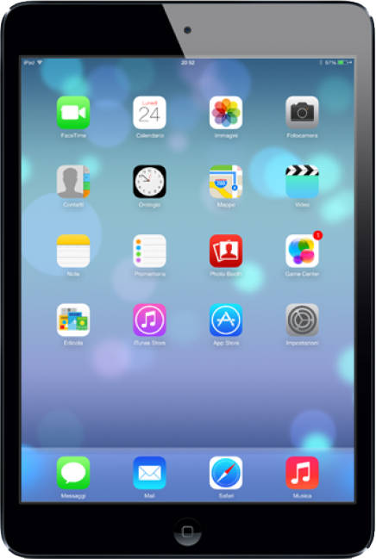
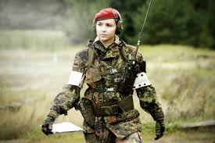
Mobile Applications
Internet Portal
Intranet Portal
ECC
+ Neptune

Slide 11
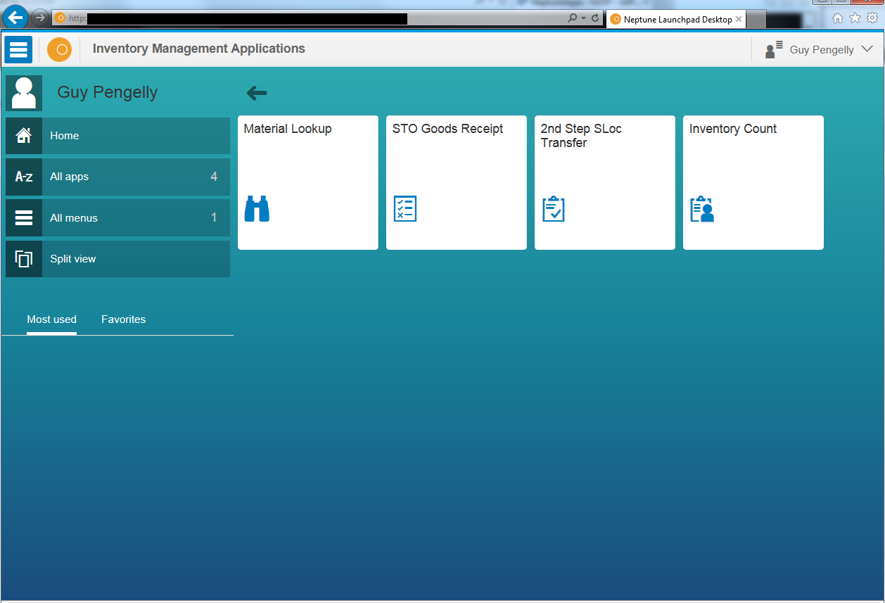
Mobile on desktop – huh ?

Slide 12
Mobile on desktop – now there’s irony!

Slide 14
Current state
Physical inventory
G/R of material transfer
Material inquiry
Material loans
Counter readings

Slide 15
Findings / Challenges
Delivery of applications is harder than building them
Doing the groundwork for the AIT marking
There are a lot of moving parts to manage
Device management
Prioritise the dozens of new application ideas

Slide 16
What next?
Configuration checker
Issue to work order
People tracker
STO-on-the-fly
Label printer
PI-on-the-fly
Code-a-chip

Slide 17
Thanks – questions ??

Slide 18
