Slide 1
Fonterra’s UX Journey with SAP Fiori
Jeremy Wee
September 2017

Slide 2


Our purpose
is to become
the world’s
most trusted
source of
dairy nutrition
Confidential to Fonterra Co-operative Group - November 2015
Page 2
Notes:
Speaker notes:
Our purpose is to be the world’s most trusted source of dairy nutrition.

Slide 3
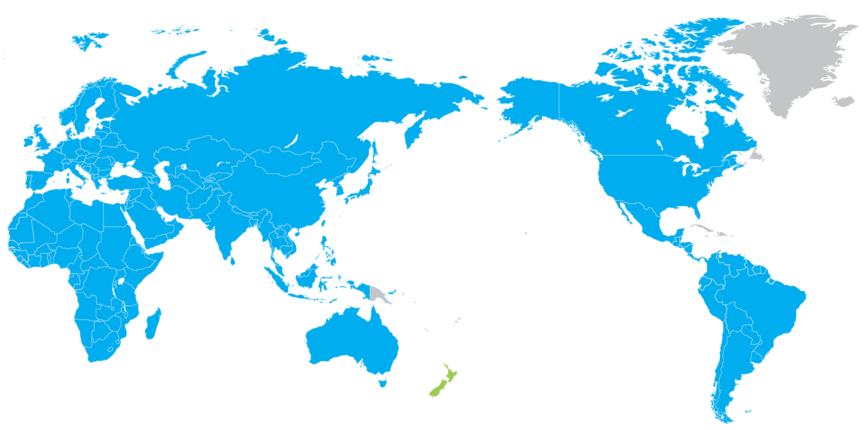
Our products and ingredients are in 140 markets
22 billion
litres of milk
processed
95%
of our milk
is exported
During peak,
container of
product loaded
every 2 mins
for export
Confidential to Fonterra Co-operative Group - November 2015
Page 3
Notes:
Speaker notes:
From our head office in New Zealand, we have operations stretching across four continents.
We are the world’s number two milk processor in 2014 (IFCN).
During 2015, we processed over 22 billion litres of milk, with 18 billion litres of that produced in New Zealand.
We export about 95% of our local production from New Zealand.
41% of our annual supply is produced over three months in spring, known as the ‘peak’.
New Zealand operations
We have 33 sites around New Zealand where we make our products, including fresh milk, milk powders, butter, cheese, yoghurt and ice-cream.
Examples of our New Zealand processing include:
Clandeboye: World-first mozzarella cheese plant. The patented technology means that frozen natural shredded mozzarella can be made straight from milk in one day, rather than two months taken by conventional mozzarella processes.
Darfield: One of the largest dryers in the world in Canterbury, capable of producing 25 metric tonnes of Whole Milk Powder per hour.
Waitoa: Packs 28 UHT packets per second and 14 containers per day, all destined for China and Asia.
Edendale: Largest producer of dairy products in the world – WPC, SMP, cheese, whey, lactose, casein, MPC, AMF.
Our markets
While our products can be found in more than 140 markets, we focus on 8 strategic markets:
China, Australia, Indonesia, and Brazil (strategic markets for growth)
New Zealand, Sri Lanka, Chile and Malaysia (leadership markets where we have a strong presence already)
While demand for good nutrition sources is steadily growing globally, there is strong demand from Asia and China due to burgeoning middle class populations and increasing urbanisation.

Slide 4
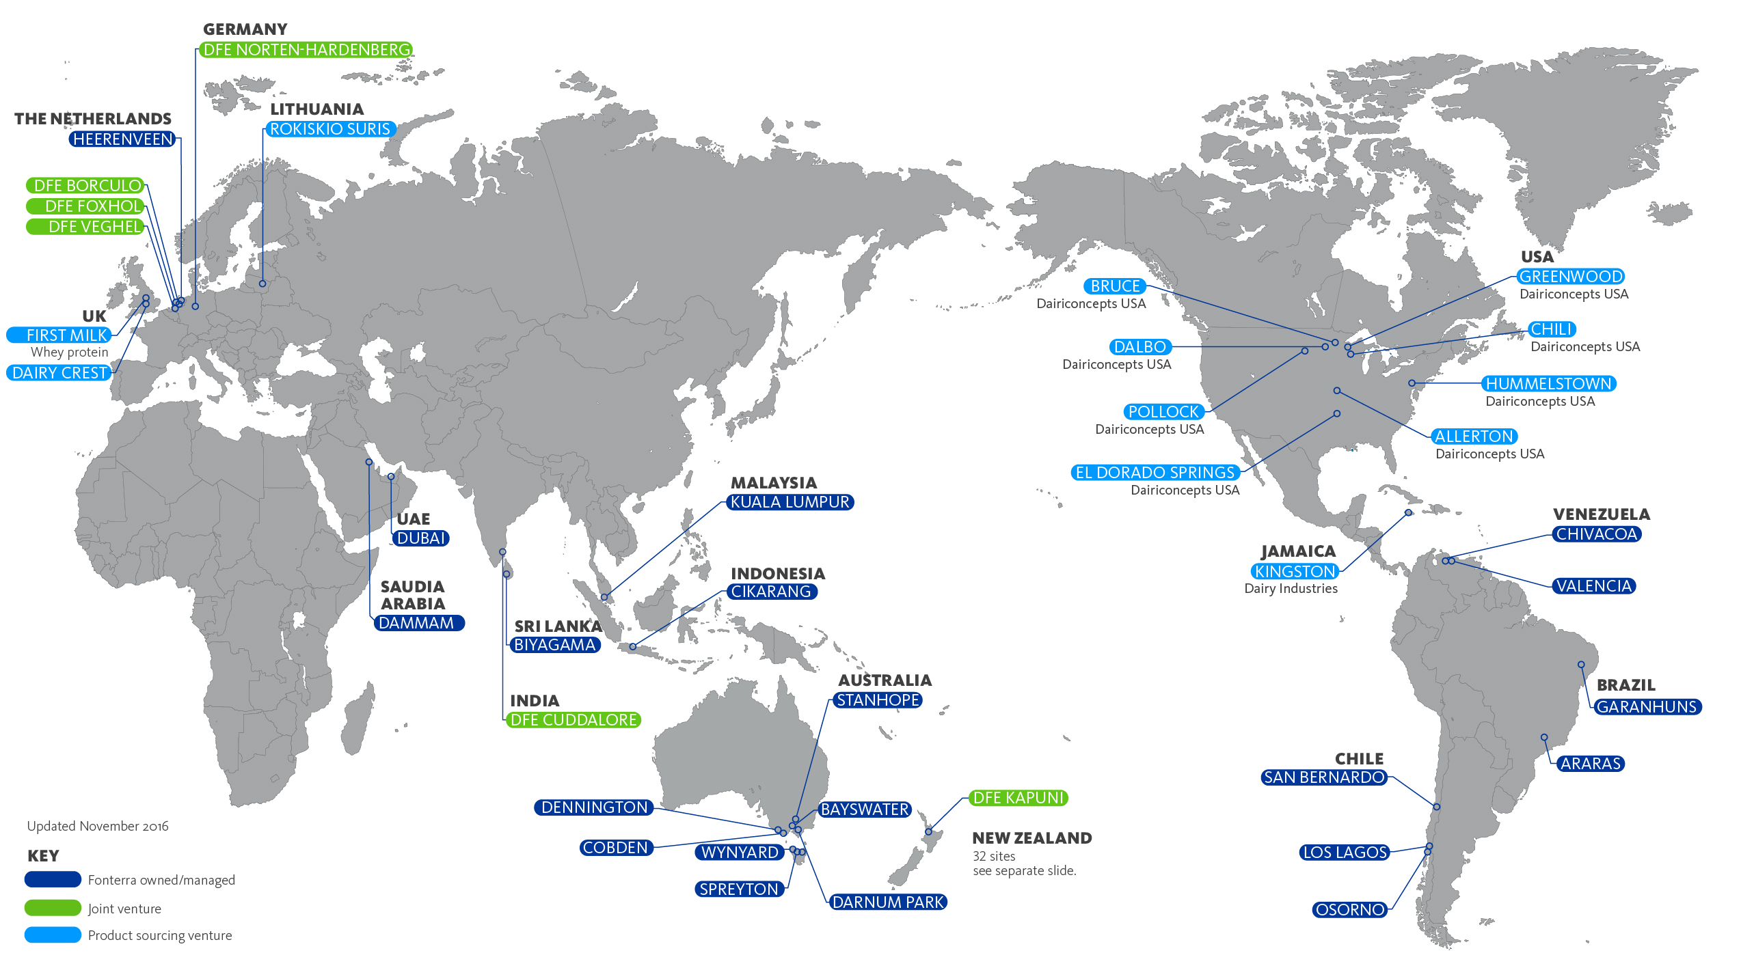

Slide 5


Fonterra’s User Experience Journey
Confidential to Fonterra Co-operative Group - November 2015
Page 5
Notes:
Speaker notes:
Our name ‘Fonterra’ means 'spring from the land’.
Our logo symbolises the green and blue of the land, water and sky.
And the white represents the purity and freshness of the milk we make.

Slide 6

What is User Experience (UX)?
“The sum of the effects caused by a person using a digital solution."
- Gartner, October 2016
Defining a Good User Experience with the Gartner User Experience Model. Author: Magnus Revang 2016.

Slide 7
Why do we need to care about user experience?
Increase
user
satisfaction
Increase
customer
loyalty
Increase
solution
adoption
Increase
ease of
learning
Increase efficiency
Save training cost
Improve Usability
Decrease user errors
Reducing
duration of tasks
Intuitive look and
feel.
Less clicks to complete
the same task.
Immediate user feedback
on data entry.

Slide 8
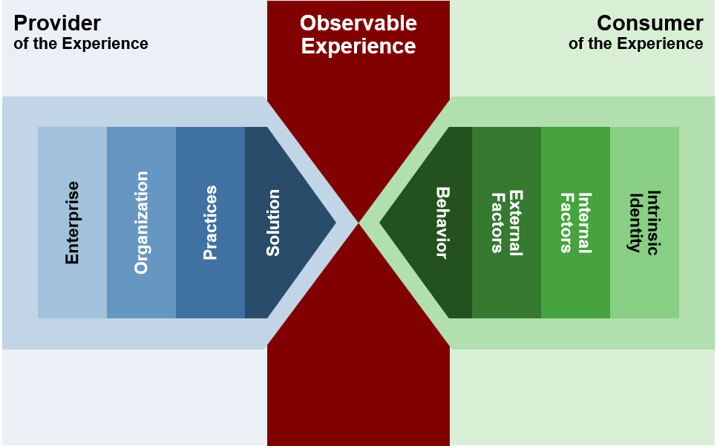
How do you start looking at user experience?
* Defining a Good User Experience With The Gartner User Experience Model Magnus Revang, 5th October 2016

Slide 9
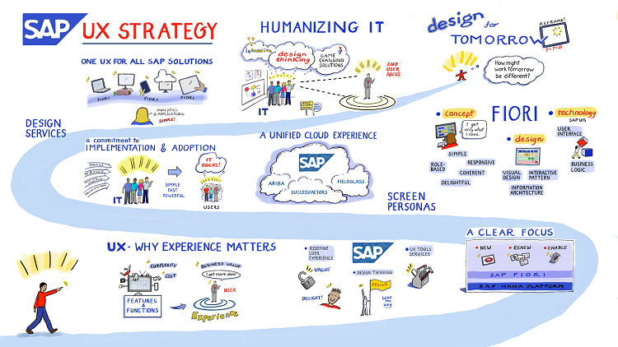
Leveraging SAP’s UX Strategy
Changing UIs in SAP HCM for UX. March 2015. Author: Soumyasanto Sen

Slide 10





Employee Persona Groups
KNOWLEDGE WORKER
MOBILE
WORKER
EXECUTIVE WORKER
FACTORY WORKER
LAB
WORKER
Thrive on information access and consumption on the go. Whether keeping connected during meetings or extending their workday in the AM or PM, having the ability to access and consume information on the mobile platform they choose is critical.
Seeking information that, while largely static, is accessible and digestible on their device of choice.
Live on the road for the better portion of their days.
Gather information and even create new IP in the field and need to share it with the home office, colleagues and customers/suppliers.
Need to be able to interact with files as they would on a PC, while they’re relying on a tablet or smartphone – increasingly their device of choice.
Need to consume computing power, but from small, easy-to-carry device.
Need access to complex computing tasks on the go.
Often dealing with highly confidential data, which requires higher levels of security.
Expected to be everywhere at once and see every corner of the business.
Need to communicate in real time throughout the day
Often work different shifts compared to a standard 5-day, daytime work week
Spend most of the day on the move within a plant
Use shared desktop workstations to review schedules, access information, or handle email
Spend a most of their day inside a laboratory.
Usually work regular business hours, but may also work evenings and weekends if they are involved in a long-running experiment
Data is key for this user group & it needs to be searchable and formatted to be used to identify larger trends that may not be visible from a single sample set.

Slide 11



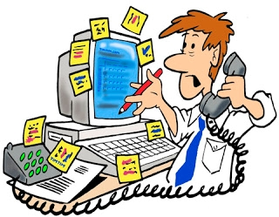
Identify the Use Case
Manual PI Sheet
entries
Poor
Data quality
Time consuming
data entry
Manual
Transactions

Slide 12

Refine the Business Process
Settle Process Order
Create Process Order
Release Process Order
Reconcile Process Order
Issue / Return Consumptions
TECO Process Order
Receive / Return Production
Close Process Order
Receive \ Return By Products

Slide 13
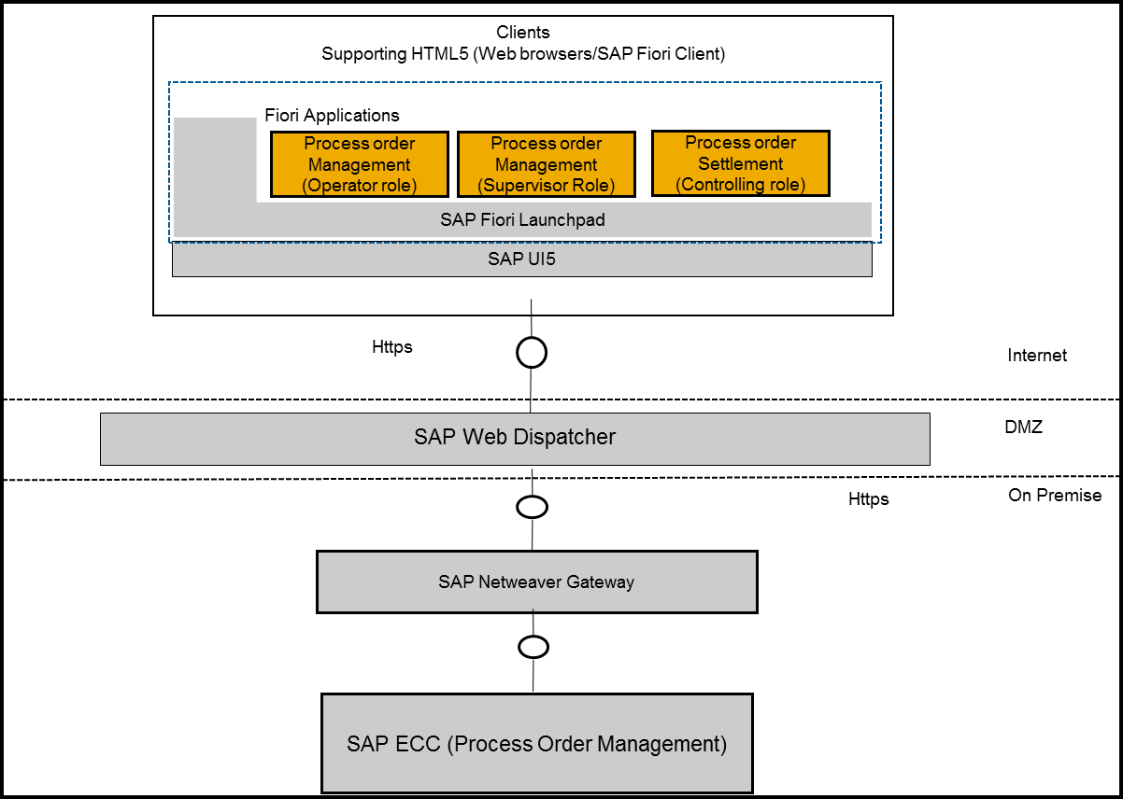


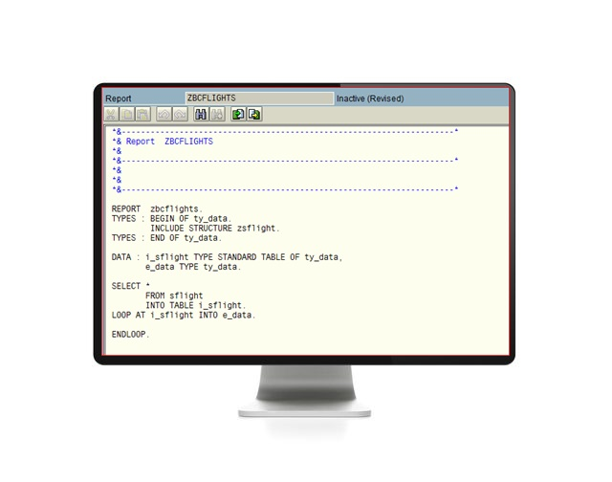
Solution Architecture
SAP Standard Architecture
Fonterra Architecture
End-Users
Single
Sign
On (SSO)
ABAP Code

Slide 14
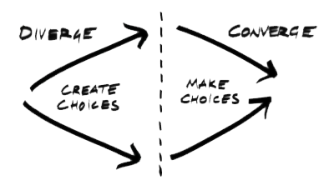


Discover with CUSTOMER Business Process Owners
Identify Process Areas
via DT Workshop
Passed with one Process Area through the DT Problem Space
Compiled Backlog with
Design Challenges
e.g. Engineering &
Maintenance
Definition of the Challenge
Log of what needs to be addressed in the new solution

Slide 15
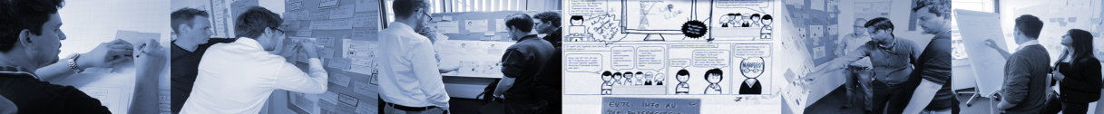
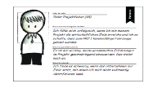
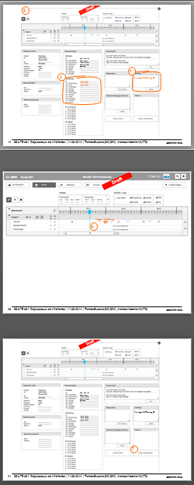
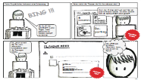
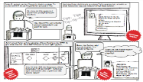
Ideate, Start Define and Start Design with End-Users
Design Thinking Workshop
With Customers End Users (+ DT, PO, [UXD]) based on Challenges Backlog
Personas / Storyboards /
Customer Journeys
(DT)
Wireframes
(UXD, PO)
Users can emphasize more easily with a story they know and can validate
Wireframes help to focus on architecture and structure first
Divers people work together to solve problems
ABBREVIATIONS
DT = Design Thinker | PO = Product Owner | UXD = User Experience Designer

Slide 16
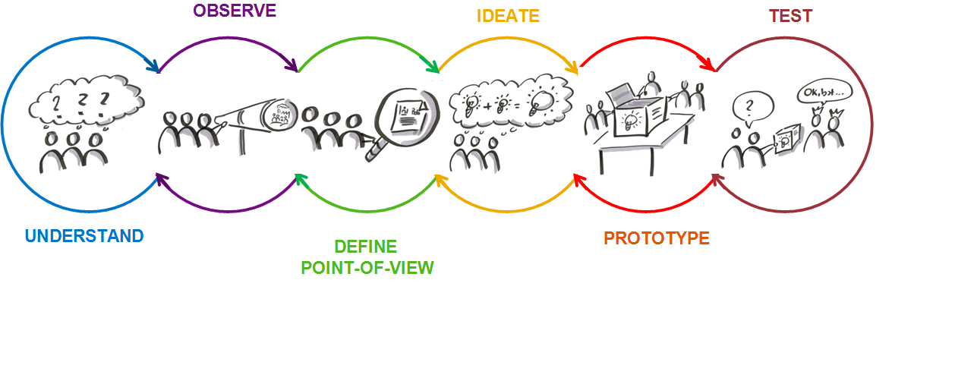
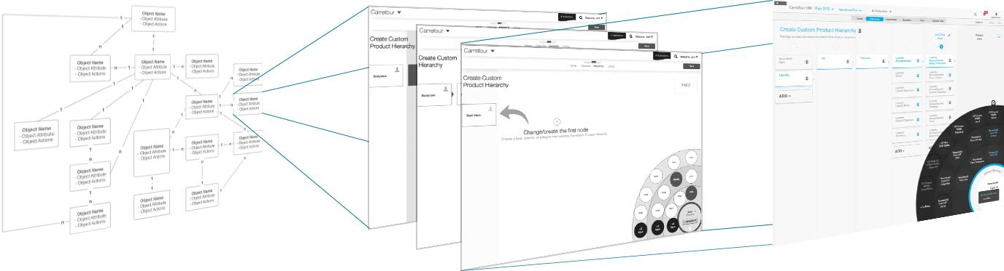
Synthesize Results, Finalize Define and Design
Synthesize User Research Results & define design
From Information Architecture to
Interaction Design to Visual Design
Definition of Information Flow and Navigation
Definition of Interaction Patterns
Branding and Visuals

Slide 17
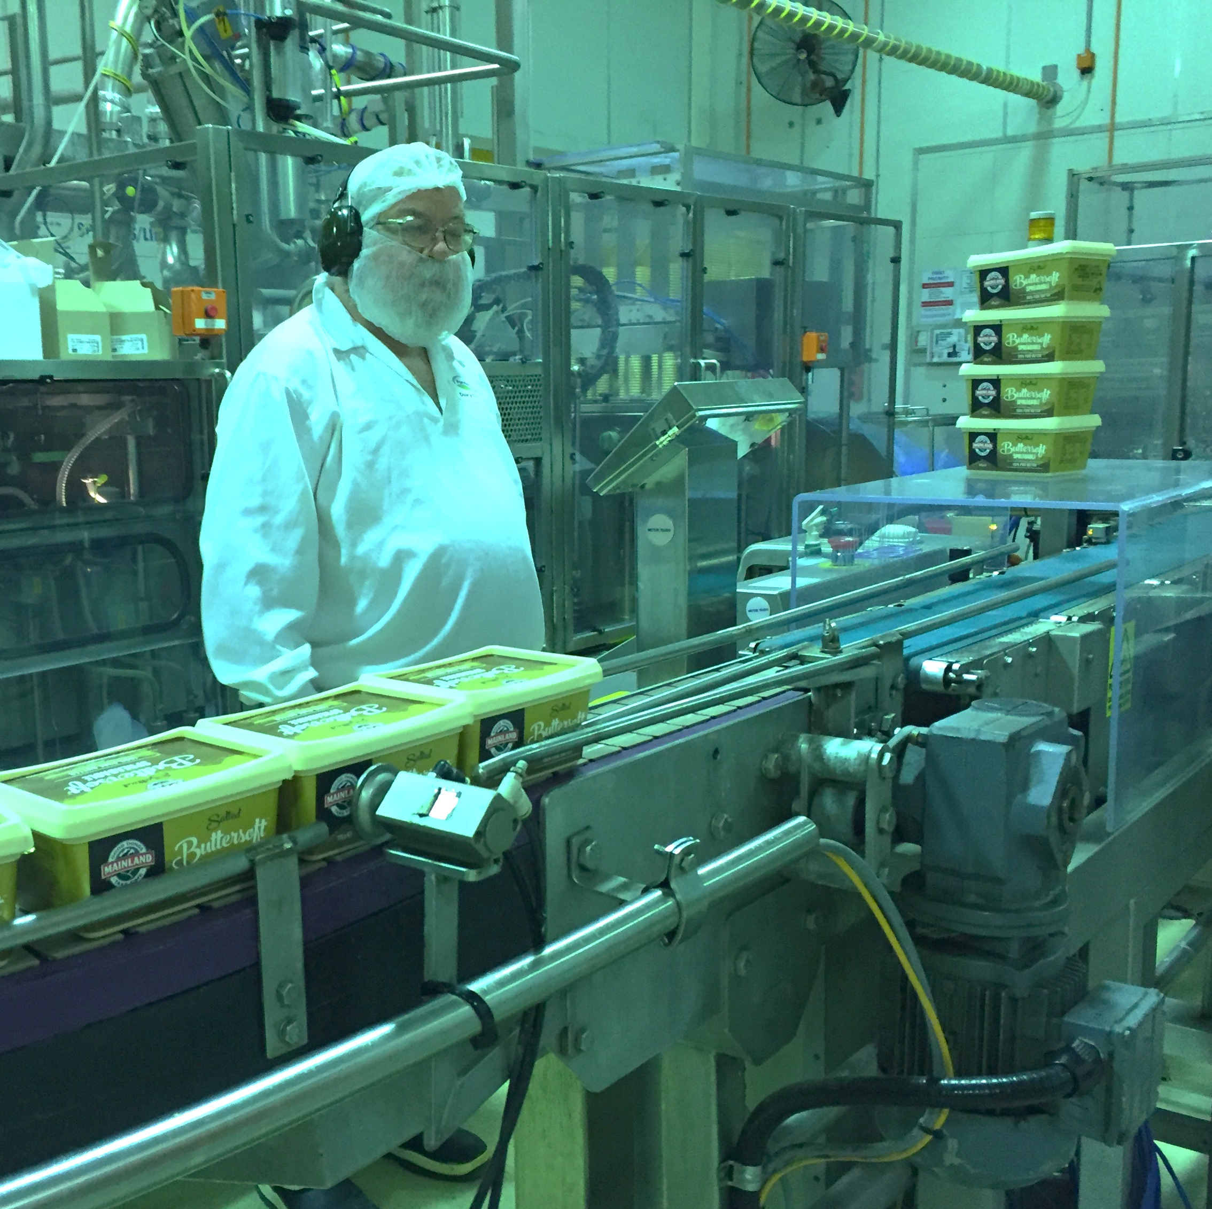
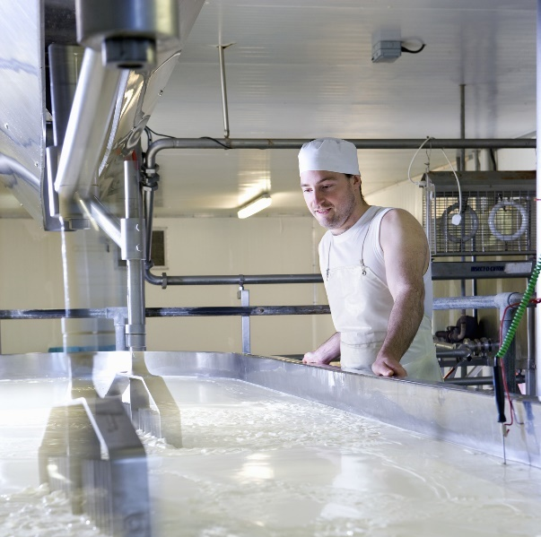

“I would like to continuously enter the production data in order to document the process order details”
Jason
Production Operator/Supervisor/Team Leader
Main Goals
As per production schedule, keep the production running
Keep a watch on the equipment functioning
Monitor the product quality and report for any observations as needed
Enter all the production details in the system for accounting and documentation
Job Responsibilities
Operates continuous flow to process milk, cream, and other dairy products
Operate and Monitor Machine, including changing equipment as needed
Tests product for weight and other standard quality parameters at various stages of process
Records specified time, temperature, pressure, and volume readings
Document the readings from the process
About
Age: 40-55 years old
Gender: Male
Manufacturing Plant Experience
  Has good understanding of manufacturing milk products
Needs
Updated information on the process order assigned
Keep track of the current stage of Process Order.
Get the right feedback from the system on the entries being done
Contextual information
Seamless system process which maps to the production line
Pain Points
Multiple PI sheets for various scenarios
Time consuming co-ordination to double check on the entries
Not able to get a visibility of the current state for any process order
Assigning batches according to storage location during goods movement
Input of results during inspection is time consuming and unstructured.
Multiple entry points for the data, both as physical as well as digital for which has to open various transactions.
No clear visual indicator of the current status of the PO
Works with
Supervisor
Other Operators
Machine Operators
Competencies
Casual User
Proactive
Team Worker
Global Focus
Innovative
Power User
Reactive
Lone Fighter
Local Focus
Conservative

Slide 18

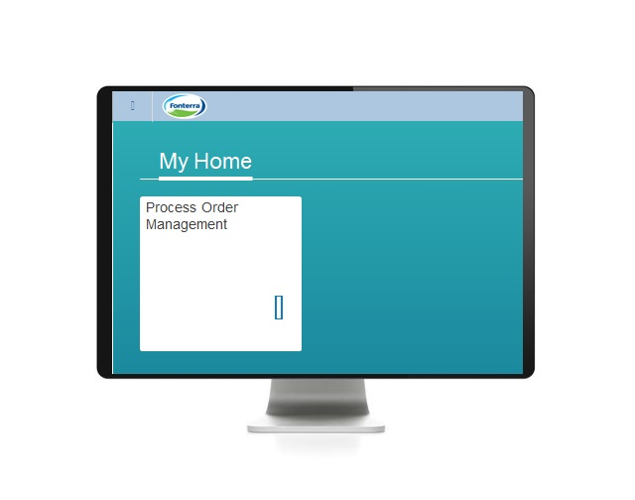
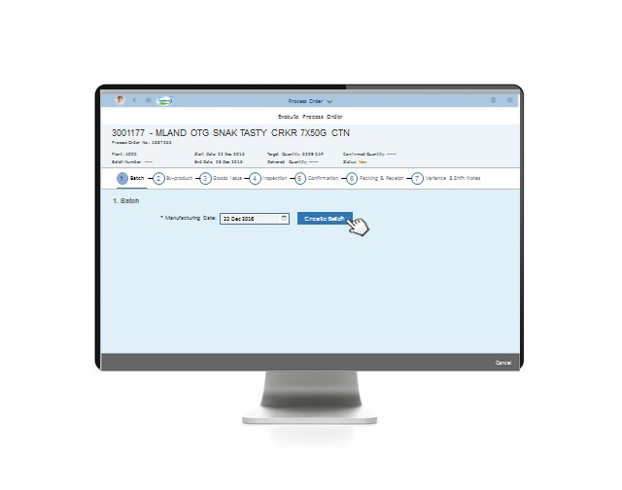
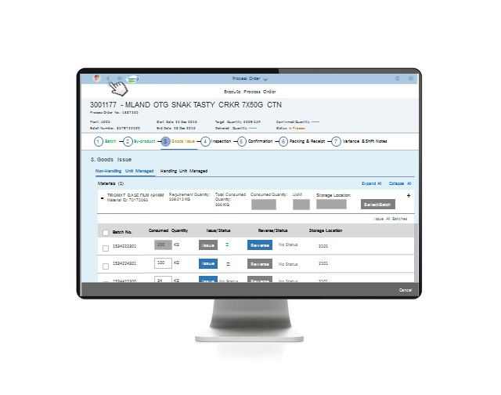
SAP Fiori User Interface (UI) Development
Production Operator
Supervisor
Team Leader

Slide 19
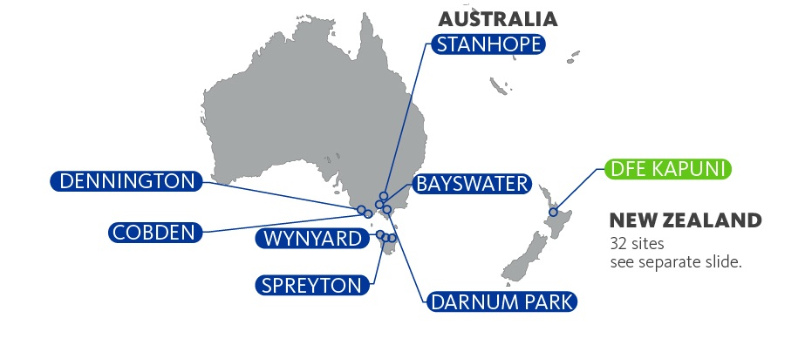
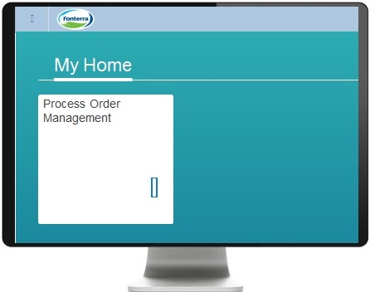
Delivery Approach (Site by Site)
Phase 1 Go-Live
Phase 4 Go-Live
Phase 3 Go-Live
Phase 2 Go-Live

Slide 20
Business Improvement Statistics
Preliminary results first 11 days production:
Date : 8th – 18th July 2017
Location : Cobden Butter Plant
Number of Process Orders: 81
Normal processing errors
PI Sheets = 25
FIORI = 0
100% Reduction
“Cannot Assign Handling Unit” in Process Order Error
PI Sheets = 40
FIORI = 0
100% Reduction
Time to TECO Process Order
PI Sheets = 10 mins
FIORI = 2 Mins
80% Reduction
Duration to correct Finished Goods Inventory Errors
PI Sheets = Days…
FIORI = Minutes…
Notes:
Updates:
Stanhope Go Live on 1 June approx.
Other Projects

Slide 21
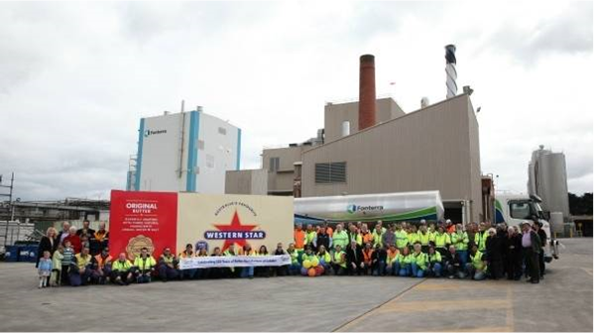
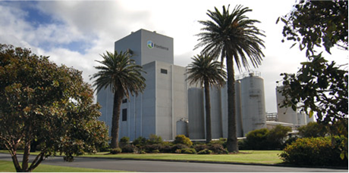
FIORI POM – August YTD Results
FIORI Time saving results:
Process Order Activity | % Time Saved | Cobden (minutes \ day) | Dennington (minutes \ day)
Time saved on inspection results | 75% | 19 | 4
Time saved on By-product goods receipt | 67% | 5 | 1
Time saved on By-product inspection lot | 92% | 25 | 7
Time saved on goods issue reversal from HU managed location | 98% | 35 | 0
Time saved on goods issue (non-HUM) | 83% | 63 | 14
Time saved on FG goods receipt reversal | 99% | 20 | 139
Accessing Variance Report | 100% | 6 | 1
Entering & accessing shift notes | 75% | 19 | 4
Time saved on signoff of order | 100% | 38 | 24
Time saved to TECO process order | 83% | 127 | 28
Time saved on end of month goods issue errors | 100% | 3 | 5
Total | 88% | 362 | 228
Hours per day saved |  | 6.8 | 3.8
Date Range from |  | 8/7/17 | 7/8/17
Date Range to |  | 31/8/17 | 31/8/17
# Process Orders |  | 731 | 67
Process Order activities reduced by 88% or 10.6 hours per day

Slide 22

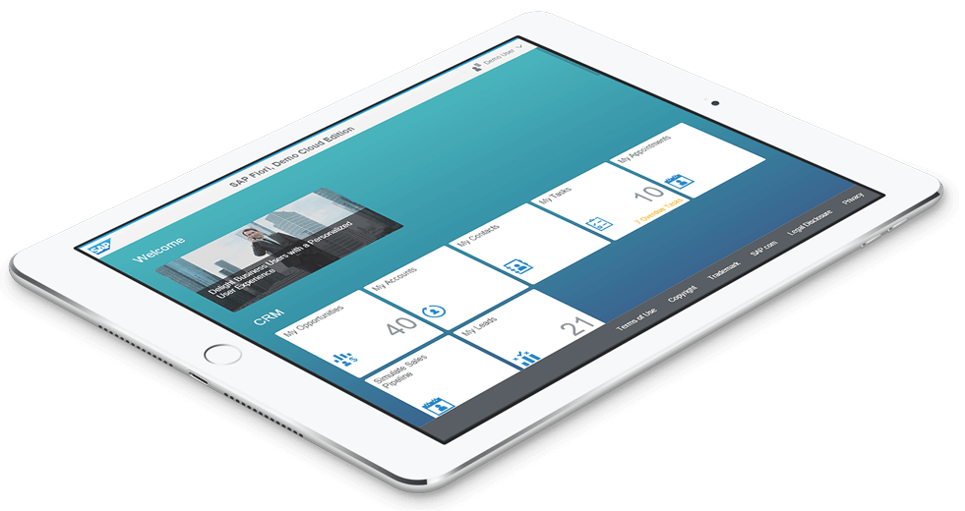
Continual Challenges for Fonterra
Outsource vs In-house Fiori development capability
Evolving the solution with the business.
SAP Upgrades (to leverage standard Fiori apps) vs custom development
Evolving the security setup (internals vs external setup)
Extending for mobile devices (limited real estate)

Slide 23
Demonstration Video

Slide 24
Questions?
Jeremy Wee
Global Design Manager
Jeremy.wee@fonterra.com

