Slide 1
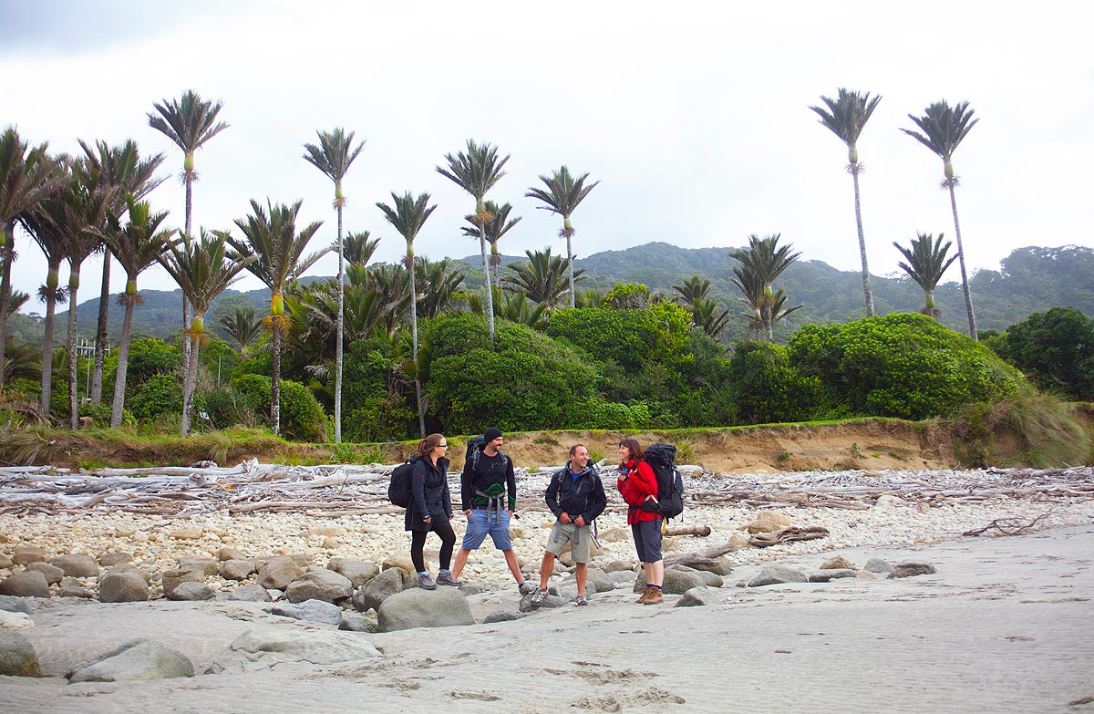
Department of Conservation
Mobile asset management
Notes:
Hi I’m…
What we’ll cover
Introduction to DOC
Our Business Needs
Our mobile asset management journey
Give you a demo of our new mobile asset management App
How that app – MyPM from soltius has been a game changer

Slide 2
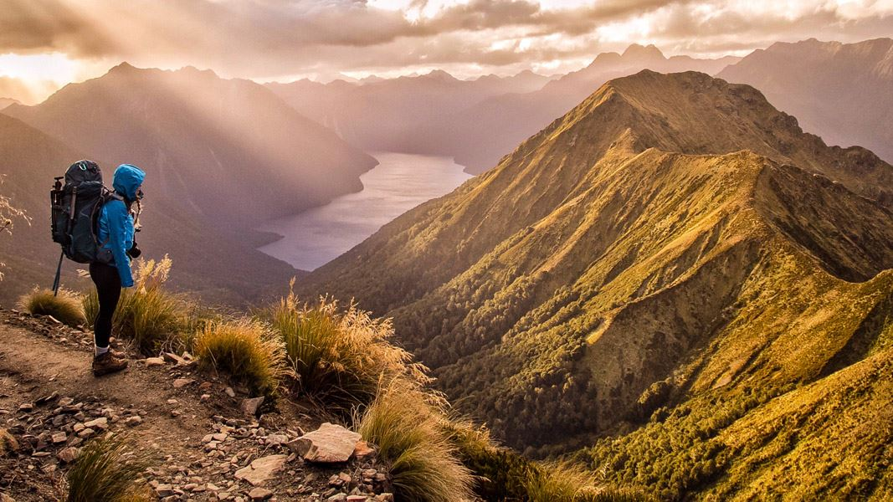
We are the government agency charged with conserving
New Zealand’s natural and historic heritage.
Notes:
So who is the Department of Conservation
We are the government agency charged with conserving New Zealand’s natural and historic heritage.

Slide 3
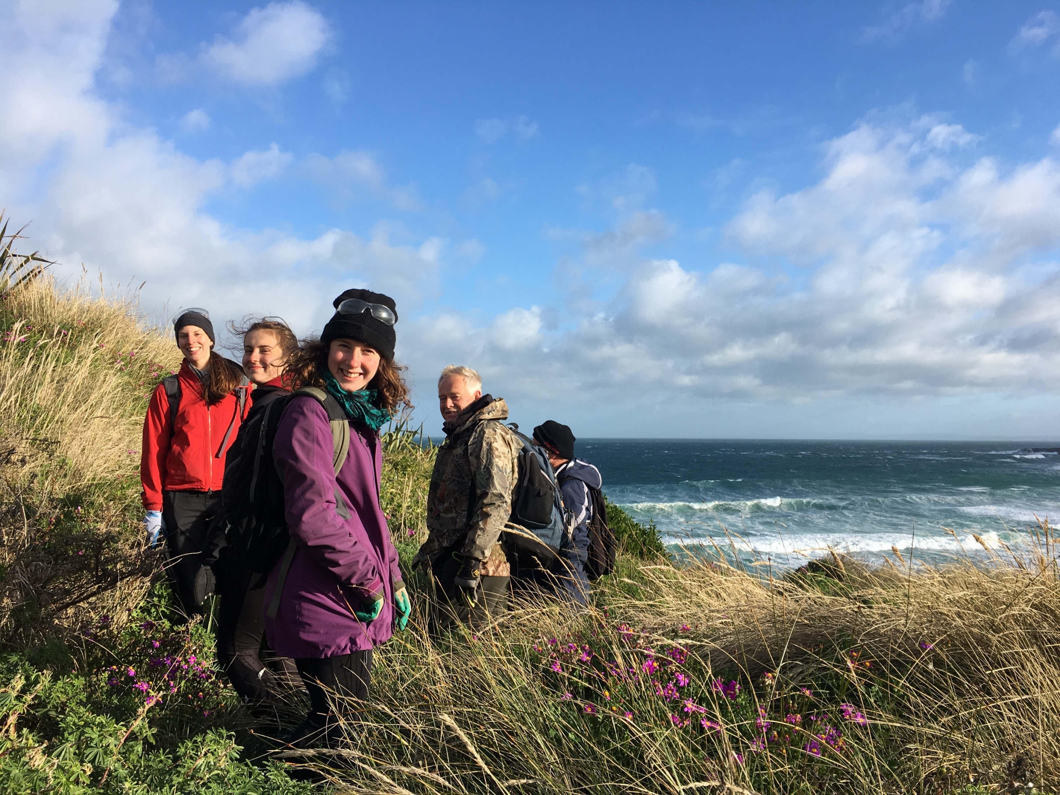
New Zealand is the greatest living space on earth
Notes:
DOC’s vision is ‘ New Zealand is the greatest living space on earth’

Slide 4
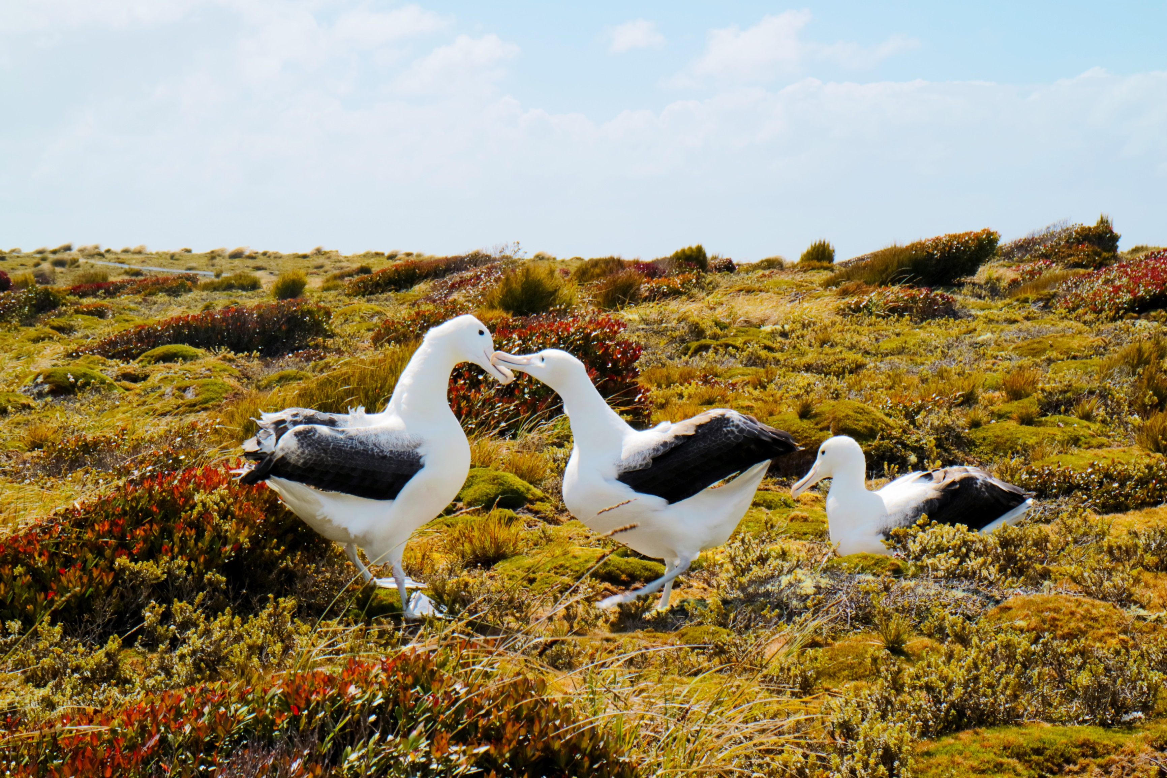
The diversity of our natural heritage is maintained and restored
Notes:
Four main areas of work
1
The diversity of our natural heritage is maintained and restored

Slide 5
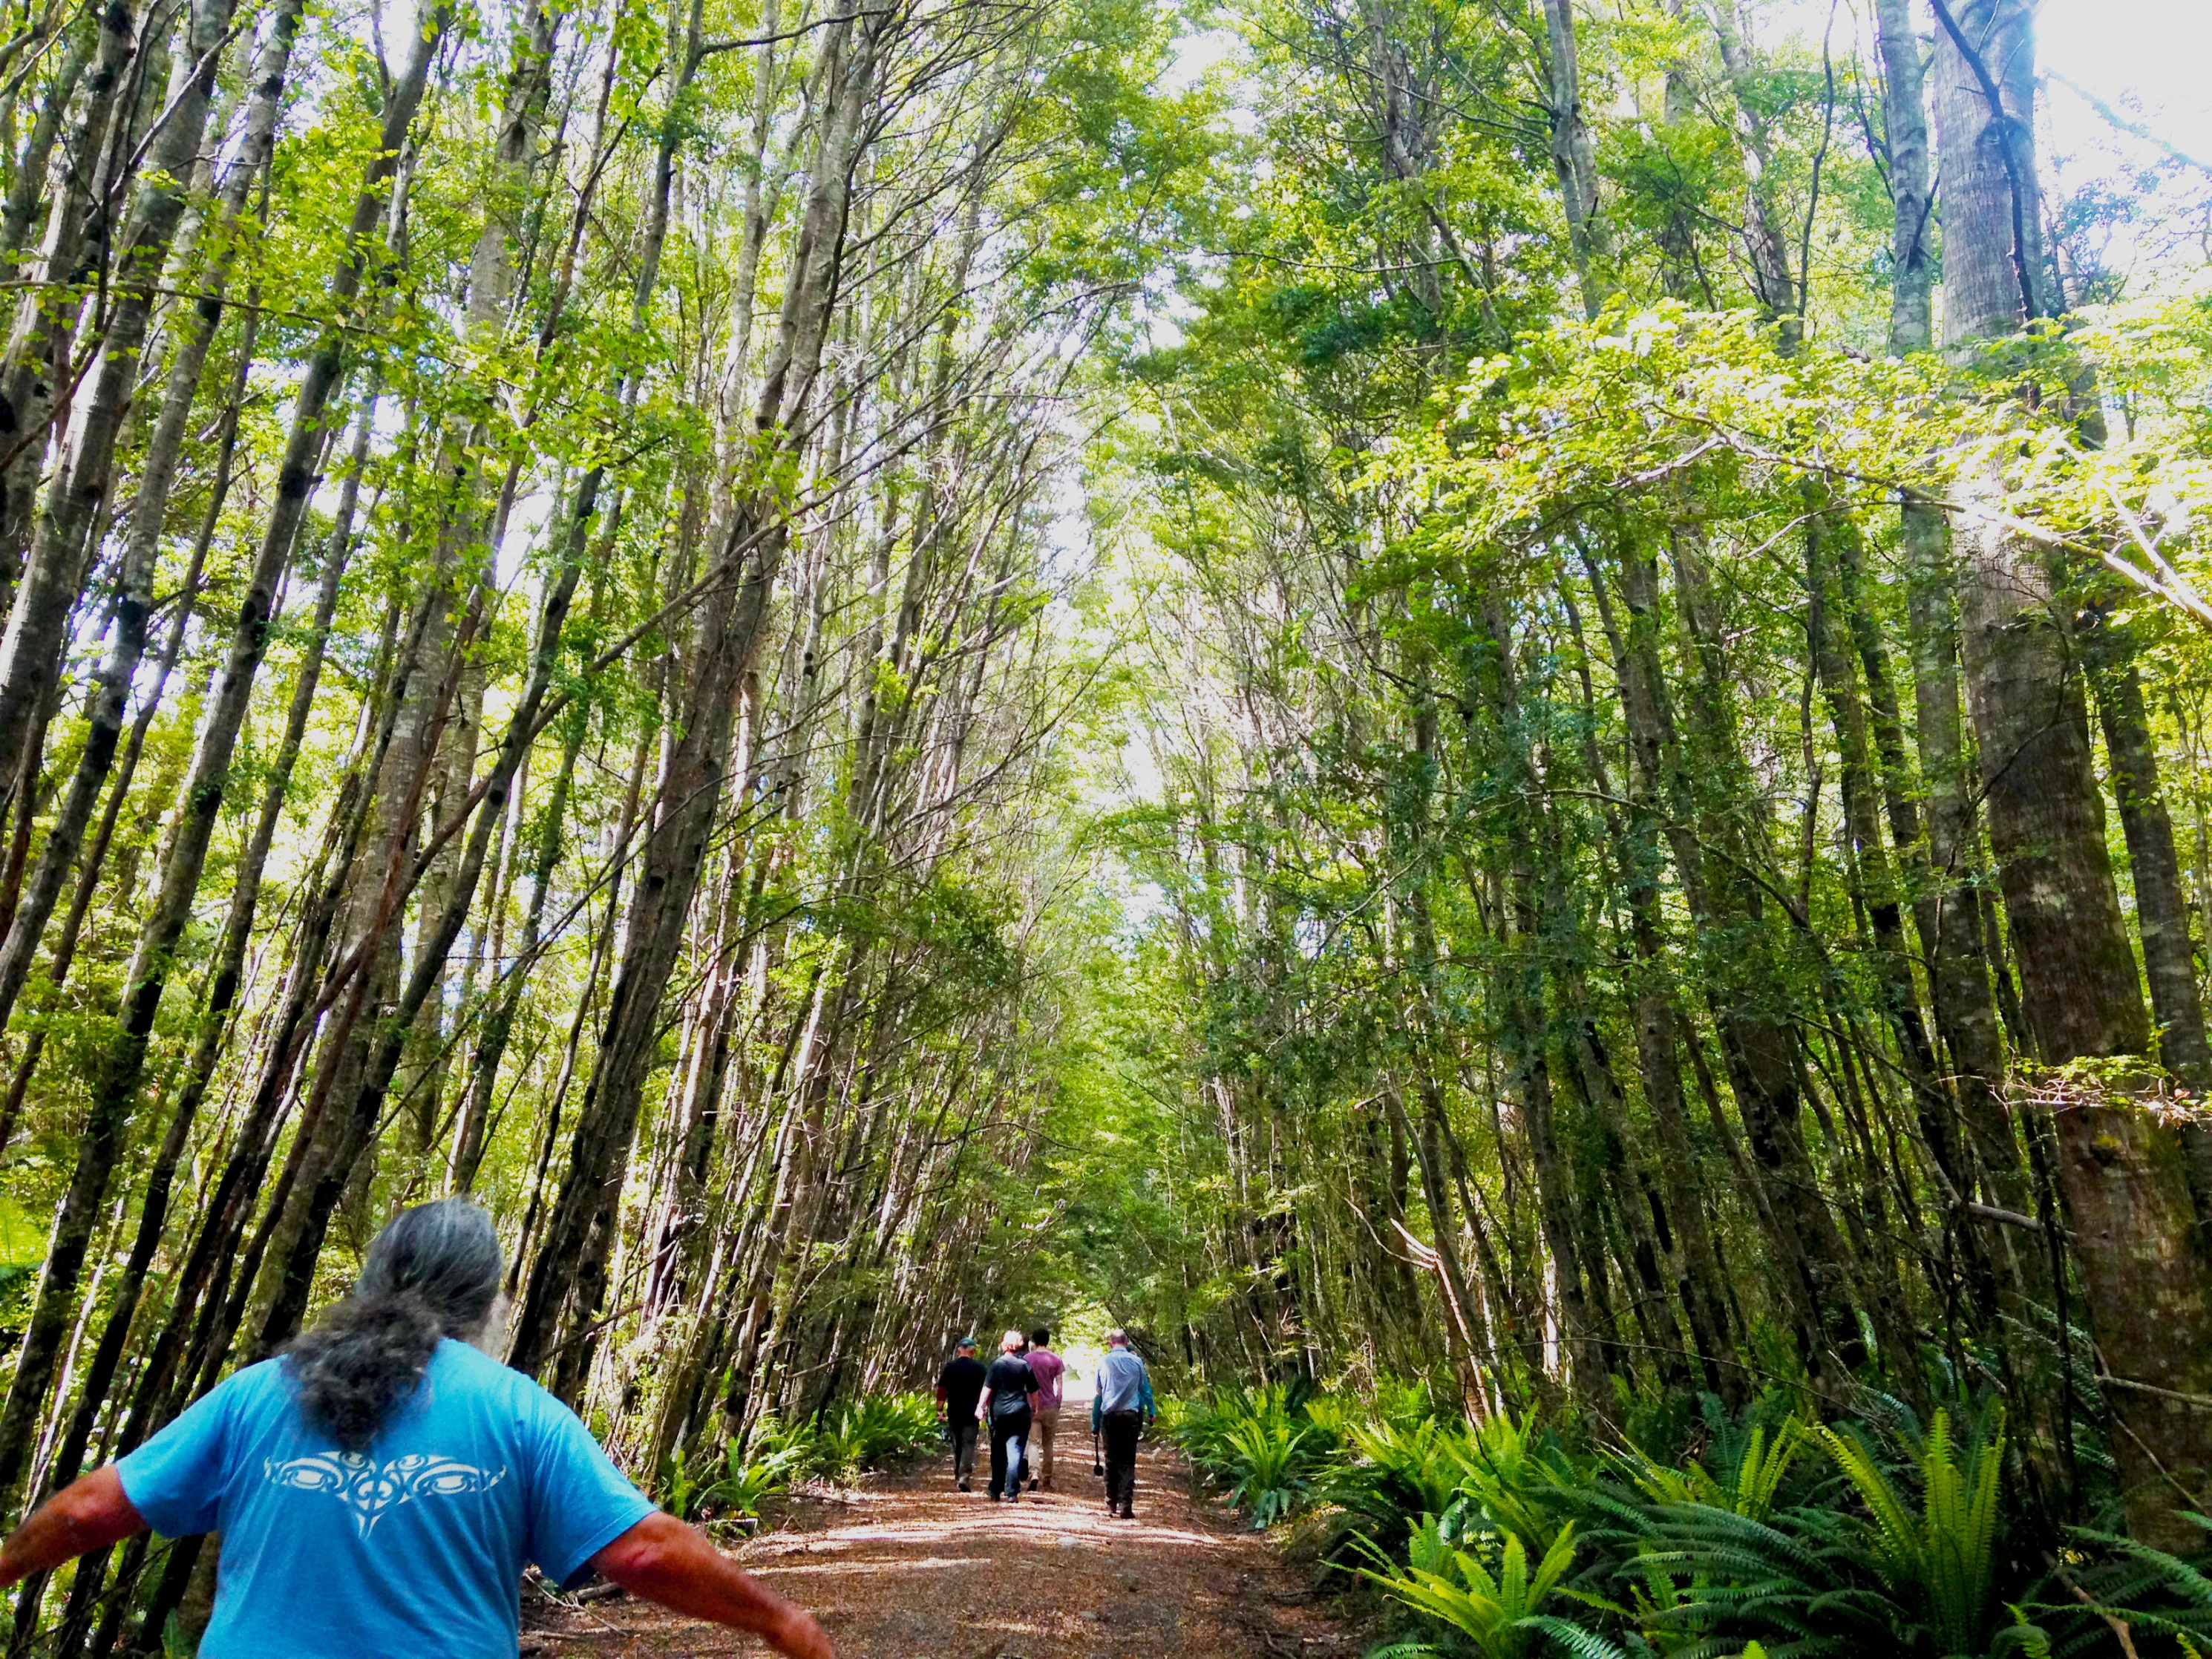
New Zealanders connect and contribute to conservation
Notes:
2
New Zealanders connect and contribute to conservation

Slide 6
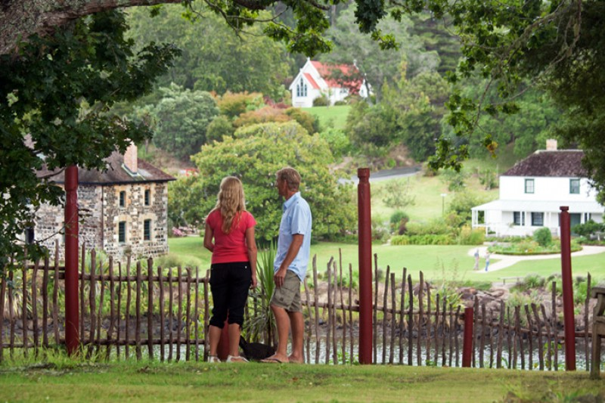
Our History is brought to life and protected
Notes:
3
Our History is brought to life and protected
As recreation historic ranger this is one of the goals I work to achieve

Slide 7
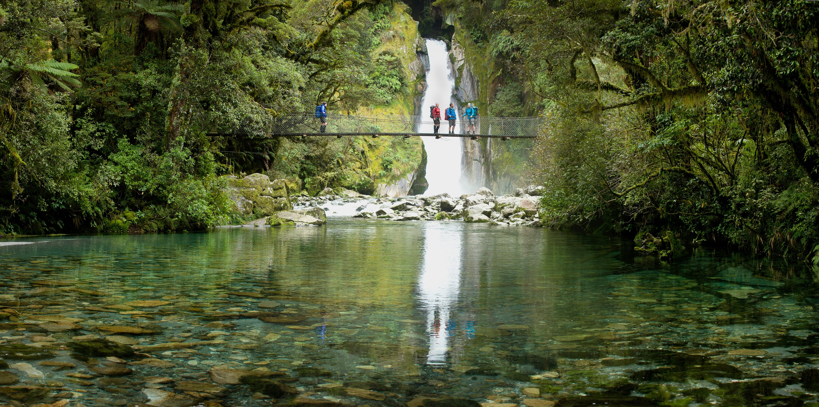
New Zealanders and our visitors are enriched by outdoor experiences
New Zealanders and our visitors are enriched by outdoor experiences
Notes:
New Zealanders and our visitors are enriched by outdoor experiences
As a recreation ranger this is the goal I’m working to achieve
‘Our Nature’ is part of what makes us who we are as New Zealanders
Big reason visitors come here
scientific evidence of health benefits
If you spend time in nature, you value it
Whats does that look like In numbers
So that’s 40 odd million visits New Zealanders make to public conservation land every year.
That’s the 5 million or more international visitors New Zealand expects to receive in the next few years

Slide 8
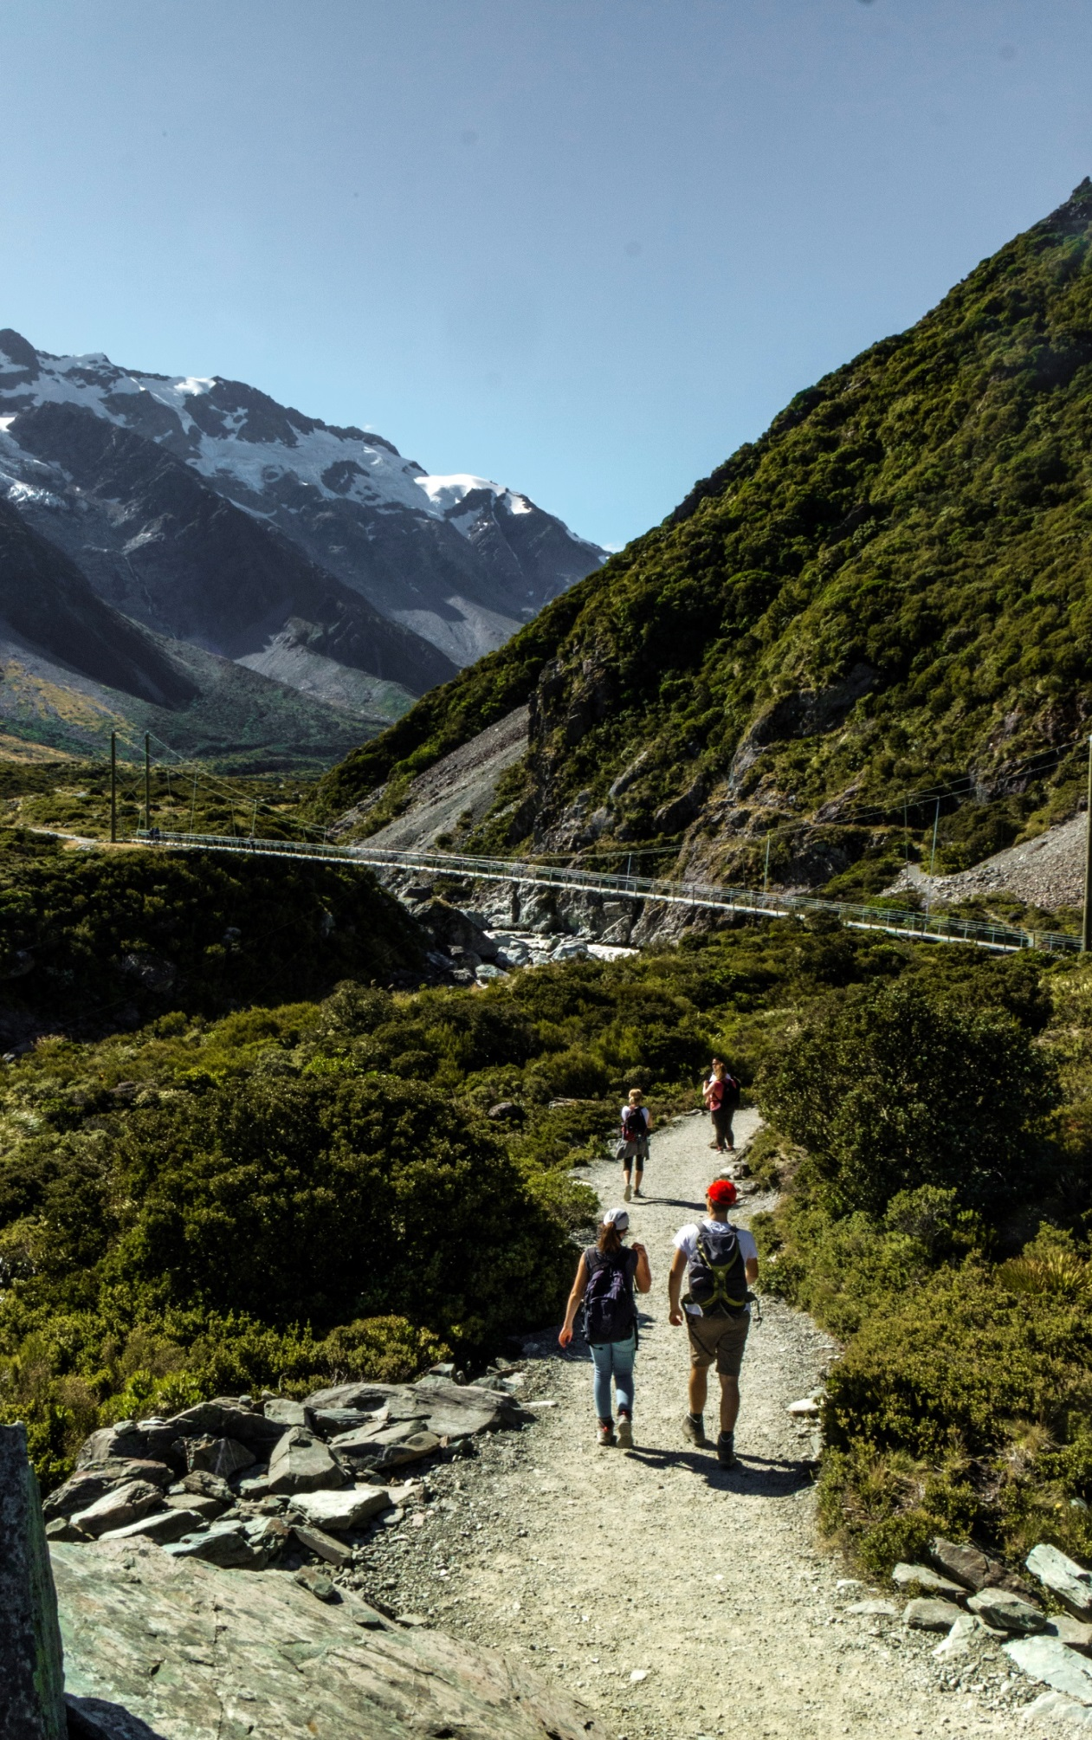
New Zealanders and our visitors are enriched by outdoor experiences
How do we achieve that?
New Zealanders and our visitors are enriched by outdoor experiences
How do we achieve that?
Notes:
In that context
How do we achieve that outcome?!
+ looking after our nature
2 things!
1 Recreation opportunities management
Meet expectations
Provide a range of high quality facilities, for different abilities
in the right place,
To a standard
Make sure people know about them
people are more likely to get outside and spend time in nature

Slide 9
New Zealanders and our visitors are enriched by outdoor experiences
How do we achieve that?
New Zealanders and our visitors are enriched by outdoor experiences
How do we achieve that?
Notes:
Nuts and bolts of that
Asset management
Part of that is making sure things are in good shape, through ongoing inspections and maintenance
And another important part is good risk management.
To do that we need to be able to store our information, plan our work, carry out inspections.
Gather good data to guide good investment of capex and time
We need to do this in the most remote places in New Zealand
Sounds like a Job for SAP plant maintenance right?

Slide 10
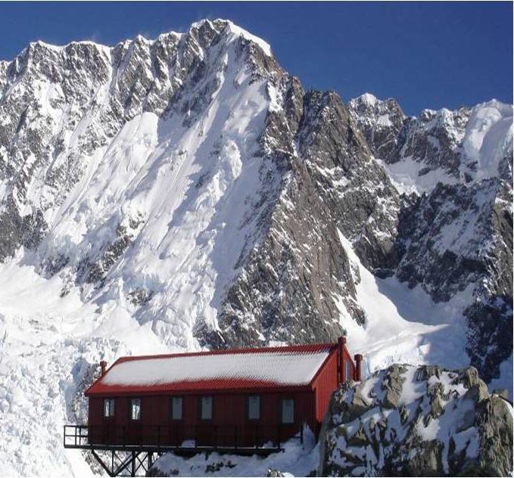
What does plant maintenance look like for DOC
101,813 Equipment
6,000 Functional Locations
8.6 million hectares of land
They look a little different to normal equipment's
Notes:
101,813 Equipment
6,000 Functional Locations
Spread across
8.6 million hectares of land
Looking after on behalf of all New Zealanders
All corners of the country
We use SAP
2,000 staff
1345 active SAP users
A little different to normal equipments

Slide 11
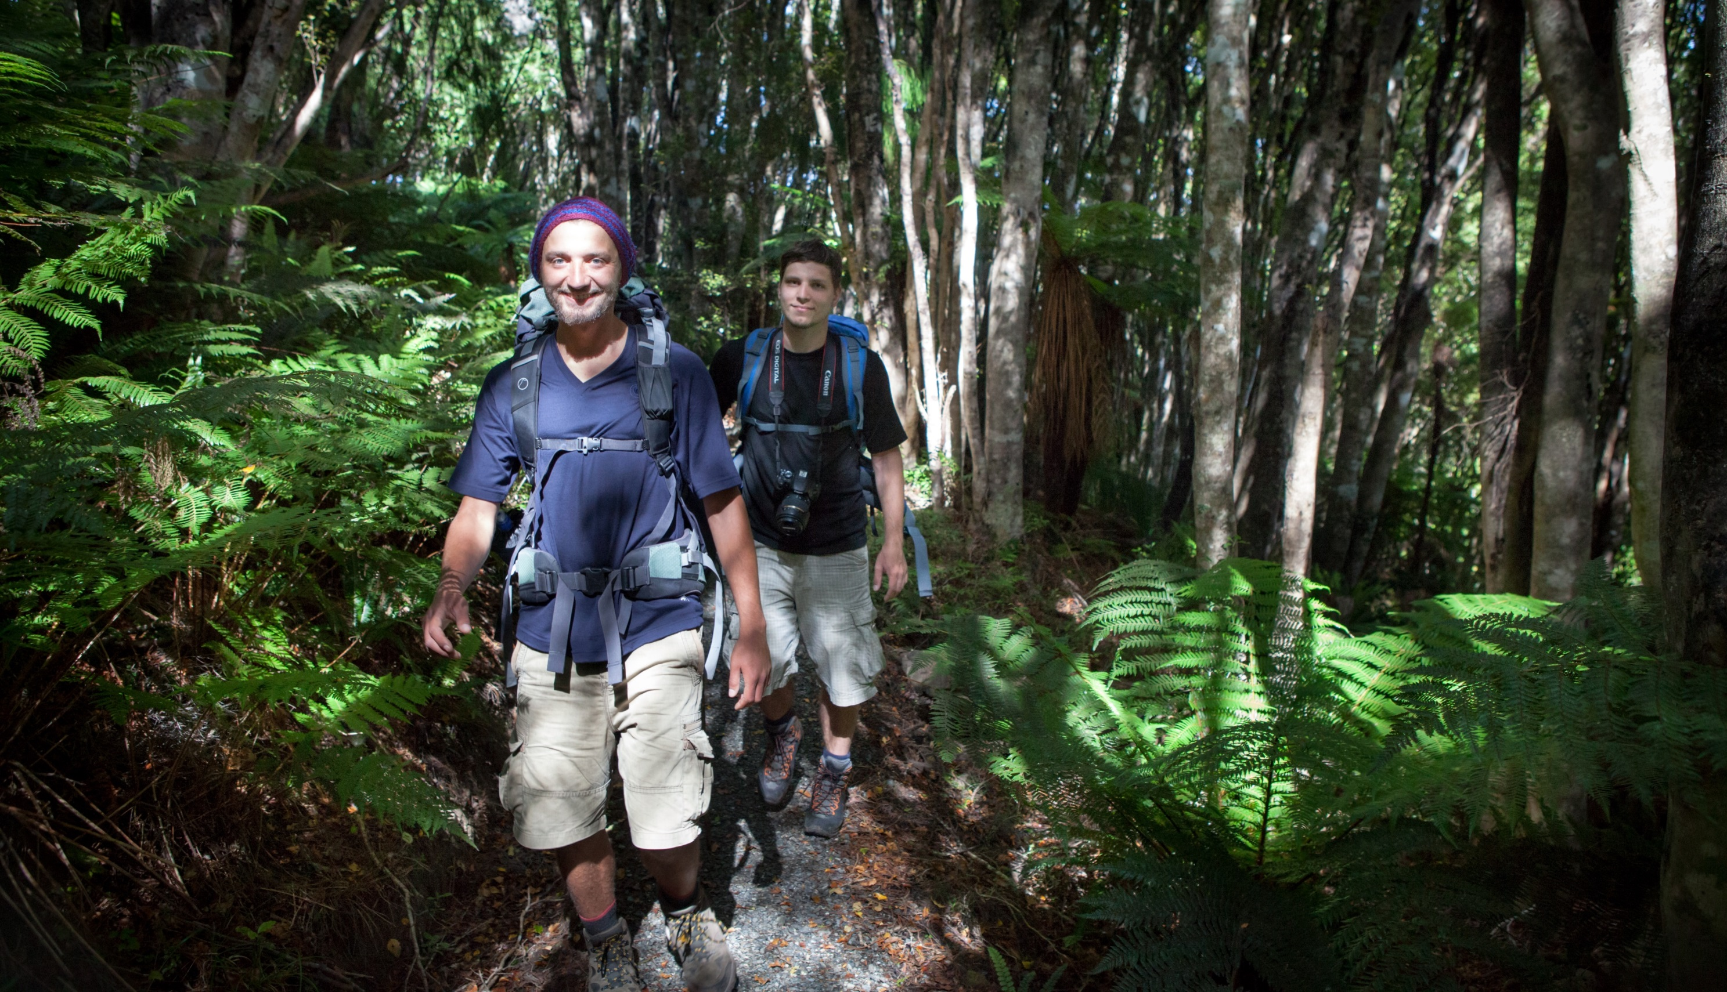
14,000 km of Tracks
Notes:
14,000 km of track
That’s enough to walk from Wellington to Washington DC
It all needs inspections and maintenance

Slide 12
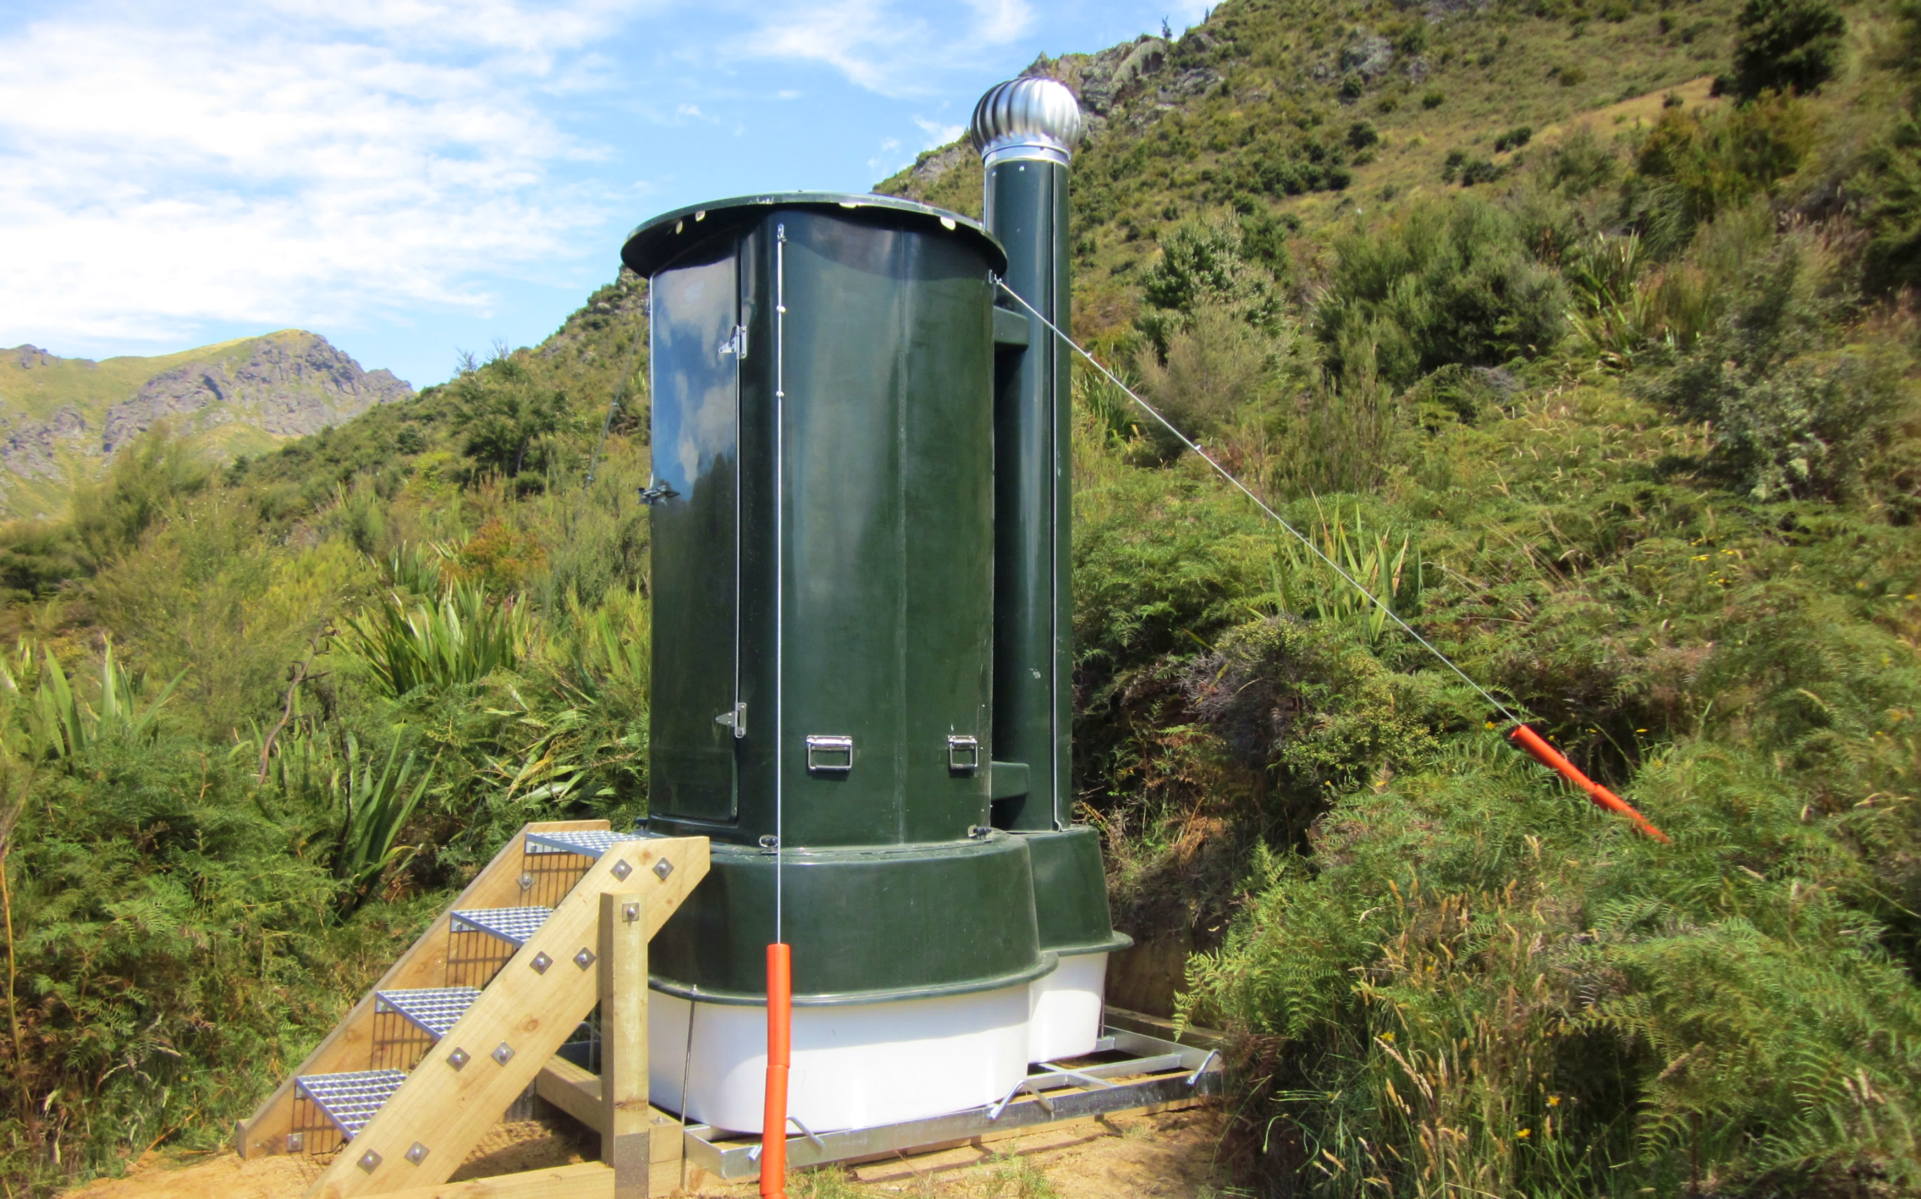
2110
Toilets
Notes:
2110 toilets
Probably one of the biggest cleaner of toilets in the country

Slide 13
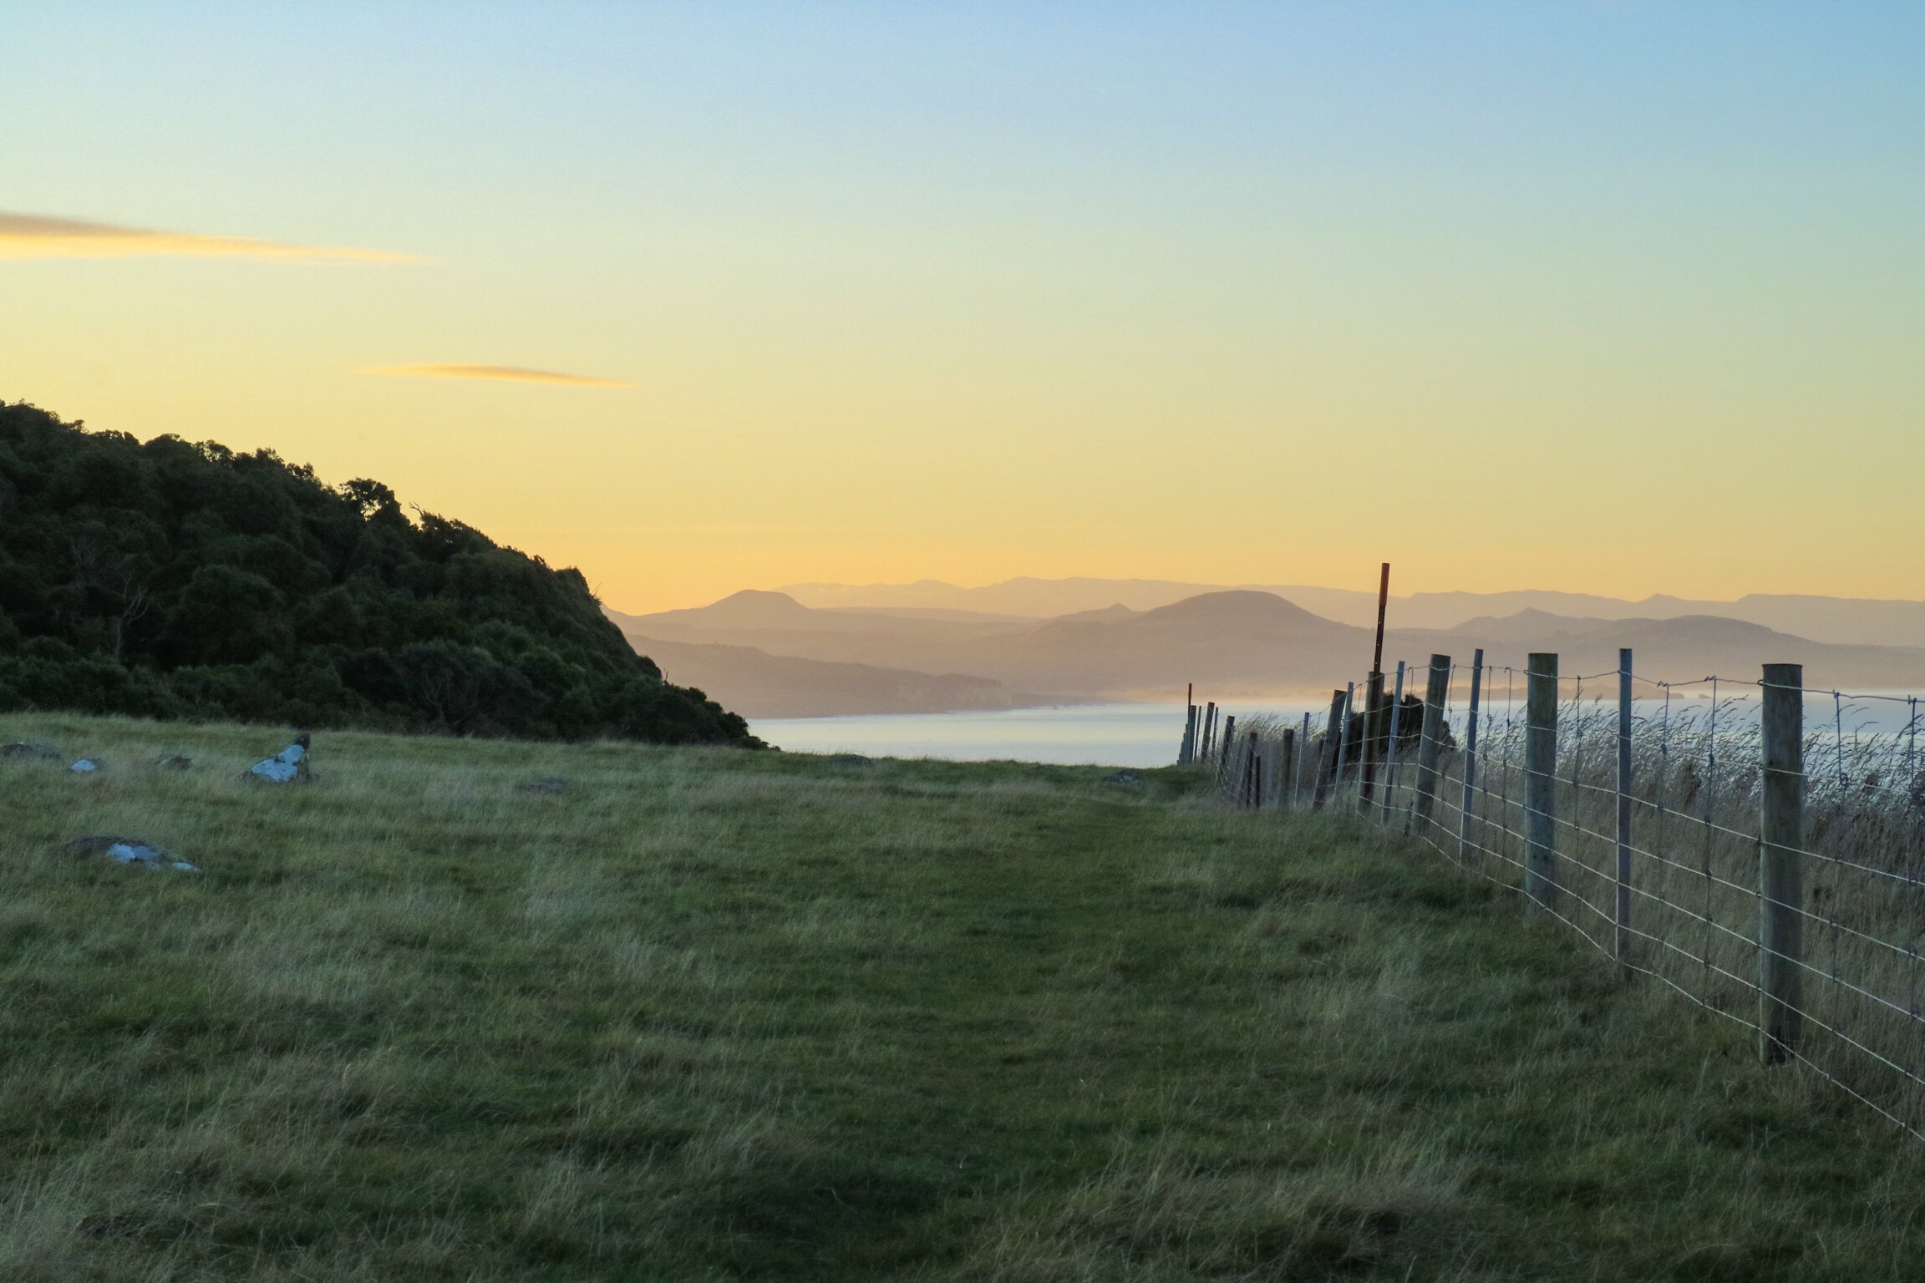
19,000km
of boundary
fence
Notes:
19000 km of boundary fence

Slide 14
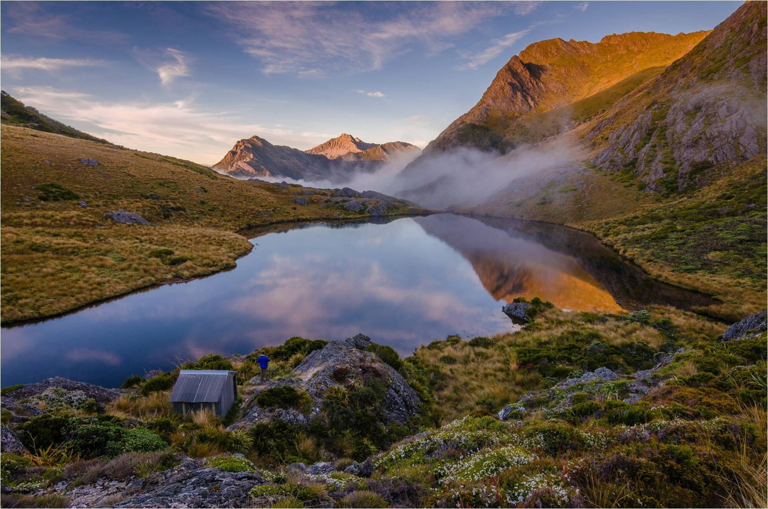
Mobile asset management is vital
Notes:
Mobile asset management is vital
350 Mobile asset management users
Out here,
In the most remote parts of New Zealand,
You need a dam good tool to help manage your work
We need good information
We can’t just pop back out there
That information can make all the difference,
When you are
Providing a great experience
keeping people safe
No substitute for information gathered at the spot
To help you Make good decisions

Slide 15
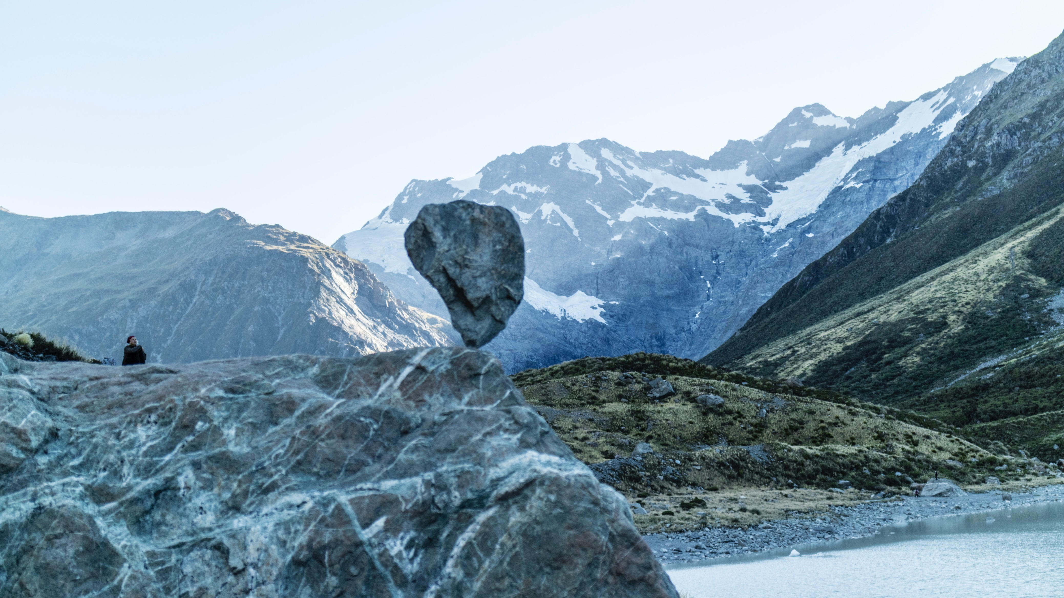
What do Rangers need from their mobile asset management?
Works in the backcountry
Works with no coverage
Sign off work orders
Create notifications
Do ad-hoc work and record it
Carry out inspections
Sends all that back to base when I’m in cell coverage again
Notes:
So what do I need as a ranger
Works in the backcountry
Works with no coverage
Sign off work orders
Create notifications
Do ad-hoc work and record it
Carry out inspections
Sends all that back to base when I’m in cell coverage again
Fast and easy to use,
so I can focus on doing a good job
The end result has to be good quality data

Slide 16
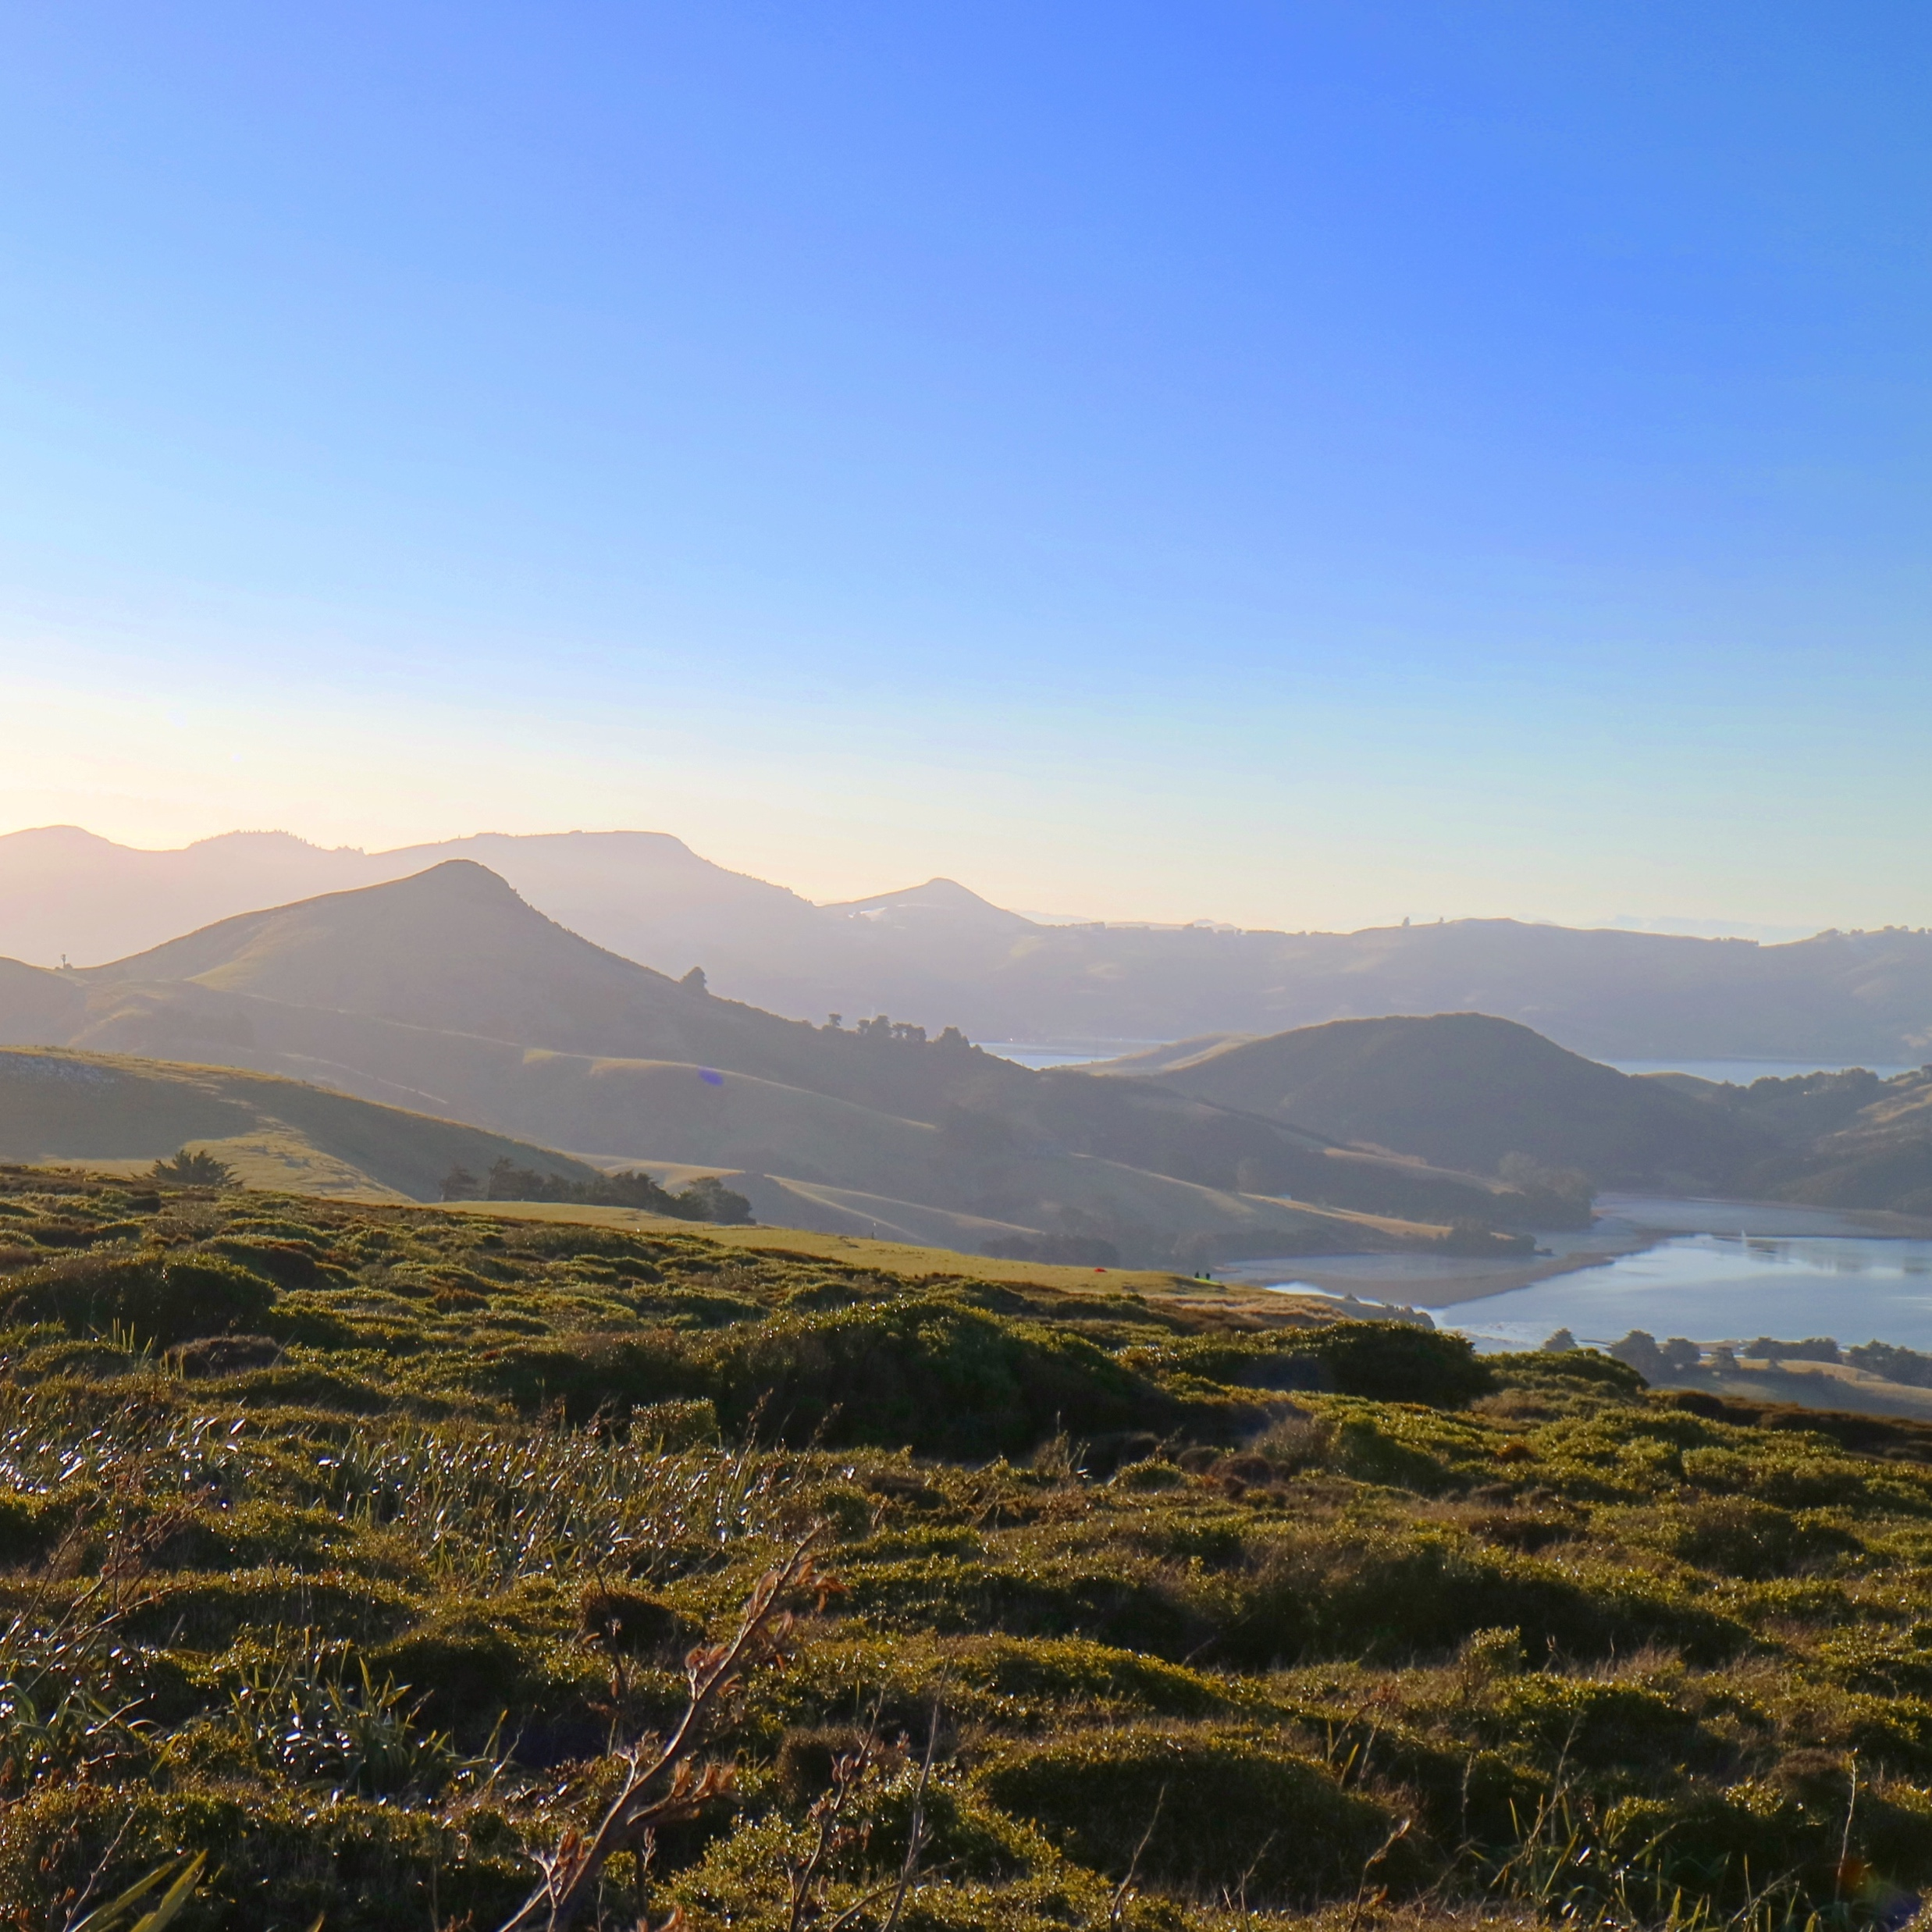
History of our mobile asset management
1998 - 2008 – VAMS
2008 - 2013 MAM
2013 - 2017 Work Manager
August 2017 – MyPM
Notes:
In 1998 the sheer task of managing all those assets using paper
was becoming un-tenable
in a world where we needed to manage risk.
We needed an asset management system,
we built one
in house,
Visitor Asset Management System or VAMS for short
a completely bespoke piece of software for mobile and desktop.
That got cranking in 1998 and saw us through to 2008

Slide 17
History of our mobile asset management
1998 - 2008 – VAMS
2008 - 2013 MAM
2013 - 2017 Work Manager
August 2017 – MyPM
Notes:
Finance implement SAP in 2004
VAMS couldn’t talk to SAP
it was time to roll out SAP plant maintenance –
So we did that in 2008
SAP has been providing our mobile plant maintenance solution
in some shape or form for 10years.
It has always been highly customized to allow the addition of inspections
DOC’s SAP support partner – Soltius
has supported us through that journey
Recently
Soltius approached us with their new product

Slide 18
History of our mobile asset management
1998 - 2008 – VAMS
2008 - 2013 MAM
2013 - 2017 Work Manager
August 2017 – MyPM
Notes:
Ben is going to explain
How we got to the point where
changing to this product
became mission critical

Slide 19
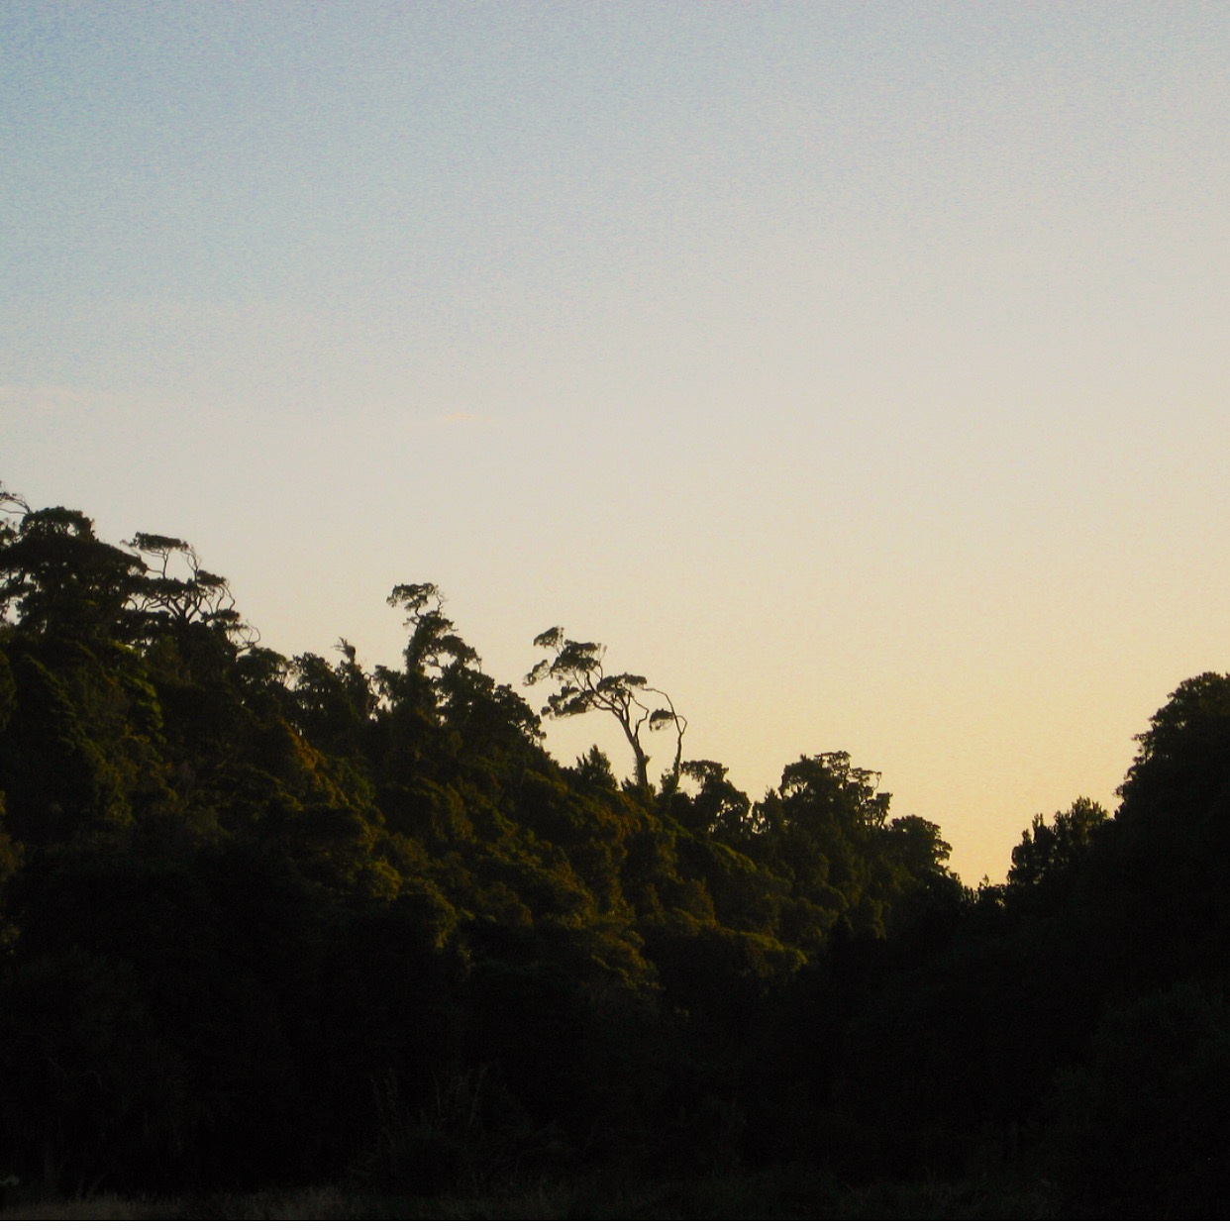
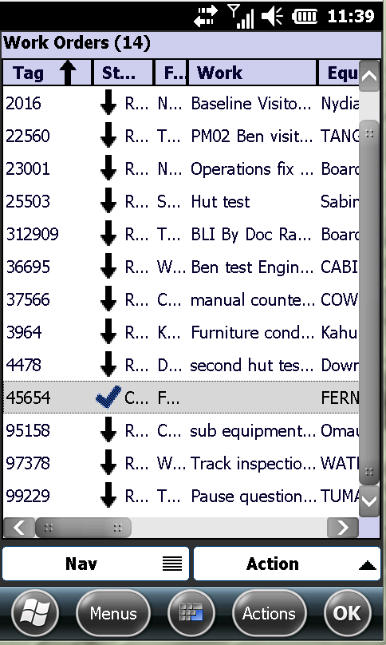
Our current problem
The Software: Work Manager
Poor reputation amongst our user base
Clunky interface designed to inspire hatred
Lack of reliability in the field
Troubleshooting issues time consuming
Beware heavy customization!
Notes:
Thank you. As Shay just mentioned, we are currently in the process of rolling out MyPM as we speak.
But before we can move on to what is so great about the MyPM solution, and it really is great, we need to look at what we are thankfully leaving behind.
So what are the issues with our current application, Work Manager?
Reputation –
Well, it doesn’t have the strongest reputation amongst our user base. Many have been continually burned by loss of work due to complications in the application.
When you have been out in the field for days capturing data from some of the remotest parts of DOC land, the last thing you want to hear is that you will have to do it all over again.
Such is the lack of confidence in WM, many prefer to perform their tasks in the field using just pen and paper.
They would then enter their data manually into the system back in the office, effectively doubling the time spent on a single task.
Interface -
If they were brave enough to use WM as instructed, they would be confronted with an interface notorious for its hostility to the person using it.
As you can see from the picture on the screen, columns of information are hidden and difficult to display.
and Navigation often involves far more taps than are necessary

Slide 20
Our current problem
The Software: Work Manager
Poor reputation amongst our user base
Clunky interface designed to inspire hatred
Lack of reliability in the field
Troubleshooting issues time consuming
Beware heavy customization!
Notes:
Reliability –
WM would also pull down the shutters at the first sign of an error often leaving users stranded with no access to new work tasks.
9 times out of 10 the ranger would have to return to the office before any resolution could be administered.
Customisation -
Perhaps most damaging of all in the long term was Work Manager’s customization.
When it was first implemented, it was heavily customized to meet DOC’s needs.
What seemed like a good idea at the time would eventually come back to hurt us.
Any attempts to update and improve the application would invariably get bogged down in extensive and costly regression testing.
Once the cost of consultation, development, testing and implementation had been factored into the equation, even a small change to Work Manager could cost 10’s of thousands of dollars.
Even if updates were to be successfully added, the logistical nightmare of deploying a new version of the application to a technophobic work force far outweighed the benefits of the updates themselves.
……Effectively, DOC were marooned on a desert island with a legacy app.

Slide 21

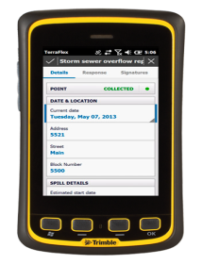
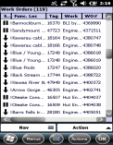
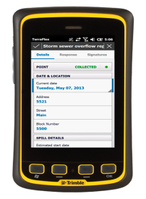
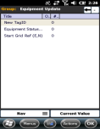
Our current problem
The hardware: Dataloggers
Expensive to purchase. Expensive to repair.
A dwindling supply
Low confidence that technology can support tasks
No remote troubleshooting
Difficult to update operating system
Notes:
When it comes to our current hardware, the news is not much better
Warranty and repair-
The Dataloggers that we use cost an eye watering $2,500 to purchase. They are out of warranty and prohibitively expensive to repair
Not only that, they would also need to be sent to America to get the repairs done meaning they would be out of action for several weeks.
Dwindling supply–
Because of the prohibitive cost of repairing the dataloggers, many simply were not repaired.
Our fleet of available devices diminished by one each time one of them malfunctioned.
Lack of confidence –
With this lack of supply, bad work habits have also been allowed to flourish.
Many workers will share one datalogger and perform all their task under a single username.
The knock on effects of this are poor visibility of who performed what task and low quality monthly reporting further up the management chain.
Unpatched software-
It has also proven extremely difficult to update the operating system of the dataloggers.
Such a task would need extensive input from our end users as there is no natural deployment tool.
.

Slide 22
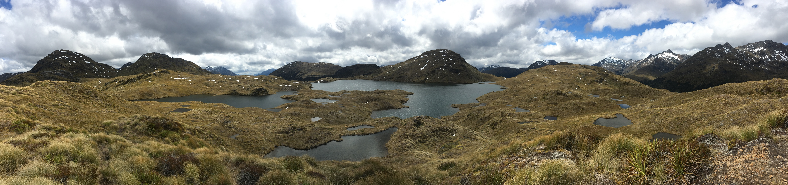
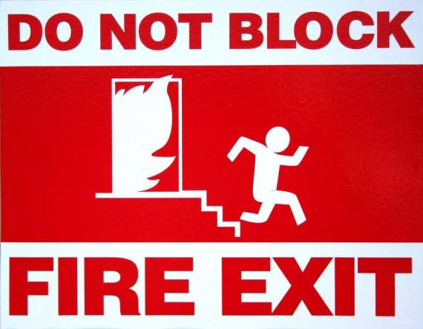
Don’t stand still,
Stay relevant!
Notes:
At this stage I think it is important to mention that….even if our current software and hardware solutions were a big success,
Even if DOC staff were happy with the status quo, the issue of technological redundancy would still loom large on our horizon.
Our current solution has passed its sell by date and we need to make a move before it has a chance to hurt us.
Any company that doesn’t move with the times, does so at its own peril.

Slide 23
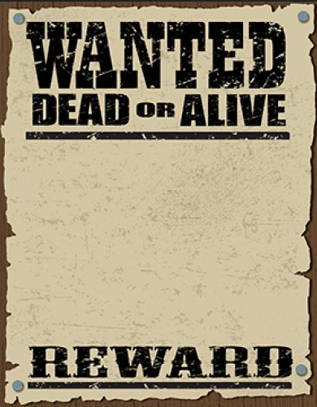



Opportunity Knocks
Notes:
So how were we going to make the change?
When DOC’s main support partner Soltius approached us with their flagship new application MyPM
It became immediately clear to us that this was the perfect tool to meet our needs.
But before we could implement any software solution we needed to resolve the issue of our legacy mobile hardware.
After all, what would be the point of a shiny new mobile application if nobody at DOC had a mobile phone for work?
LUCKILY another project was under way at DOC to remove all staff desk phones and replace them with mobile devices.
This was the perfect opportunity for MyPM to strike.
Following in the slipstream of this other project held many distinct advantages:
- We could retire the dataloggers without needing to organize any new devices
- We could also use the new mobile management system to package and safely deploy MyPM in a controlled fashion to all relevant users.
Which brings us to the application itself…….. MyPM

Slide 24
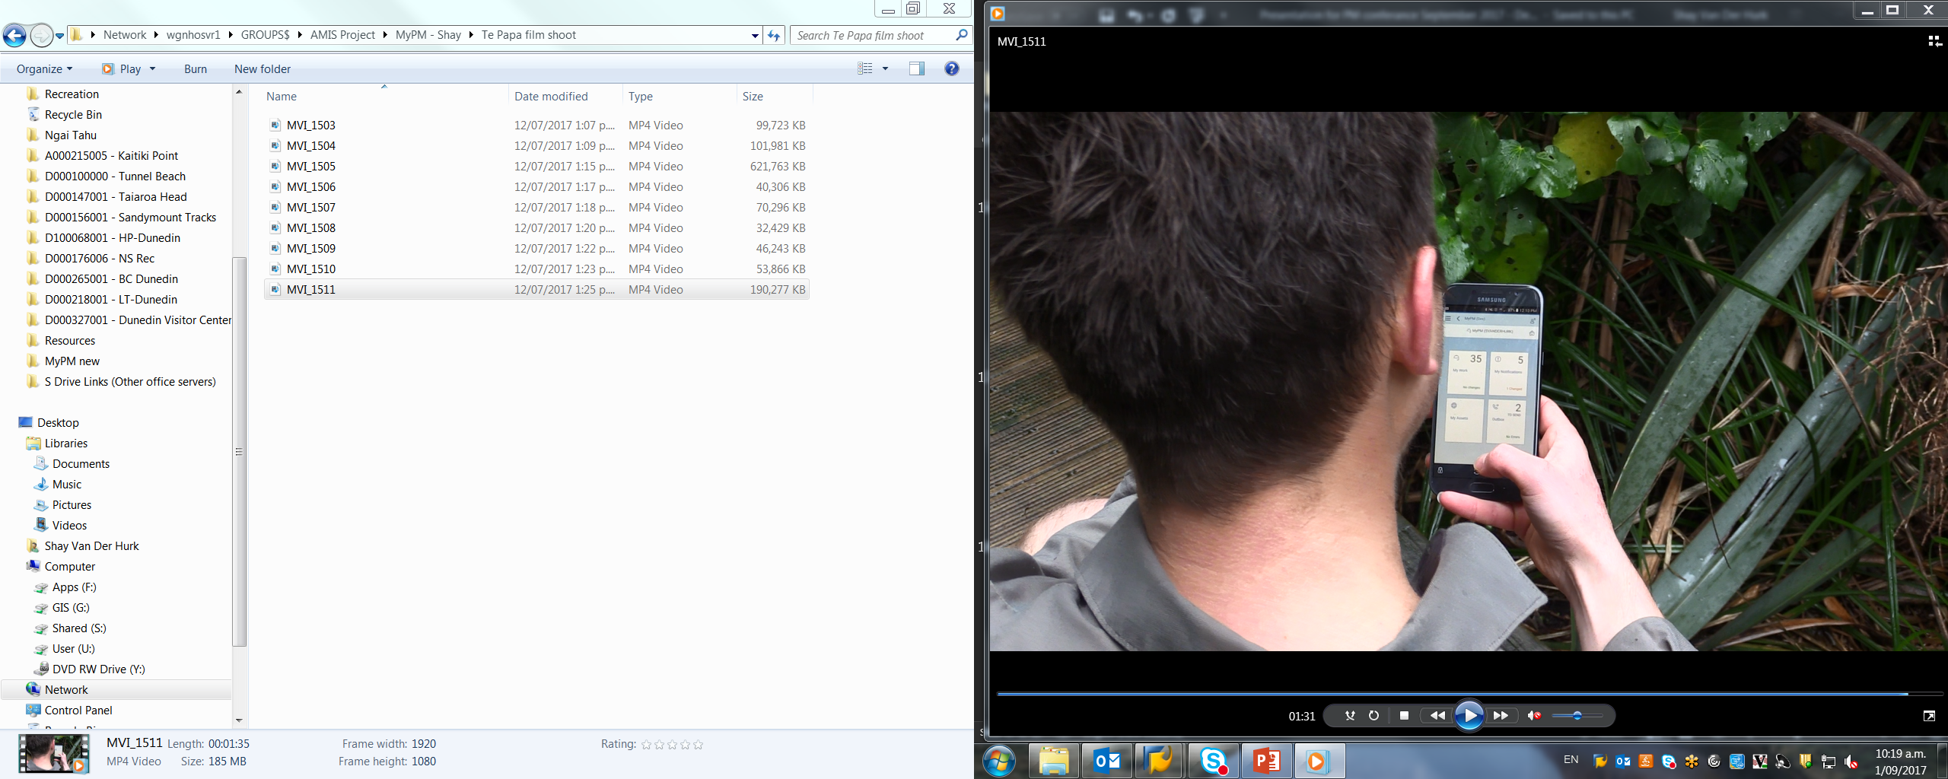
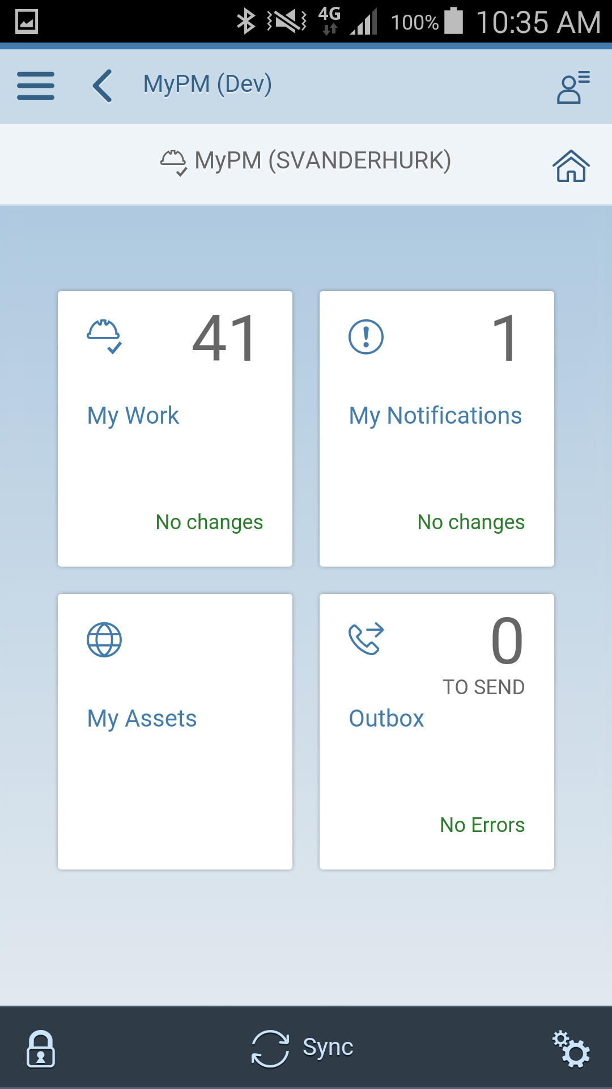


MyPM
Notes:
We will give a much more in depth overview of its functionality during Shay’s live walkthrough in a few minutes
But for now here is a brief introduction
- MyPM is our new mobile asset management solution
- It is designed to work offline.
- Even though it is built in SAP it uses the latest Fiori interface for a dynamic friendly user experience.
- The app can work on any device type or size, not just the fleet of Samsung android phones that DOC currently use.
- MyPM can also be packaged as a web based application so that a ranger can use it just as easily in the office as out in the field.
And now I will hand over to Shay.

Slide 25
Benefits we are seeing already
Designed to work in the field
Helps us do our work,
Easy to use
Increase in mobile device use
Teams on top of their work
Happy confident Rangers
Good data = Good decisions
Notes:
Its designed to work in the field
Without cell phone coverage
Which is crucial for our work
We are no longer battling against the tool designed to help us do our work in the field
We can, Sign off work orders, Make notifications and Do Inspections
Its easy to use
It doesn’t add time to completing a task

Slide 26
Benefits we are seeing already
Designed to work in the field
Helps us do our work,
Easy to use
Increase in mobile device use
Teams on top of their work
Happy confident Rangers
Good data = Good decisions
Notes:
That means we are seeing a major increase in the use of mobile devices in the field.
Even from rangers who swore they’d never use one again after work manager.
My collegue Barry for example
Is signing off more work orders more often in MyPM
He says he can sign things off really quickly and carry on doing the work he is there to do
That makes both of us happy
It means our teams are on top of their work
We can make really good decisions because we’ve got good data
the responsiveness of the app and the failsafe sync
Gives us confidence, that the information is going to the right place
That means rangers like us are in boots and all.

Slide 27
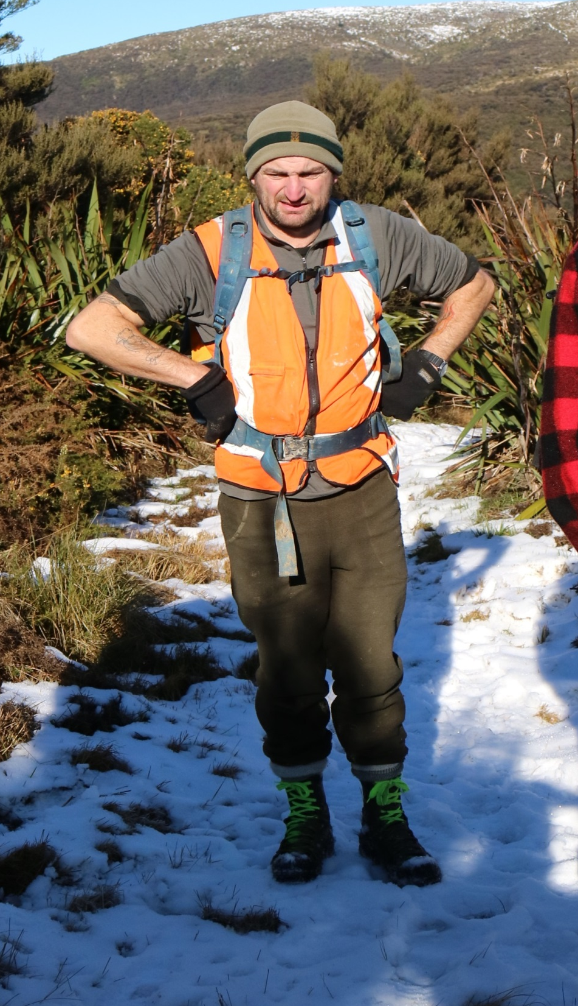
‘ Don’t know about the new app, too bloody easy to use and don’t know what to do with my spare time now’
Notes:
I got this text saying

Slide 28
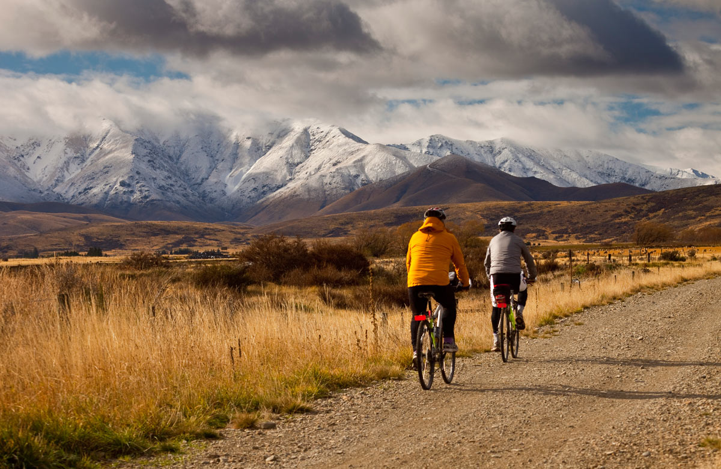

Future roadmap
MyPM has functionality DOC haven’t deployed
GIS mapping
Pictures
DOC will continue to benefit from new features
Notes:
There is Functionality in the app that DOC haven’t deployed YET
Geospatial mapping – really complement our huge geospatial datasets
Pictures – barry sends me 20 emails a week
As Soltius continue to develop MyPM
DOC will continue to benefit from new features,

