Slide 1
Foray into the Digital Universe
Jayshree Ravi – Enterprise Architect
Craig Brown – SAP Application & Enhancement Manager
  2 June 2017

Slide 2
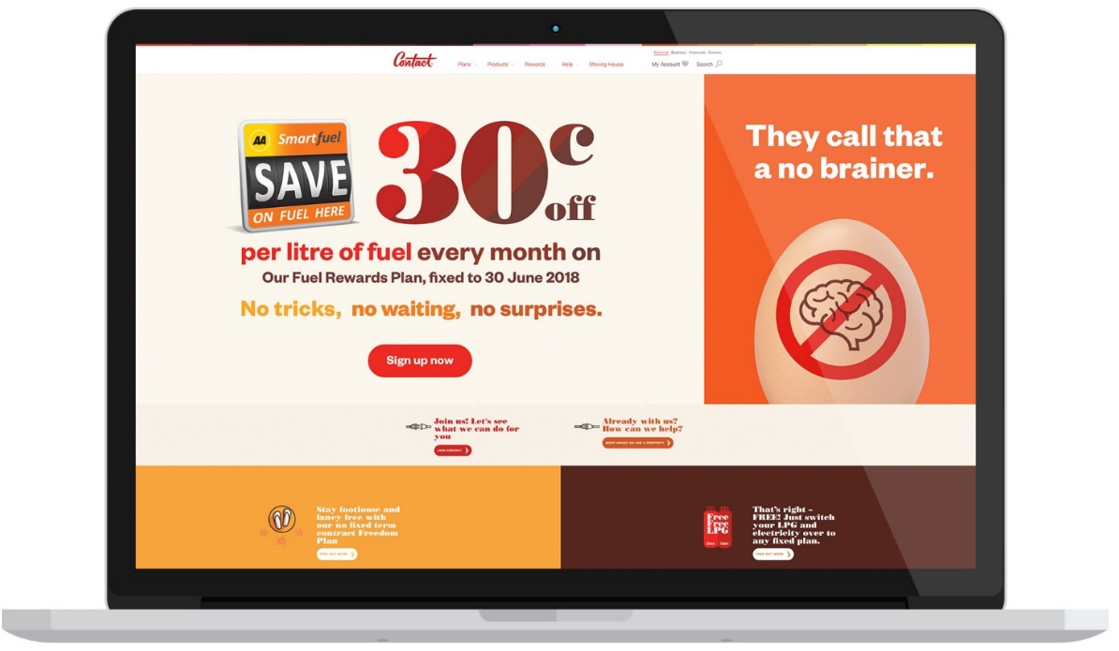
What We’ll Cover
Agenda
About Contact Energy
The Digital journey
What we set out to do
What we achieved
Lessons learned
What’s next
Questions
Our digital presence is a critical part of our
strategy that helps us get ahead of the other kids
in the playground.
We’ve developed a set of digital principles to help us move from delivering a functional experience to a pleasurable one – that’s worth sharing.
Notes:
C starts

Slide 3

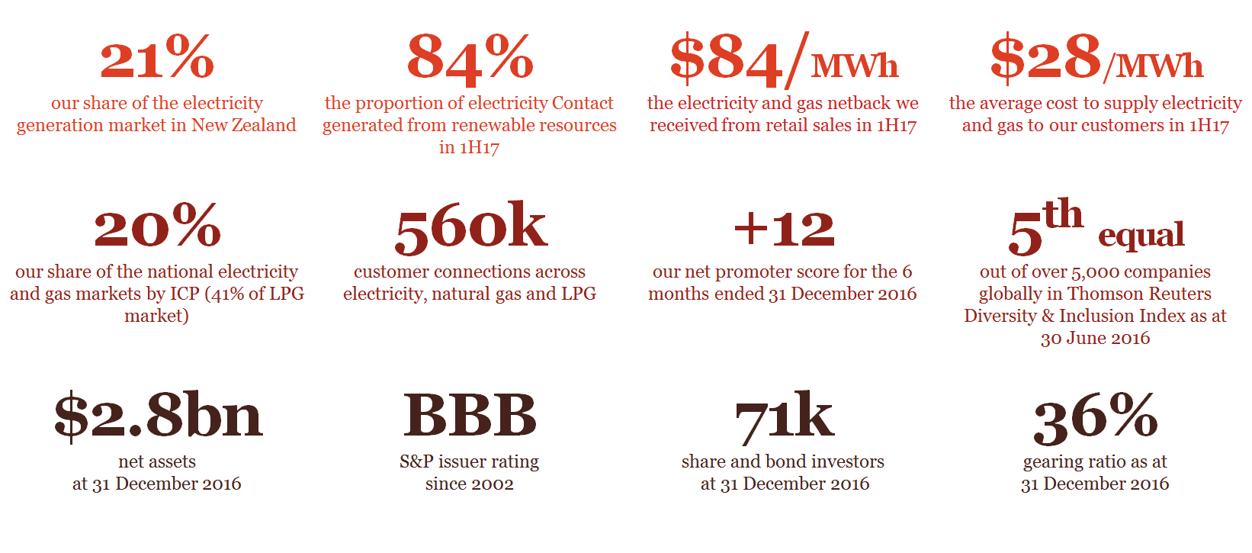
About Contact Energy

Slide 4
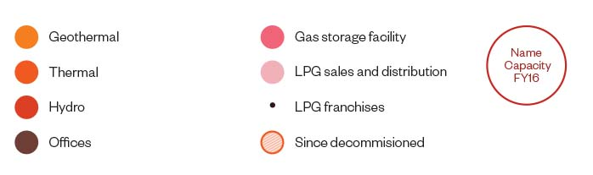
Where we Operate
Name
Capacity
FY16 Gen

Slide 5
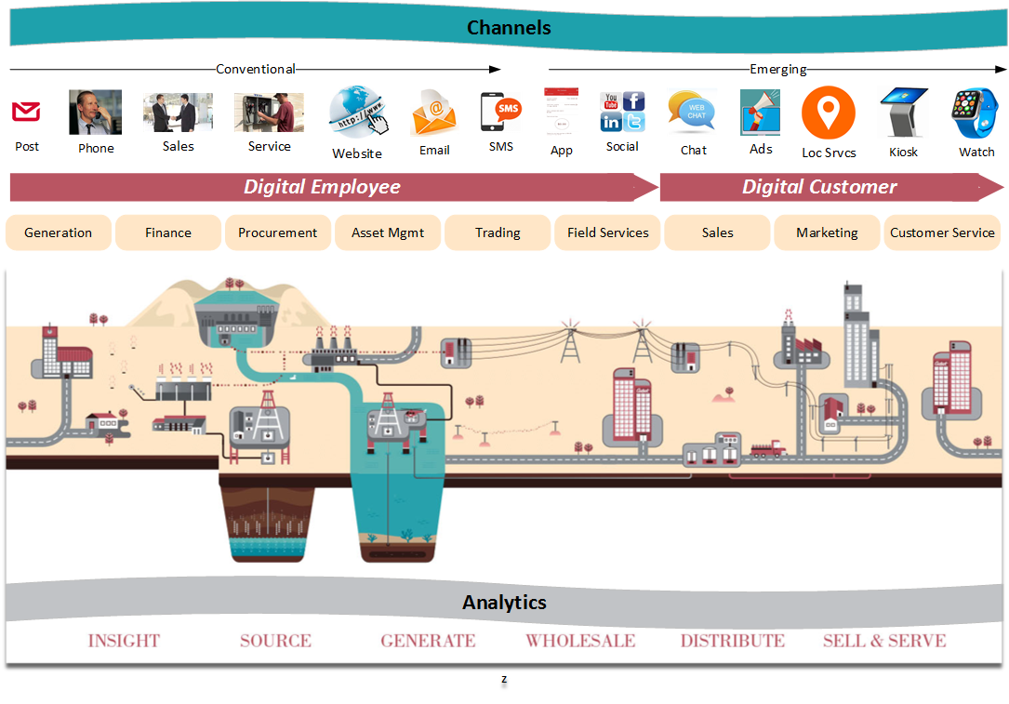
Digital @ Contact – Where did it start?

Slide 6
Initial State
  Portal for residential customers
  Limited functionality
  Limited channels
  Multiple applications
  Different technology components
  No single customer view

Slide 7

Opportunities Galore!
  Enhanced functionality for residential customers
  Digital Marketing
  NPS Surveys
  Enabling self-service for business customers
  Integration with external portals and API’s
  Field Sales
  Door-to-Door sales
  Mobile Asset Management
  Employee productivity apps

Slide 8
The Digital Customer

Slide 9
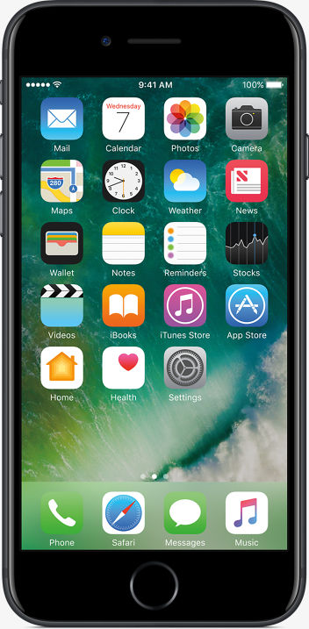
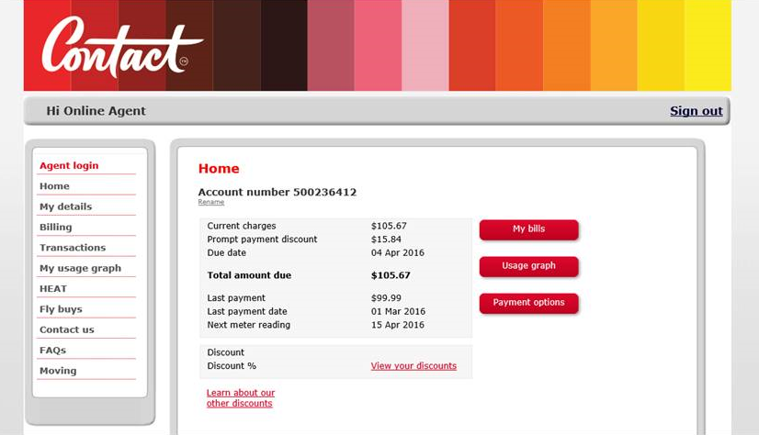

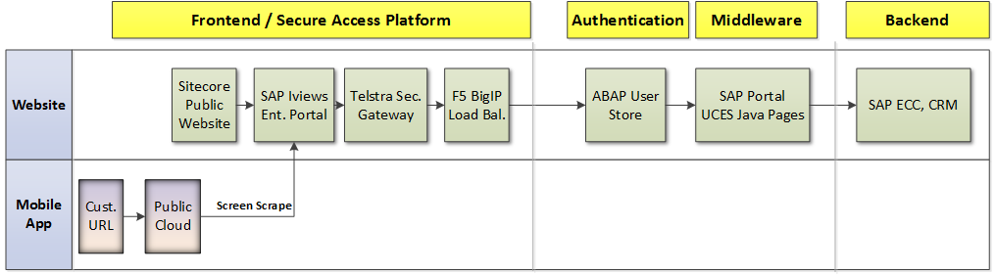
In the Beginning ……
Portal for residential customers
Mobile App with screen-scrape
Notes:
J starts

Slide 10

Issues with the Customer Portal
Technical limitations:
  Based on SAP UCES
  Security vulnerabilities and needed upgrading
  Designed for desktop use and not mobile friendly
  Consumption graph based on Adobe Flash
  No reminder, alert or notification functionality
  Customised solution
→ Led to poor customer experience

Slide 11
Why Multichannel Foundation for Utilities?
A customer friendly and responsive solution
  Quick to deploy and change
  Meets digital requirements
  Reuse of existing code and hardware
  Future-proof
Opportunity does not knock twice!!
  Had to migrate all SAP systems
  Moved to MCFU at the same time

Slide 12
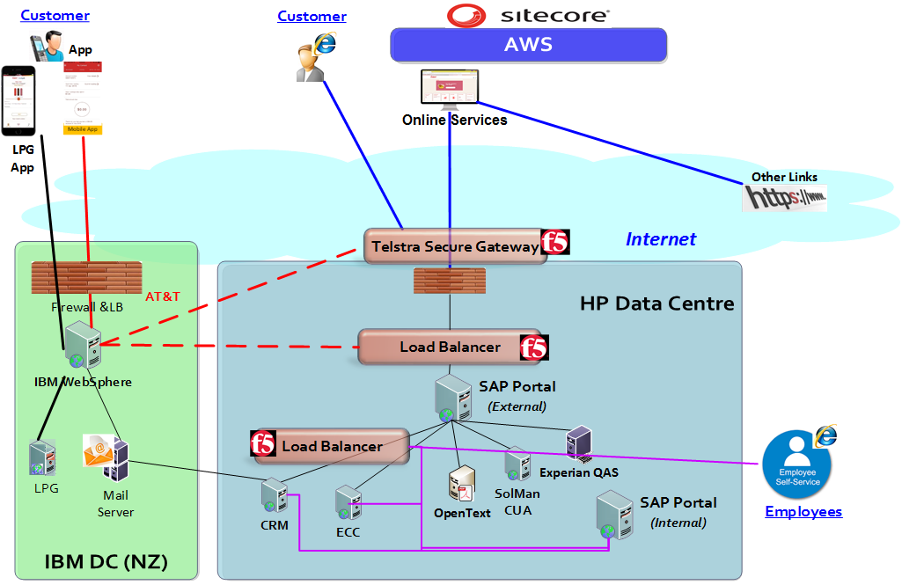
Key Considerations
Examples
Login/Authentication
Load Balancer?
Internet connectivity
Impact of lag
Which WAF?
Retrieving pdf
Consumption Graph
Performance
What type of App?
Tooling?

Slide 13

We Started with a POC
Focus on ease of installation, customization, changing the front-end and brand template
We found:
    Most screens worked 'out of the box'
    Standard functionality for a number of functions
Detailed look at:
    Login / Authentication using Netweaver Gateway UME
    Displaying the consumption graph
    Displaying the pdf of a customer’s invoice from Opentext

Slide 14
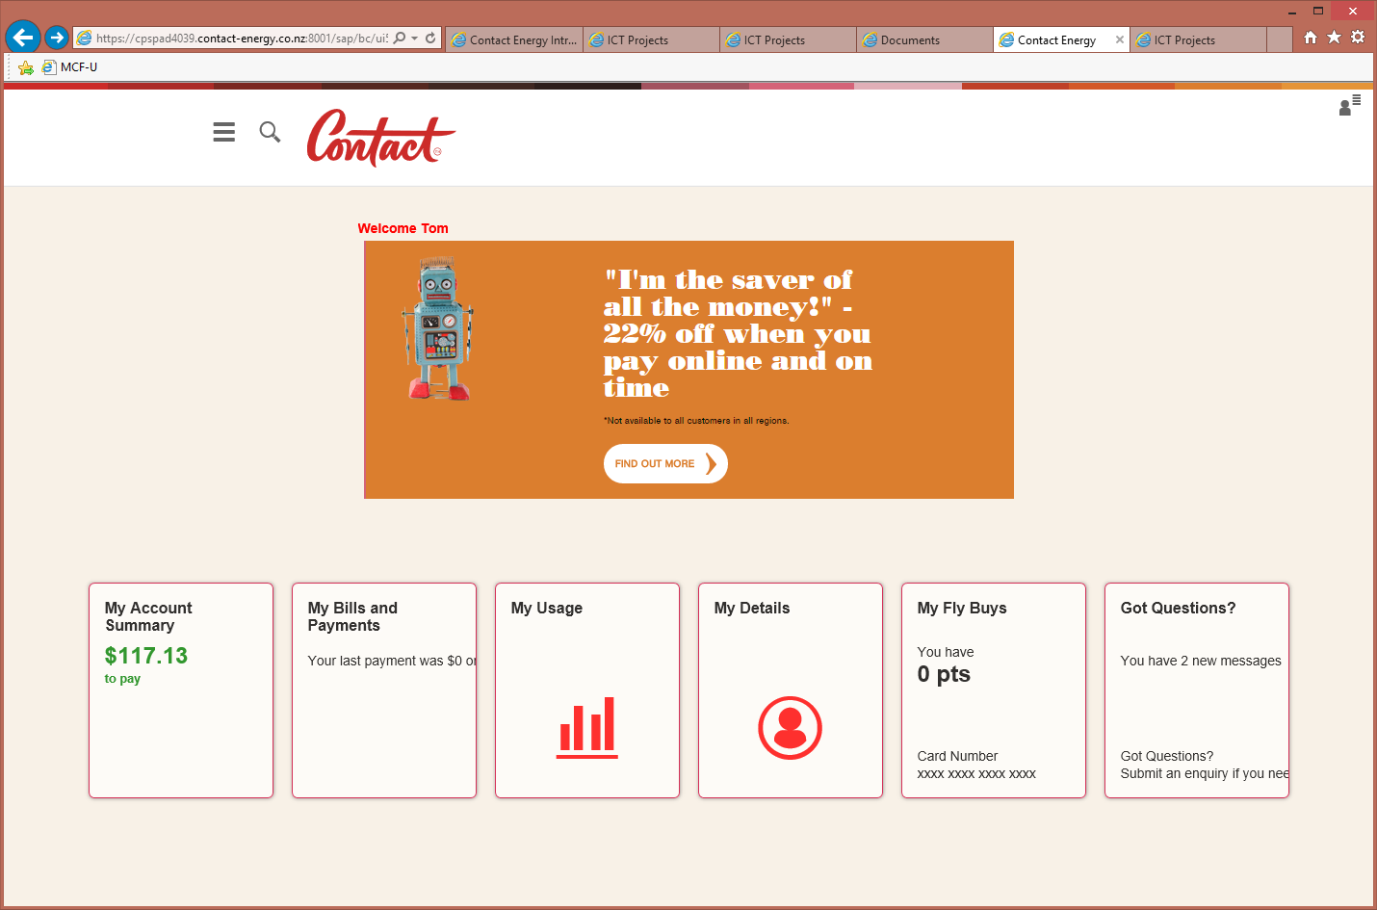


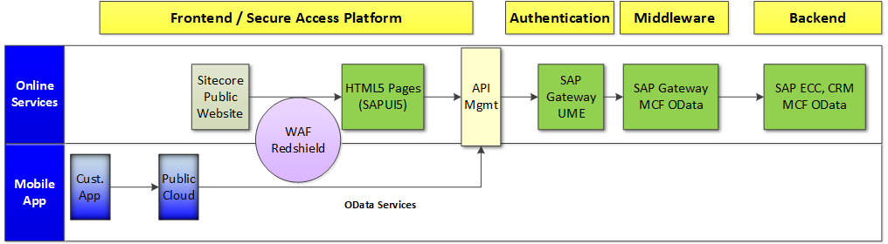
What did we do?
From this
To this
Replace current OLS solution with MCF-U
Most functions implemented as-is
Some customised using MCFU extension framework
Use of OData calls
Stuck to standard UI - SAPUI5
Big Bang Go-Live
mobile application to connect to new OLS
Screen Scrape

Slide 15
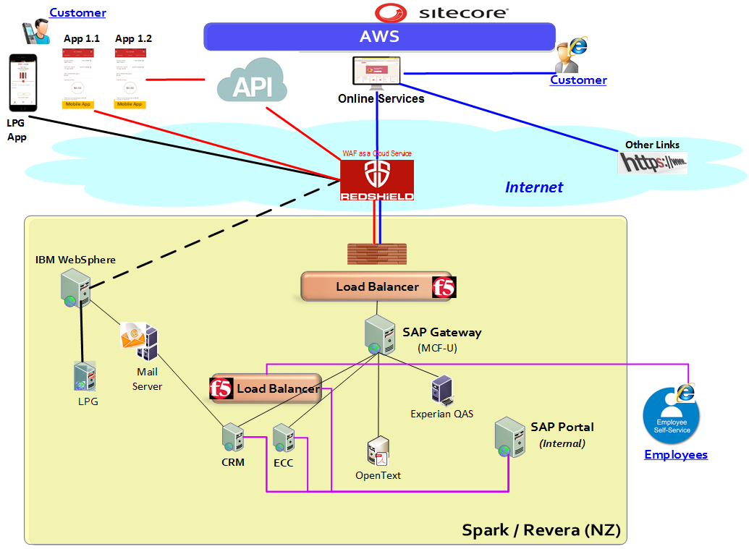
Where we are now

Slide 16
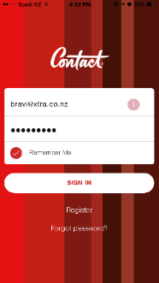
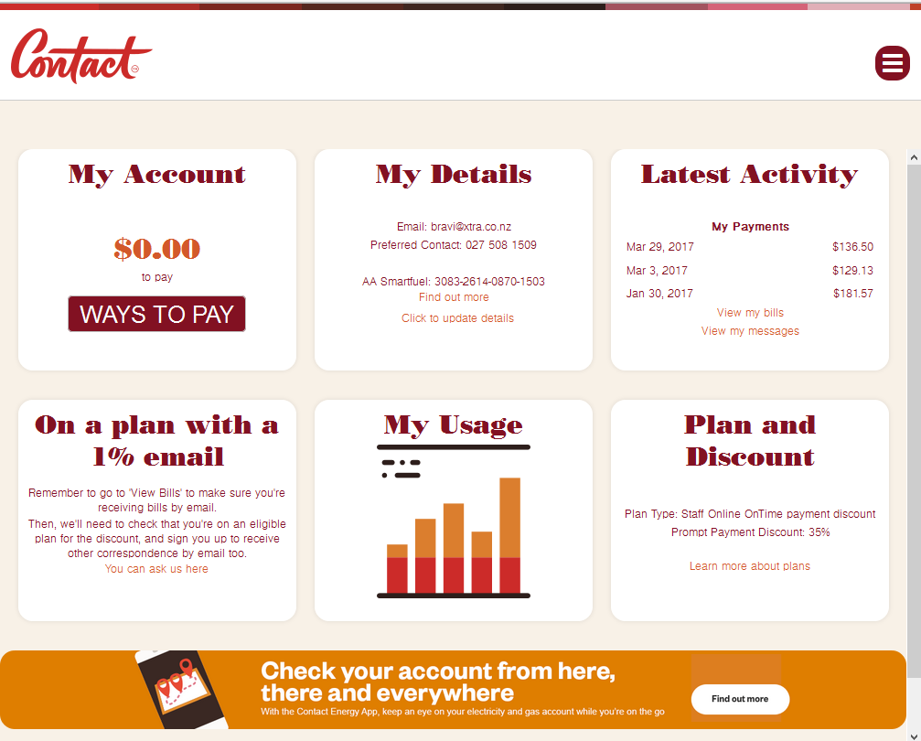
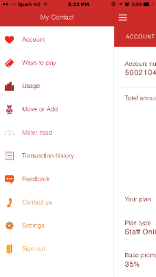
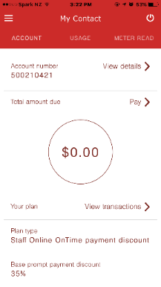
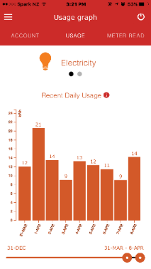
What does it look like?
Mobile App
Website

Slide 17
What Did We Achieve?
No more ‘screen-scrape’
Improved customer experience
Separation of presentation from application layer
Reduced change effort
Lightweight standard OData calls
Reuse of OData services in other applications
Standard features 'out of the box'
Robust foundation to support customer digital strategy
Still two sets of code for App and Website

Slide 18

Lessons Learned
Proof of concept was invaluable
Security and connectivity is complex
SAP UI5 has its own challenges:
  SAP’s proprietary version of HTML5
  Resourcing was difficult
  UX design using standard tiles
  Effort to include menu and side bars
Performance Testing
  Batching of static HTML to one call
  Better CX in loading tiles asynchronously
  Use Google Analytics tags
  Have the right tools!!

Slide 19

Lessons Learned
Implement 'like-for-like' functionality
Don’t be afraid of 'mantronics'
Quick decisions to enable on time delivery
Big Bang go-live with prior ‘production test’
Focus on easily changeable front-end
  Use standard software
  Good development and debugging tools
  Ensure tools are easily installed
Test on multiple devices, browsers
Notes:
Testing for multiple devices – AWS Device Farm, Browserstack

Slide 20
The Digital Employee
Notes:
C starts

Slide 21

Opportunities for the Digital Employee
Generation staff
  Mobile Asset Management
  Complex Screens
Customer sales
  Field Sales for Account Managers
  Door-to-Door Sales
Employee Productivity
  ESS/MSS
  Approvals
  Simplifying SAP Screens

Slide 22
What we dabbled with
Fiori
HTML5/CSS3
Sitecore
Personas
Javascript

Slide 23
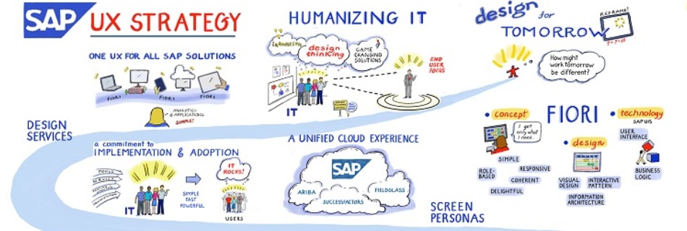
SAP’s UX Strategy

Slide 24

Fiori – Things to Consider
Three Application Flavours
  Transactional, Analytical and Fact Sheets
  If you don’t have HANA, only transactional!!
Re-think your screen
  Allows re-design of process flow
  Mobile deployment
Technical
  Embedded or Hub?
  Fiori Launchpad or Individual Applications?
  Internal Use only or External Connectivity required?
  Make sure you are using Fiori 2.0
  Developer Tools
Notes:
J starts
Recommend using Gateway as Central Hub

Slide 25
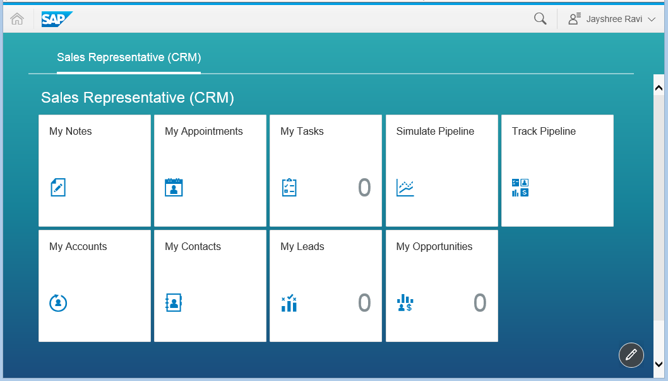
Fiori Trial for Account Managers
Notes:
C starts

Slide 26
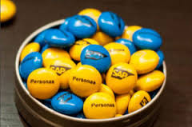
Personas – Things to Consider
What can it do?
  Modern-looking screens without programming
  Personalise SAP GUI / Webdynpro screens
  Great with a TCODE that has many fields but only a few are used
  Scripting allows additional simple functionality
  Theming can make the look and feel of SAP GUI like Fiori
Why did we do it?
  Screens were difficult for shop floor users to navigate
  Quality of transactional data was poor
  Data entry was not streamlined
  Difficult to find data
  Business satisfaction was low

Slide 27
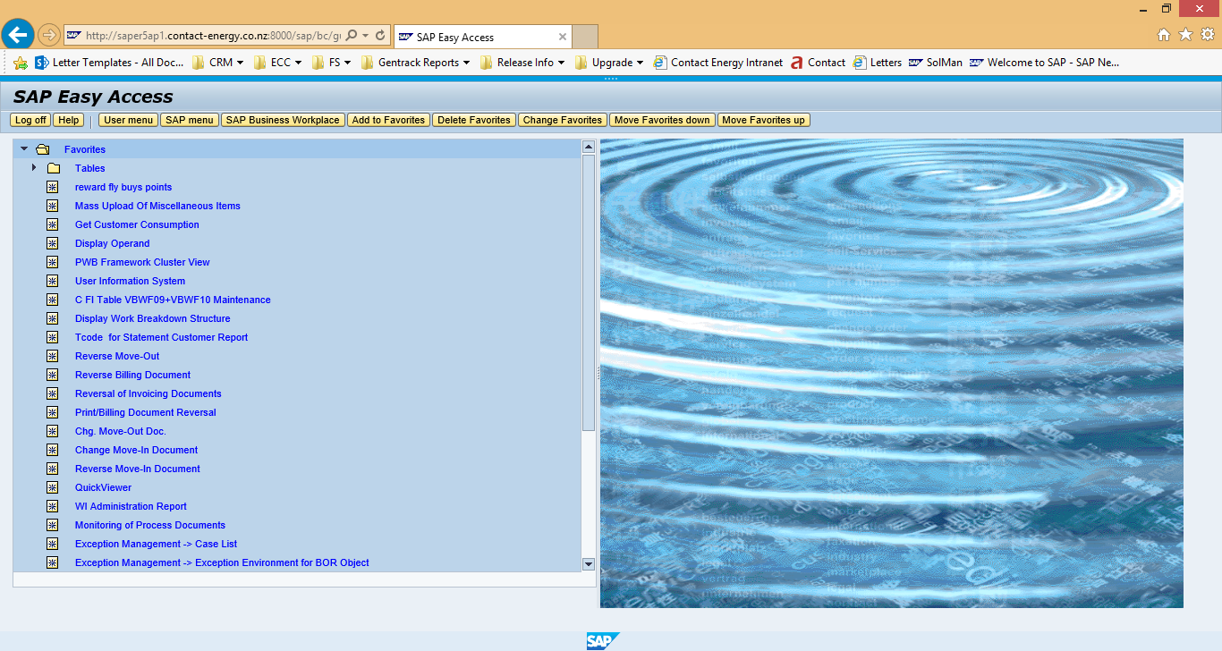
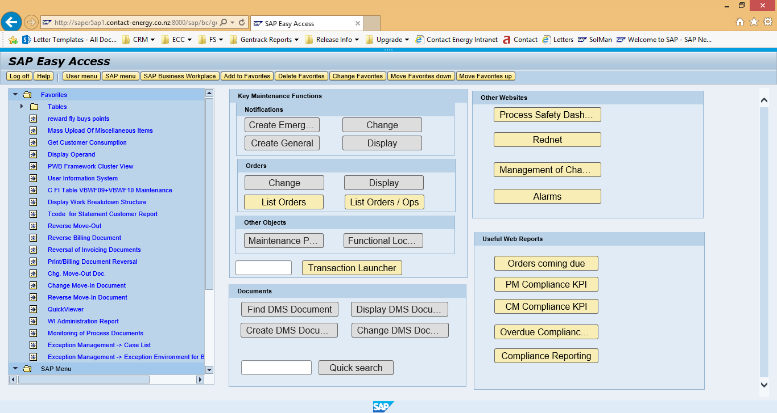
Improved Overview Screen - SMEN
From this
To This

Slide 28
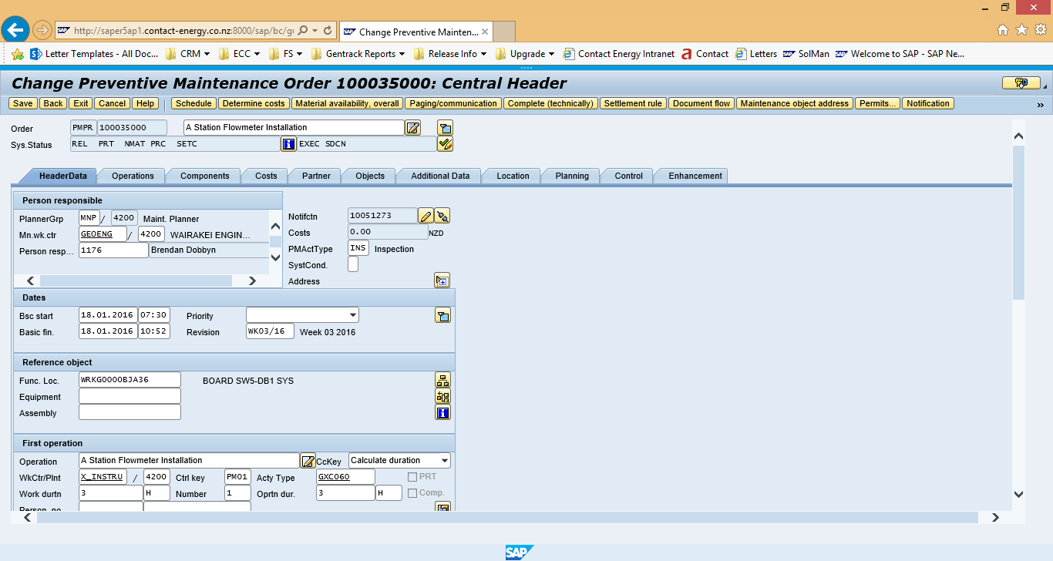
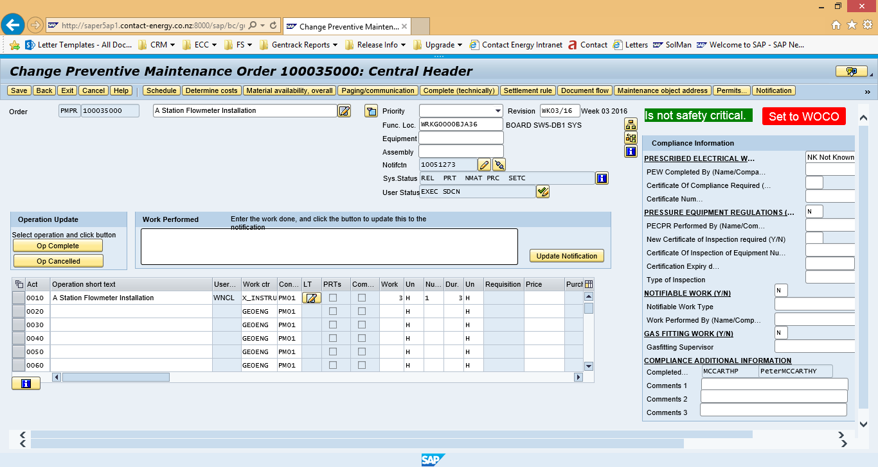
Simplified Data Entry - IW32
From this
To This

Slide 29
Personas Lessons Learned
Involve end users
Limited value with initial designs
Web UI settings identical across environments
Develop in a transactional data environment
Need to consider roles
Can only do simple screen changes
Not mobile
Consider initially developing a Personas framework

Slide 30
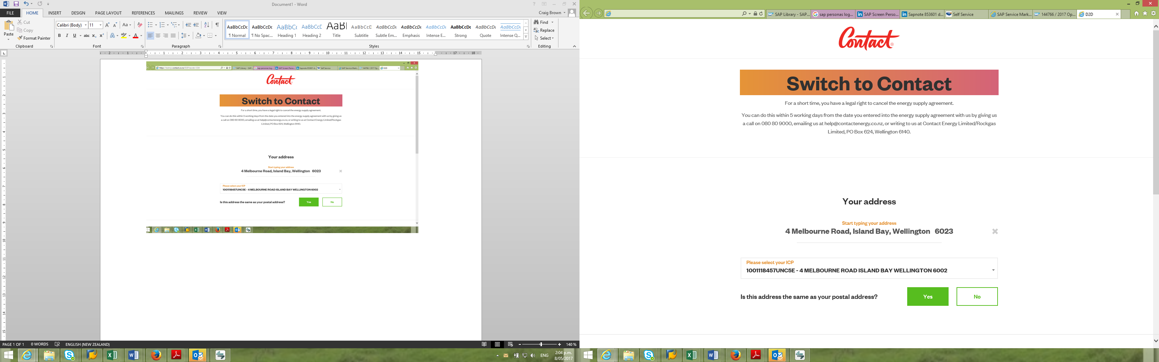
Door-to-Door Sales
How?
Built using Sitecore
Key outcomes:
Paperless, timely & error free
Immediate customer feedback
Email to customer & back-office
Easy input into SAP

Slide 31
What’s Next?

Slide 32

What’s Next?
Extend the Digital reach
  Social Media Integration
  Full Customer Sign-Up
  Single Sign-On using Social Media credentials
  Expense Claim, Timesheet, PO approvals
  Workflow Approvals
A word of advice
  Don’t be afraid to experiment!!
  Focus on delivering good API’s from SAP backend
  Don’t be restricted by SAP front-end tools!!
Notes:
J starts

Slide 33
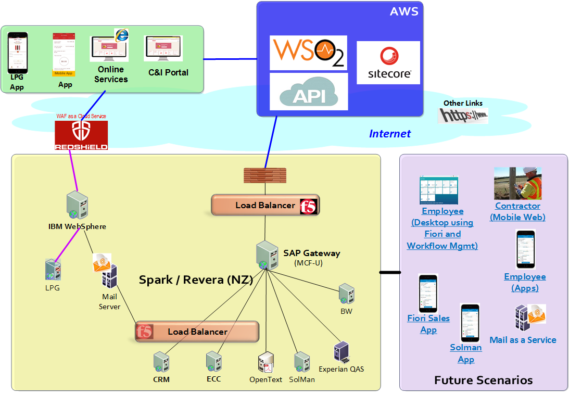
The Future Landscape?

Slide 34
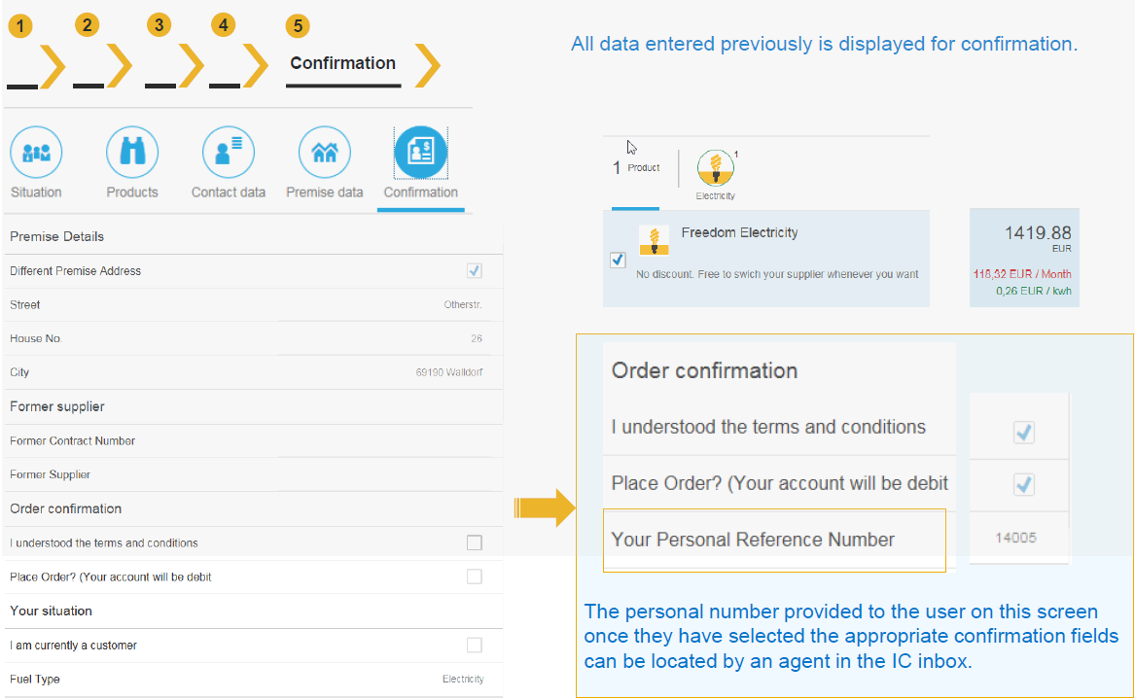
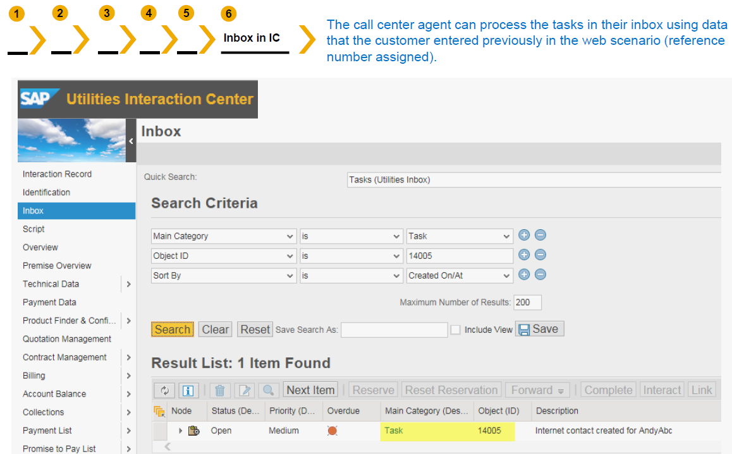
Improved Customer Sign-Up Journey
Customer signs up via mobile app or website
Customer receives a tracking number
Move Data automatically stored in SAP
Agent checks key data
Agent confirms work item
Sign-Up complete!!!
Notes:
Change title to reflect example customer future offering

Slide 35
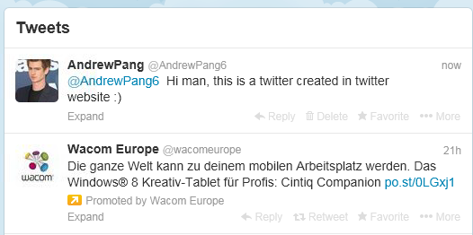
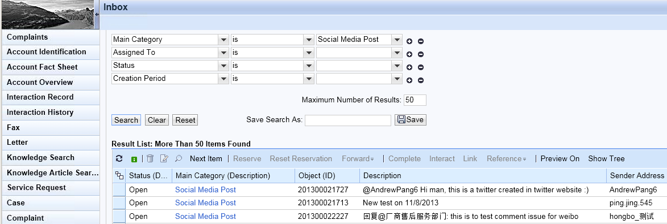
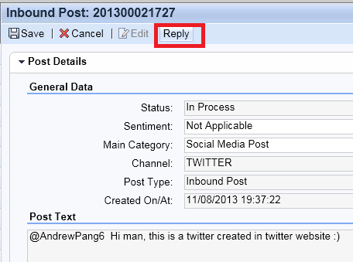
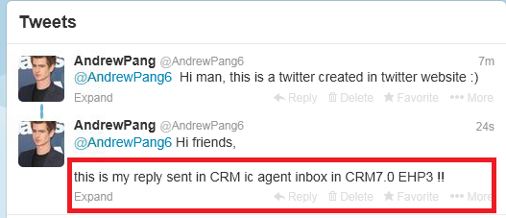
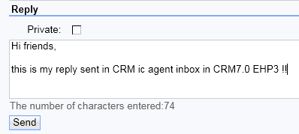
Integrating Social Media with CRM
Step 1 - Customer tweets
Step 2 – Twitter feed arrives in CRM Inbox
Step 4 – The reply
Step 3 – CSR replies from CRM
Step 5 – Reply appears in Twitter

Slide 36
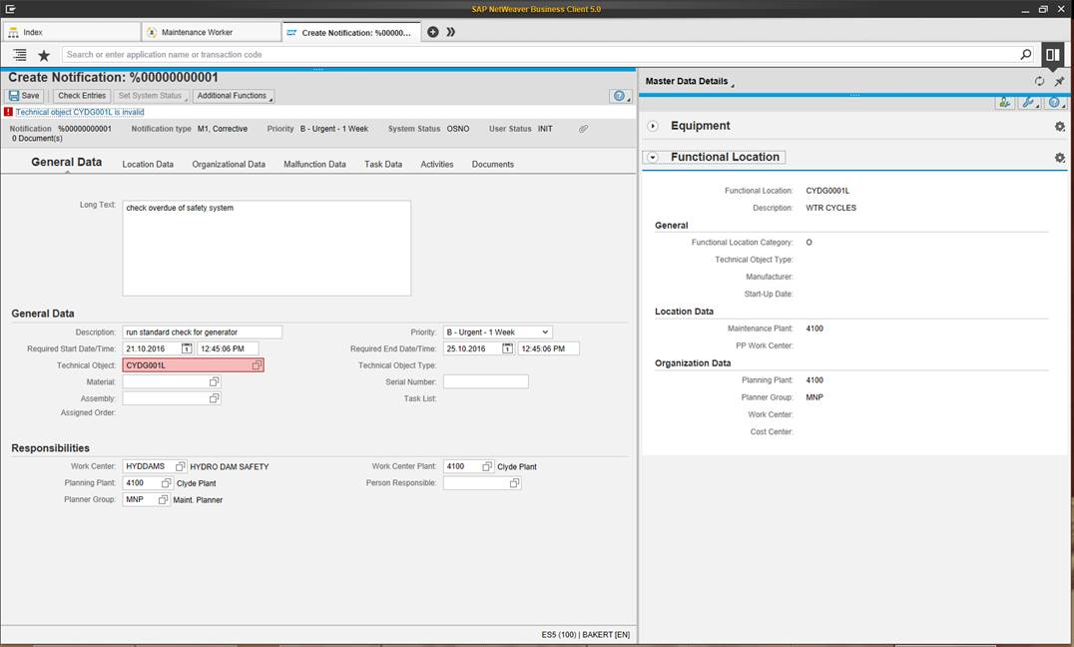
Capitalise on Side Panels

Slide 37
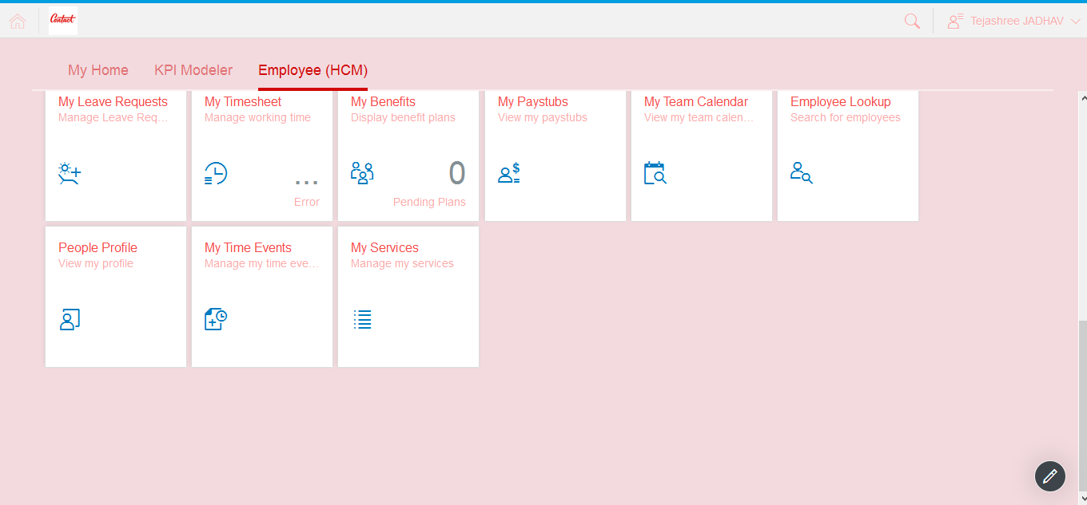
Fiori Launchpad to Replace Portal
About…
One Entry point for SAP apps on many devices
Replacement of Portal
Home page with tiles for applications to launch
Common UI for mobile apps, CRM and ISU access

Slide 38
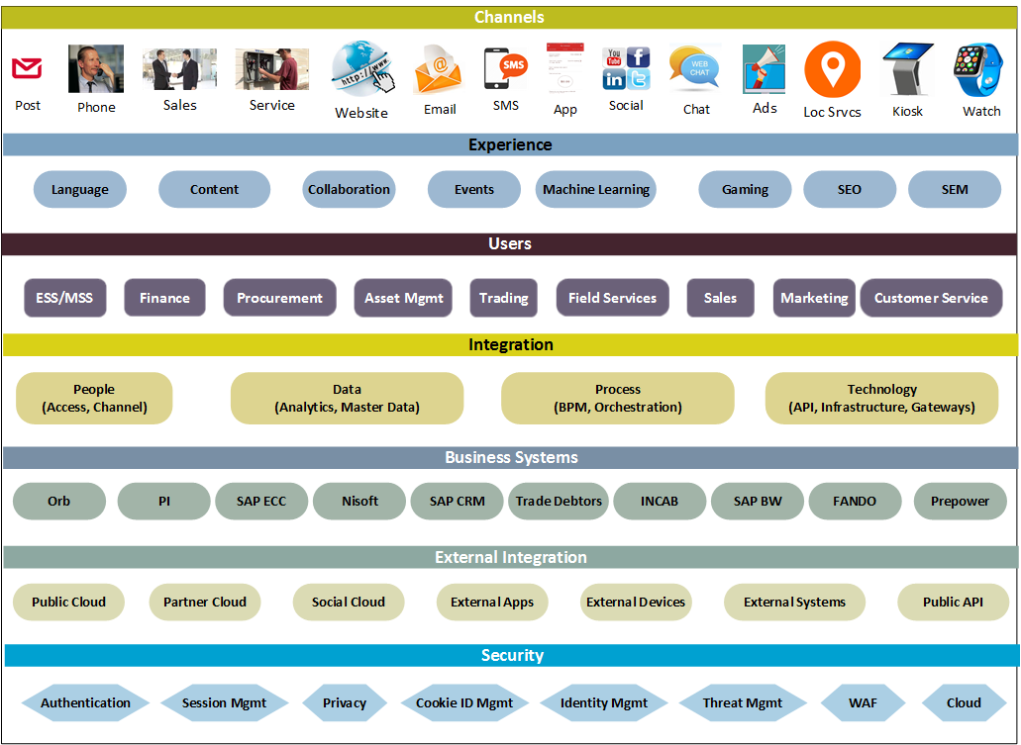
Towards a Digital Architecture

Slide 39
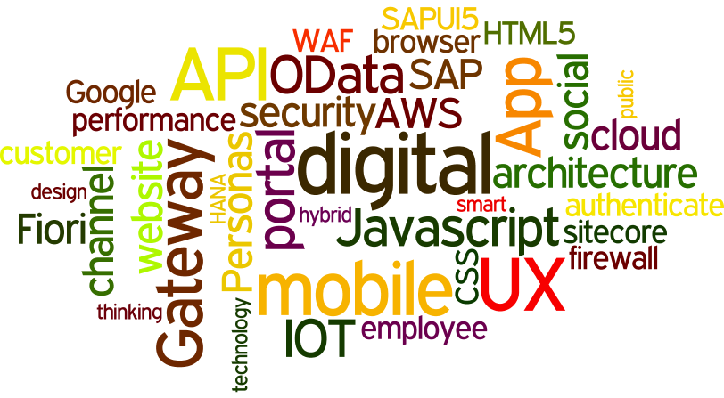
Questions?

