Slide 1
Sprinting to Unlock the Full Potential of SAP Solution Manager
Craig Brown
SAP Application & Enhancement Manager, Contact Energy

Slide 2
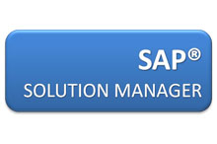
What I’ll Cover
Contact Energy
The SAP Solution Manager implementation challenge
Vision, journey and roadmap
The journey to date
The future
Questions
Key Points to Take Home

Slide 3
About Contact Energy
$2.9b Our net assets are $2.9 billion (at 31 December 2016) | 166 (gross) of geothermal generation commissioned May 2014 | 1,066 We employ 1,066 people from Auckland to Invercargill | 1 New Zealand’s only underground gas storage facility
11 Contact owns and operates 11 power stations throughout New Zealand | 556k Contact has 556,000 customers across electricity, gas and LPG | 5 Geothermal stations in the central North Island | 22% We supply 22 per cent of the New Zealand electricity and gas retail markets (at 31 December 2016)
23% Contact generates around a quarter of New Zealand’s electricity | 2 Hydro power stations at Roxburgh and Clyde | 71,000 Contact is one of New Zealand’s largest listed companies with around 71,000 shareholders across our NZX and ASX listings | 84% Proportion of electricity Contact generated from renewable resources in 2016
MW

Slide 4
Where we Operate

Slide 5
The Challenge
Demystifying SAP Solution Manager can seem overwhelming, daunting even – but we found a way through

Slide 6
Our Vision
Solution manager vision:
Run SAP like a factory
Application Lifecycle control
Pro-active
In doing so we would then:
Reduce the total cost of ownership
Increase efficiency
Mitigate change risk
Add to the bottom line

Slide 7
Where to Start?
- “SAP Solution Manager”:
5,370,000 results
NZ – 6,210 results
AU – 51,600 results
- “SAP Solution Manager”
40,725 SCN Forums
2,895 SCN Wiki
10,099 SAP Notes
SAP Related Seminars:
SAP HANA
SAP Solution Manager

Slide 8
Initial Investment in Solution Manager
Initial implementation:
Business blueprint defined
Configuration management
No champion
Next major project did not use Solution Manager
Lots of talk

Slide 9
Our Reference Point

Slide 10
Our Starting Point
Solution Manager 7.1 - Contact Usage & Roadmap
Area | Function | Tool | Priority
Implementation | Setup | Document Management | 0
 |  | Project Administration | 0
 |  | Solution Landscape | 0
 |  | System Landscape | 0
Run SAP like a Factory | Business Process Operations | Business Process Configuration | 1
 |  | Business Process Monitoring | 2
 |  | Business Process Performance | 1
 |  | Data Consistency Management | 4
 |  | Implementation Content | 4
0 - Base set-up. Pre-requisite for future work |  | Interface Monitoring | 1
1 - Core functions to be implemented prior to Retail |  | Job Scheduling Management | 2
2 - To be implemented post Retail | Technical Operations | BI Monitoring | 1
3 - Future road-map item, high priority |  | Business Process & Interface Monitoring | 1
4 - Future road-map item, low priority |  | Data Volume Management | 1
5 - Unlikely to be looked at |  | End User Experience Monitoring | 1
 |  | PI Monitoring | 1
 |  | Root Cause Analysis | 1
 |  | System Monitoring | 1
 |  | Technical Administration | 1
 |  | Technical Analytics | 4

Slide 11
Road Map
Today

Slide 12
The Environment

Slide 13
Technical Monitoring – What to Monitor?

Slide 14
Technical Monitoring
Standard list of SAP alerts
Gathered multiple inputs
First cut determined
Tweaking and tuning
Communicating the alerts
We knew before the users

Slide 15
Technical Monitoring
Used extensively to check:
Are all systems available?
Are all interfaces working?
Is there sufficient space in the database?
Is there sufficient space in the file systems?
How many ABAP dumps are there?
Are there any critical errors in SAP work process logs?
Is the database backup OK?
Are there any Java exceptions?
Are there many entries in the RFC queues?

Slide 16
Technical Monitoring – Planning Your Alerts

Slide 17
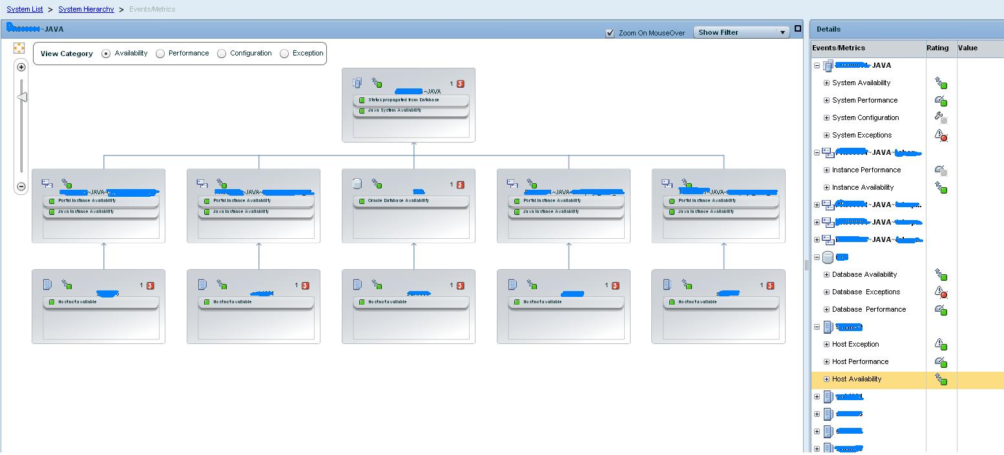
Technical Monitoring – Graphical Interface

Slide 18
Technical Monitoring – Alert Inbox

Slide 19
Technical Monitoring – Email Notifications

Slide 20
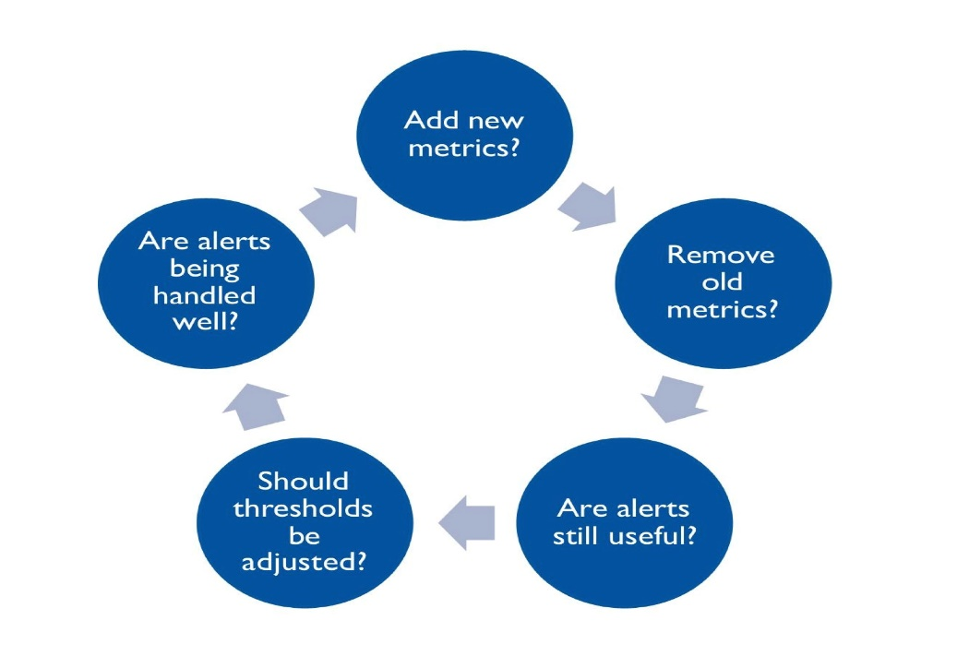
Technical Monitoring – Lessons Learnt
Ongoing refinement is critical

Slide 21
Technical Monitoring – Lessons Learnt
Earn and maintain confidence
Robust process to manage alerts
Get an independent review
Update the spread sheet
Measure your progress

Slide 22
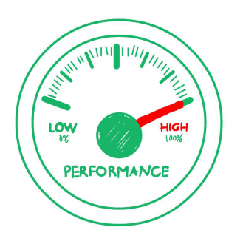
Root Cause Analysis
Extensive performance testing phase
Tools to support the testing:
End-to-End Trace Analysis
Wily Introscope
The tools for the data centre move

Slide 23
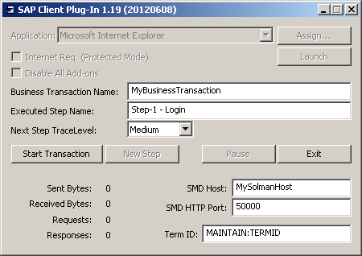
How We Used End-to-End Trace Analysis
Scenario
Testers complained of high response times when saving a Business Partner and Contract
These transactions are updated in CRM and then replicate to ECC
E2E Trace Analysis Steps
Enable Trace
Record Activity using Client
Plug-In
Collect Trace Data
Review process flow
Analyse in detail to identify
problem

Slide 24
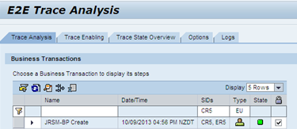
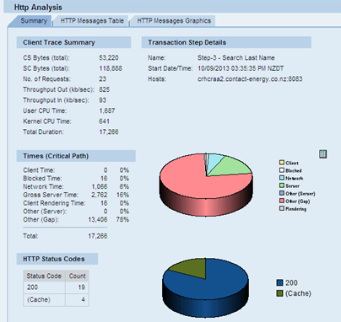
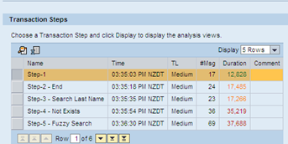
End to End Trace Analysis

Slide 25
How We Used End-to-End Trace Analysis
Server Analysis showed significant time in a RFC call to TREX

Slide 26
Wily Introscope – How We Used It
Monitor and report on performance
Various job mixes were run during day and night
Wily used to used to check what happened:
Host Triage (CPU Util%, Disk Util%, Paging, LAN Packets)
ABAP Triage (Free Processes, %Users, ICM/Gateway connections)
Java/Portal Triage (Threads, Memory, Http Sessions, Garbage Collection)
Only very basic use of PI and BI Monitoring

Slide 27
Wily Introscope – How We Used It – Check Monitors

Slide 28
End-User Experience Monitoring
Location specific performance
Why is it important for us?
Data Centre in Australia
multiple locations
Robots installed at different locations
Experience latency issues

Slide 29
How We Use EEM – Example Result

Slide 30
Solution Documentation
Business blueprint developed
Different options evaluated
SharePoint solution with link
All stakeholders can access
No ARIS integration

Slide 31
ChaRM
Pre-configured “Add-on”
Four-tier business-as-usual environment
ChaRM for both SAP and non-SAP changes
Retrofit and Repack functions used
Change diagnostics for reconciliations

Slide 32
ChaRM – The Benefits
Has introduced good disciplines
Standardised process for managing change
Facilitated the documentation of changes
A robust approval process of changes
No non-approved changes
Manages code conflicts
A one stop shop for change history

Slide 33
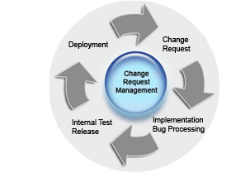
ChaRM – The Challenges
Pre-configured solution was buggy
Four-tier landscape created challenges
End-user adoption has been slow
Multiple process iterations
Status management

Slide 34
Test Management
Multiple concurrent projects
Reusable test library
Test Workbench
CBTA
BPCA to optimise testing

Slide 35
CDMC and SEA
Benefits:
Reduced effort and cost in testing and maintaining custom code
Early estimation of project effort & cost
How:
Clearing Analysis
Change Impact Analysis
Test scope optimisation

Slide 36
CDMC and SEA

Slide 37
What’s Next
Upgrade to Solution Manager 7.2
Potential implementation of process modeller as a replacement to ARIS
Dashboards
Solution Manager on mobility apps
BI and PI monitoring
Business Process monitoring
Job Monitoring – currently use Control-M

Slide 38
Key Points to Take Home
Solution Manager roadmap is key
Don’t be daunted or overwhelmed
Plan and review your technical monitoring
Size your technical requirements
Monitor the performance of Solution Manager
Quality resources out there help http://support.sap.com/solutionmanager
Before you start take a deep breath!

Slide 40
How To Contact Me
E: craig.brown@contactenergy.co.nz
M: +64 274 653316
P: +64 4 462 1124
Li: linkedin.com/in/craig-brown-0a3a64/

