Slide 1
Budgeting & Forecasting for Cost Centres
Portal Online Masterdata Change Forms
Enterprise Support Services
SAP Business Warehouse Integrated Planning

Slide 2
Todays Presentation Agenda
Overview of Inland Revenue Business Transformation (BT)
Overview of Enterprise Support Services (ESS)
Overview of the Online Forms
Business Pain Points – Manual Forms
Masterdata Scope
Solution – New Process Online Forms
Solution Design
Demo
Business Benefits Delivered
Q&A

Slide 3
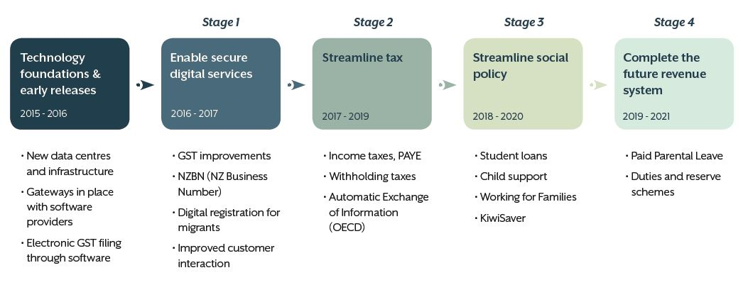
Overview of IR Business Transformation
Notes:
Inland Revenue’s transformation is a major government investment to make tax simpler for New Zealanders.
This is the sequence of how we’re rolling out the improvements - managed in stages to minimise risk for you - our customers.
The stages have been designed in a logical sequence. As new policies and online improvements are introduced, we’re accumulating more and more benefits to make tax simpler, more open and certain for customers. For example, the new PAYE proposal around payday reporting in Stage 2 lays the foundation for future social policy changes.
Stage 1 complete: As you’ve seen, we successfully delivered Stage 1 on 7 February when we switched on GST in the new revenue system.
Stage 2: We have also been working on planning for Stage 2 which involves streamlining business income taxes. This stage will include the introduction of the new Accounting Income Method option – this lets small businesses choose to pay provisional tax ‘as they go’. More about that shortly.
Stage 3 is focused on social policy. It’s going to build on the better information available in earlier stages to improve the delivery of social entitlements like Working for Families and Child Support.
A final stage will pick up what’s left to complete the new tax administration system.

Slide 4
Overview of Enterprise Support Services (ESS)
ESS Stage 1 (Releases 1 & 2):
is about getting some house-keeping done, so we can:
Address specific pain points through remediation to support the organisational transformation
track, report and plan effectively for Business Transformation (B&F for projects)
model, plan and budget for our transforming organisation (B&F for cost centres)
we have started small
we have taken a low impact high benefit approach to what is delivered
ESS Stage 2 will focus on process optimisation (Feb 2017 to Apr 2018).
Stages 3 and 4 will deliver ESS business transformation enabling support services of the future (from Apr 2018).

Slide 5
Business Pain Points – Manual Forms
The Business Transformation programme will drive a significant increase in the volume of projects and changes to the organisational structure as the business goes through transformation
Current manual processes mean that:
Hand written forms are used which can be illegible and have to be returned to users
Multiple approvals take place using an off-line process that is not easily auditable
This results in time consuming manual offline communications
There is significant duplication of effort
Manual master data maintenance has to be completed by the SAP masterdata teams
We still have ‘paper’ in a ‘paperless’ society and this does not align with Inland Revenue new ways of working

Slide 6
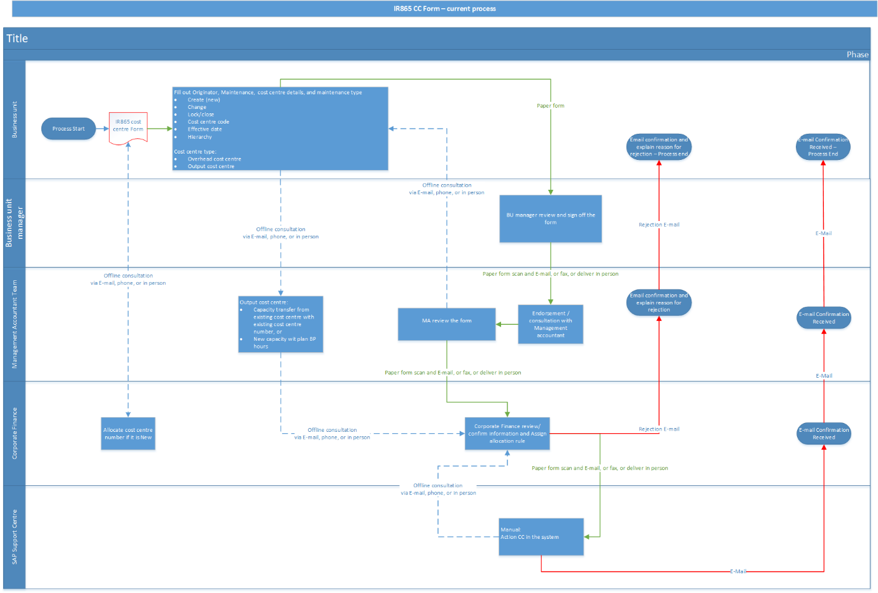
Business Pain Point – Manual Forms Create and Change a Cost Centre Business Process
Notes:
Business Process for creating or changing a cost centre.
Steps:
Print the manual form from the intranet
Complete the form
Obtain Business Manager’s approval
Send the form to the management accountant
Review the form, obtain additional details if form not completed
Obtain MA Line managers approval
Send the form to Corporate Finance
Review the form, obtain additional details if form not completed, add the allocation rules
Obtain Corporate Finance Line manager approval
Send the form to SAP Support
Review the form, obtain additional details if form not completed, create masterdata in SAP, Inform all parties master data created.

Slide 7
Masterdata Scope – Online Forms
Cost Centres (Create or Change)
Project Internal Orders (Create, Change or Delete)
Business Processes (Create only)
Notes:
We created 3 new SAP Web Dynpro online forms
Cost Centres (Create or Change, Delete still a manual process)
Internal Orders (Create, Change and Delete a project order)
Business Processes (Create only, Change and Delete still a manual process)

Slide 8
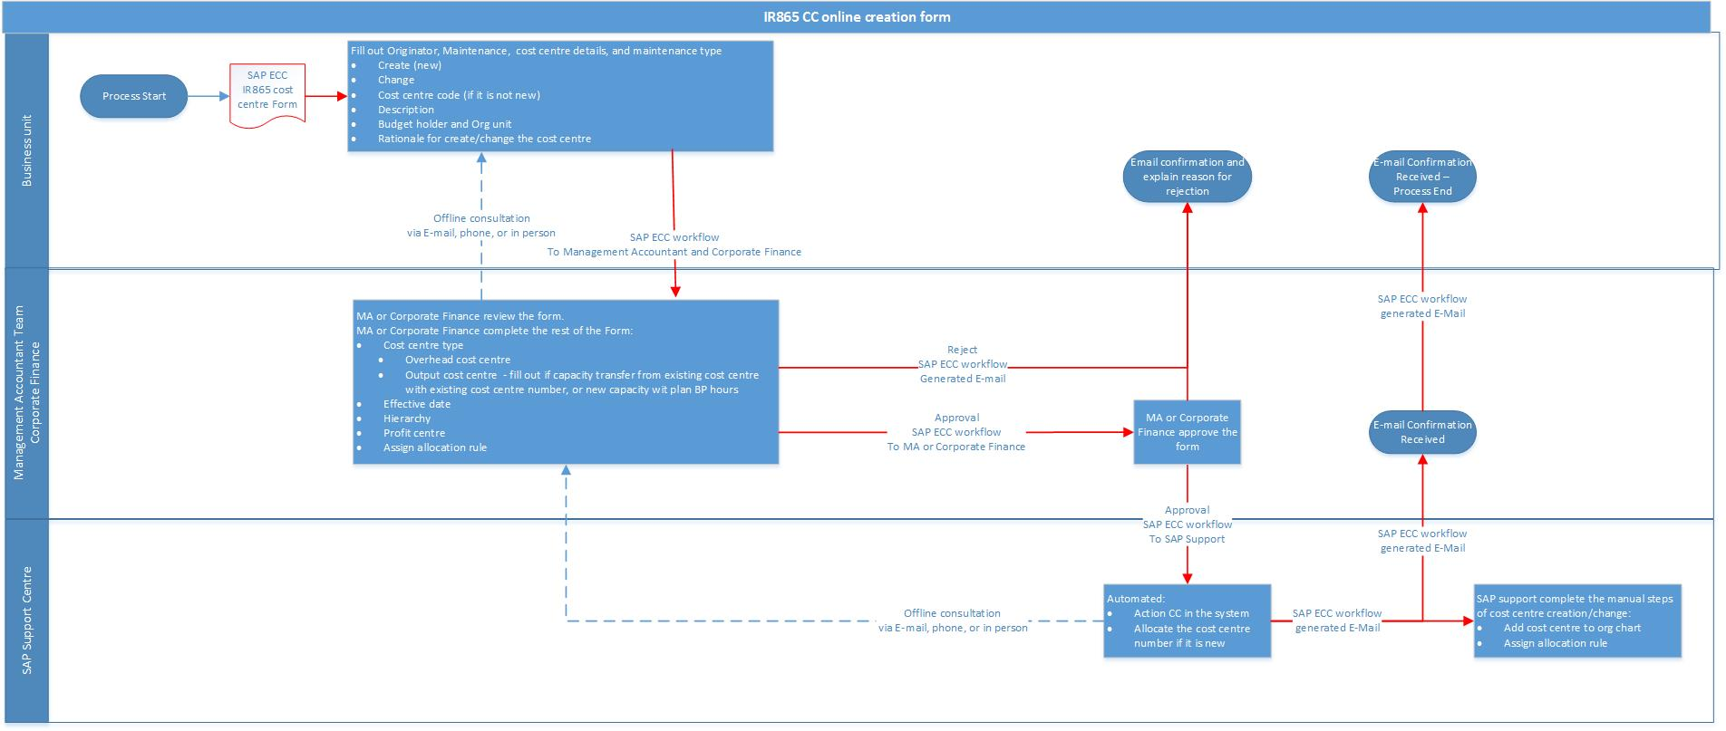
Solution – New Process Online Forms Create and Change a Cost Centre Business Process
Notes:
A much simpler Business Process:
Business completes the form online
Workflows to Management Accountant Team
Management Accountant review form and complete additional details which business do not know
Workflows to Corporate Finance who approve
Cost centre master data auto created in SAP and a notification sent to SAP Support with details so they can complete additional processes.

Slide 9
Solution Design - Forms Framework
IRD was looking to implement Finance forms based on WebDynpro ABAP to be delivered via the SAP Portal in a new role.
A framework approach was seen as advantage against a 100% custom development, due to reduced implementation time and reusable components for future usages.
Decision:
Usage of HR administrative services framework – generic forms, based on Webdynpro ABAP FPM (Floor Plan Manager) technology

Slide 10
Solution Design - Forms Framework Components
Launchpad
Provide a dashboard type launchpad to start the services. The launchpad is a re-used SAP standard component, which also provides services to dynamically display services based on the users authorisations
Forms
Configuration of form fields, instead of customisations
Customisation for additional screen logic, special field validations and the core business logic – generic forms processing
Framework based forms data model to save requests during processing
Standard approval processing
Workflow:
All workflows are based on standard approval template, customisation only for notification processing (HTML e-mail notifications)
Standardised workflow inbox based on WebDynpro ABAP (Universal Worklist)

Slide 11
Solution Design – System Requirements
ERP
ERP 6.0 - Enhancement Pack 7
Existing ESS/MSS licence
Activate Business Functions for HR Administrative Service / ESS / MSS Webdynpro ABAP – Generic Forms Services

Slide 12
Solution Design Forms Framework – Pro’s & Con’s
Pro’s
Reusable components -> reduced implementation effort
BADI development vs. from scratch custom development of all components
UX similar to existing ESS/MSS Portal Services
Con’s
Restrictions on some framework provided functionalities (e.g. no data change in approval step)
ESS / MSS license necessary
Future Architecture & Reusability
WebDynpro ABAP FPM is still on the SAP UX strategy roadmap next to Fiori
UX improvements via Screen Personas to make the Forms look like Fiori

Slide 13
Demo

Slide 14
Business Benefits Delivered
All key/volume masterdata changes now managed online
Fully Auditable approval process
No double keying of data
Data entered by the business is validated at point of entry reducing errors and re-work
Numbering conventions are followed through automation within the process using algorithms to ensure there is no logic driven into the number
Notes:
Launchpad: The Launchpad is a webDynpro ABAP application, based on the SAP standard employee self-service application, which allows the end user to trigger the forms.
Business Logic Classes: The business logic used in the forms to process the content is created in separate classes. There are two different categories – Forms related processing and backend related processing to submit the data.
SAP Workflow Inbox: It was decided, to use the simplified WebDynpro ABAP based workflow inbox to process the workitems, containing finance forms. The UWL is not displaying any forms related workitems.
Forms Design Time: The Forms Design Time, allows to create and amend forms as a configuration activity. The forms are rendered as WebDynpro ABAP FPM (floor plan manager) forms.
Configuration Tables: Next to the design time a set of configuration tables are used/created to control the forms (e.g. global table, table with questions for the business process form, etc.)
SAP Workflow: SAP Workflow is used and linked to the forms, in order to establish the process flow logic. Also the agent determination is realised with the means of the SAP workflow.
Portal Role: The Finance Forms Launchpad as well as the Workflow inbox are embedded in the MIRI Portal as a new role. The Launchpad application is also directly accessible from the MIRI menu in the SAP Portal.

Slide 15
Questions

