Slide 1
Drive Successful Business Transformation
through just in time just enough learning
David Dekker, SAP
September 07, 2017

Slide 3
It’s about people…
Innovative organisations are moving away from one-time training events to continuous micro-learning to provide the right people, with the right information at the right time to ensure team members have the skills and knowledge to perform their job effectively and efficiently.
Learn how you can achieve value from your technology investment, successfully deliver business outcomes and provide ongoing continuous improvement.

Slide 4
It’s about just in time, just enough...

Slide 5
Why is that relevant – 3 observations
Employees change
Business processes gets digitised
Software moves to cloud
Notes:
Employees changer – people don’t memorise, but know where to find stuff; if you’d memorize, you can learn and remember, now the expectation is different.
2. Business processes get digitised, whereas they used to be on paper
3. Software moves to cloud -> updates happen more frequently
4.

Slide 6
4 stages of user enablement
Be an informed buyer
Have the skilled project teams
Have a successful go-live
Have a sustainable post go-live

Slide 7
1. Be an informed buyer

Slide 8
“If I had asked people what they wanted, they would have said faster horses.”
Henry Ford
Notes:
From a system of records, to a system of

Slide 9
Who should know what
Business / IT
Architects

Slide 10
Who should know what and how SAP can help
Business / IT
Architects
Design Thinking
Learning Hub

Slide 11
2. Have the skilled project team

Slide 12
“The greatest enemy of knowledge is not ignorance,
it is the illusion of knowledge.”
Daniel J. Boorstin
Notes:
Daniel Joseph Boorstin was a historian, professor, attorney, and writer. He was appointed twelfth Librarian of the United States Congress from 1975 until 1987.

Slide 13
Who should know what
A small group of people need to be upskilled in a short timeframe
They know the business need, so they are safeguarding the solution is implemented as it should
It is continuous as sprints evolve
Most content is readily available as cloud implementations are about configuration, not customization

Slide 14
Who should know what
Project team training
A small group of people need to be upskilled in a short timeframe
They know the business need, so they are safeguarding the solution is implemented as it should
It is continuous as sprints evolve
Most content is readily available as cloud implementations are about configuration, not customization

Slide 15
3. Have the successful go-live

Slide 16
“Hurry up when you have time,
so you have time when you need to hurry up.”
David Dekker

Slide 17
Setup for success
Cloud ≠ no training is needed
Logistics
Ebbinghaus forgetting curve

Slide 18
So what does good look like
Training strategy
High quality content
Just in time just enough delivery

Slide 19
So what does good look like – and how SAP can help
Training strategy
High quality content
Just in time just enough delivery
Part of project team
SAP Enable Now

Slide 20
SAP Enable Now
Quick Facts
Scalable content production environment
Used externally by 1.500 customers and partners
Used internally in approx. 50 internal SAP projects
Existing synergies with other SAP products (Mobile Documents, Solution Manager, SuccessFactors, LSO, eCATT, KA, etc.)
Single-source technology with content localization & maintenance
Project team collaboration & content lifecycle management support
Single source recordings can be published in multiple format to significantly reduce the time to produce training and support content.
SAP Enable Now is an end-to-end authoring suite for creating, editing and distributing various training and performance support materials.
Notes:
Accelerator tool

Slide 21
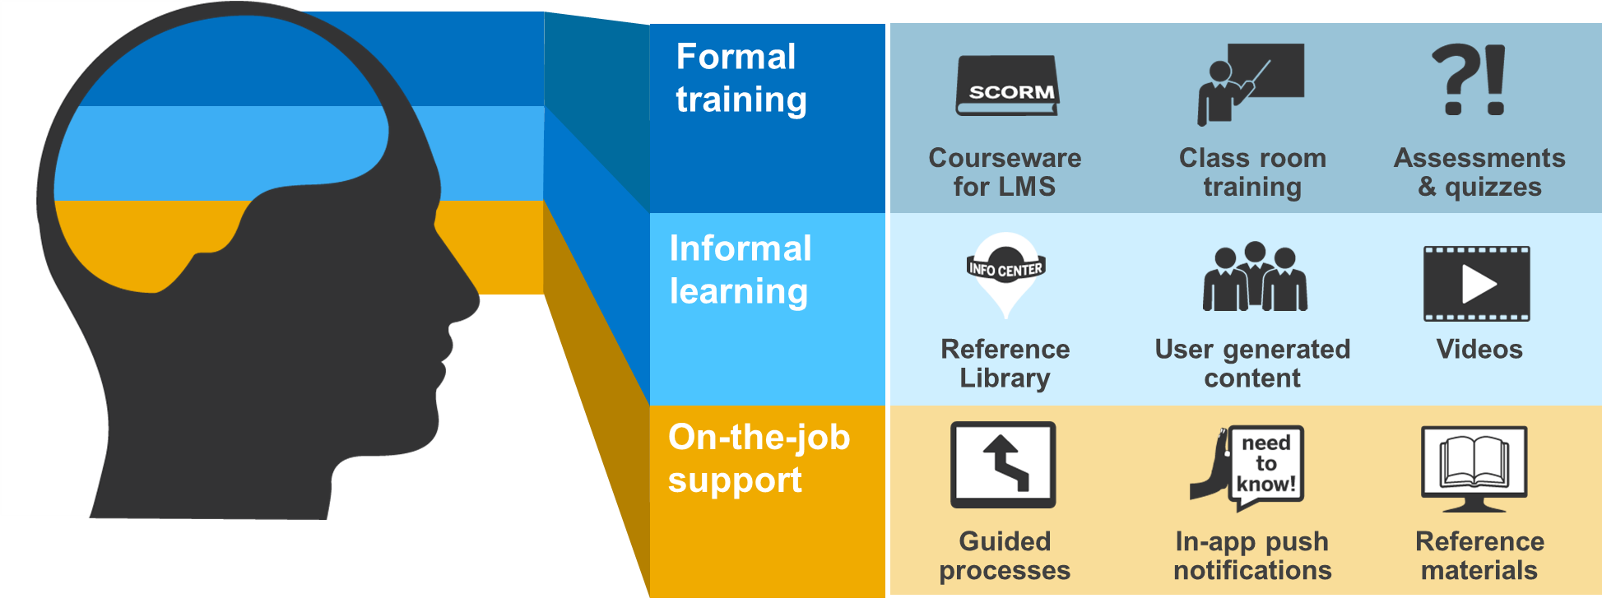
SAP Enable Now The key to successful knowledge transfer
SAP Enable Now is SAP’s leading knowledge content management solution, supporting the entire extended workforce by providing fast and efficient production of enablement materials: formal, informal and on-the-job support – unleashing the full knowledge and productivity of all employees and increasing the potential ROI for the entire IT landscape.
Formal Training
Traditional instructor lead training
Online courses
Informal Learning
Self-directed learning
Sharing of knowledge
On-the-job Support
In application micro-learning
Push notifications directly users
In application process guidance
Notes:
url to youtube

Slide 22
So what does good look like – and how SAP can help
Training strategy
High quality content
Just in time just enough delivery
Part of project team
SAP Enable Now
SAP Enable Now
UEM by KNOA

Slide 23
How user analytics help with SAP S/4HANA migration projects
1
Before Migration
Assess current challenges and inefficiencies
Employ user-centric success criteria and key performance indicators (KPIs)
Define top migration scenarios (business processes and user groups)
During Migration
Identify actual business workflows in your current environment
Uncover user experience (UX) issues and identify improvements
Validate new UX designs
After Migration
Identify adoption gaps for newly deployed apps
Monitor performance proactively
Prove ROI and quantify success
2
3

Slide 24
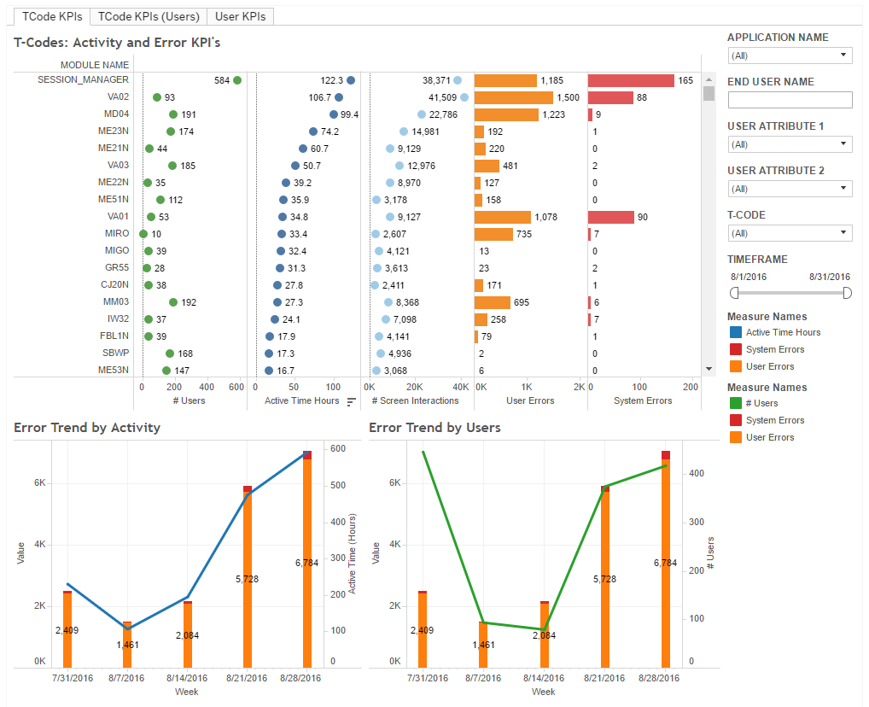
Migration use case Which transactions in SAP software do we need to improve?
Rank transactions in SAP software by user-experience metrics (KPIs)
Identify transactions with:
Highest error rates
Longest response times
Highest degree of complexity
Highest level of user activity
Identify the user impact
Select transactions that should be targeted for migration to SAP Screen Personas, SAP Fiori, or SAPUI5
After the migration, compare KPIs against premigration benchmarks to validate improvements

Slide 25
4. Have a sustainable post go-live

Slide 26
“Insanity is doing the same thing over and over again,
but expecting different results.”
Albert Einstein
Notes:
Learn from your mistakes; almost always the training part is where organisations can improve
Have data available to learn from

Slide 27
What good looks like
Apply the doctrine
Performance support
Measure to improve
People come
People go
SAP Enable Now
Cloud software get updated
Just in time just enough
Notes:
Just in time just enough
Cloud software gets updated; continuous learning & content updating
People come/people go, how do they get trained

Slide 28
SAP Enable Now
Notes:
url to youtube

Slide 29
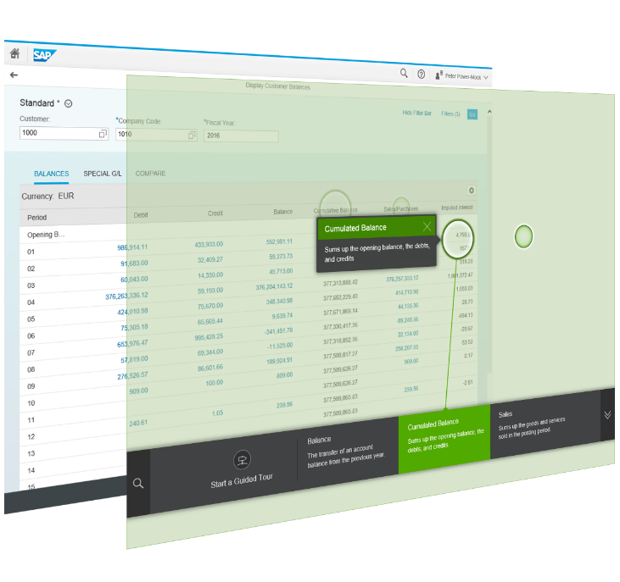
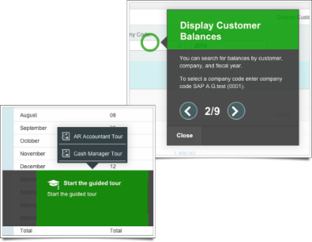
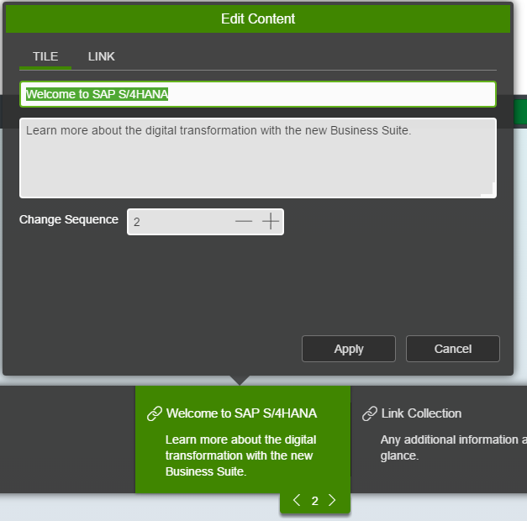
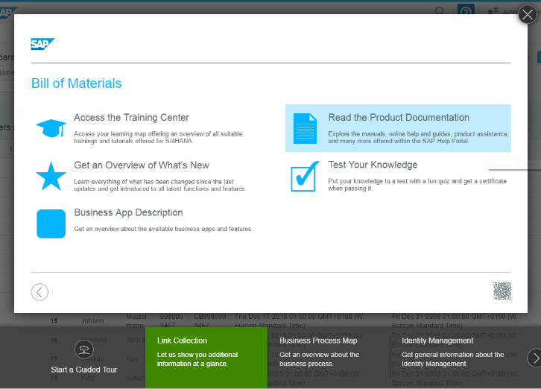
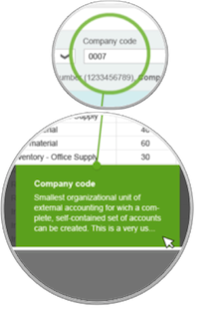
Web Assistant- Must Have for S/4HANA Customers
Guided Tour
Web-based creation & editing
Add existing content for in-app delivery
Context Help
Notes:
The context help provides context specific information for UI elements directly within the application. Only help that is appropriate for the current screen is shown. Hotspots emphasize the UI elements for which help is available for. The different contents are represented in a carousel that is shown at the bottom of the screen. A laser highlights the connection between the help content and the hotspot.
The guided tour guides the user step-by-step through a process within the application. It reduces the time to complete processes and shows best practices at the same time. Each process step is represented by a bubble that contains useful instructions and information for the user.
To enable the efficient re-use of existing content, the Web Assistant can display process tutorials and courseware directly on top of the application.

Slide 30
What good looks like
Apply the doctrine
Performance support
Measure to improve
UEM by KNOA

Slide 31
Data driven decision making

Slide 32
Summary
Include enablement from the beginning to the end
Use the right solutions to support you
Do it in a smart way
Notes:
Time is against you

Slide 33
Thank you.
Contact information:
David Dekker
Head of Education ANZ
168 Walker Street, North Sydney, AU
+61 466 385 344

