Slide 1
Making Identity Management Business Sexy
Frank Gebhardt
IT Architect, Christchurch City Council

Slide 2

…..
Notes:
Identity
Is an IT perspective
Has the notion of access rights (inclusion)
Could have the notion of exclusion
Is a method to identify a person “I’m confirming this is Frank”
This is not business sexy and just necessary to manage classified information

Slide 3
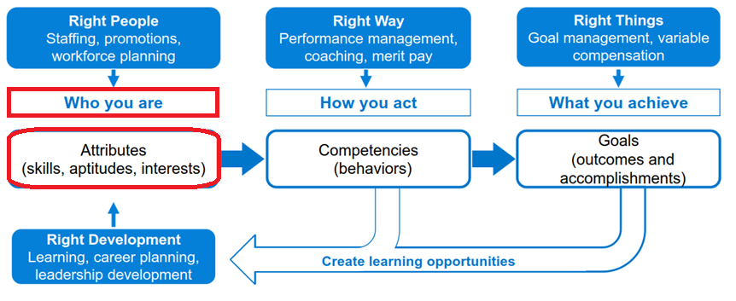
Notes:
Identity → profile
Much more than identity (it’s a person perspective)
It gives meaning to a person (who am I, what can I do, how can I be contacted, what have I done)
It is social
Identity is the very basic profile information

Slide 4
Introduction
55
Notes:
Who am I, what do I do at the Council, where do I come from
IT Architect
IT Manager
Captain in the German Army
My father was a Mayor
My father-in-law a butcher
My wife is a communication consultant
We have 3 sons and 2 grandsons

Slide 5
What I’ll Cover
good enough
practical versus by the book
don't box yourself in – a question of scope
Notes:
Good enough for what?
Customers
Requirements
Users
Other systems
The future
Stakeholders
Practical vs by the book
We are a Council, a Local Govt Agency
We do things by the book by default because
We are in the public eye and our processes are driven by compliance
So don’t get me wrong. This is not about short cuts or ignoring a step
On the contrary this is about conscious decisions to what extent each step is followed.
Ask for clarification when people say “the regulation xyz requires that we do it this way”
Scope
What have you promised (expectations)
What can be done (feasibility)
What must be done (compliance, regulations, dependencies)
What should be done (scope)

Slide 6
Stakeholders
Notes:
Stakeholders have usually a vested interest in the status Quo because they have been part in creating it
Be aware of the impact when you burst such a system
Creating a power grid is in my experience a possible way to manage different stakeholder interests

Slide 7
Business Needs
Notes:
Business Needs – Stakeholder Power grid
Customer Services - we need to help our customers to connect with the right people
HR - who works for us in which role
Facilities - ensure who works here has building access and a place to work from
IT - people who work here have the right technical communication and access capabilities
Staff - need to contact and find other staff

Slide 8
Stakeholder Concerns
I want
I need
I have
Notes:
Want – future thinking / aspiration
Need – compliance / regulations / expectations of those I represent
Have – that’s what I bring to the table and have invested thus far in it

Slide 9



Timing and Business processes
Notes:
Before people start working here
- what comes first IT or HR records?
- technically HR, practically IT
When people start
- Desk
- computer
- phone
Changes
- hierarchical
- location moves
- access rights
When people leave the organisation
- timing (of closing an account)
- systems and people who need to know
After people have left
- does the account stay open for a while?
- could the account being re-used?

Slide 10
Approach

Slide 11
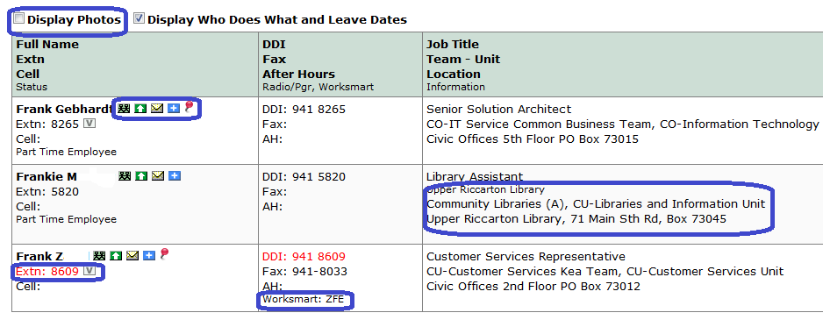
User Experience (UX)
Notes:
Forms and internal developed apps
What source is easier to access?
What source is most likely up to date?

Slide 12
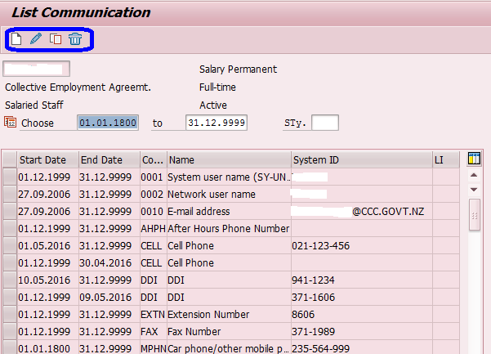
UX – SAP Screen

Slide 13
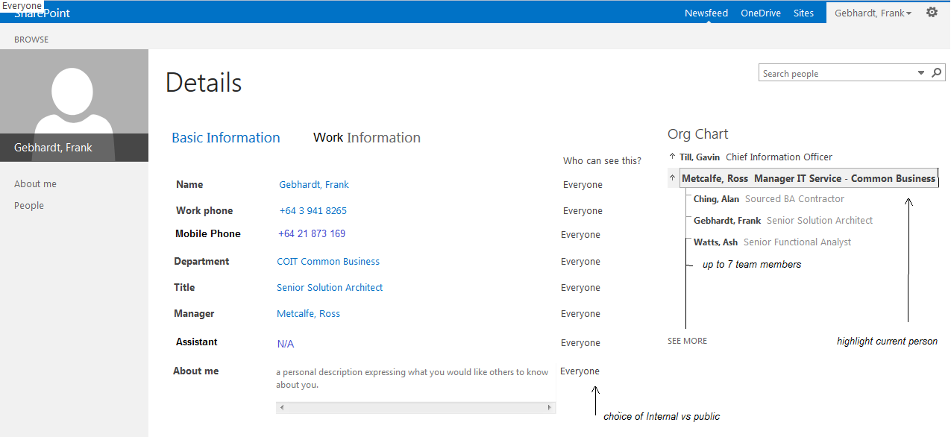
UX – SharePoint / SuccessFactors

Slide 14
A Question of Trust
Notes:
Trust in data correctness
Who works here? Answered by HR based on SAP data checked by GM via Phonelist
Problem
Source of truth
Technical spaghetti monster
Organic processes don't match job descriptions
Agreement
SAP = Source of truth

Slide 15
Notes:
Design Concept
SAP is the Master of people who work here
Facilities started to manage desks in SAP -> benefit occupancy report (Council is known for internal moves and regularly short of space)
Customer Services stopped managing a separate data instance
Staff got the ability of self service
Reports are running against a consistent source and accommodate historical reporting.
“shadow IT” dependencies were unearthed
Future proofing for SAP Successfactors

Slide 16
Notes:
Data stewardship
Job title – job description – purpose of role and job sizing – capabilities > for our purpose good enough?
Hierarchy – organisational structure – team members (tick)
Name – only one place to correct a spelling mistake
Desks – new – linked to floorplan on intranet – also occupancy reporting on hierarchical level
After hours and mobile numbers – major discussion point to not mix data in the Phonelist and personal data in SAP
Photos – used so far only for identity cards – significant discussion where, who, and how

Slide 17
Notes:
Lifecycle of an employee

Slide 18
Key Points to Take Home
good enough
practical versus by the book
don't box yourself in – a question of scope
What’s next ?
Notes:
Communication
SAP - AD - Applications
Stakeholders and Details
- the red phone numbers
- who is first IT or HR
Trust
"this is my turf"
What's in it for me?
- occupancy report
- staff self service
- alignment (remove dbl handling)
Late discoveries
- unknown dependencies
- tacit knowledge
What’s next?
Business Case for Work force data management -> Employee Central?
Business Case for SuccessFactors Performance and Goals

Slide 20
E: frank.Gebhardt@ccc.govt.nz
M: +64 21 873 169
P: +64 3 941 8265
Li: https://nz.linkedin.com/in/frankgebhardt/
Tw: @frankthegrey

