Slide 1


SQL 2016 and kordia
Presented by Gavin Martin and Logan Gouws
Gavin.Martin@kordia.co.nz
logang@syd.co.nz

Slide 2


Notes:
Frame it up and Logan will add the substance

Slide 3
Agenda
Who we are
What was the business problem
Why have we gone down this path
Technical overview
Q & A

Slide 4
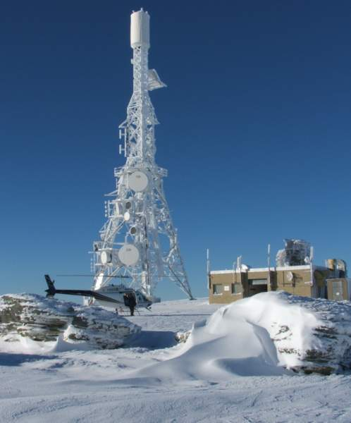
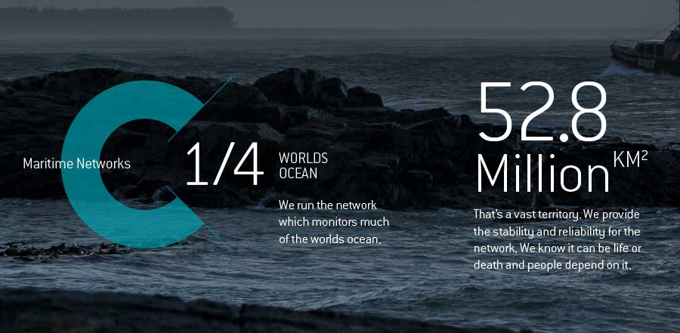

About Kordia
Notes:
We are one of the few truly converged Service Providers in NZ offering end to end Quality of Service support for voice, video, internet and corporate WAN data over the same access
There’s a lot of talk about Cloud - Kordia have worked with Syd iniitally with the accreditation of SAP on Azure.
First to run SAP on SQL 2016
We have onkor - WAN services
Business internet – premium / pairing and direct route into AWS and Azure ……Office 365
Surveliance ‘ trusted network ‘ support for Maritime NZ

Slide 5

About Kordia
Major Infrastructure provider New Zealand & Australia
We have diverse engineering skills (1000) supporting ours and our clients network(s)
Our field teams are at multiple locations across New Zealand and Australia to support our network
75 years trading - maintaining and running New Zealand’s ‘Lifeline Utility Network(s)’
Notes:
Only Telco dedicated to business.
We are one of the few truly converged Service Providers in NZ offering end to end Quality of Service support for voice, video, internet and corporate WAN data over the same access

Slide 6

Business Problem
SAP environment behind in Service Pack and Enhancement packs
Opportunity to move to SQL2016
Future proof the environment
Notes:
Scheduled an upgrade for service packs and enhancement packs. We had recently rolled out Fiori and had a few issues. Personals are the next step and we felt that we should move ontp the latest and greatest.
More the opportunity to assess SQL 2016
Consolidate upgrade to minimise implementation and testing
Reduce unnecessary disruption to the business

Slide 7

Is this about hana……..
Notes:
It’s not about Hana - Kordia currently do not see the value based in the investment required at this point of time,
SQL 2016 provides greater compression, space saving, in memory which will help bridge the gap.

Slide 8

Why Azure?
Use as much as little at the ‘turn of a handle’
Principals of lean
Notes:
,
Talk with Logan about the process.
Standed on A3 and pushed A7 for processing
Again In the process we started with an A5 machine and ramped it up during the process.
We then scaled this down
Aware of the cost‘

Slide 9

Ahead of the curve
Notes:
Kordia are current a hybrid environment – E3 / EMS and have just completed moving all mailboxes into Office 365. We have SAP on premise and DR in the cloud. This is another good example of standing up a clone environment – without impacting production
SQL 2016 – you want to be in a position / experiment / early adopters and obtain what benefits - there is some risk – keep looking forward and looking for opportunities that can add value.
Need to be ahead of the game or you get quickly swallowed up

Slide 10

Digital Transformation......
Notes:
I likes the slide – again transformation / disruption is the buzz word. By experimenting we are looking for the edge…….

Slide 11

Bridging the gap….
Notes:
From the deployment of SQL2016 we haven’t completed the project (UAT). It was a little late, hence a rush to get all the information together. We are still tweaking the environment to see what gains can be made.
There are two dimensions What does this really mean –

Slide 12
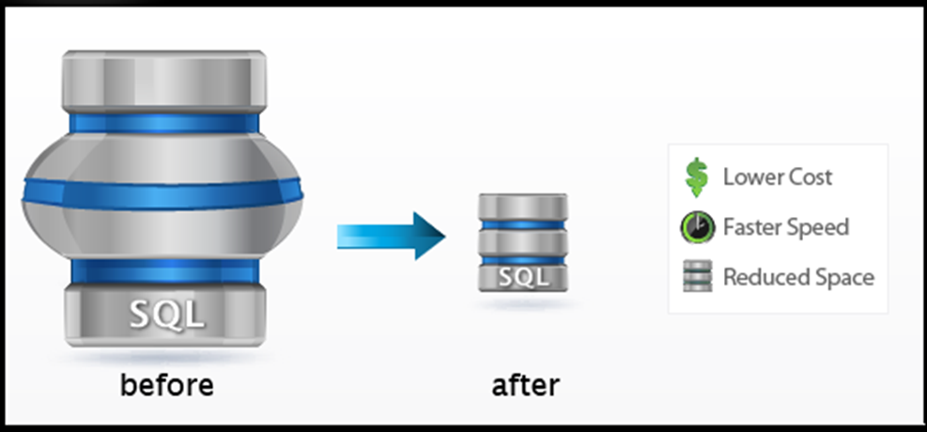
SQL Upgrade requirements
Notes:
This is the core reason for the move

Slide 13
Snotes and restrictions
SNOTE 2201059 - Release planning for Microsoft SQL Server 2016
Windows2012 and higher
No 64bit for sql.
Products not supported on SQL 2016
SAP Solution Manager 7.0 EHP1 and earlier releases of SAP Solution Manager
SAP CRM 5.0 and SAP CRM 6.0 (also known as SAP CRM 2007)
SAP SCM 5.0 and SAP SCM 5.1 (also known as SAP SCM 2007)
SAP SRM 5.0
SAP NetWeaver Developer Workplace is not supported on SQL Server 2016.

Slide 14
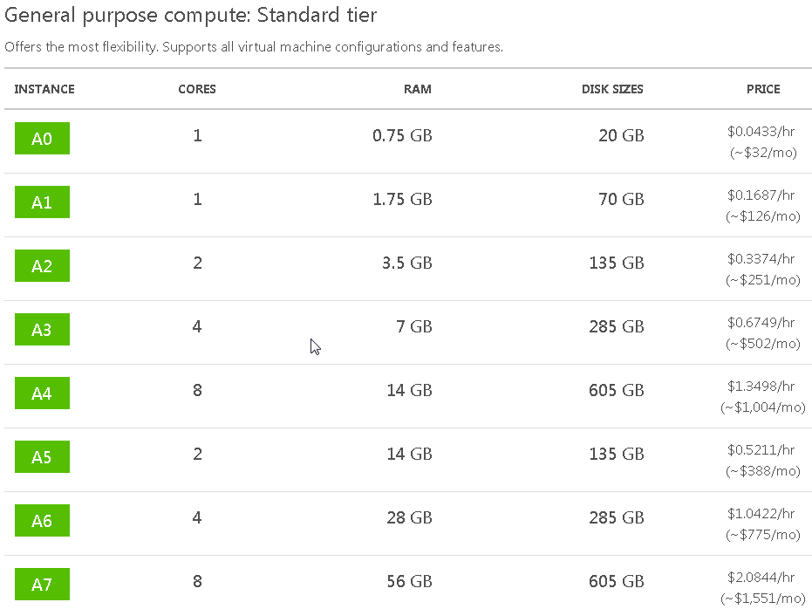
Azure Sizing
Server selection is key to Cost saving.
Special attention to IOPS

Slide 15
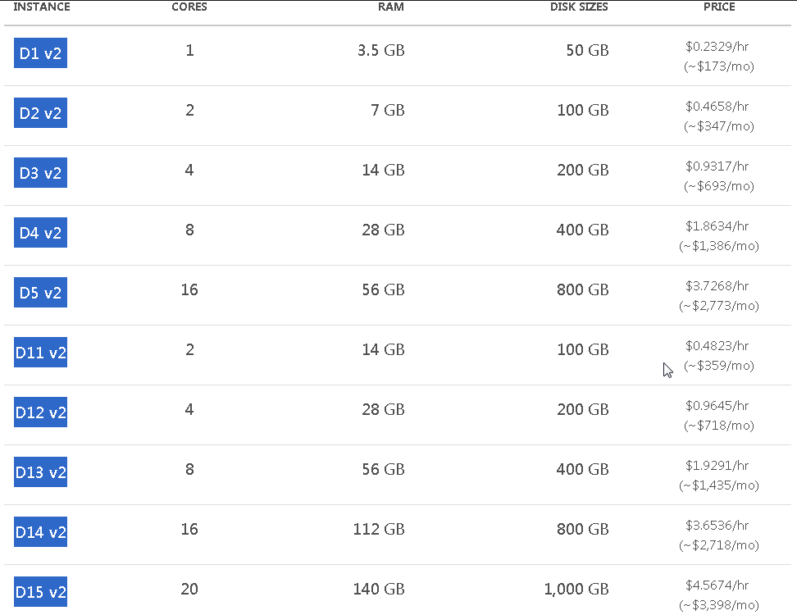
Azure Sizing
New variant of the Dv2-series sizes called “DSv2” that are specifically targeted for Premium Storage. The pricing and billing meters for the DSv2 sizes are the same as Dv2-series. SSD storage included in Dv2-series VMs is local temporary storage. For persistent storage, use DSv2 VMs instead and purchase Premium Storage separately.

Slide 16
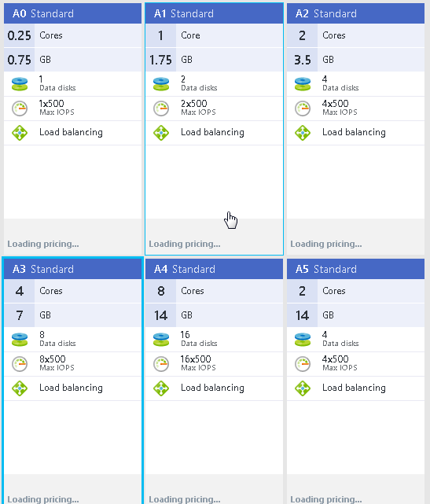
Azure Sizing
Example of IOPS differences
Notes:
A D v2 with premium disk can have iops starting from 500 iops to 500000
Cost involved.

Slide 17
SQL Upgrade requirements
SQL Server 2008 Service Pack 4
SQL Server 2008 R2 Service Pack 3
SQL Service 2012 SP 2
NO 32 BIT version.
.net 3.5 (as featured required)

Slide 18
SQL Savings
ECC has very little savings between sql 2012 and sql 2016 less than 5%
BI has a +/- 20% space saving. Only after running MSSCSTORE and converting to CS
Performance increase of about 15% for BI reports without changing BI model.

Slide 19
SQL Server Parallelism
1654613 - SQL Server Parallelism for SAP
RSADMIN parameters
MSS_MAXDOP_QUERY
For database servers with at least 16 CPU threads we recommend setting MSS_MAXDOP_QUERY = 4. You may further increase the value of MSS_MAXDOP_QUERY in accordance with the number of CPU threads on the database server. If the RSADMIN parameter is not set, the default of 2 applies. Setting MSS_MAXDOP_QUERY = FALSE turns off the BW coding for query parallelism. In this case the SQL Server configuration option "max degree of parallelism" applies (which is 1 by default).
MSS_MAXDOP_QUERY also has an impact on other BW activities, which use BW queries, for example filling of aggregates and executing DTPs.
MSS_MAXDOP_CUBE_<cubename>
This RSADMIN parameter overrides the MSS_MAXDOP_QUERY setting for a single BW cube. It is described in detail in SAP note 1126568. However, by applying SAP note 1654613 the behavior of MSS_MAXDOP_CUBE_<cubename> changes a little bit. It does not turn off parallelism on other cubes any more, once it is set for a single cube.
MSS_MAXDOP_INDEXING
This RSADMIN parameter controls the number of CPU threads used for index creation in BW process chains. The default value is 8. You may further increase the value of MSS_MAXDOP_INDEXING in accordance with the number of CPU threads on the database server. Setting MSS_MAXDOP_INDEXING = FALSE turns off the BW coding for parallelism at index creation. In this case the SQL Server configuration option "max degree of parallelism" applies (which is 1 by default).
Setting MSS_MAXDOP_INDEXING = 0 results in maximum index creation performance. In this case all available CPU threads are used. However, this might have a performance impact on parallel running BW batch jobs or queries.
Ideally, the value of MSS_MAXDOP_INDEXING is lower than the number of CPU threads on the database server. For an old database server with only 4 CPU threads we recommend setting MSS_MAXDOP_INDEXING = 2.

Slide 20

Q&A
Notes:
The question you have to ask is why wouldn’t you?

