Slide 1
Planning in SAP using EPM
New Zealand SAP User Group
8th September 2016
by Feroz Buksh & Fritz Scheepers

Slide 2
Agenda
Introduction
Tools - Past and Present
Issues/Limitation
Capabilities
Life Demo Examples
Summary
Q&A

Slide 3
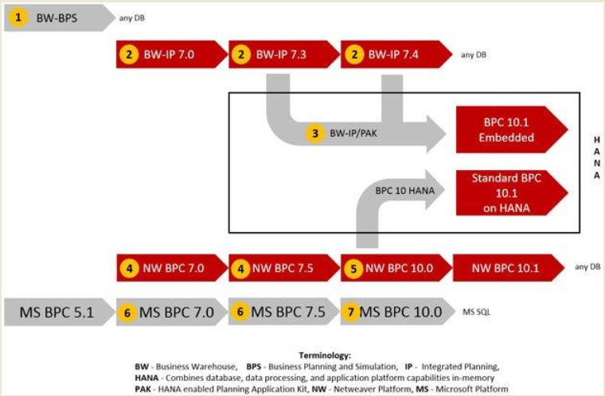
Tools - Past and Present - Roadmap

Slide 4
SAP Planning Tool: Issues/Limitations
BPS | BW-IP
Separate add-in application Multiple replications of cubes Current cubes contain custom fields End of life Performance issues Not user friendly | Fox formulas. Performance Ability to maintain commentary Lack of Status and tracking. WAD and BEX being phased out.
End of life / out of support
HANA: No migration option?

Slide 5
Tools - Past and Present - Comparison
 | IP |  | BPC (10.0)
Functionality | BW | on HANA | NW | on HANA
Integration with BW | ● | ● | ◑ | ◑
Leverage existing Content (MD, Actuals) | ● | ● | ◑ | ◑
Realtime BW | ● | ● | ◑ | ◑
Lower level data available for drilldown queries | ● | ● | ◑ | ◑
Redundancy of data storage | ● | ● | ◑ | ◑
Reuse existing authorization concept | ● | ● | ◑ | ◑
Business Driven / Flexibility | ◔ | ◔ | ● | ●
New master data creation | ○ | ○ | ● | ●
Change to planning environment | ◑ | ◑ | ◑ | ◑
Periodic maintenance by business | ◑ | ◑ | ● | ●
Excel Integration | ◑ | ◑ | ◕ | ◕
Excel frontend for data entry / reporting | ● | ● | ● | ●
Full blown excel integration | ○ | ○ | ◑ | ◑
Functionality | ◑ | ◑ | ● | ●
Planning functionality | ● | ● | ● | ●
Consolidation functionality | ○ | ○ | ● | ●
Performance | ◑ | ● | ◑ | ●
System performance | ◑ | ● | ◑ | ●
Cost | ● | ○ | ◔ | ○
Leverage Existing investments | ● | ○ | ◑ | ○
Initial installation costs | ● | ○ | ◑ | ○
User Licences | ● | ○ | ○ | ○

Slide 6
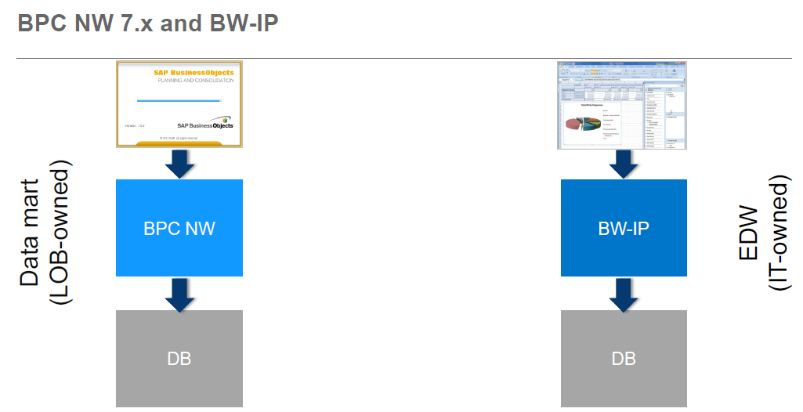
Tools – BPC vs IP current ownership

Slide 7
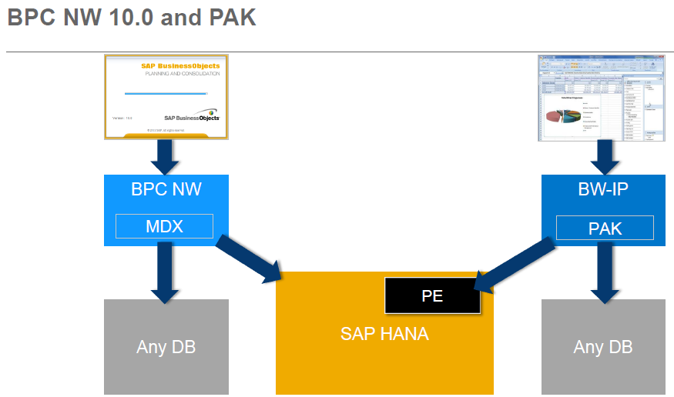
Tools – BPC & IP in PAK

Slide 8
Best of BPC & IP capabilities combined in PAK

Slide 9
SAP EPM Planning Split Model

Slide 10
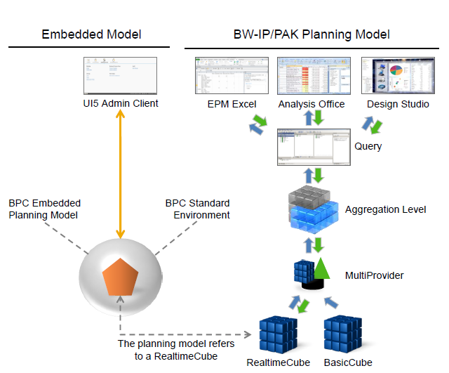
SAP EPM Planning Integrated Model
Current issues addressed in SAP EPM Roadmap :
Status and Tracking vs. BPF’s
Auditing of data changes
Slow Performance
Input Layouts BPC vs. BO vs. BI7
Comments Reporting
Standard Functions toolset, Fox, Logic Scripts, SQL or ABAP
Offline planning or What if models End User created
Integrated Best Practise Data Model
One version of data to report and analyse variances with latest UI’s UI5,BO or BI7 or other.

Slide 11
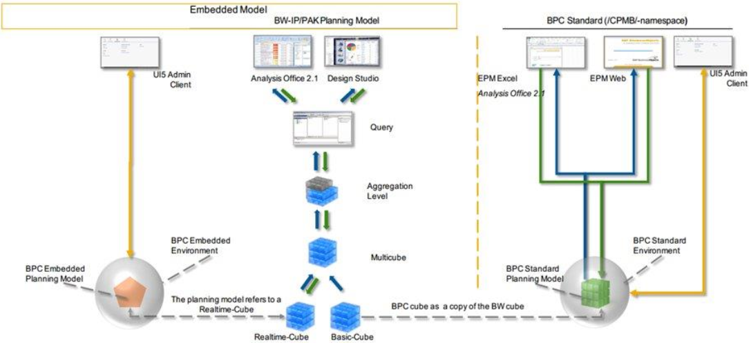
SAP EPM Embedded Model

Slide 12
SAP EPM Application Capabilities
BPC | BW-IP/PAK
Structured application: Consolidation, Eliminations, Inter-company Monitoring activities and consolidation steps Planning model generates the real-time cubes and the version EDW source objects. Embedded business process flow in to the IP model Adds new capabilities to existing BW-IP features, like commenting | Budget / Forecast Planning: Planning covers a wide range of topics, from simple data entry to complex planning scenarios, forecasting, and simulations Provides business experts with an infrastructure for creating and operating planning scenarios Offers various planning functions out-of-the-box and the possibility to write own planning functions
Application add-on to SAP BW | BW-IP is an integrated framework to implement planning solutions within SAP BW
HANA: Leverages the existing SAP BW application’s integrated planning models and benefits from SAP HANA acceleration | HANA: Planning functions and processes are to a very large extent optimised by SAP HANA with the usage of the Planning Applications Kit With PAK, extensive calculations are processed directly in SAP HANA

Slide 13
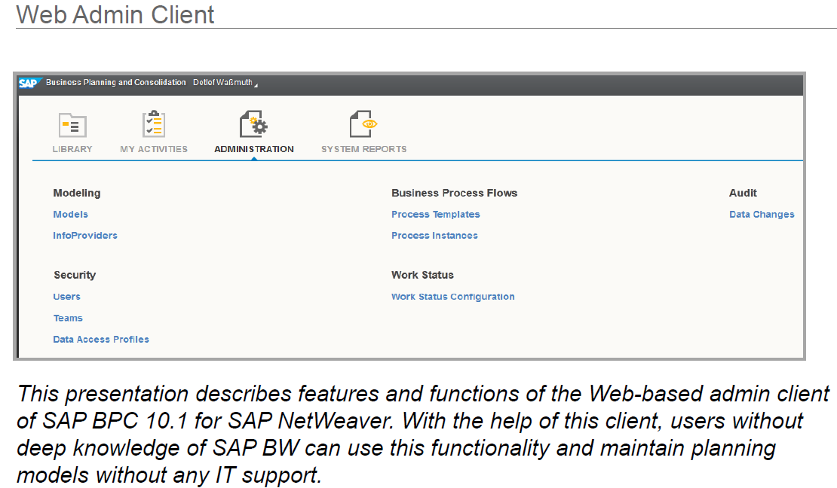
SAP EPM Tools - User Interfaces

Slide 14
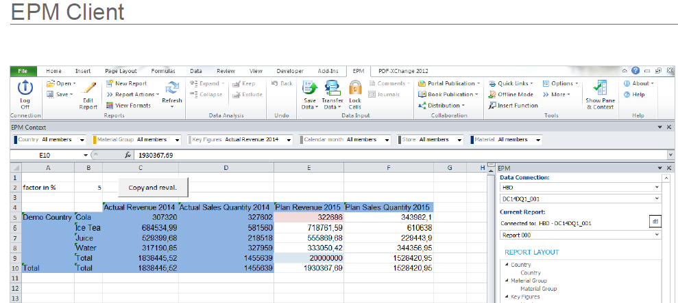
SAP EPM Tools - User Interfaces

Slide 15
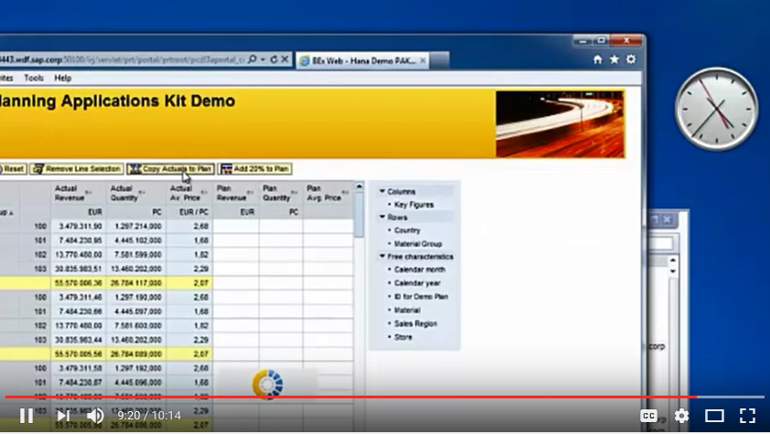
SAP EPM Key example of performance

Slide 16
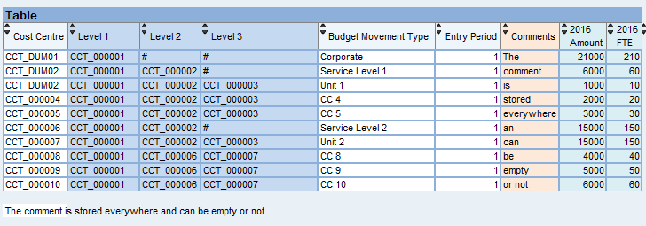
SAP BW 7.4 SP5 Comments example

Slide 17
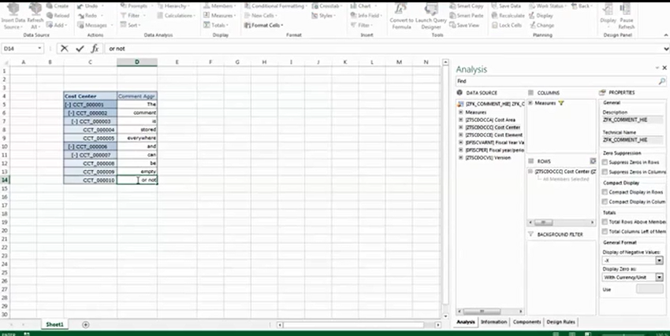
SAP EPM Comments example

Slide 18
SAP EPM BPF example

Slide 19
SAP EPM Key Takeaways

Slide 20
Q&A
?

