Slide 1


Making the right strategic decisions – How the digital economy is impacting the SAP Portfolio
Hala Zeine
SVP Head of SAP Portfolio Strategy & Pricing
New Zealand User Group 2016

Slide 2
Data processing
SAP R/1
Globalization
SAP R/2
Internet
SAP R/3
Digital
SAP S/4HANA
1972
1982
1992
2015

Slide 3

Connected
Businesses
API
Economy
Internet of
Things
Machine Learning
By 2020
Cloud will be mainstream
Always connected
Security
Security

Slide 4
Biggest Enterprise Customer Network
Extensive Business Process Expertise
Most proliferated Enterprise Software Platform

Slide 5
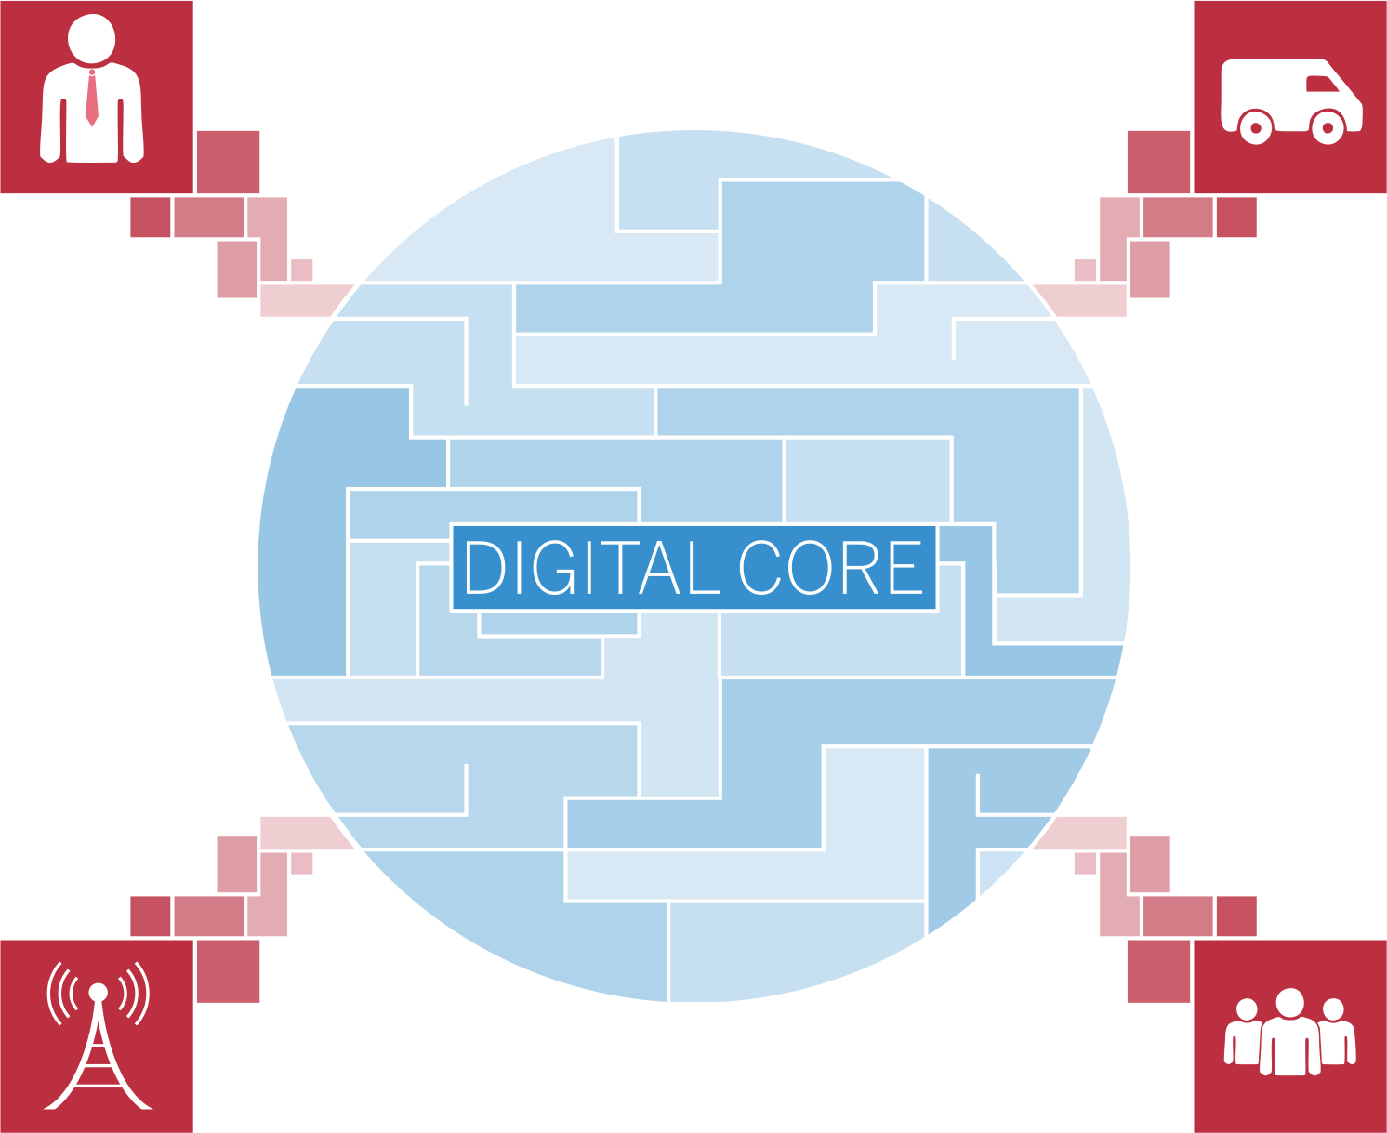
Customer Experience
Suppliers
Internet of Things
Workforce Engagement

Slide 6

IoT-Applications
Applications
…
Digital Boardroom
Cloud for Analytics
Hybris
as a service
IoT- Platform
SAP S/4HANA
IoT-Services
Business Services
SAP HANA Cloud Platform
Vora
SAP HANA Platform
Hadoop

Slide 7












































































300,000 customers

Slide 8


Co-Innovate with Customers
Co-Innovate with Startups
1
Early Adoption
Influence on Roadmap
Collaborate on Development Projects
Co-Innovate on Brand New Solutions
Innovation Center Network
2
SAP Startup Focus Program
3
4
Sapphire Ventures
Notes:
Early Adoption:
Beta programs: Experience a new product release in test phase, prior to RTC.
SAP Early Adopter Care: Adopt SAP innovations early on, directly after RTC.
Influence on Roadmaps:
SAP Roadmaps: Access SAP current roadmaps for insight into planned innovations.
User Groups: Collaborate with your peers and SAP on SAP’s future direction.
Advisory Councils: Strategic councils for SAP and customers to network and influence.
Collaborate on Current Dev Projects
Co-Innovate on building solutions to improve business performance.
Work collaaboratively with SAP on defining brand new solutions.
Extend the R&Da arm of a customer with resources and processes from SAP.
Co-create new Business Models
Take part in SAP’s Customer Engagement Initiative
Get an early insight into SAP product plans.
Influence development projects that are currently in the design and concept phase.
Co-Innovate on Brand New Solutions
Co-Create with SAP to initiate new joint business.
Pioneer Next Generation business models.
Collaborate with SAP, leveraging R&D expertise and cutting edge technologies.
Machine Learning
Blockchain
Security
3200 Startups
56 Countries
205 Startup Solutions
1,4bn US$ Volume
137 invests
36 IPOs

Slide 9
SAP‘s STRATEGY
FINANCIAL AMBITION
& mid-term Financial Plan
MONITOR
INVEST & DISINVEST
MARKET TRENDS
& CUSTOMER PERSPECTIVES
BALANCE the PORTFOLIO
based on End2End category plans
CRITERIA
1. Is the market attractive?
2. Does SAP have a winning idea?
3. Does SAP have a right to play by contributing a core strength?
4. Does SAP have the ability to execute?
5. What are the required finances based on the investment approach: Make-Buy-Partner?

Slide 10
Strategic initiatives to ensure customer success in the digital economy and their transition towards it
Integration
Roadmaps
By 2020
Cloud Simplification
Cloud will be mainstream
API Hub

Slide 11
Thank you

