Slide 1
Mobile IoT
NZSUG September 2016

Slide 2
What I’ll Cover
Introduction to DOC
Business Challenge
Business Needs
Data enables us to...
Notes:
In this session I'll introduce:
DOC and the journey
What was the:
Business needs
Business Problems and how we solved it
Why did you chose this solution:
SAP
Neptune Software
Soltius New Zealand

Slide 3
Introduction
Notes:
8.7 Million Ha of Public conservation Land – 30 % of NZer’s land area
13 National Parks
44 Marine reserves and 6 marine mammal sanctuaries
2,800 Threatened species

Slide 4
Introduction
Notes:
Annual Operating $420m
Annual Capital $ 55m
Annual Operating $350m
40% for recreation services
60% for natural & historic heritage protection
2,000 staff
1200 SAP and BI users
350 Mobile users
NZ’ers make up an estimated 35-40 M visits per year to PCL.
services
60% for natural & historic heritage protection
2,000 staff
1200 SAP and BI users
350 Mobile users

Slide 5
Introduction
14,000 km
tracks
324
campsites
921
toilets
487
picnic
967
huts
2,408 km
roads
13,144
structures
Notes:
83,000 Equipment on 4,000 Functional Locations
19,000km boundary fence
14,000km walking track
13,144 structures, bridges, boardwalks
3,000km roads
17,500 signs
967 huts
324 campsites
967 toilets

Slide 6
Introduction
Notes:
Climate / geographic conditions shortened life of counters.
High end machines relied on mains power.
Power consumption was/is an issue; hardware needed to run/survive 5-10 years on a single battery.

Slide 7
Introduction
Notes:
No support offered/available for the ‘proposed’ technology.
Of the shelf technology was/is expensive, poorly constructed or had a short in-field life.

Slide 8
Introduction
Notes:
Collection of data in remote area places expensive and time consuming (system is completely off-line).
Needed to connect (Bluetooth) in the field to the mobile device.

Slide 9
Challenges
Notes:
Inconsistently collected and stored
There were many different methods of collected visitor volumes and these were held locally.
Data collected and not always fed into business decisions.

Slide 10
Challenges
Notes:
Expensive data.
The old boardwalk counter was temperamental, required frequent checking for reliability and to get time based data (e.g. monthly) therefore had a high staff cost.
Obvious tools.
The boardwalk counter evolved into a tool that was at times was too far from water courses or damp ground, becoming a far too obvious target for vandalism or leading too over-counting and unreliable data.

Slide 11
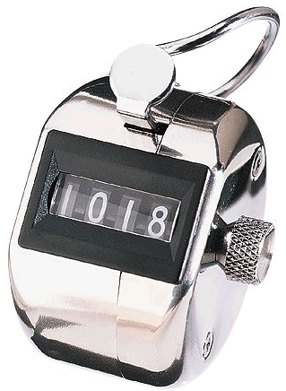
Business needs: why count?
Counter data provides DOC input
towards:
understanding visitor demand: the trends of visitors,
what the priorities for investment should be, and
how to allocate budgets.
Notes:
Counter data help DOC make prudent investment decisions
Understanding visitation: the trends of visitors.
What the priorities for investment should be.
Indicate to field staff that their hard work is delivering benefit, and the trends in degree of benefit delivered.
Provides the evidence DOC needs to tell its performance story

Slide 12
Business needs: why count?
Counters capture a unit of use.
Counters show trends and ROI
Notes:
1. The counters capture a unit of infrastructure asset use – i.e. each time a person, bike or vehicle passes a given point. In this respect they measure human activity at a site by the hour, 24/7/365 – thereby telling DOC how hard its capital assets are being worked.
2. Because a unit of use also represents a unit of benefit delivered to a visitor – which is the reason DOC invests in the assets - counts also represent a form of ROI
3. Over time, counters show trends in ROI – i.e., is asset use growing/stagnant/declining

Slide 13
Count data enables DOC to:
Notes:
Count data therefore enable DOC to:
a) Determine and justify nature and scale of capital investment in visitor infrastructure necessary to deliver a given ROI at a given site

Slide 14
Count data enables DOC to:
Notes:
Count data therefore enable DOC to:
b) Determine how actual ROI of capital investment compares with projected ROI

Slide 15
Count data enables DOC to:
Notes:
Count data therefore enable DOC to:
c) Set service delivery standards at sites – i.e., sites that have thousands of visitors per day will have higher service standards

Slide 16
Count data enables DOC to:
Notes:
d) Develop maintenance plans – i.e., the more the asset is used, the more it needs to be maintained

Slide 17
Count data enables DOC to:
Notes:
Use 6x different counter types for different applications, all developed in-house: 3x pedestrian (pad; step; door); 1x bicycle; 2x vehicle, 1 x water flow meter.
Use four different sensors: piezo-electric – i.e. Pressure activated (pad, step, and bike counters); infra-red (door/entranceway counters); inductive loop (permanent vehicle counters); pneumatic tube (temporary vehicle counters) and water flow meters

Slide 18
Count data enables DOC to:
Notes:
Counter network has grown organically over past 10 years, and there are some gaps – i.e. doesn’t yet give a complete picture. To address this, network is now being ‘designed’ according to a number of criteria. Will result in a permanent ‘strategic’ national network that will be statistically representative of the entire network, and a ’tactical’ regional network than will adapt to changing organisational priorities.
Network of over 658 counters deployed across all Public Conservation lands – haven’t figured out how to count swimmers or divers yet!
Counters installed at sites of all levels of activity – from front country sites with thousands of visitors per day to back country sites with 200 visitors per year
Examples of added value to New Zealand communities and overseas visitors as a result from publishing the track and asset counter data:
Hospitality industry - understanding and responding to visitor numbers in specific destinations (e.g. coffee carts, RBnB, MTB hire).
Tourism industry - understanding and responding to visitor numbers in specific destinations (e.g. where to go and when to go to avoid HIGH numbers of visito

Slide 19
Solution Summary and Demo
NEW ZEALAND’S MOST TRUSTED SAP PROVIDER

Slide 20
What I’ll Cover
Solution Overview
Demonstration
Building the Application
What we learned
Questions

Slide 21
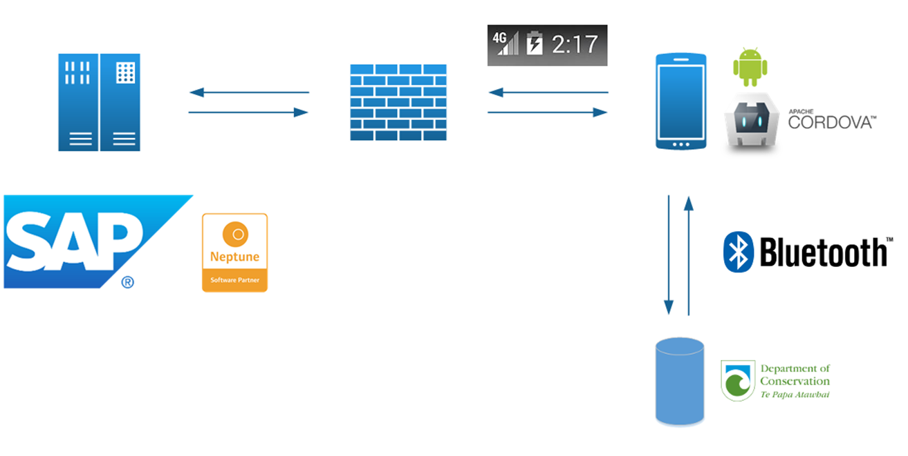
Solution Overview
Mobile Smartphone and Application
SAP ERP System
Cellular Communication
Counter Device

Slide 22
Agenda
Solution Overview
Demonstration
Building the Application
What we learned
Questions

Slide 23
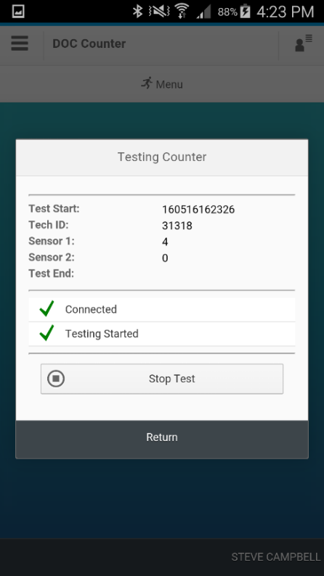
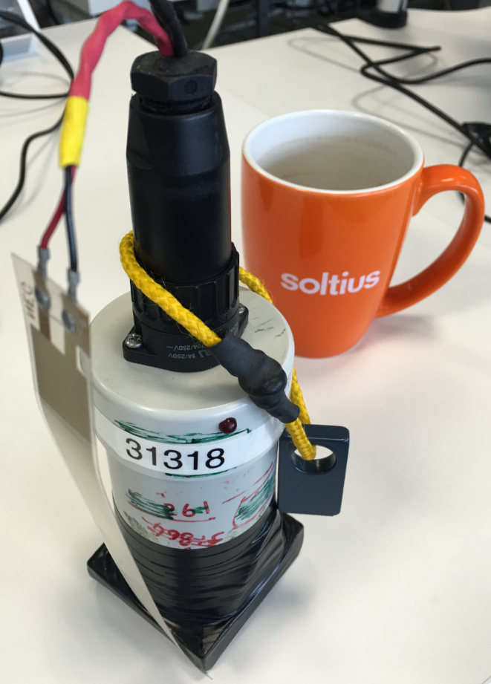
Demonstration
Logon
Launch Application
Connect and Download Counter Data
Counter Test
View Outbox

Slide 24
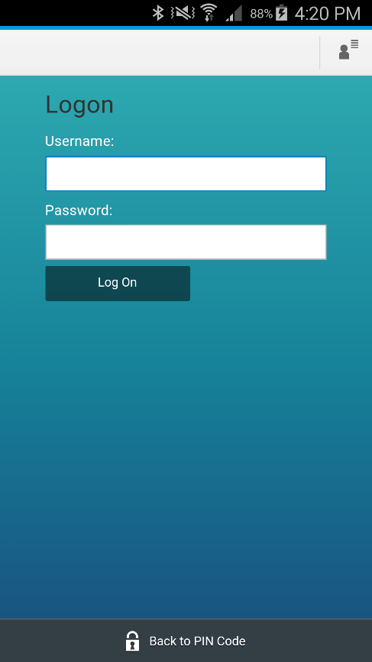
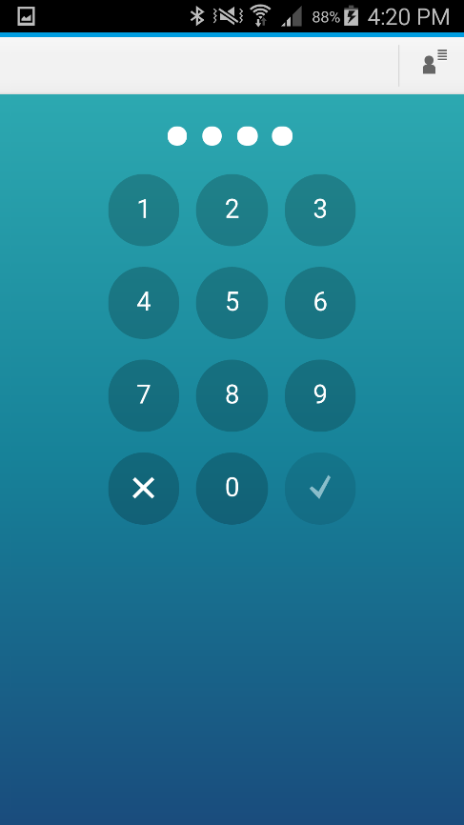
Demonstration
Logon
SAP Username and Password
PIN Code

Slide 25
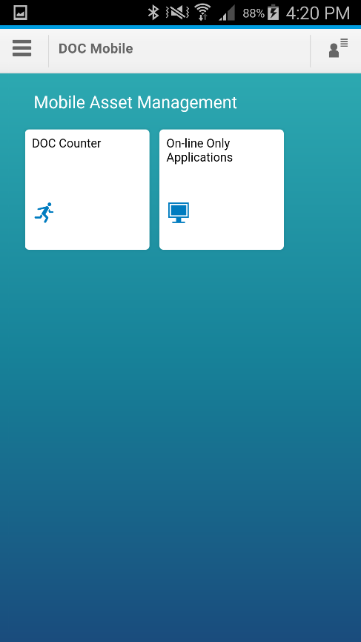
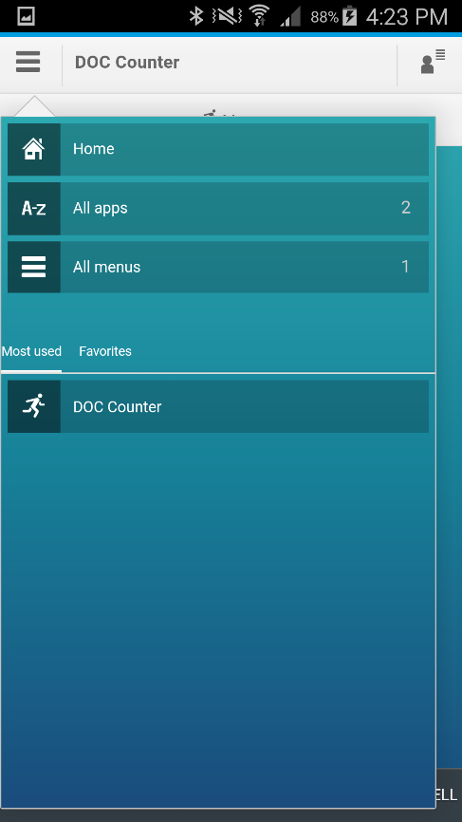
Demonstration
Launch Application
Menu Based
Favourites
Applications run in their own sandbox

Slide 26
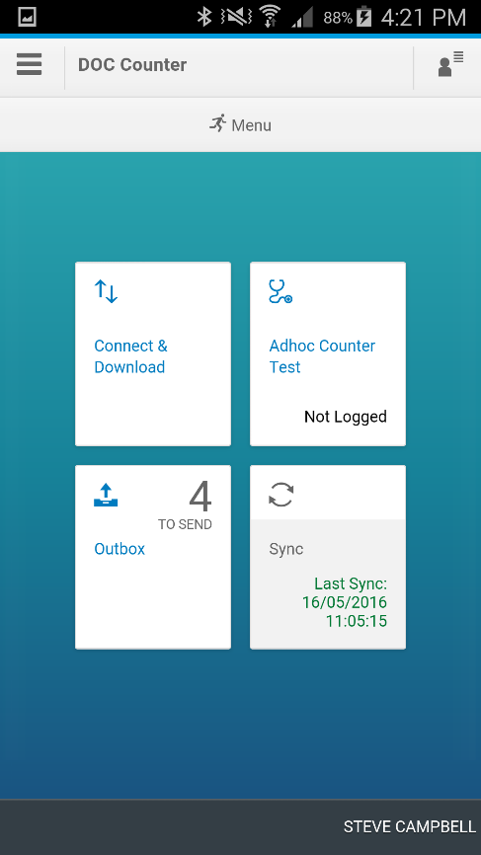
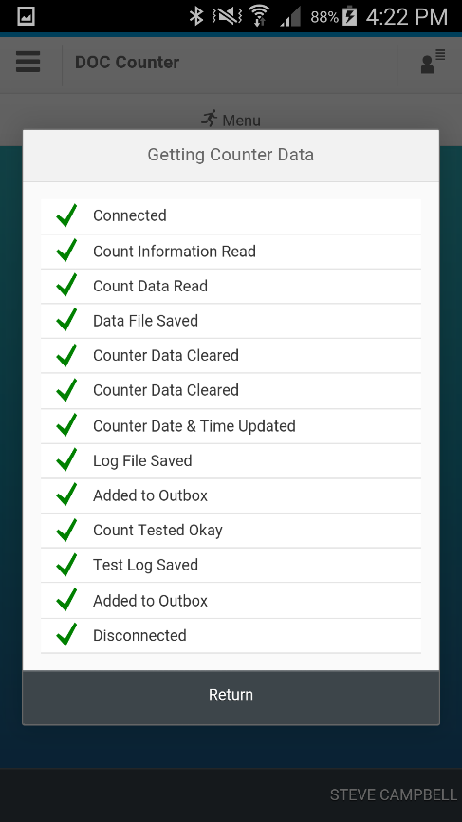
Demonstration
Counter Data Download
Connect to Counter
Files Saved on Device (backup)
Data Saved to Outbox
Device Tested
Device Reset

Slide 27
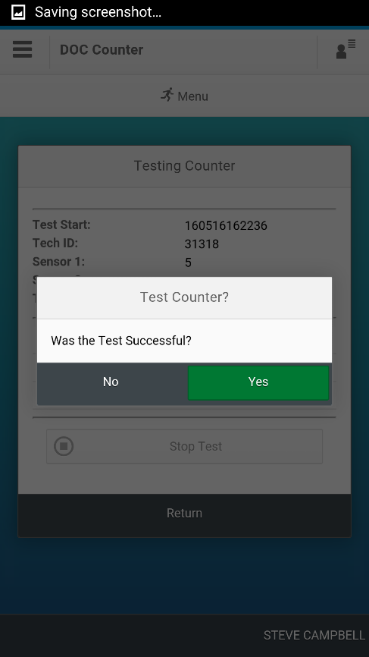
Demonstration
Counter Test
Ad-hoc or as part of the data download
Audible Feedback

Slide 28
Agenda
Solution Overview
Demonstration
Building the Application
What we learned
Questions

Slide 29
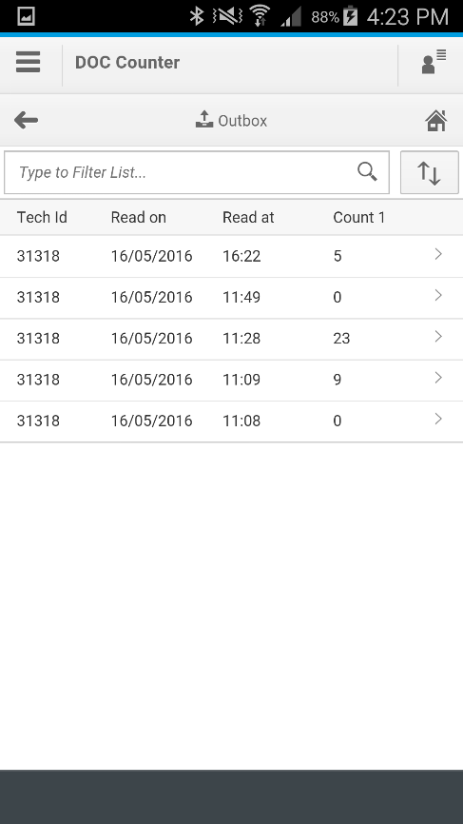
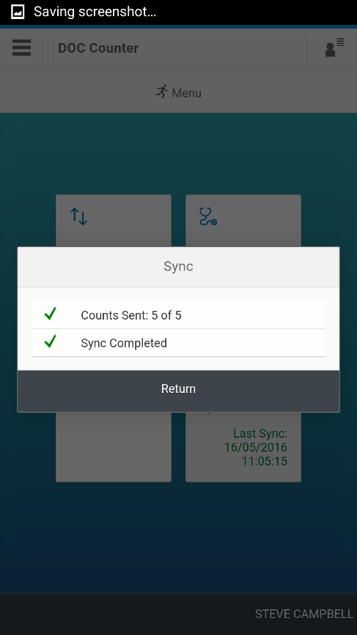
SAP Processing
Send to SAP
Data stored in Outbox
Connection over Mobile Network or WiFi (Internal)
Each record is transferred and confirmed before being removed from device
Device maintains last sync date and time

Slide 30
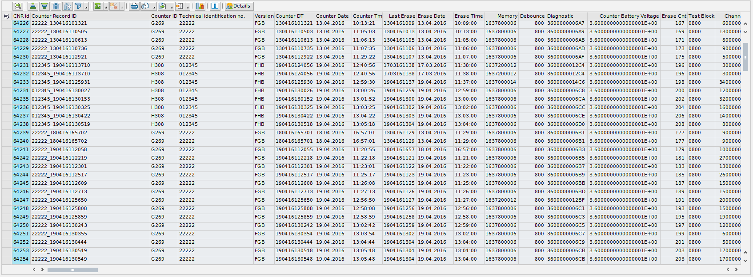
SAP Processing
Back End
Sync Updates Custom Tables
Exported into other system for data validation and normalisation
Processed back into SAP – Measurement Documents

Slide 31
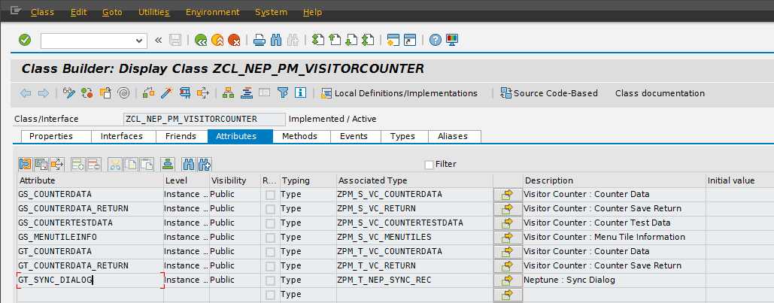
SAP Processing
Application Class
Contains application attributes and methods
Public Attributes are used for data structures in the application

Slide 32
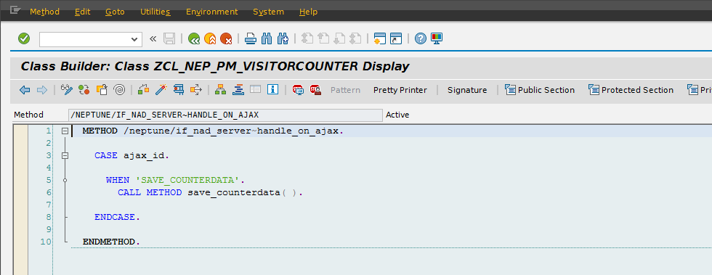
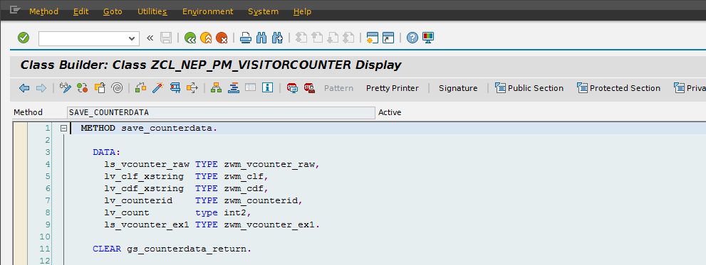
Building the Application
Application Class
Class Methods are be called by the application

Slide 33
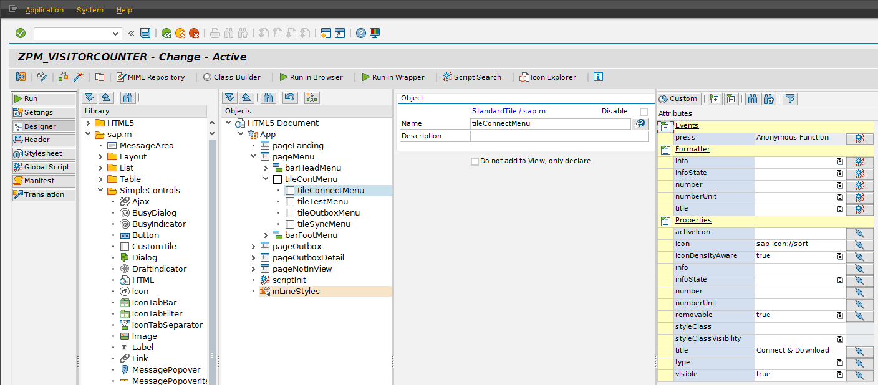
Building the Application
Application UI
Application screens designed with SAPUI5 controls

Slide 34
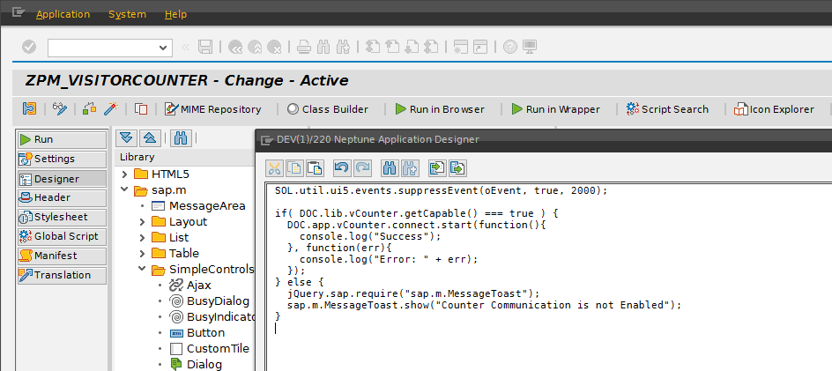
Building the Application
Application Logic
Application Logic using JavaScript

Slide 35
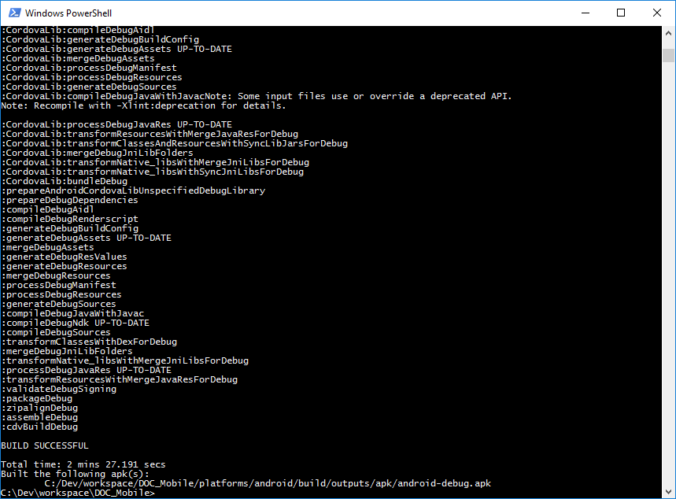
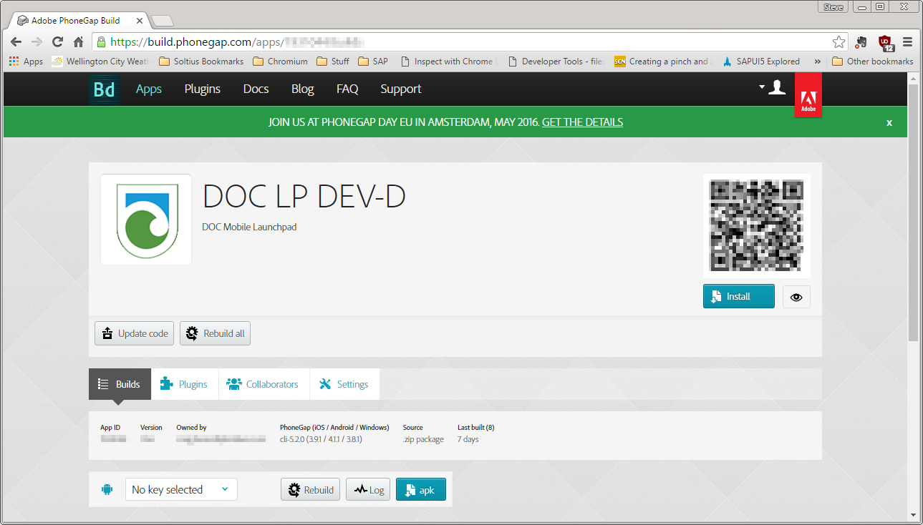
Building the Application
Mobile Application Build
Application Built with Cordova (Command Line or Adobe PhoneGap Build Service)

Slide 36
Agenda
Solution Overview
Demonstration
Building the Application
What we learned
Questions

Slide 37
What We’ve Learnt
Understand Requirements - A well understood business process is vital.
Involve Users - Get feedback on screen designs early in the process as often interacting with those designs pulls out missing requirements.
Break Down Complexity – Plan the project into chunks, proving each part. For example:
Separate Bluetooth connectivity and prove that functionality. Once proven you’ll have a much better idea how to implement it as part of the application
Create a simple app to work on just that component (doesn’t need to be UI5!)
Reuse - Start to build reusable JavaScript methods from your first project. For example if you have export a table to CSV, allow time to write a generic method that you can reuse the next time you need to export a table to CSV. As you gain experience you can improve the methods.
Test - Testing, especially end user testing, is crucial across the mobile device range that you are planning to use.

Slide 38
Agenda
Solution Overview
Demonstration
Building the Application
What we learned
Questions

