Slide 1

Ballance Agri-Nutrients Places SAP S/4HANA at the Core of its Digital Future
New Zealand’s First Organisation to Go Live with SAP S/4HANA Increases Productivity, Speed of Decision Making and its Customers’ Digital Experience
Dave Scullin
Chief Information Officer
Ballance Agri Nutrients Limited

Slide 2
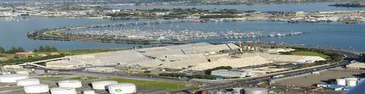

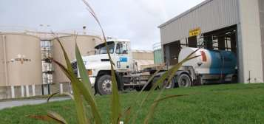
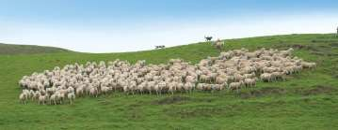

Ballance Agri-Nutrients
New Zealand based Farmer owned
cooperative
Manufactures Fertiliser and Animal Feed
Nationwide coverage
In a duopoly market –
Turnover is $920m
  Trading profit before rebate distributions is ~ $80m
Employ 800 employees
Ballance is a supply chain company
  Has become vertically integrated

Slide 3

Our World is Changing
Connected Cars
Connected Houses
Gesture Technology
Smart ‘Iron’
Widespread Machine to Machine Communication
Drones
Unmanned Aerial Vehicles
Geo Spatial
Internet of Things
Crowd Workers
Sensors Everywhere
Ubiquitous Broadband
Augmented Reality
Paperless processes
Connected appliances
Human Computation Model
Connected Clothing
Voice Recognition
Mobile Devices out number human population
Connected Glasses
Real Time Analytics
Connected Cities
Big Data

Slide 4


Our Customers Digital Future
Prediction is very difficult,
especially if it's about the future.
– Niels Bohr
Farm & Field Data exchange
Tech. & Solution Provider
Best local and demand fitting variety
Climate & Crop & Soil
& Product Data
Seed Producer
Weather Stations & Laboratories
Connected
Informed
Tailored Fertilizer/Crop Protection
Fertilizer Companies
Risk Management
FARMER
Banking & Insurance
Sensor Tech. & mobile data exchange
Improved SCM
Trader & Industry
Machine Manufacturer

Slide 5
Our customer profile and expectations
Bigger farms
  Bigger farms and therefore fewer customers
  Require more use of professional advisory services and a dedicated focus on corporate customers
  Multi-tiered relationships (Managers, Owners, Boards) driving tailored solutions for those relationships
Greater expectations
  Higher service expectations wanting more value on farm
  Greater information needs via electronic interfaces and self help online solutions 24*7
  Not just nutrient advice, but depth in agronomics and farming systems
Customised solutions
  Greater level of comfort with digital service channels
  Comfortable with using multiple channels to do business based on specific needs
  Geo spatial context

Slide 6
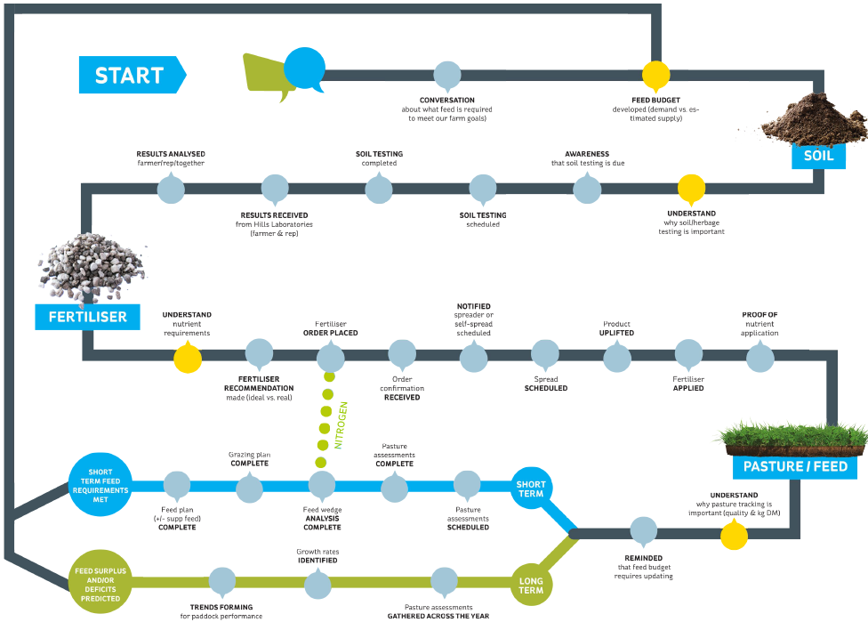
Customers want their journey digitised

Slide 7
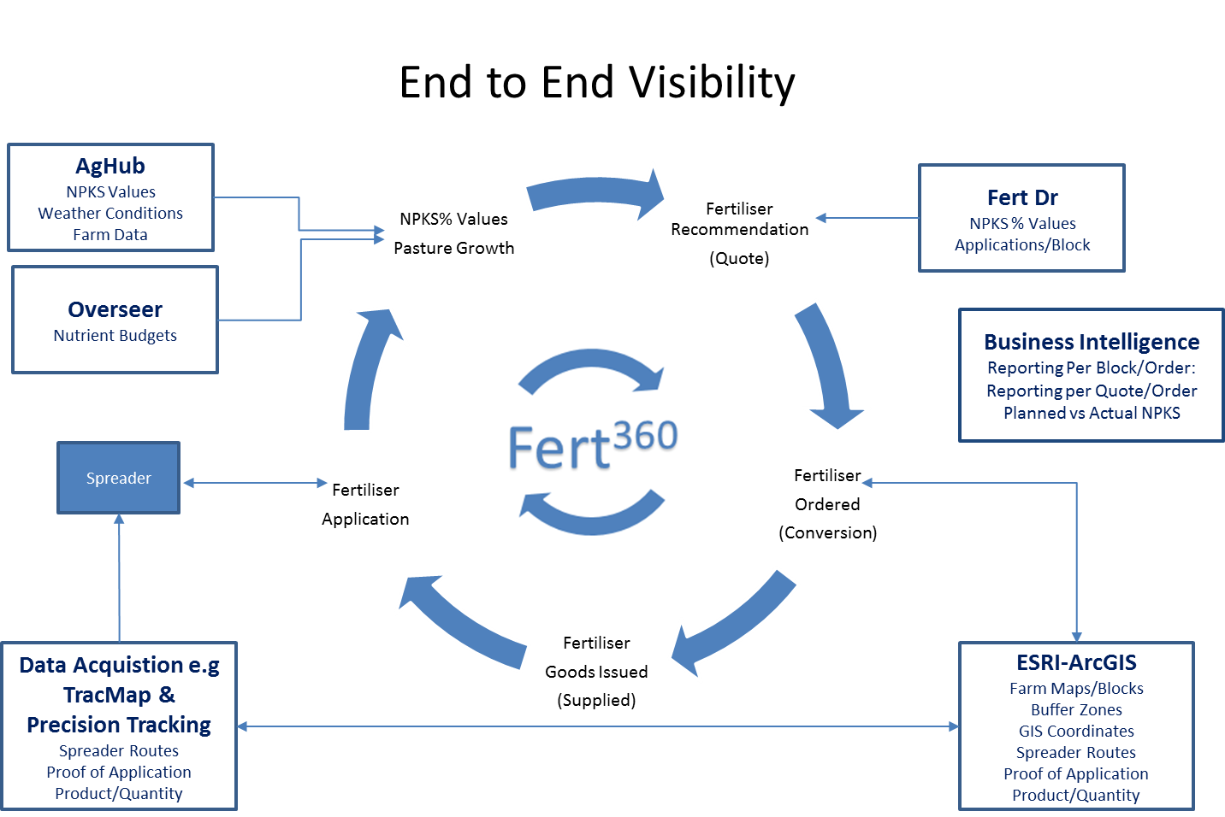
With Strength in Precision Pastoral Farming

Slide 8





So where is Ballance Heading
4
Sustainably double our EBIT by 2026: Working with customers who lead, integrating global innovation with our depth in NZ soil and feed, driving regional connections and performance
Grow Our Business
Grow Our Capability
Focus on growth markets and our brands
Seamless customer service
Choose the right partners
Simplify to drive out cost & complexity
Grow through the right channels
Sustainably double our
Go digital
EBIT by 2026
Grow Our People
Grow Our Customers
Understand our customers more
Engaged, safe, and capable people
Farm system selling of tailored solutions
Winning culture of high performance
Shop the world for innovation
Connect deeply with our communities

Slide 9
































What we stand for
Digitising Ballance for Competitive Advantage
How we turn up
ALIGNED Enabling AGILE
Customer Experience
Knowledge Growth &
Information Sharing
Process Simplification
Strategic Pillars
Complete Digital Strategies – align to Customer Journey and Employee Value Propositions
Implement CRM solutions
Implement an Omni Channel Platform
Implement a geo-spatial platform and capability
Implement a scalable ‘Big Data’ platform &
business intelligence capability
Implement knowledge sharing and collaboration solutions
Mine data to seek out product and service value-add opportunities
Develop API and integration strategy
Build beneficial partnerships with other data providers
Implement SAP, Microsoft and other solutions that will simplify and automate our business processes (CRM, Simple Finance, Simple Logistics, Predictive Maintenance and others)
Mobilise key business solutions to increase productivity and reduce duplication
Initiatives
Digital is the preferred
customer channel
NPS increases
75% of transactions are digital by 2020
Digital connects our communities & delights our stakeholders
Customers see value in information linked to our products & services
Standardised processes
Efficiency and improved
productivity
What is success
Increased employee engagement
5

Slide 10

Digital and Data Value
How are we going to win? |  | What will we do?
Create a great customer digital experience | Design and build solutions that are mobile, intuitive, robust and valuable enabling our customers to be more autonomous, productive and to do business with us easily | Complete Digital Strategies – align to Customer and Employee Value Propositions Implement CRM and new online solutions Implement a geo-spatial platform and capability
Support knowledge growth | Provide solutions for our customers, employees and other stakeholders by transforming data into accessible, valuable information to enable knowledge sharing and decision making | Implement a business intelligence capability Implement knowledge sharing and collaboration solutions Mine data to seek out product and service value-add opportunities

Slide 11
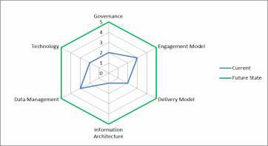






















Findings from the Health Check
The findings highlighted
A lack of information architecture – multiple cubes to service the same reporting area therefore inconsistent information being reported
Very weak Governance – credit was given for project governance, other than that no governance existed
“Ballance decision makers are suffering from a general lack of insight and are consequently frustrated with the status quo”
“I feel let down by our BI System”
“We don’t read many reports because we don’t believe them.”
“Management have no insights whatsoever… we are at ground zero”
“We are bereft of information”
“We are too accepting of workarounds in this business”
“Despite its perceived importance to the business, Ballance is by and large not leveraging its valuable data assets to identify strategic and competitive advantages.”

Slide 12



































































































































This is where we were at
Information Delivery
SAP Enterprise Portal
On Demand
Monthly Board Report
Business Intelligence
FFG
GM Monthly
Report
On
Demand
Email
Broadcast
On
Demand
On
Demand
Business Intelligence
On Demand
SAP Business Explorer (BEx)
IBM Cognos Disclosure Management (CDM)
IBM Cognos TM1
Executive Viewer
On
Demand
On
Demand
On
Demand
On
Demand
On
Demand
Data Storage
Demand & Supply Planning
Data Warehouse (SAP BW)
Financial Budgeting &
Planning
On Demand (Data Extracts)
On Demand
SAP APO
SAP BW
IBM TM1
On Demand
Monthly (ABAP)
Monthly (ABAP)
Data
Integration
Daily (ABAP)
On Demand (Data Extracts)
On Demand (Data Extracts)
On
Demand
Air Maestro
Global
Equip
Quick Books
Prodlog
PI (PLC)
SAP ECC
Overseer
Data Sources
Air Care
Gold Mine
Dist. Control Log
RMS 2000
Seales Winslow
Ballance Subsidiaries
AgHub
Weigh Bridges
Landlogic
Supplier
Data
SuperAir
AgInfo.
Kapuni
Fert. Ops
Ballance Agri-Nutrients
ArchGIS
Zeacom
Merchant Customer Data
Web Data Sets (eg. Weather, FEx)
Ballance Managed Business Systems
External Data Sources
Legend:
Current BI Processes & Technology
Current Operational & Planning Systems
Current External Data Sources

Slide 13
The S4HANA Difference
“Our leadership team values data and simplicity, and by providing solutions for our employees, suppliers and customers to transform data into accessible, valuable information enables greater knowledge sharing and more powerful decision-making. With SAP S/4HANA we are readying Ballance for the digital revolution; digital connects our communities; digital delights our stakeholders.”
Since going live with SAP S/4HANA in early June 2016, Ballance has increased the productivity of its sales team and simplified the reporting requirements of its finance team. Management sales reporting for example has decreased from two hours to 20 minutes, while key business processes have become 75 per cent quicker. In some cases, delivering real-time insight on a year’s worth of data is taking less than a second.

Slide 14

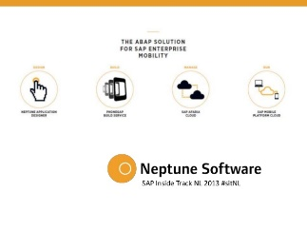



Our Digital Future
Workforce
Engagement
Supplier Collaboration
Business Networks
SAP FIORI
Digital Core
HANA & BUSINESS OBJECTS
PLATFORM
Big Data, Mapping & Internet of Things
Customer Experience
Omni-Channels
IN MEMORY COMPUTING PLATFORM

Slide 15
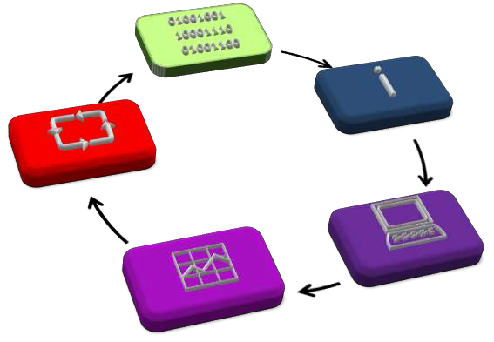



The Ballance Intelligence Capability
❶ Funnel raw cornerstone data from a multitude of source systems into a central data warehouse…
❷ Processes the raw data into meaningful, contextualised information…
❸ Provide our decision-makers with convenient access to that intelligence.
Data
Source systems of
record
Data owned at origin
Raw cornerstone data
Information
Standardised
information
Timely information
Zero human intervention
Implementation
Process improvement
Tactical
opportunities
Real-time tuning
Decision Making
Right information
Right decision- makers
Right time
Feedback loop to
results
Intelligence
KPI’s
Ad hoc Queries
Alert Notification
Lead Information

Slide 16



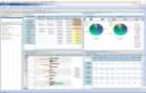
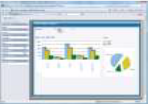

End to End Analytical Capability
BICC – Governance, Delivery & Support
Business Intelligence Applications
Enterprise & Functional Leadership
Select KPIs providing a crisp, holistic summary of the current state of the enterprise
Enterprise Scorecards & Dashboards
Operations Leadership
KPIs providing thorough review of the current sate of the business unit
Business Unit Scorecards & Dashboards
Monitor & Feedback Loop
Analysts & Power Users
Comprehensive detailed data supporting ad hoc analysis
Business Unit Reporting & Analytics
GOAL – seamless Drill to Detail
Detailed BI reporting and information consumption to meet operational needs
Business Units
Detailed Reporting & Analytics
Data Foundation – Single Source of the Truth

Slide 17
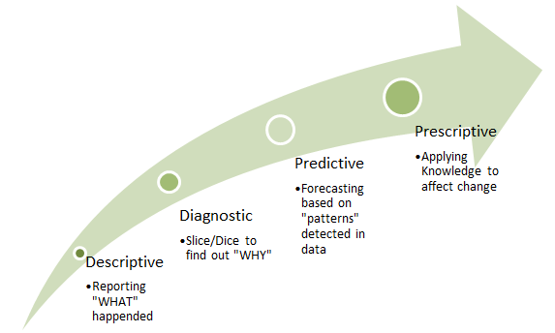


The Digital Pathway
Target May 2018
Target May 2017
We are now here
We were here
We need to move with speed down this pathway

Slide 18
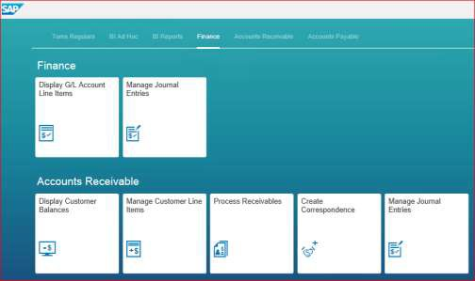
Why did we select S/4 HANA?
Tender process for BI implementation highlighted the ability to move to S/4 Finance for a relatively low incremental project cost increase.
Alignment with SAP’s strategic product
Roadmap and our Digital strategy
Ability to take live feeds of data from SAP
Ability for end users to create their own information with ease
Agility and advanced analytics
Improved business processes – real time reporting
Fast implementation time
Able to easily integrate S/4
Modules and simplify the user experience
  S/4 Finance
  S/4 Logistics

Slide 19















Key Principles
The business must own the project requirements and IT enable the solution
The business owns the solution
Ownership
Future
Proofing
Align the Ballance ERP system platform with the SAP Roadmap
Data as an
Asset
Data → information → decisions → profitability
Project Principles
Sound Project Management
Change management is key to deployment
Return on Investment
Improved decision making
Access to information for our customers
Process simplification
Strategy execution

Slide 20

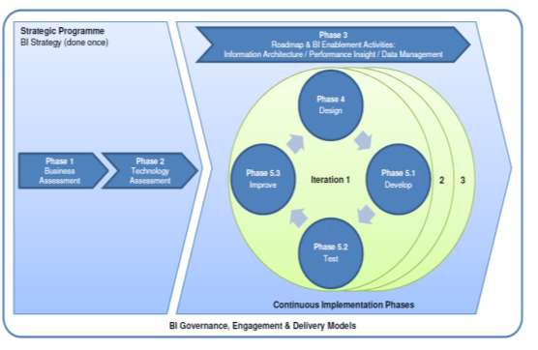

Programme Journey – how are we going to implement
Phase 1 – Business & Tech Assessment
Governance Model and Tools
Phase 2 – Fondations
Infrastructure and BI to Hana (May)
Phase 3 – Enablement
✓
✓
S/4 Finance (June)
Through iterations of business functions BI Capability
Sales & Marketing
Finance
Logistics
HR
Procurement
The business owns the solution – IT enable the solution
* ROI: Annual productivity gains of $1.4m p.a. through improved decision making

Slide 21
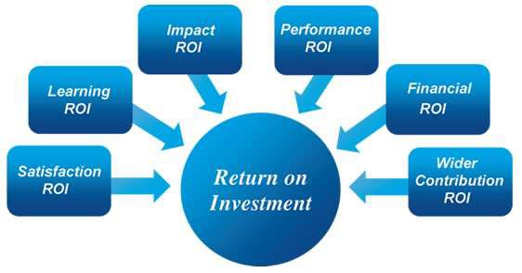
Return on Investment
Accurate timely information that enables
better decision making capability
Satisfied customers getting enhanced information
Simplified processes & real time information
Strategy execution
Getting data from several systems onto
the one platform for uniform reporting
So how does one value the return on Investment for a BI Project
Found no real consensus so took the following approach
  Project cost was equivalent to 0.6% of total operating and overheads (excluding raw materials)
  Then asked the Board to consider whether they believed that such an
implementation would reduce costs or increase margins by 0.6%

Slide 22
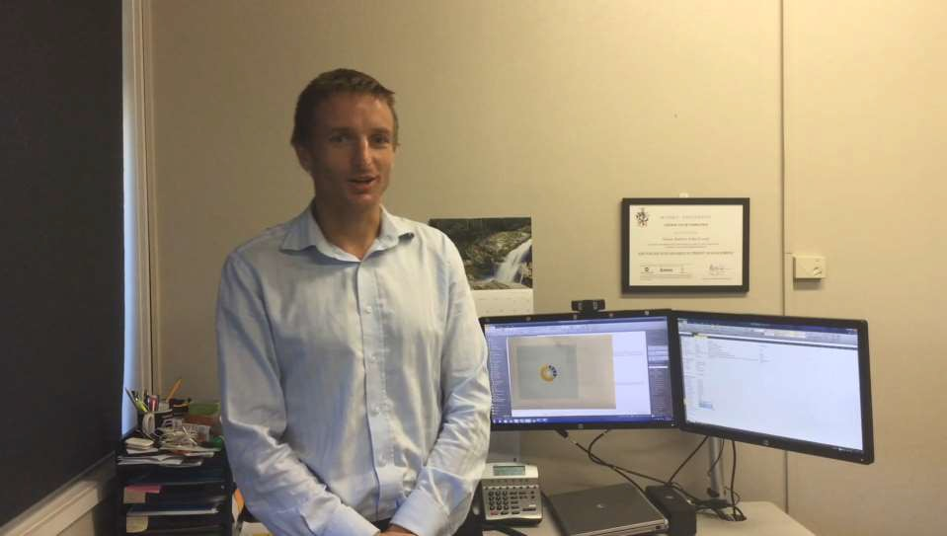
What our people are saying
21

Slide 23
Benefits to Ballance
Speed and Integrity of the system
Forecast download of 23 million records used to take 100 minutes now takes five
Nightly refresh run times reduced from 6 hours to under 2 hours
✓
Sales segmentation reports involving the whole customer database of 49,000 customers would take 10 minutes to load now takes less than a minute
Now able to segment down a number of levels without timing out
Analysis and ad hoc reporting
There is now only one source of the truth this will give consistent information for more robust decisions
✓
Finance currently gets requests from the business to prepare reports, now the business can prepare their own reports and Finance can assist with interpreting those reports
With query performance no longer an issue on HANA, more reporting characteristics and metrics (measures) can now be made available with the need for fewer query data sets - which also reduces the maintenance overhead.

Slide 24
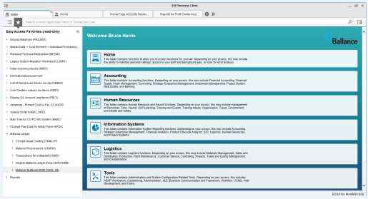
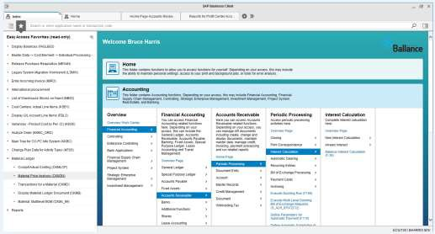
Home Page – Business Client
Ease of Use
Able to access numerous functionality at click of the mouse
Able to easily drill down through
the menu to the transaction
Favourites readily available
Easily flip between tabs
Layman's terminology
Enhanced speed
Search speed is enhanced
Operating speed is up to four times faster
Reporting times significantly
reduced

Slide 25
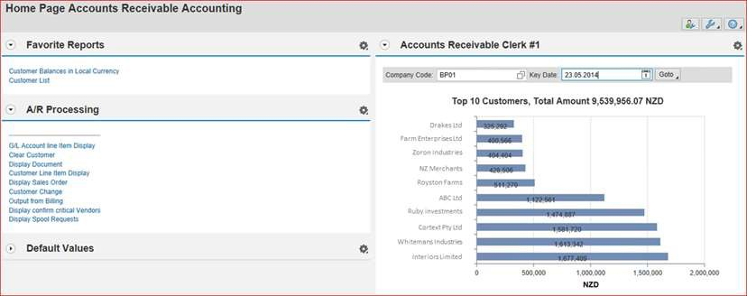
Home Page for an A/R Clerk
First screen that you see when you log on
  Key Drivers tile
  Favourites
  Regular transactions in laymans terms

Slide 26



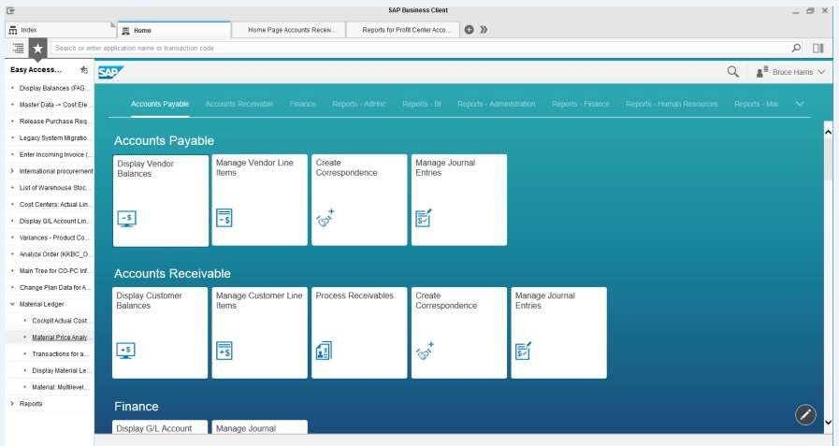
Role Based Fiori Apps
Favourites
Search Bar
Tiles
Tabs
Additional Functionality

Slide 27
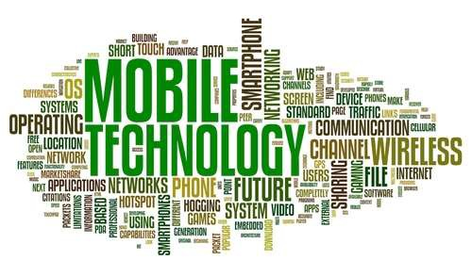
Improved Mobile Capability
Diverse business front end that needs
support through mobile interfaces
Integration with CRM platform (Dynamics)
Reporting to Executives on the go
Fiori and Neptune
Have started project to implement Omni Channel & Enterprise Mapping (Hybris & ArcGIS) to digitize the customer journey

Slide 28


